Slide 1
ASSIMILATION AND ITS DISCONTENTED
Kay Deaux
Western Migration Conference
London, Ontario
April 30, 2011

Slide 2
The U.S. context today:
Demographics
Attitudes
Federal and State-level policies

Slide 3
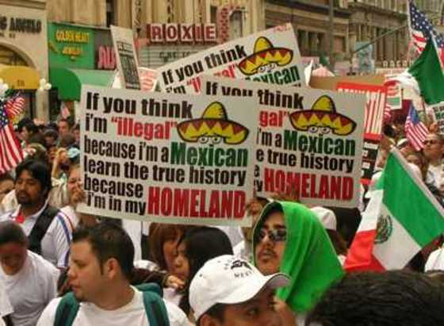

Slide 4
Question:
Are 2nd generation immigrants more or less
successful
acculturated
satisfied
than 1st generation immigrants?

Slide 5
Two forms of generation analysis:
Historical or family generation
Generation-since-immigration
Telles & Ortiz, 2008

Slide 6
Model 1: Historical or family generation
Grandparents
Parents
Children
HISTORICAL TIME

Slide 7
Model 2: Generation since immigration
3rd
2nd
1st
Time of measurement

Slide 8
Why a cohort model?
Reduce historical concerns
Ask different questions
Look at contemporary conditions
Notes:
8

Slide 9
General research strategy:
Comparison of 1st and 2nd generation respondents, primarily in New York City
Generally equivalent in age, education, socioeconomic status
Focus on Latino and African descent immigrants (“visible minorities”)

Slide 10
Comparing 1st and 2nd generation immigrants:
Academic performance
Perceived acceptance by others
Belief in meritocracy and opportunity

Slide 11
Academic performance:

Slide 12
Performance decrements for 2nd generation immigrants?
Evidence for decreases in outcomes
  Telles & Ortiz educational outcomes
  Data on West Indian immigrants
Stereotype threat in African American and Latino students (Steele, 1997; Massey et al., 2003)

Slide 13
Do 1st and 2nd generation West Indian immigrants differ in susceptibility to stereotype threat?
Knowledge of stereotypes about Black Americans?
Perceived relevance of stereotypes to the self?

Slide 14
Experimental study of stereotype threat:
1st and 2nd generation WI college students
tested on GRE English items
in conditions that made stereotype threat likely (diagnostic) or unlikely (non-diagnostic)

Slide 15
Stereotype threat: Performance (% correct) for 1st and 2nd gen. West Indians
Deaux et al., SPQ, 2007

Slide 16
Stereotype threat (ST): Performance (% correct) for 1st and 2nd gen. West Indians
F=4.59, p<.05

Slide 17
Perceived acceptance by others:

Slide 18
Generational differences in Perceived Public Regard (WI immigrants)
18
  t (270)= 4.52, p<.001
(Wiley, Perkins, & Deaux, 2008)

Slide 19
Bicultural identification and acceptance by others:
Dominican and Mexican immigrants
Too Latino for Americans?
Too American for Latinos?

Slide 20
Generational shifts in identity comfort
 | 1st Gen. | 2nd Gen.
Too Latino for Americans | 2.81
Too American for Latinos | 2.83
Note: Latino = Dominican and Mexican immigrants
(Wiley, 2008)

Slide 21
Generational shifts in identity comfort
 | 1st Gen. | 2nd Gen.
Too Latino for Americans | 2.81 | 3.52
Too American for Latinos | 2.83 | 3.21
p=.014
n.s.
Note: Latino = Dominican and Mexican immigrants
(Wiley, 2008)

Slide 22
Feeling too Latino is negatively correlated with:
Perceived respect from Americans
Perceived evaluation of one’s group by Americans
Own evaluation of Americans
Belief in legitimacy of one’s ethnic group status in the country

Slide 23
Belief in meritocracy and opportunity:

Slide 24
“It is not really that big of a problem
if some people have more of a chance
in life than others.”
Source: Latino National Survey, 2006

Slide 25
“It is not really that big of a problem
if some people have more of a chance
in life than others.”
Source: Latino National Survey, 2006
F (1,4043) = 16.80, p <.001

Slide 26
Belief in Meritocracy
(Sample items from Levin et al., 1998)
“If people work hard in the U.S., they almost always get what they want.”
“Advancement in the U.S. is possible for all individuals.”

Slide 27
Do 1st and 2nd generation Mexican and Dominican immigrants differ in their beliefs in meritocracy?
Do beliefs in meritocracy predict endorsement of collective action on behalf of one’s ethnic group?

Slide 28
Mean scores on measures
1st gen. 2nd gen.
Meritocracy belief 4.17 3.38 p<.001
Ethnic identity importance 4.25 4.54 n.s.
Endorsing collective action 6.16 5.86 n.s.
Wiley, Deaux & Hagelskamp, 2011

Slide 29
Importance
of
Ethnic identity
Belief in
Meritocracy
Endorsement
of
Collective action
Wiley, Deaux & Hagelskamp, 2011

Slide 30
Importance
of
Ethnic identity
G1: .05 (.16) n.s.
G2: -.52 (16) **
G1: -.06 (.05) n.s.
G2: .27 (.10) **
Belief in
Meritocracy
Endorsement
of
Collective action
G1: .19 (.09) *
G2: -.08 (.13) n.s.
** p <.01; * p <.05
Parameter coefficients and standard errors in unconstrained model
Wiley, Deaux & Hagelskamp, 2011

Slide 31
Some conclusions:
Value of generation cohort analysis
Discontent in the second generation
Not all immigrant groups are equivalent: in U.S., Latinos and Blacks more likely to have difficult time
Psychological states can affect behavior, e.g. academic performance, willingness to organize for change
Notes:
31

Slide 32
Some research needs:
New York City or U.S.?
Canada – U.S. comparisons
Other ethnic groups
3rd generation?
More data, more theory

