Slide 1
Tigers, Coyotes and Cats: Precariousness and Masculinity among Mexican Migrant Workers in Canada
Tanya Basok, Danièle Bélanger, and Eloy Rivas

Slide 2
Two trends in migration governance
Restrictive Immigration Policies
Temporary migration

Slide 3
Neoliberalism and temporary migration
Race to the bottom – cheap, flexible and unprotected labour
Responsibilization of migrants to contribute to economic prosperity in home countries

Slide 4
Neoliberalism and Migration Control
Liberalization of border for trade and investment
The need to re-assert sovereignty
The moral ethic of neoliberilism (migrants = uncitizens = anti-prudent, dependent and unethical)

Slide 5
Temporary workers and precariousness
restricted mobility in the labour force
dependent on employers,
Denied permanent settlement
separated from family members,
restricted access to social benefits
Exploitative and insecurity labour conditions

Slide 6
Unauthorized migrants and precariousness
Denied access to social protections and services
Subject to authoritarian practices by immigration authorities
Exploitative and insecurity labour conditions

Slide 7
Precariousness - defined
Goldring, Berinstein, & Bernhard (2009) define precariousness by: the absence of work authorization, the right to remain permanently in the country, freedom of movement in the labour market, independence, or access to social citizenship, such as education or health coverage.

Slide 8
Current research on precariousness
Precariousness as constructed by specific state policies, regulations, and practices of policy implementation
Transition from one precarious status to another
Daily experiences of precariousness
Impact on physical and mental health

Slide 9
Our contributions
interaction between different categories of migrants in precarious conditions and the impact of the recently increased presence of diverse groups of precarious migrants on precarious migrants of the earlier waves.
subjective perceptions of increasing vulnerability.
cultural responses to precariousness.

Slide 10
SAWP and other agricultural workers
1966 – Jamaican program
1974 – Mexican program
20,000 workers annually
2002: Low Skilled Workers Pilot Project (LSWPP),
10,000 LSPWW workers annually
Unauthorized migrants
Leamington (South-Western Ontario): 3,000-4,000 migrant workers

Slide 11
Our study
Summer, 2010
Interviewed 30 workers
Three themes
increased pressure
competition
strong drive to outperform other workers

Slide 12
Fear of replacement
Fear of being replaced by Guatemalan, Thai, or Caribbean workers
No perceived threat from unauthorized workers
Manufactured threat of replacement
Response: construct themselves as the most experienced, toughest, fastest and best workers of the region.

Slide 13
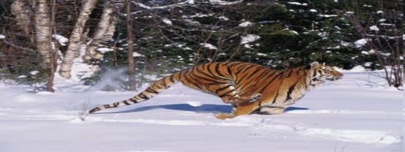
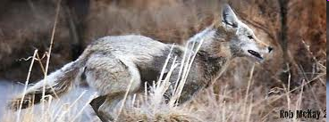
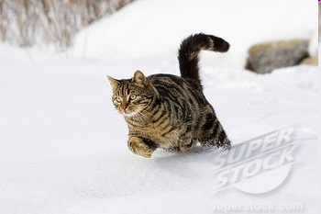
Tigers, coyotes and cats: The spiral of competition and hierarchization amongst workers
Tigers
(Young, fastest, strongest-
mainly undocumented-)
Coyotes
(Fast, strong, experienced)
Cats
(Young inexperienced/oldest/docile/not strong/not agile)

Slide 14
Masculinity and gender values among Mexican peasants
Will and capacity to work hard (Echarle ganas),
2) Physical and mental strength (Ser fuerte),
3) Responsibility to protect their own family (Ser responsable),
4) Solidarity and empathy for the ‘weak’ (Ser bueno y protector),
5) Communitarian leadership (Ser el más chingón),
6) Self-Government (Ser independiente),
7) Stoicism (No rajarse and No quejarse).
Hegemonic Model of gender socialization in rural Mexico
-mainly embedded in subsistence economies based on
organic and mechanic solidarity (as theorized by Emile Durkheim)

Slide 15
Labour insecurity and the reconfiguration of masculinity
In the context of labour flexibilization, which demands speed, discipline, instrumental abilities, and physical resistance, the Mexican migrant workers have realized that some of their “masculine qualities” are particularly useful, while others must be hidden.
The gender qualities they have reinforced: 1) Labour discipline, 2) Physical and mental strength, 3) Stoicism, and 4) Responsibility to protect the family.
The gender qualities that have been deliberately subjugated are:
1) solidarity and goodness.

Slide 16
Outcomes: 1) The deterioration of physical and mental health
In the interviews, the workers (whether they are tigers, coyotes, or cats) spoke about:
Mental health issues:
1) Stress, anxiety, depression and uncertainty are experienced when realizing that they will find difficulties in maintaining their jobs for a long period of time.
Physical health-related issues:
Permanent back pain
Hand and shoulder pain
Repetitive strain injuries generated by the intensification of the work process and the spiral of competition amongst them.

Slide 17
Outcomes: 2) The impossibility of workers’ collective resistance
Consequences generated by the subjugation of solidarity and empathy:
The workers do not speak amongst themselves about the mental and physical problems they face
Nor do they offer moral and material support to the ones who need it;
They fight sometimes amongst themselves.
Increasing acts of boycott against co-workers
Final result:
Difficult to organize, demand and create better working conditions

