Slide 1
Contested Legality

Slide 2
Two possible stories of the last ten yearsof refugee law:
The first suggests frenetic activity;
The second suggests constancy.

Slide 3
The frenetic story would refer to at least the following 10 factors:

Slide 4
a Smart Border Agreement, that led to front end security checks for all refugee claimants;
- a Safe Third Country agreement, challenged unsuccessfully in the domestic courts
- a direct back policy, recently challenged successfully before the Inter-American Commission on Human Rights on the ground that it violates the American Declaration of the Rights and Duties of Man
- changes to the security certificate regime and successful challenge before the Supreme Court,
- accession to International protocols on people smuggling and human trafficking,
(over)

Slide 5
- the enactment of significant legislation both at the beginning and the end of the decade
- a judicial reconsideration of the substantive definitional criteria of refugee status to cope with war resisters from the United States,
- the imposition of visa controls on Mexico and the Czech Republic specifically to reduce the number of refugee claimants ,
- an explosion of cases in the Federal Court,
- internal procedural changes within the IRB.

Slide 6
The story of constancy would note that our experiences at the beginning and at the end of the decade are remarkably similar:
- Consternation produced by the arrival of boats;
-the development of strategies to prevent further marine arrivals;
- the introduction of new legislation to get tough on smuggling;
- the introduction of legislation to streamline IRB processes;
- Supreme Court decisions allowing removal of refugees.

Slide 7
The governmental strategies that we are witnessing today are however more extreme than those formerly used.
They threaten the rule of law:
2 examples:
In the dealings with Thailand, we have mass arrest and detention and RCMP involvement.
Is there any way that the government can be held to account for that? We have seen a very unsatisfactory threads of jurisprudence has been related to the legal control over government activities overseas.

Slide 8
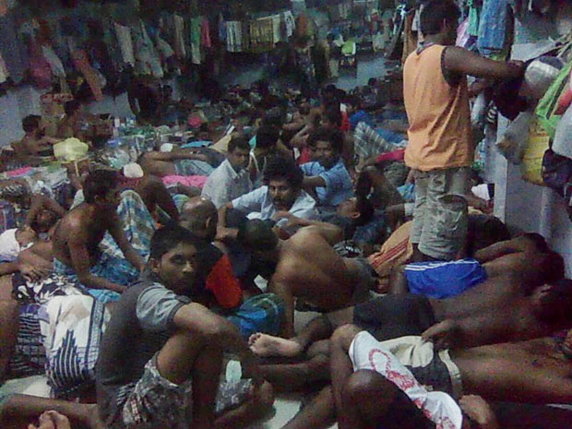
National Post Photo (identified as a cell phone picture of Thai detention centre)

Slide 9
Quote from Stewart Bell, National Post (March 29, 2011)
The detention centre is a prison with several blocks. Within the blocks are cells that hold 100 to 200 who share two toilets. They show a rectangular room so overcrowded there is hardly room to tread. The detainees said 140 men are housed in the cell; they must sometimes sleep in shifts because of the scarcity of floor space. “There is not enough room to sleep — even stretch our limbs freely,” one said.

Slide 10
Additional quote
Royal Thai Police officials said the detainees were free to leave Thailand once they had purchased plane tickets to Sri Lanka. They said they were doing their best but acknowledged prison conditions were not ideal.
“Our detention facility is limited. And the sheer numbers of them that come in has caused us a lot of difficulty,” said Major General Manoo Mekmok. “We try to do our best to keep their living conditions decent, up to the United Nations standard, but some are very hard to provide, like shower and nice toilet.

Slide 11
Compare with Italy/Libya Deal: Gaddafi Visit Celebrates Dirty Deal
http://www.hrw.org/en/news/2009/06/09/italylibya-gaddafi-visit-celebrates-dirty-deal

Slide 12
Berlusconi promised to provide US$200 million a year over the next 25 years through investments in infrastructure projects in Libya. Italy provided three patrol boats to Libya on May 14, and has promised three more. Italy has also said that it will help construct a radar system to monitor Libya's desert borders, using the Italian security company, Finmeccanica.

Slide 13
2nd example
Bill C-49
Designating people as mass arrivals after the fact without clear definition on criteria.
This amounts to retroactive determination with unknowable meaning. A venture into extra-legality. People do not know in advance whether they will be subject to mandatory lengthy unreviewable detention.

Slide 14
Conclusion
In her book, Walled States, Waning Sovereignty, Wendy Brown has alerted us to the consequences of such measures:
Officially aimed at protecting putatively free, open, lawful and secular societies from trespass, exploitation or attack, the walls are built of suspended law and inadvertently produce a collective ethos and subjectivity that is defensive, parochial, nationalistic and militarized. They generate an increasingly closed and policed collective identity in place of the open society they would defend.

