Slide 1
PDA in the libraries
Presented by:
  Bruce Fyfe
  Nicole Nolan
  Harriet Rykse
  Nazi Torabi
wlpda@uwo.ca

Slide 2

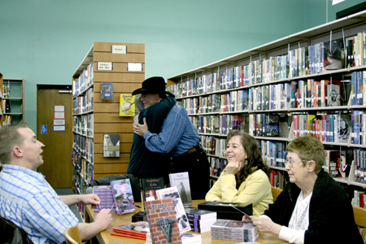


Notes:
We were somewhat surprised when Jennifer asked us to present about PDA in the library – although we all acknowledge that it can be an issue. After some discussion we realized she probably wasn’t talking about public displays of affection. . .

Slide 3
Agenda
What is PDA
History of PDA at Western
PDA Process
Assessment and Future
Notes:
Not talking about public displays of affection – Patron Driven Acquisition
Brief agenda

Slide 4
What Is PDA?
Patron Driven Acquisition (PDA)
Purchase on Demand (POD)
Demand Driven Acquisition (DDA)
Definition:
“Fundamentally, it's any system whereby documents are acquired by the library in response to patrons' direct requests or selections, rather than in response to librarians' speculations about which specific documents patrons are going to need.” (Rick Anderson, 2011)
Notes:
-
Patron Driven Acquisition has several different names.
Can apply to print or electronic material. Acquisition based on ILL requests is a form of PDA. So is acquisition based on a user request for a print title such as we’ve been responding to for years. Both these types of PDA are “mediated” as a librarian reviews the requests and makes the decision whether or not to add the item to the collection.
Electronic PDA can also be mediated.
WL PDA is currently for electronic books only and is not mediated directly. However, the collection librarians have tweaked the profiles in order to avoid monographs that consider out of scope of our collection.

Slide 5
A short history of PDA IN WL
2006
2007
2008
2009
2010
2011
2012
First EBL ebooks purchased at Western
EBL expanded to include PDA
Coutts pilot begins
Analysis of EBL pilot results and report with recommendations
Analysis of Coutts pilot & report with recommendations
EBL pilot for purchase of ebooks
OCUL PDA
PDA process part of normal workflow
Notes:
EBL (e-book Library) e-books were purchased starting in 2006.
In 2008 the EBL pilot was expanded to include PDA and ran through 2009
Report of this trial is available on the PDA intranet page – accessed from the IRSC website
One of the recommendations was to run a second trial for PDA using our primary book vendor, Coutts.
Coutts trial began in June 2010 with initial load of 1313 books. These are still in our catalogue.
Analysis of the results began after one year in May 2011. A report with recommendations was submitted in fall 2011.
In May 2012 officially began acquiring material via PDA as part of our regular processes
All reports are available on the IRSC website
WL PDA functions like this:
Books need to be accessed twice before a purchase is made. Reviewing the ToC, the index or the front matter of a book DOES NOT count as an access.

Slide 6
Why PDA
PDA aligns with the WL strategic plan in two areas:
“Western Libraries will enhance and expand access to collections in support of and response to the needs of users . . .”
“Western Libraries will enhance the quality of its physical and virtual infrastructure by . . . expanding the digital library resources and establishing the virtual library”
Notes:
The decision to make the PDA program part of our regular acquisitions methods aligns with the WL strategic plan - “Western Libraries will enhance and expand access to collections in support of and response to the needs of users . . .” and “Western Libraries will enhance the quality of its physical and virtual infrastructure by . . . expanding the digital library resources and establishing the virtual library”
Additional points for inclusion if the PPT is posted – do not need to be stated during presentation
Why PDA? (Nixon 2010) (Nixon, J. M., Freeman, R. S., & Ward, S. M. (2010). Patron-driven acquisitions: An introduction and literature review. Collection Management, 35(3), 119-124. )
Usage : One frequently cited study revealed that 20% of the collection receives 80% of the use (Trueswell 1969).
By the early 2000s, more and more libraries explored a new approach that resembled industry’s “just in time” inventory model.
“Purchase ILL request” 1999 - early 2000s
“Purchase on demand” (Hulsey 2003)
Patron Driven e-Book Acquisition evolved from purchase on demand when ebooks became available
Some advantageous: cost-effective collection development; user satisfaction; high subsequent circulation; and strong evidence of interdisciplinary use

Slide 7



PDA Books Journey
Records updated by Barb
Invoices are received and paid by Sharon Gadke and Nada Robson
Patrons access an e-book twice to trigger a purchase
Coutts Profiles maintained by librarian
New titles are added weekly by Barb St.John
Notes:
Librarians monitor and tweak the profiles to ensure the books added fall within our collections scope. Using Coutts’ OASIS program collectors can view titles that are waiting for a possible electronic copy, review titles sent for PDA and review titles purchased through PDA.
New titles are added weekly by Barb St. John.
Invoices are received weekly by acquisitions staff and paid by Sharon Gadke who adds an order record and Nada Robson who posts the payment and ensures a check is sent.
Record is updated - link is moved from the 856 field to the checkin record by Barb St. John.
A nod out to:
John Silvester for setting up the user survey that pops up when an unpurchased title is accessed
Anne Deacon for helping to fine tune the acquisitions pieces

Slide 8
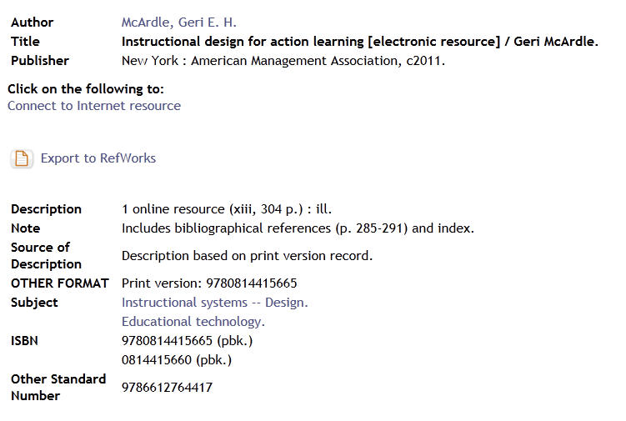
PDA title before purchase
Notes:
Screen shot of what a record looks like prior to purchase. By clicking on “Marc Display” the 039 Marc field will indicate this is an unpurchased PDA title. This particular title was loaded into the catalogue in January of 2011.

Slide 9
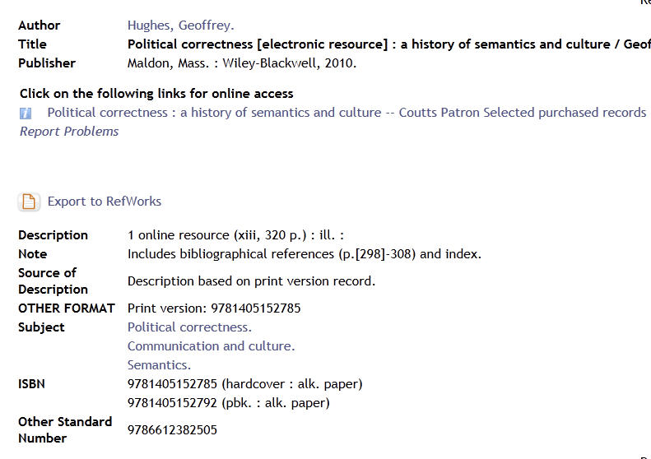
PDA title after purchase
Notes:
Screen shot of a title that has been purchased – you can tell by the wording in the link.
The wording in the link is to ensure that we will be able to identify these books in the future – should we have a need to. The note in the 039 field may disappear if the book is merged with a second copy.
Books purchased after May 2012 (our official start date for PDA preferred with all profiles in Coutts) are indicated with a notation at the end of the link

Slide 10
Now for a few stats. . .
Since the PDA trial with Coutts began in 2010:
Titles loaded | Titles purchased
Over 7500 | Over 1000
Notes:
Since the beginning of the Coutts PDA trial in June 2010 over 7500 records have been loaded and over 1000 records have been purchased. This means around 6500 records are waiting in our catalogue for a user to trigger a purchase.

Slide 11
Since May 2012:
Month/Yr | Records Loaded | Books Purchased | Total Cost
May/12 | 266 | 48 | $4818.98
June/12 | 1197 | 40 | $4203.34
July/12 | 503 | 28 | $3047.05
Total | 1463 | 88 | $9022.32
Notes:
Summary table is updated monthly on the wiki
The number of records loaded in June was larger than usual due to a backlog at Coutts.

Slide 12
What are our users saying
“I always thought that a preference for paper vs. electronic was generational, but to my surprise when I assigned my students readings from electronic books (available through the uwo library catalogue), they hated them and complained!”
“Electronic books are a real pain to read! It's impossible to "flip through" the book, and clicking from one electronic page to another takes about twice as long as turning pages in a real book.”
“I think integration with e-reading technologies available on iPad and Kindle (and others) would make e-book reading infinitely better.”
“. . . electronic books are incredibly useful in terms of their ability to allow more than one patron to make use of the material at the same time.”
https://staff.lib.uwo.ca/cgi-bin/pda-ebook-results.cgi
Notes:
Thanks to John Silvester for setting this up and making the results easily available.
The survey displays at the point of access to an unpurchased MyiLibrary ebook.
Results are dynamically generated.
The results are VERY raw and will need to have some refinement prior to drawing any conclusions.

Slide 13
What are our users saying
“It depends”
Notes:
What is the most common answer to the question about preference for print or electronic?? (click mouse to show)

Slide 14
What’s next?
Downloading to e-readers E.g. e-pub or MOBI formats
Print on demand
PDA for journal articles or book chapters
Textbooks
Notes:
The desire to download content to e-readers is obvious in the comments seen in the survey. There will be increasing pressure on the provider and the publishers to offer this option.
Print on demand – may be a way to answer the “it depends” nature of print vs e – could be funded by library or user
Offering PDA for book chapters or individual journal articles is also possible. Journal articles on demand is already possible. If the “big deals” for journals packages disappear – will articles on demand provide an alternative??
Is information packaged in books and journals a relic of the print world? Will our users accept/expect smaller bites of information that specifically answers their need? What would this look like for the library? (Not really expecting answers or discussion – just some “thinking points” to take away
Demand for textbooks is growing. Lots of different initiatives to meet this demand. What does it mean for the publishers? Do students want e-textbooks? (One comment in our survey suggests “no”)

Slide 15
Questions?

