Slide 2
Licensing and ‘Big Deal’ Analysis at Western
Provost’s Task Force on Open Access & Scholarly Communications
September 12, 2019
Samuel Cassady
Shawn Hendrikx
Western Libraries

Slide 3
Presentation Agenda
Introduction to journal licensing at Western
Task Force Questions:
Paid Subscriptions
Usage & Analysis
Considerations
Open Discussion
Western Libraries

Slide 4
Introduction
History of the ‘big deal’ & Canadian context
From print to online!
Kenneth Frazier coined ‘big deal’ in 2001
CRKN formed (CNSLP) primarily as a national buying club
Most university libraries in Canada subscribe to the same ‘big deals’
Elsevier, Wiley, Taylor & Francis, Springer, Sage (~10k titles)
Top five commercial publishers control over 50% of market (above 70% in some disciplines) and have profit margins in the order of 28-38.9%
Benefits: Expanded access, technical services & collection development, cost containment
Drawbacks: Cost containment, OA transfers, inflexibility, industry power
Western Libraries

Slide 5
Question 1
What are the paid subscriptions the Library currently holds including costs and journal names and if possible, any overlap* between subscriptions?
Western Libraries

Slide 6
Question 1
Western Libraries acquisition budget
$15M CAD
80% budget spent on serials
Serial content at Western:
~50k journals
~10k titles in ‘big deals’
~6k ‘priority’ titles, about half in ‘big deals’
Western Libraries Cost Data webpage
First in Ontario to publish our costs!
Non-disclosure is a work in progress
Western Libraries

Slide 7
Question 2
What is the usage of the various subscribed journals through Western Libraries or highlight the main ones that get accessed (including any historical data for trend analysis)?
Western Libraries

Slide 8
Question 2
Western Libraries Context
Since 2015, significant investment in serial analysis
Faculty consultation, including surveys
Citation and usage analysis
Priority title list
Based on 3 factors, differentiated by discipline
Western Libraries

Slide 9
Thresholds
Discipline | Downloads | Mentions | References
AH | 56 | 1 | 0.6
BM | 207.4 | 1 | 25.4
NSE | 148.8 | 1 | 17.2
SS | 96.25 | 1 | 6.8
Western Libraries

Slide 10
Question 2
JIM (Journal Inventory Manager)
First step: Journal Usage Project results
Added Western-specific subject codes
Extra round of faculty consultation to confirm priority status
2019-20 Serials Review Project
$270k cancellation target (already 100k identified)
Faculty consultation continuing with upcoming survey
Western Libraries

Slide 11
Question 2
Overlap
Aggregate packages vs. publisher bundles
Can rely on either (pros and cons)
Perpetual access, cost, embargos, DRM
Western Libraries

Slide 12
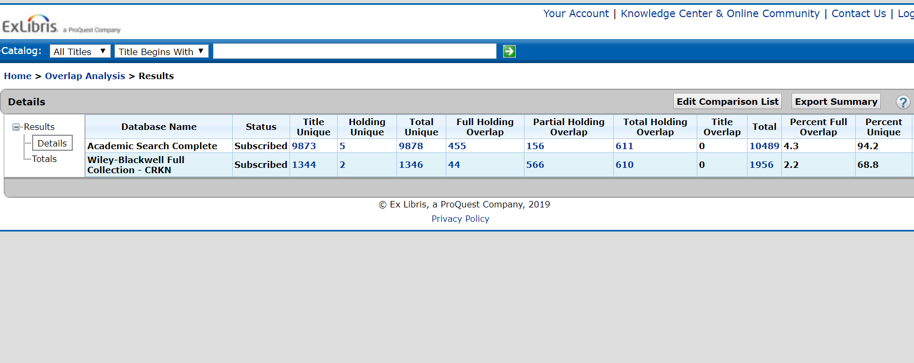
Overlap Analysis Tool
Western Libraries

Slide 13
Considerations
What have others done?
Cancel ‘big deals’ outright
Unbundle and repurchase select titles
Continue to subscribe and negotiate license terms
Discussion & Questions?
How do we reclaim power within the industry?
Western Libraries

