Slide 1
It’s all in the Relationships: A Liaison Role for Librarian-Publishers
Emily Carlisle, Western Libraries
Kristin Hoffmann, Western Libraries
ELPUB June 2018
Notes:
Hi everyone. I’m Emily Carlisle, a Master of Library and Information Science student at the University of Western Ontario and a Library Assistant at Western Libraries. Kristin is a Librarian at Western Libraries, and also the lead on the project that I’m about to present to you. Unfortunately Kristin is travelling and couldn’t be here today, but rest assured that you’ll learn lots about her as I move through this presentation.
Without further ado, I’d like to tell you a story.

Slide 2
“What advice do you have for new journal editors?”
Notes:
Back in March, Western Libraries hosted our second annual Journal Day, bringing together editors from across all of the different journals that we host. Part of this event was a panel of editors, with our final question to them being: “What advice do you have for new journal editors?”

Slide 3
“Work with Kristin and Emily!”
Notes:
The first editor, and all that followed, answered “Work with Kristin and Emily.”
We were pleased to hear this, not just because it was an unexpected compliment, but because it showed that our work to support journal editors has been successful.

Slide 4
Anticipating & Meeting Needs
Identifying Needs
Building Relationships
Providing Education
Notes:
In this presentation I’m going to talk about that strategy for supporting editors, and how we’ve drawn on 3 strengths of the typical liaison librarian role to do so: building relationships, meeting and anticipating needs, and education. As I discuss these strengths of the liaison librarian role, I’ll share stories about how we’ve employed them while migrating our 32 library-hosted journals from the bepress Digital Commons platform to the Open Journals Systems platform, OJS 3.1.

Slide 5
Liaison Librarians at Western Libraries
For a given academic department:
manage collections
information literacy instruction
in-depth reference services
scholarly communication outreach
build relationships with the faculty, staff, and students
Notes:
But first, some background on liaison librarians:
For at least 40 years, many academic librarians have defined their role as that of a liaison. Today, the term liaison librarian typically refers to librarians who work with users in a particular discipline, so that users benefit from the librarian’s subject expertise.
Here’s how the liaison model has worked at Western. Liaison librarians have worked with one or more academic departments to (among the roles listed on this slide): manage collections in those subject areas, answer in-depth reference questions, and generally build relationships with individuals in that department.
Just this spring though, Western Libraries moved from a liaison model to one based on functional expertise. That is, the library is now divided into units focused on User Experience, Collections, and Scholarly Communications (among other functions). This trend to re-evaluate the liaison role is evident across North America.

Slide 6
Anticipating & Meeting Needs
Identifying Needs
Building Relationships
Providing Education
Notes:
Still, it’s no coincidence that the model was successful for many decades, nor that some libraries are choosing to keep their liaison subject models. Its emphasis on building relationships, anticipating and meeting user needs, and providing relevant education make it successful.
These principles remain relevant today, now used in roles beyond those of the traditional liaison librarian. For example, where some literature suggests that librarians are unequipped to meet journal editors’ needs, librarians at Western Reserve University in the States recently wrote about their success supporting a faculty-run open access journal by using liaison principles. We’ve had success doing the same, but on a larger scale to support all of our library-hosted open access journals.

Slide 7
Notes:
For context, since 2008 Western Libraries has been a bepress customer, using their Digital Commons software to run our institutional repository, host e-theses, and host 32 online journals. These journals are run by faculty, graduate students, and undergraduate students. Some have started up since 2008, some have ceased, some have gone through extended periods of inactivity ... it’s a real mix.

Slide 8
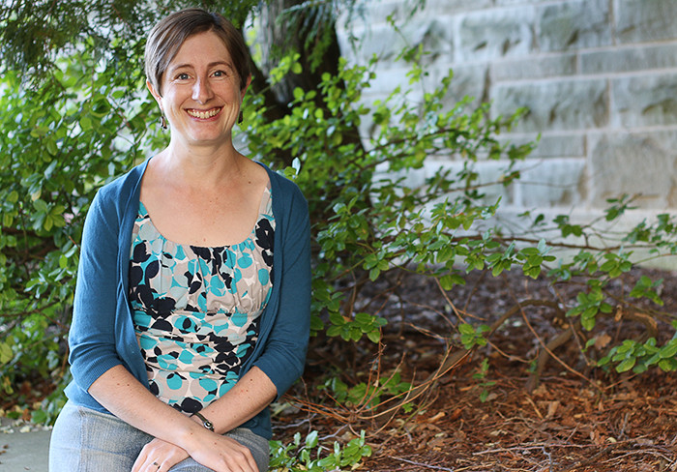
Notes:
For most of the last 10 years, our repository and journal hosting has been managed by one person, who in recent years has managed the IR and journal hosting in addition to other responsibilities. Then, in summer 2017, Kristin took on responsibilities for the library’s journal hosting. Kristin was a liaison librarian at the time, but was also on the library’s scholarly communications committee and familiar with journal publishing as an author, reviewer, and editor herself.
Since this was the first time that Western would have a librarian dedicated to journal hosting, separate from also managing the IR, Kristin wanted to get to know editors.

Slide 9
“What will happen now that Elsevier has bought bepress? Will they put ads on our pages? Will they sell our data?”
Notes:
At the same time, Elsevier had just acquired bepress, and some of our editors were quick to get in touch asking, “What will happen now that Elsevier has bought bepress? Will they put ads on our pages? Will they sell our data?” With concerns like this, and a librarian newly responsible for supporting journals, there was a natural cause for outreach to editors.

Slide 10
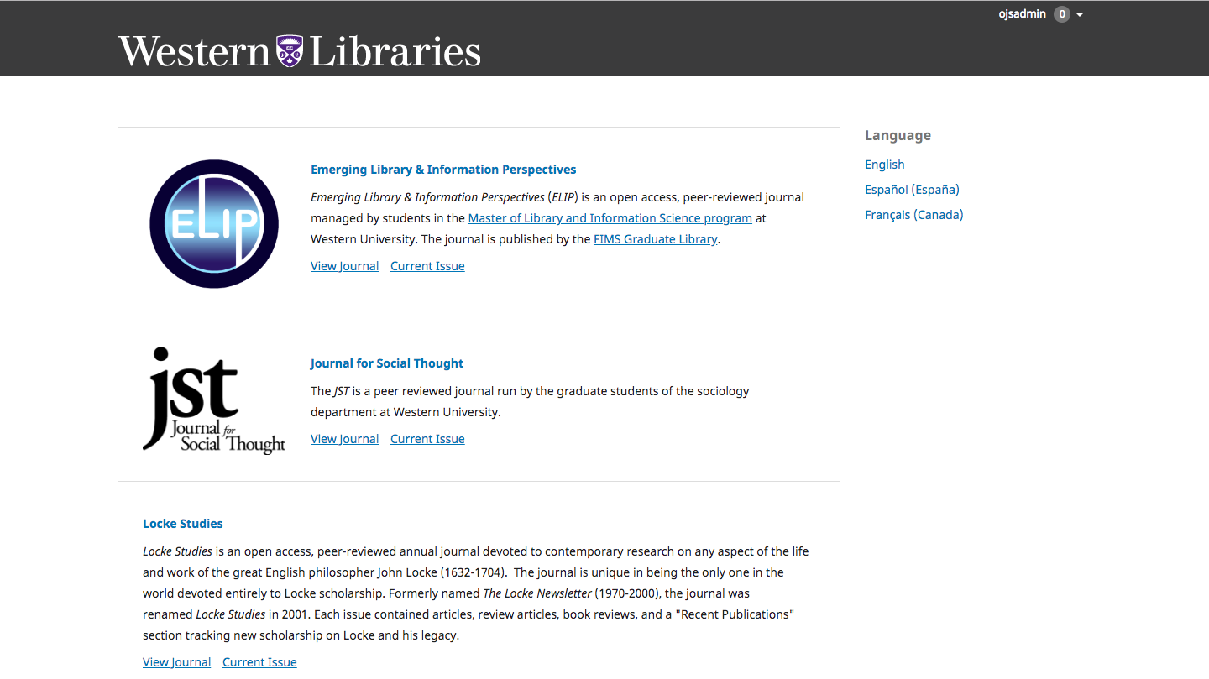
Notes:
So, last fall, Kristin and I met with editors from 15 journals, where it became clear that editors wanted to learn more about the acquisition. Even more notably, they encouraged us to explore options that would protect the openness--and their control over--published content.
And so we did. By November we’d confirmed that all 32 of our library-hosted journals would move from Digital Commons to OJS 3.1.

Slide 11
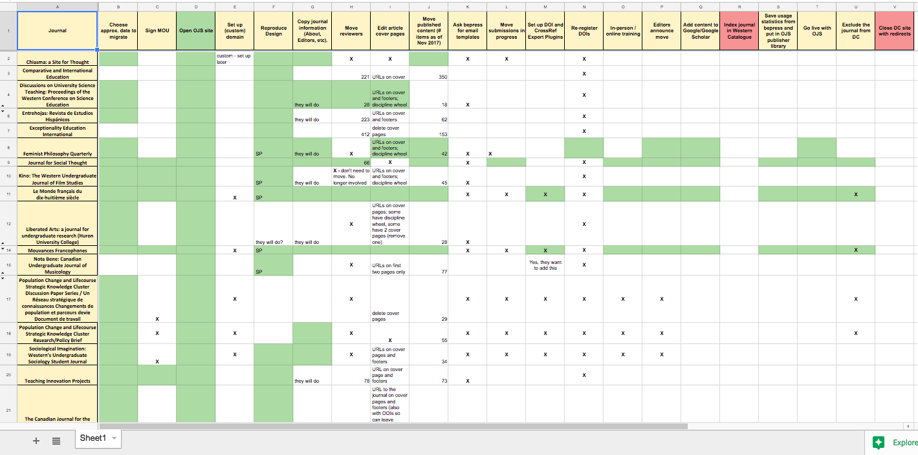
Notes:
It’s an ambitious project. A look at our working spreadsheet gives you a glimpse at what’s required: it show 21 steps to consider in migrating each journal. Some are simple, like opening up a new journal page on OJS.

Slide 12
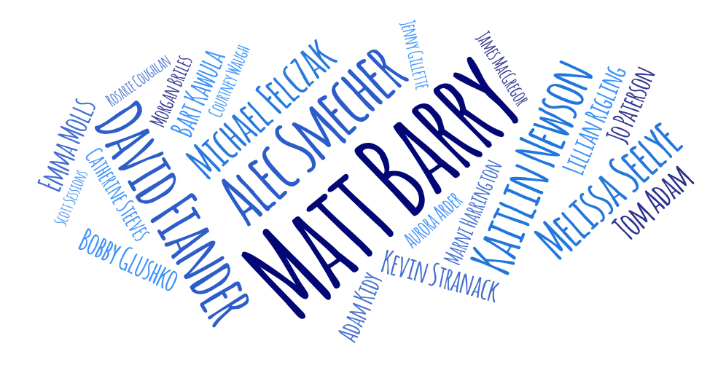
Notes:
For other steps, we’ve had to take advantage of technical expertise offered by folks across Western Libraries and beyond.
For example, one of our metadata librarians has written a code to transform reviewer data into the XML format needed to import it into OJS. Another has written a Python program that does the same for article metadata. For all of this, and for all of the individuals on this slide, we are grateful.

Slide 13
Notes:
So far, 8 of our journals are operating fully on OJS. As you might gather from this spreadsheet, the migration is definitely still a work in progress.

Slide 14
Anticipating & Meeting Needs
Identifying Needs
Building Relationships
Providing Education
Notes:
But it’s also worth it. We’re providing a better service to our editors. Where bepress staff used to be their primary point of contact, that role is now filled by us. In this new position, we’re able to employ the key principles of a liaison librarian, which I’d like to illustrate through 3 stories.

Slide 15
Building Relationships
Notes:
Starting with Building Relationships
I said that the 15 editorial teams who we met with before deciding to move to OJS had asked us to consider other options. This is true. But there were editors from 17 journals who we were unable to connect with before coming to our decision.

Slide 16
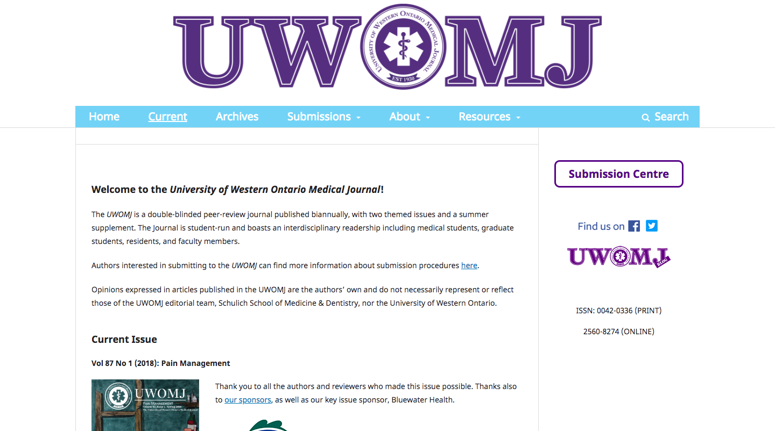
Notes:
One of these 17 teams had just invested “a lot of time and energy” setting up and learning how to manage their journal on Digital Commons. This included many emails with bepress, so as you might imagine, news of the migration came as an unpleasant surprise.
That’s not to say that they weren’t concerned about Elsevier’s acquisition. But before preparing for another transition, they wanted to know a few things: would there be DOI support? Would submissions and communications be automated? And would they be able to control most of their own site set-up?
In a carefully crafted email and follow-up meeting, we addressed each of their concerns, highlighting the amount of control that they would have over their settings and the advantages of having on-campus support for their journal.
By the end of that first meeting the editors were excited about the move, soon becoming one of our first to make the transition and publish a new issue on OJS. With continued support and communication, they’ve now taken advantage of the full range of possibilities available with the software, including customizing their design and developing their own plugin.

Slide 17
The Takeaway
Action rooted in listening builds trust
Notes:
So our takeaway here: Action rooted in listening builds trust. For us, trust has fostered a willingness to pursue open avenues.

Slide 18
Anticipating & Meeting Needs
Notes:
Now, in other meetings (with editors of undergraduate journals especially) it became clear that frequent turnover of editors is often a barrier to success. It often means limited transition planning for editors who take over.

Slide 19
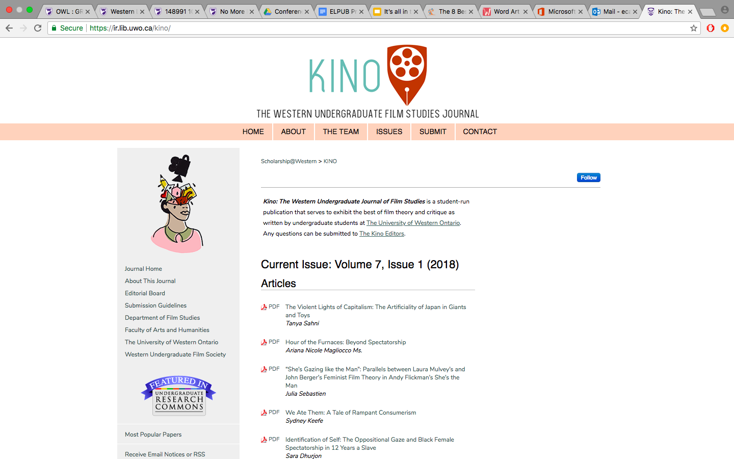
Notes:
Knowing this, we were prepared when we met with two undergraduate editors who were restarting their journal after 2 years of inactivity. In our first meeting they were just looking for general direction. They didn’t have a team and they weren’t aware of the different workflows that their journal could operate with.
Knowing this, we were prepared when we met with two undergraduate editors (of the journal on this slide) who were restarting their journal after 2 years of inactivity. In our first meeting they were just looking for general direction. They didn’t have a team and they weren’t aware of the different workflows that their journal could operate with.
Inspired by this and other meetings, we planned a larger meeting to bring together all undergraduate editors from different journals. They shared their workflows, strategies for recruiting staff, and ideas for promotion. A few weeks later, the new editorial team (of the journal on this slide) had recruited new executives and editors, and established a workflow that would allow them to publish 2 issues in 4 months.

Slide 20
The Takeaway
The more that we build relationships with our users, the better that we can plan for their current and future needs
Notes:
The lesson: Users don’t always articulate their exact needs, but the more that we build relationships with our community of users, the better that we can plan for current and future needs. Here, we saw an opportunity to build community among editors with similar challenges, so that even when transition planning may fail their journal, they can learn from the experiences of editors from other journals.

Slide 21
Providing Education
Notes:
Speaking of learning … last summer we had an editor approach us about moving his journal from its long tradition of print to an online, open access format. As he explained it, the move was inspired by a commitment to providing open access to scholarship forever, and he wanted to ensure that he was following best practices in the process … whatever those may be.

Slide 22
Notes:
Given that this was the journal’s first foray into online publishing, we took this as an invitation to teach those best practices, like choosing Creative Commons and adding DOIs to articles. The more information that we offered, the more that the editor was willing to ask, so that we have now also provided education in creating accessible documents and indexing.
Fortunately, OJS makes it easy to add Creative Commons licenses during set-up, and DOIs can be registered directly through the system. For this reason, and because editors want to know how to improve their journals’ visibility and use, we now discuss DOIs and licensing while we’re teaching editors how to use OJS. Since starting this migration, 4 journals have adopted Creative Commons licences and 5 have started using DOIs. We have more work to do, but we’re encouraged by these successes.

Slide 23
The Takeaway
To provide education that our users will respond to, we need to know our users
Notes:
The final takeaway then is that to provide education that our users will respond to, we need to know our users. We need to know who is open to learning from us, and what they are open to learning.

Slide 24
3 Pillars to Success
Anticipating & Meeting Needs
Identifying Needs
Building Relationships
Providing Education
Notes:
This last point leads me back to the liaison model. Kristin has said that as a liaison librarian, she’s often had to adjust her approach for different departments. Some departments care more about collections, so she’d talk more about collections. Some are more open willing to have a librarian in the classroom, so she’d bring more information literacy instruction to them.
Our approach is similar. We’re adjusting how we support our editors based on their openness to different aspects of our publishing support. But to provide this support, we need to build relationships, because it is through relationships that we can gage interests and pair them with editors’ needs. And then we educate, so that our support doesn’t stop at the library, but translates into actual practices that show our editors’ own commitments to open access scholarship. Through these 3 principles we’re building a sustainable open access journal publishing service.

Slide 25
Contact Us!
Kristin Hoffmann
khoffma8@uwo.ca
Emily Carlisle
ecarlis2@uwo.ca
Notes:
Thank you.

Slide 26
References
Bonn, M., & Furlough, M. (2015). The roots and branches of library publishing programs. In M. Bonn & M. Furlough (Eds.), Getting the word out: Academic libraries as scholarly publishers (1-16). Chicago, IL: Association of College and Research Libraries.
Case, M. M., & John, N. R. (2007). Opening up scholarly information at the University of Illinois at Chicago. First Monday 12(10).
Corbett, H., Ghaphery, J., Work, L., & Byrd, S. (2016). Choosing a repository platform: Open source vs. hosted solutions. In B. B. Collicott, D. Scherer, & A. Wesolek (Eds.), Making institutional repositories work. West Lafeyette, IN: Purdue University Press.
De Groote, S. L., & Case, M. M. (2014). What to expect when you are not expecting to be a publisher. OCLC Systems & Services: International digital library perspectives, 30(3), 167-177.
Eddy, M. A., & Solomon, D. (2017). Leveraging Librarian Liaison Expertise in a New Consultancy Role. The Journal of Academic Librarianship, 43(2), 121–127. https://doi.org/10.1016/j.acalib.2017.01.001
Hoodless, C., & Pinfield, S. (2016). Subject vs. functional: Should subject librarians be replaced by functional specialists in academic libraries? Journal of Librarianship and Information Science, 1-16. https://doi.org/10.1177/0961000616653647
Lippincott, S. K. (2017). Why Library Publishing? In S. K. Lippincott, Library as Publisher: New Models of Scholarly Communication for a New Era. Ann Arbor, MI: Michigan Publishing, University of Michigan Library.
Michalak, T. J. (1976). Library services to the graduate community: The role of the subject specialist librarian. College & Research Libraries, 37(3), 257–265.
Neds-Fox, J., & Archuleta, KL. (2014). Alignment with editors’ expectations. Journal of Librarianship and Scholarly Communication, 2(4), 82-89.

Slide 27
References
Simser, C. N., Stockham, M. G., & Turtle, E. (2015). Libraries as publishers: a winning combination. OCLC Systems & Services: International digital library perspectives, 31(2), 69-75.
Unsworth, J. (2014). Pubrarians and Liblishers at 20: Reflections on library publishing from 1995-2014. Journal of Librarianship and Scholarly Communication, 2(4), 68-81.
Vandegrift, M., & Bolick, J. (2014). “Free to all”: Library publishing and the challenge of open access. Journal of Librarianship and Scholarly Communication, 2(4), 107-116.

