Slide 1
Embedded Research Guides
Are they doing what students want?
Thursday, June 7, 2018, 10:15-11:00 a.m.
WILU 2018 Ottawa
Jim Seale and Alison Wetheral
Western University
Notes:
Good morning Everyone!
Welcome to our session on Embedded Research Guides: Are they doing what students want? Today we are going to share our experience with embedding Research Guides into our Learning Management System.More importantly, we are going to share with you the results of research we conducted that asked students about their experience using research guides.

Slide 2
Agenda
What we did
How we did it
What we Discovered- Activity Time
Recommendations
Questions?
Notes:
Here’s a breakdown of today’s session:

Slide 3
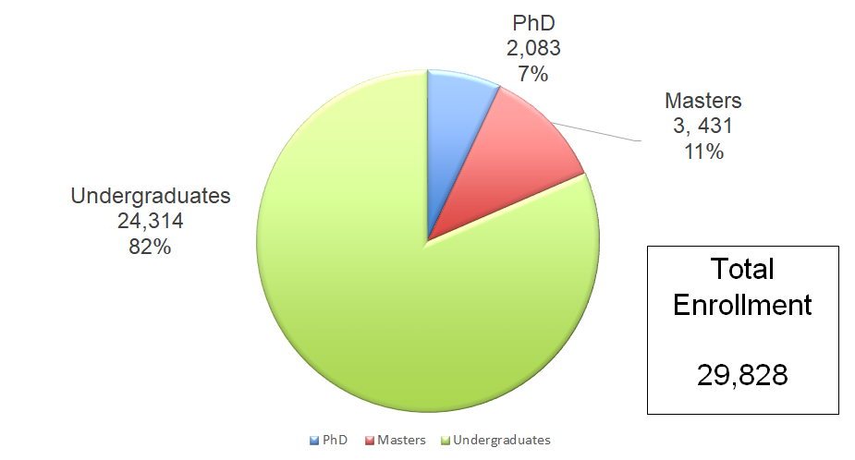
Notes:
Before we dive in, let’s set the stage. Western University is located down in southwestern Ontario in London.We have just under 25,000 undergraduates which represents just over 80% of our total enrollment. Our research project , the results of which we are going to reveal to you today, focused specifically on Undergraduate Use of Research Guides.

Slide 4
Research Guides at Western
407 Research Guides | 156 Subject Guides
 | 130 Course Guides
 | 118Topic guides
 | 3 General Purpose Guides
Notes:
And a little context about Research Guides at Western. We have been using Springshare’s LibGuides as our content management software since 2015. Research Guides is the term that we use to talk to our campus community about our LibGuides. Our network of Research Guides is fairly extensive We have 156 Subject Guides which is a legacy of a goal to have a Research Guide for every program at Western. We also create course-specific guides to support research happening at the course level. We have topic guides on topics such as how to access geographically-specifc information, how to search for specific formats etc. Our general purpose guides are a place we can curate collections, for example our Streaming Videos Research Guide.
At Western Libraries, individual librarians have been responsible for the creation and oversight of Research Guides that supported their liaison areas. Library assistants also participate in the maintenance of the guides. There hasn’t been much centralized management or oversight of research guides, which is one reason why this research has been so interesting for us. Western Libraries is currently in a transitionary phase. We are in the midst of a transition from a location based liaision model, to a system-wide, functional model of service.There is the potential for centralization of research guide management. Basically this means that we have the opportunity to review the management of our Research Guides and determine how to best support these resources in our new functional model. Our findings that showcase how undergraduate students are using Research Guides will give us some direction as we move forward.

Slide 5
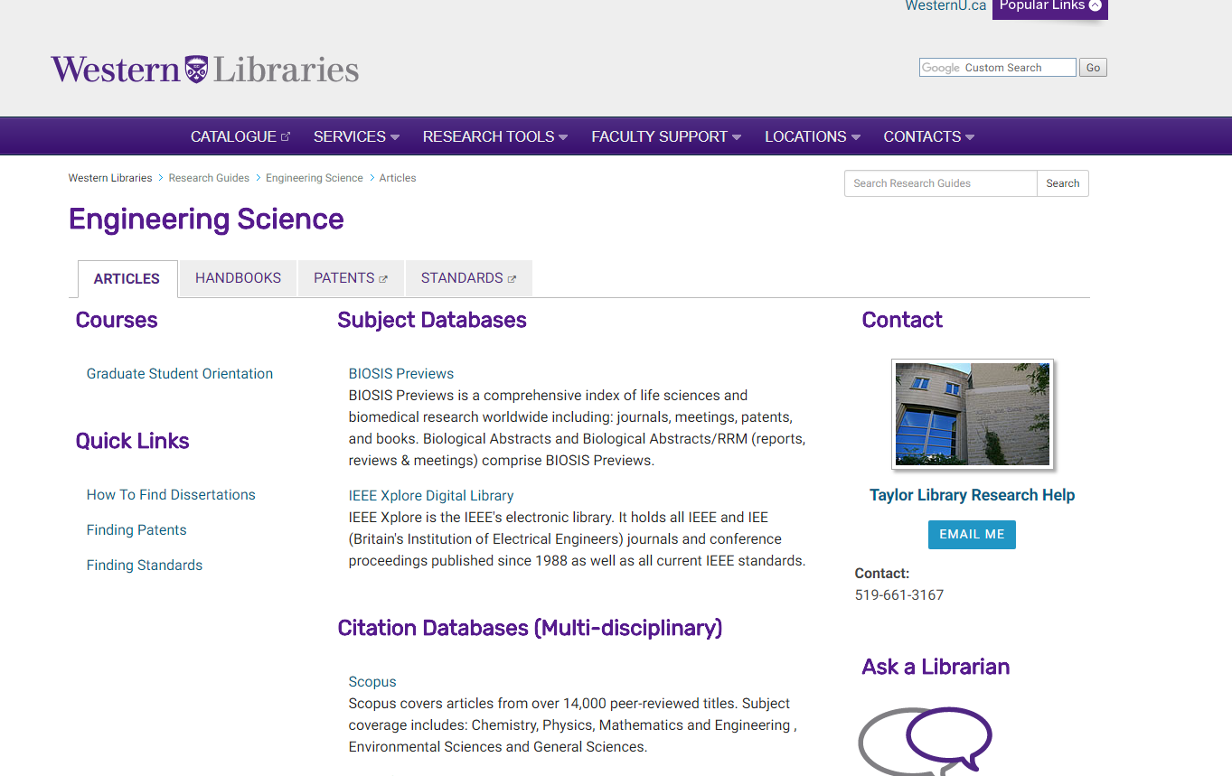
Notes:
This is a typical Research Guide at Western. It is laid out by format and basically serves as an online pathfinder to certain types of resources… in this case we are looking at our Engineering Science Research Guide which highlights the typical engineering resources: articles, handbooks, patents, and standards.

Slide 6
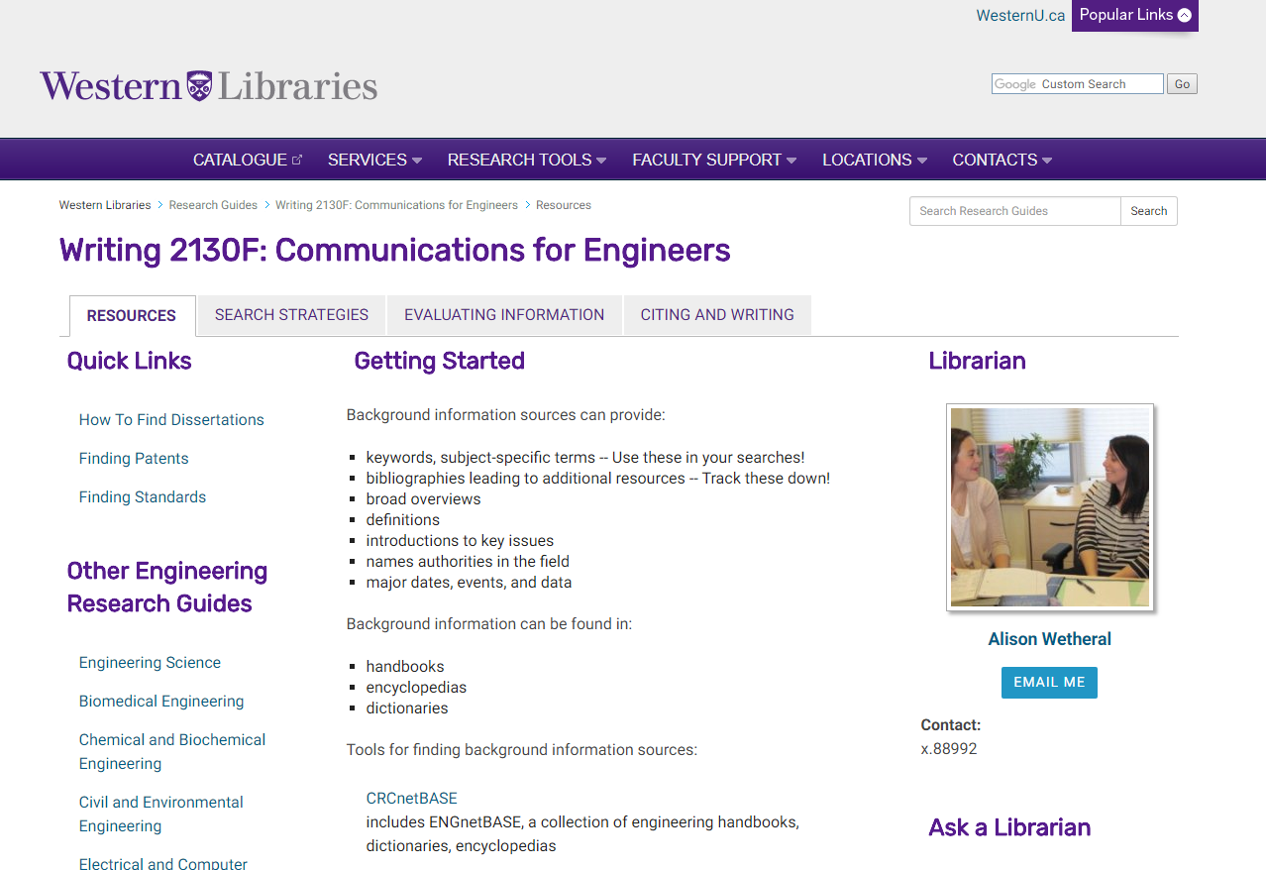
Notes:
Here we have a typical course guide. This guide is one that I made when I was acting as one of the Engineering Librarians at the Taylor Library. Its framework is based more or less on the research process. These are the two types of Research Guides that you typically see at Western: Pathfinder vs. Process. In our study, we got some great feedback from undergraduates on both of these types of guides. Is one better than the other? We will get to that.
But so far we have just been talking about research guides generally and I bet y’all are more curious about the “embeddedness” that we promised to talk about. What does that look at like Western?

Slide 7
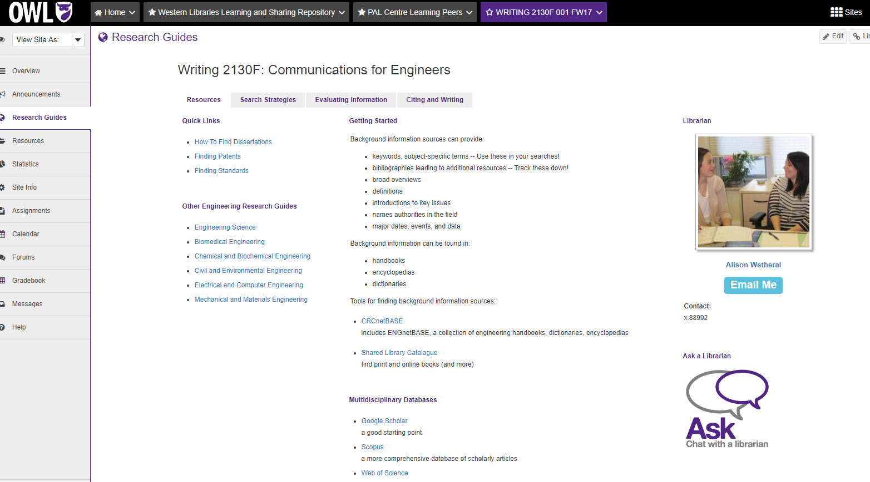
Notes:
Well it looks like this! This is the same guide I was just showing you, only this is what it looks like in our course mangaement system.
Marg Sloan, one of our research team members, brought this idea to Western Libraries after attending an eLearning Symposium. After discussions at our Teaching and Learning Standing Committee, a working group was formed to discuss potential implementation. Our Working Group was successful in pitching the idea to the Instructional Technology Research Centre aka the group that oversees the learning management system. We hooked up our IT with their IT to get to work on it. Research Guide OWL integration went live in September of 2016
As I mentioned we use Springshare as our Research guide platform. Springshare talks to Sakai/OWL, our learning management system, using an LTI (learning tools interoperability) tool. I will just say that I was not the ITRC and am not a member of our library IT department, so that is about as technical as I will get in this presentation.
But basically how it works is that we input course metadata on the Springshare side, and the Research Guides LTI tool reads the data and pushes the guide to its corresponding course. We have complete control over what course sees what guide.
So when students login to OWL and select one of their courses, they will see Research Guides on their side menu and can click on it to open up the guide. And now in 2018 we can say that at least 86% of courses currently have an embedded research guide.
But why are we here today?

Slide 8
71% → ?
Notes:
Well, after our initial launch in 2016, we have been assessing the impact of the integration. We saw a 71% increase in Research Guide access. What does this increase mean? Is this increase because of the OWL integration? Are students using them more because they are in OWL? Or are the accesses a one-time click? We formed our research team to learn more.

Slide 9
Research Team
Matt Barry, User Experience Librarian
Roxanne Isard, Teaching and Learning Librarian
Marg Sloan, Teaching and Learning Librarian
Meagan Stanley, Teaching and Learning Librarian
Jim Seale, Reference Librarian, Woodstock Public Library,Former Co-op Student, Western Libraries
Alison Wetheral, Library Assistant, Music Library, Former Research and Instructional Services Librarian, Western Libraries
Notes:
We had quite a large research team supporting this project.

Slide 10
Research Questions
•Do students know about research guides and how did they learn about them?
•How are students using research guides?
•By what means are students accessing research guides?
•Do students feel that research guides are valuable?
•Do students feel that research guides are effectively supporting research needs?
Notes:
We actually took a fair amount of time to figure out what we wanted to learn from the study. We were interested in seeing how students were interacting with Research Guides in OWL, but more generally wanted to know how students are using research guides and how they feel about them.
And now I’ll turn things over to Jim to talk more about what we did and how we did it …

Slide 11
Methodology
Survey
Surveyed students in the classroom
They ranged in age from 17-24 and were mostly in 3rd or 4th year
11 questions designed to measure student knowledge, use, access and perceptions of Research Guides
4 demographic questions
277 students completed survey
Focused more heavily on whether students were using research guides
Notes:
Can we include the fact that those surveyed and interviewed ranged in age from 17-24 and were mostly in 3rd and fourth year.

Slide 12
Methodology
Interviews
Survey participants who expressed interest were interviewed.
Semi-structured interviews ranging in time from 7-21 minutes
6 main questions for students to answer
7 students completed interviews
Focused on how students were using research guides
Notes:
Can we include the fact that those surveyed and interviewed ranged in age from 17-24 and were mostly in 3rd and fourth year.

Slide 13
What we discovered…….
Notes:
In both our surveys and interviews, we gathered evidence that will help us create more relevant tools for undergraduate students. Some of what we discovered was more surprising than others. We will share with you findings that challenged our own assumptions as librarians and creators of LibGuides.…. We will also share findings that reaffirm what has already been shared in the literature around LibGuide best practices. We thought we would share our findings with you today by categorizing them in to surprising vs. non-surprising……
But before we get into that we are actually going do a little activity…….

Slide 14
Activity: Think, Pair, Share
Dr. Uhura’s 3rd year assignment for Health Communications requires students to pick a topic of their choosing. The only requirement is that they must have at least 5 scholarly sources.
With a partner:
What steps would you as a librarian take to research for this assignment?
What resources would you consult?
Why?
Notes:
Before we get into our findings, we’d like to set the stage by doing a little think, pair, share activity with you . So we are going to have you get into pairs and think about following:
Dr. Uhura’s 3rd year assignment for Health Communications requires students to pick a topic of their choosing. The only requirement is that they must have at least 5 scholarly sources.
What we would like you to do in your pairs is to discuss the steps you would take as librarians to complete this assignment. What resources would you consult? Why would you take those steps and consult those resources?
You don’t need any devices for this, just think of the process you would take and chat it over with your partner. We will take a few minutes to do this and then we will come back together as a group and discuss.

Slide 15
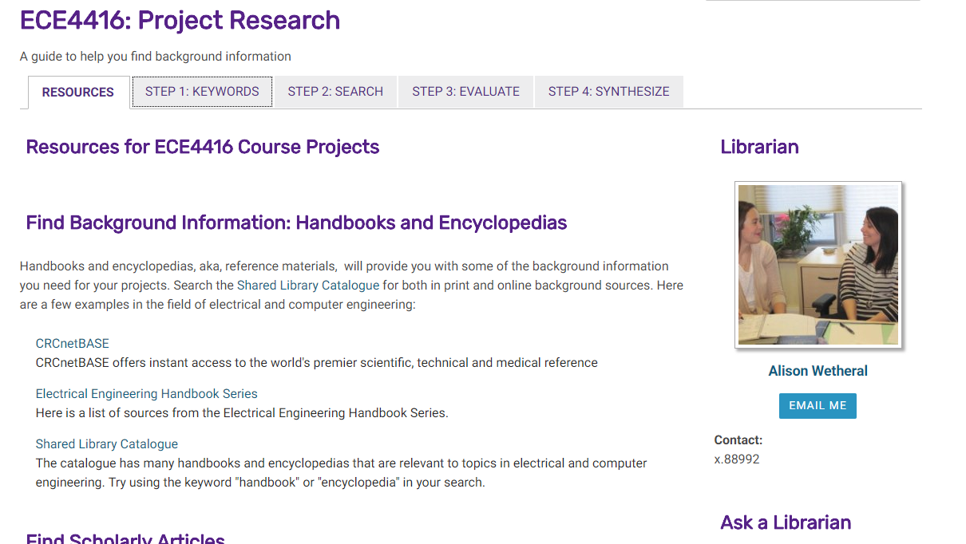

Slide 16
Notes:
This is Scotty…
While you may know Scotty as Chief Engineer on the U.S.S. Enterprise, you may not be so familiar with his side hustle as Western undergraduate student in Health Sciences.
Scotty was in Dr. Uhura’s class and was asked to complete the same assignment we just saw. He decided to do his assignment on “effect of warp drive on human health”

Slide 17
Scotty’s Research Process
Dr. Uhura mentioned PubMed is a good place for scholarly sources… it’s so hard to find stuff in there though.
So let’s type in “effects of warp drive on human health” and see what I come up with!
Well I got good info off Google when I asked it my question, but I have no idea if Dr. Uhura would consider it a scholarly resource…. Spock said Google Scholar might be something to check out.
Maybe I can use Google Scholar to search… and then once I find a good article, I can check it to see if it comes up in Pub Med…
Notes:
Scotty’s Research process for his warp drive topic was not as linear, or categorical as ours was …
Not knowing where to start, Scotty turned to what he knows best. Google. He says I’m just going to throw my topic in and see what I come up with.
Not seeing anything super useful, he says well, Dr. Uhura did say the have to be scholarly, maybe Google Scholar would give me better results. Just then, he received a notification through OWL with additional instructions from Dr. Uhura saying that they should be searching PubMed for scholarly resources. So he goes to pub med and types his topic in …. He gets no relevant results and becomes easily frustrated He was having better luck with Google Scholar so he returns there and continues searching.
Just to double check that his sources are “scholarly” he goes back to PubMed, the prof sanctioned resource, and searches for the resources by title…. If they come up in PubMEd he knows he is golden.

Slide 18
“This is a second year course, so I think half the class would maybe go and [use research guides], and half the class would just use Google.”
Notes:
Interestingly, we didn’t just make up Scotty’s Research process. Scotty’s experience is reflective of what we heard from students about their information seeking routines.
When looking at a Course=Specific research guide, this student spoke to the research process of her peers… recognizing, unsurprisingly, that Google is often to go-to, not Research Guides.

Slide 19
[Asked to show what research guides they use, they show Google Scholar]
Notes:
Part of our interview process was having students show us how they get to the Research Guides they used most recently to complete an assignment. This person went directly to Google Scholar.

Slide 20
“Our professor said we had to use PubMed, so I was only using PubMed for that, but because I was having trouble with PubMed I kinda cheated and went to Google. And after I went to Google I made sure it was something I could have got from PubMed.”
Notes:
When we asked students what they used other than Research Guides, and what they valued about these resources, we found out more than we really bargained for…..
This student said ““Our professor said we had to use PubMed, so I was only using PubMed for that, but because I was having trouble with PubMed I kinda cheated and went to Google. And after I went to Google I made sure it was something I could have got from PubMed.”
4 out of 7 students spoke to checking their sources in a “scholarly database” after finding them in a “not so scholarly database” . So they value ease of use …. But they also value authority… or know the importance of authoritative resources.

Slide 21
“When I’m doing … medicalized meta-analysis … This semester I’ve been using it a lot for my research methods class because we are doing specific case studies and we have to back up our information using … really medicalized studies.”
Notes:
In that same vein, we have this student explaining the importance of backing up information using “really medicalized studies.”

Slide 22
Librarian Mental Models vs.
Student Mental Models
Mental models:
Librarians | Categorical Focus on process of research
Students | Product-driven, Focus on end result
(Castro Gessner, Chandler et al 2015)
Notes:
But why did we work through this little activity with you today?
Sometimes we as librarians have a tendency to want to include all the things, each with a 500 word description explaining all the things we talk about as librarians: scope, authority, breadth, currency … We also like to categorize things, sometimes in ways that only we could categorize them….
In a 2015 study titled “Are you reaching your audience? The intersection between LibGuide authors and LibGuide users”, the authors speak to this idea of mental models: mental representations for constructs that individuals bring to a situation which afford them an understanding or lead them to a particular action.. “ We often have very different mental models than those that we teach. We are the experts in our field, and our students are just rookies. Students and Librarians think about research and Research Guides differently!“The “mental models” of both librarians and students inform how they go about creating content and consuming content.”
The exercise that we just participated indemonstrated this. We as librarians approached Dr. Uhura’s assignment a little differently than an average student would. We are going to propose through our findings, that this difference in librarian vs. student mental modes MUST inform how we design Research Guides.
So without further adieu I am going to pass this off to Jim who will reveal some our findings that surprised us a little and will talk about how we can use this information to design tools that fit better with student’s mental models.

Slide 23
Unanticipated Findings aka. The Surprises
Notes:
In the beginning of this research project, we were hoping to better understand how students use research guides and whether or not our integration into OWL had any sort of effect on whether students were using research guides and HOW they were using them. The findings our research uncovered were not what we were expecting to find.

Slide 24
Level of Student Information Literacy Skills
Students have a habit of using “unsanctioned” research methods and reverting back to conventional research methods to check the authority of something they have found (4 out of 7 interviewees reported this behavior!) Sometimes I’ll just do a generalized Google search … and then if I find an article that I like … If I’m on Google Scholar, I’ll try and find it on the Western database
“Scavenger hunt” research methods.
Students have an “authority complex”
Faculty endorsement crucial to research guide credibility
I think some, definitely for English, I feel like some were just websites given to us [by professors], and been like “use this”
Notes:
Can we really blame students for following what the faculty member says? They are trying to get the best marks possible and if they see research guides as superfluous to a decent mark, they are not going to budget their time to learn new skills.
I7-16] I feel like I have to learn to do research on my own.

Slide 25
Convenience Factor
Convenience and familiarity are of paramount importance
If it’s what I’m used to using, then I use it all the time and I love it.
It is easy to blame students for this, but there are many factors to consider:
Students are learning in an oversaturated information environment.
Students are often dealing with multiple competing priorities
Students may have underdeveloped time-management skills
The connection between better research practices and better marks is unclear
Ensuring that students can quickly recognise how research guides will save them time will ensure that they are used by students.
It’s good that [databases are listed] first, because for example if Handbooks came up first I would be like wow this is useless and then I would just leave.
Notes:
Database Access
Jim- There is some good survey data on this ……

Slide 26
Lack of recognition of Research Guides
Frequently muddled with “summon”, Western Libraries search tool, and databases more generally.
239 out of 277 (86.3%) students surveyed said that they had heard of research guides before the survey.
Surveys made it clear that when students self report familiarity, that they often are thinking of a different research tool.
Distinctive branding and intuitive design are key for student usage.
I didn’t know this existed, so I think even just …letting [first year students] know this is available would be a great thing

Slide 27
Research Guide-LMS integration overblown?
71% increase in Research Guide access after integration into our LMS
Despite this fact, the vast majority of students (218 out of 264 or 82.6%) report accessing research guides through the library website.
This finding may be affected by the previous finding that students have trouble differentiating Research Guides from other Western Libraries research tools.

Slide 28
The Non-Surprises
Notes:
So we heard from Jim, a few things that caught us off guard. We did find a few things that we were expecting to find in our results.

Slide 29
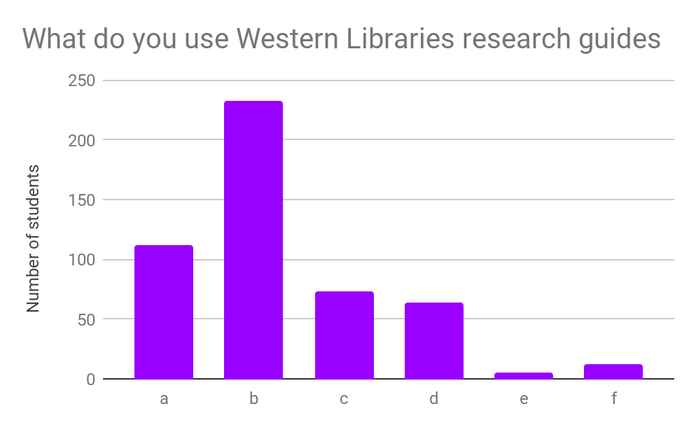
Student Use of Research Guides
What do you use Western Libraries Research Guides for?
a | Deciding/refining a topic for my assignment
b | Finding sources for my assignment
c | Help with citation
d | Learning about a subject that I am unfamiliar with
e | Finding contact information
f | Other
Notes:
In our survey we asked students what they use Research Guides for. 233 out of 277, about 85% of respondents indicated that the use them to find sources for their assignments, which is to be expected. The second most selected answer was deciding/refining topics for my assignment, which to me suggests that there is a recognition amongst the students that research guides are more than just links to relevant sources. They should be help them from start to finish with the process.
Should we recognize that students are using Google on our research guides? Should be present them with information on using Google to form a topic, on how to take a Google search through to different sources? Maybe we should meet them where they are and take them to where we want them to be.

Slide 30
Relevancy Factor
Purposeful “I guess I’m trying to figure out what they’re wanting us to use it for. ‘Cause that’s something that I am not getting from it … what part of … this course they’re actually hoping it will help us with.
“What exactly are they? I don’t really understand how to use them or what they’re for … obviously they’re guiding you on conducting specific types of research, but I’ve never taken the time to look at them.”
Useful Landing/Home Page “at least Kinesiology goes to the databases right away. Whereas here [English Research Guide] I’m like what’s all this and then it just kinda seems useless to me and I wouldn’t even search up biographies or something like that ‘cause I wouldn’t know of it.”
Notes:
Related to the idea of research guides as assignment , and building on the convenience and ease of use factor that Jim mentioned is what we are calling relevancy factor.
“What exactly are they?” one student asks., “I don’t really understand how to use them or what they’re for… “ when we asked students about their experience with them the majority of them did not know what we meant by research guides. Once they were shown a research guide, 4 out 7 of expressed that it was not obvious why they should use them.
We also had students explore research guides that corresponded with their current course work. When exploring the research guides, 3 out of 7 students mentioned the fact that the landing page is very important. The quote we pulled here illustrates this: “at least the Kinesiology goes to the databases right away. Where as here (on the English Guide)” I”m like what’s all this and then it just kinda seems useless to me. ..
Should we be intentional with the purpose of the Research Guide : aka … outcomes based guides … this guide will help you…. XXXX or would students read that?

Slide 31
Relevancy Factor
Course-specific: “There’s only one of my courses, which is interesting ‘cause we definitely have to use it in some of our more general courses that would be in Engineering Science for everybody. So those seem strange to me to be missing library guides.”
“I find some of the guides are too broad. It would be well worth the time to make more specific guides”
Databases: “ But I would still say databases is by far the most used and … it’s good that that’s first, because for example if Handbooks came up first I would be like wow this is useless and then I would just leave.”
Notes:
Kind of on that same vein, the students demonstrated a preference for course-specific guides.
We understand that it is probably not sustainable to have a course-specific research guide for every single course offered at Western: one could dream…. But perhaps we need to think strategically about what courses we do have research guides for? Should have a course specific guide for the major first year courses for example? Should we focus in on capstone sources? Should we determine which courses have more of a research focus and ensure there are guides that accompany those courses? My colleagues spoke about their recent experience in Curriculum Mapping, could a similar exercise me applied to Research Guides?
Not surpisingly, students still like the curation of databases that Research Guides are known. We need to keep this factor in mind…. If we design Research Guides on Process alone, chances are databases would get buried on tabs, etc., which as students have said, is not as useful.

Slide 32
What do you feel is the most useful part of Western Libraries Research Guides?
Notes:
Our survey results also reflected this notion. We asked students what about what they feel is the most useful part of Western Libarires Research Guides…. We have created a wordcloud to demonstrate the most frequent responses and as you can see databases, access and articles are definitely the most prominent concepts. This reaffirms the findings from multiple previous students that outline how students primarily rely on Libguides for finding articles or databases.

Slide 33
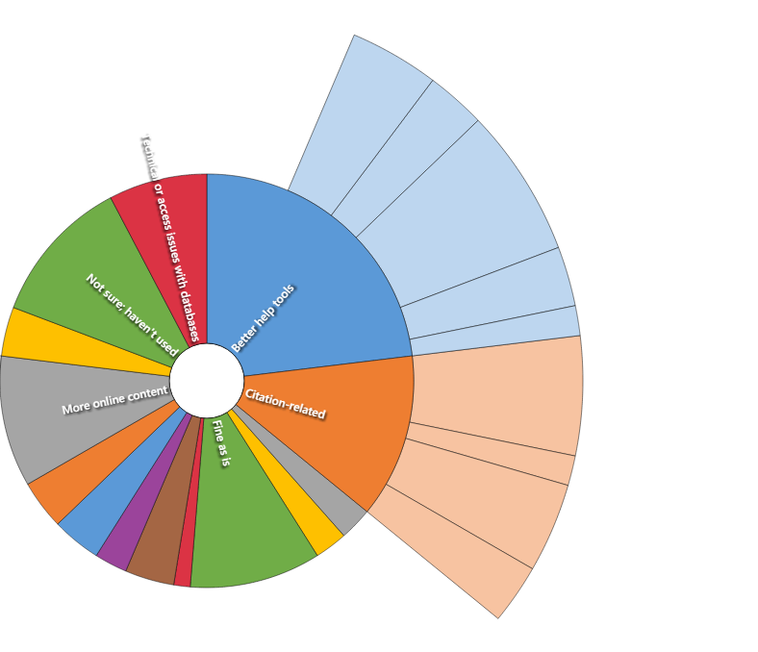
A
B
Better Help Tools
How-to videos
Instructions on how to navigate guides
Instructions on how to use databases
Step-by-step research help
Smaller summaries of resources
Citation-Related
Help with citation
Citation management tool
Citation generation tool
Pregenerated citations for recommended resources
C
D
E
F
G
H
I
Notes:
Our survey also provided insight into how to enhance the relevancy factor . This diagram here represents the responses that we received through the survey when we asked students what they would like included in Research Guides. Their answers were quite diverse ranging from “I don’t know I’ve never used it…. To I want to see more of the “CRAPP test”.... We used envivo to – We used envivo to analyze and survey results and we saw two main themes emerge- Better Help Tools and Citation-Related Tools .
Instructions on how to use databases and help with citation were the most frequent answers… won’t it be nice for all of us if there were pregenerated citations for recommended resources on our guides??? But maybe we need instructions on how to easily gather that information…. Citation management tools….. ?
So the question becomes, how do we create a guide that includes incorporates the expressed needs of students in a way that they can see the value-added to their own research routines?

Slide 34
Design Best Practices
Consider tab blindness “I honestly wouldn’t even see that there’s other tabs.”
Use bullet points “I don’t know, it’s kind of just like, the things are really descriptive here. It would be nicer if this was point-form. To say what it’s talking about more.”
Maintain for Currency “So this actually feels super outdated. I think this used to be more of… like keywords that they used on the old project page. But I don’t think we actually do literature reviews anymore in this course.”
Notes:
We also uncovered a few design considerations. These are fairly established in both the world of web design and within the existing literature around LibGuides Best Practices. In our interviews, we had students look at existing research guides in their area/s of study. We asked them if they had any suggestions on how we could improve them and they often spoke to design elements. These three themes emerged from their answers….
Consider tab blindness: We need to be thoughtful about our use of tabs… should we still use them?
Students also commented on the “text-heavy” nature of the guides. I think this falls back to librarians mental modes, where we want to divulge everything about a resource, to make sure our patrons have evertyhing they need. We need to balance the need for information with best practices in writing for the web, so we that we don’t discourage students from using the research guides. Short and sweet and to the point.
Because of the dispersed way that we currently manage research guides, sustainability and maintenance is often an issue. We have an opportunity at Western to be strategic in our approach to research guides. Whatever our approach ends up being, we will need to make sure they are up to date and relevant.

Slide 35
Need for Promotion
Student Awareness (Ouelette, 2011): [After being shown a research guide]”Okay, so yeah, I’ve never been on this. … I didn’t know this existed.”
“I’m in my fourth year, so it’s kinda sad that I didn’t know beforehand [that research guides existed].” *
Perceived Usefulness: “[When asked what we could do to improve research guides] … I didn’t know this existed, so I think even just … making sure that when you’re in first year, [in the] very broad Kin courses that everyone has to take, I think letting them know this is available would be a great thing”
Notes:
I think its no surprise that we need better promotion and we were not shocked to learn that we have a student awareness problem, Given our access data and analytics, we were surprised by how big that problem was.

Slide 36
Need for Promotion
Branding [Asked to show what research guides they use, they show Google Scholar]
Faculty Endorsement (Ouellette 2011)“ Having profs mention [research guides] would be great too, because all I’ve really heard from my profs are … they’ve been pushing PubMed. One of them mentioned Scopus so I checked it out.”
“…now that I think about it, because I have papers coming up, it would be helpful if the professor showed us the OWL on our screen, like showed us in class instead of saying if you go to OWL site and you go here, like, no-one listens. But if you show everyone and say we have an essay coming up, this will help you find research.”
Notes:
Jim mentioned that we were surprised by these two areas, but I think its really important to emphasize these factors when we talk about the obvious need for promotions.
I think its very clear that the term “Research Guide” is not resonating with students. Some of the responses that we received in our first classroom visit suggested that students answered the survey thinking of not Research Guides, but our Discovery Layer Summon…. They thought often mistook databases for Research Guides….. To the point where we adapted our survey introduction to briefly show a research guide while handing out the survyes. , one of our interview questions had interviewees show us how they accessed research guides. Not one person accessed it through OWL, most either Googled or navigated to it through our website. (It did confirm that we have done a decent job when it comes to navigating to them on the website… .) How can we make our embedded research guides recognizable as a Western Libraries product? I think we need an entire rebranding to better describe them to undergraduate students. Further user consultation is needed to determine how to name them so that they are more easily recognizable
Students also understand the power of the professor… they speak to professor influence on their research routines and behaviours. Even if we aren’t in classrooms face to face, research guides provide a way for students to learn about research asynchronously. Having professors introduce these tools is one way to increase awareness.

Slide 37
Recommendations
Research Guide as “Process or Pathfinder or ????”
Incorporating Guides into student information seeking routine
Course-specific when possible
The challenge is to teach students research skills while also saving them time as opposed to spending it.
Notes:
Move away from Research Guide as “Pathfinder”

Slide 38
Recommendations
Audience work- who are we designing them for?
Rebranding-further consultation with users as to what name would best describe them.
Promotions and Awareness - Partner with Faculty
Notes:
Promotions and Awareness- not only to spread the word, but to increase the relevance of guides to course content
We should mention something about how to Turn these Embedded REsearch Guides into Tools to change information seeking behaviour

Slide 39
Embedded Research Guides: Are they doing what students want?
Probably not.
Notes:
As you can see, we can’t correlate the integration of Research Guides and the increased access of Research Guides with increased usage of guides. We just didn’t find a lot out about meaningful use of Research Guides in this particular study. However, we did hear about what students want out of a research guide, and the fact they once they know about them, they think they are useful. More importantly, we heard a lot about students’ researching routines and discovered how we might adapt embedded research guides to align with what students want.

Slide 40
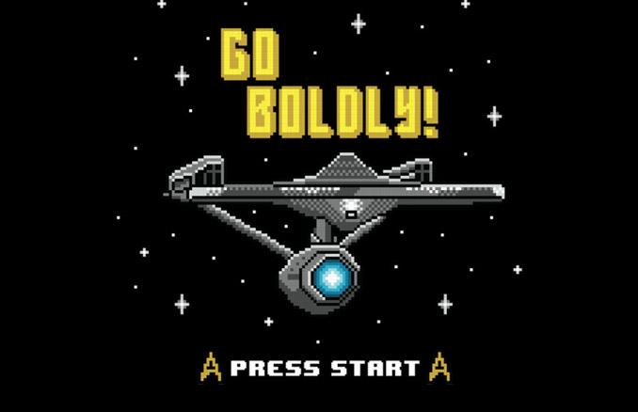
https://www.geekalerts.com/star-trek-go-boldly-t-shirt/
Notes:
We will leave you with this. The whole theme of this conference is Information into Action. Our findings have really gotten me thinking about how we can design research guides in a way that transform information into action. We need to think in new ways and perhaps boldly go where we haven’t gone before with the design and creation of Research Guides.

Slide 41
Thank you! Questions?
Jim Seale, jseale3@uwo.ca
Alison Wetheral, awether2@uwo.ca
Research Team, rgresearch@uwo.ca

