Slide 1
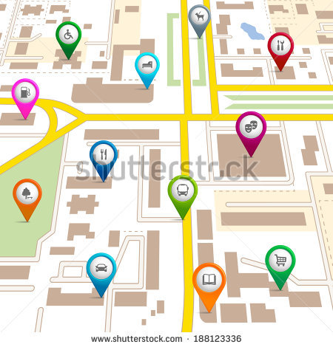
“A POSITIVE LATITUDE” or...
GEOREFERENCING AND ACCESS TO ARCHIVES
Tom Belton
Society of American Archivists
Research Forum
Washington, D.C.
August 12, 2014

Slide 2
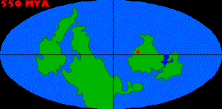
AGENDA
Overview of topic.
Outline of literature review so far.
Research problem.
Proposed methodology.
Secondary lines of inquiry.

Slide 3
OVERVIEW
Not access to maps, but maps to access.
Some examples:

Slide 4
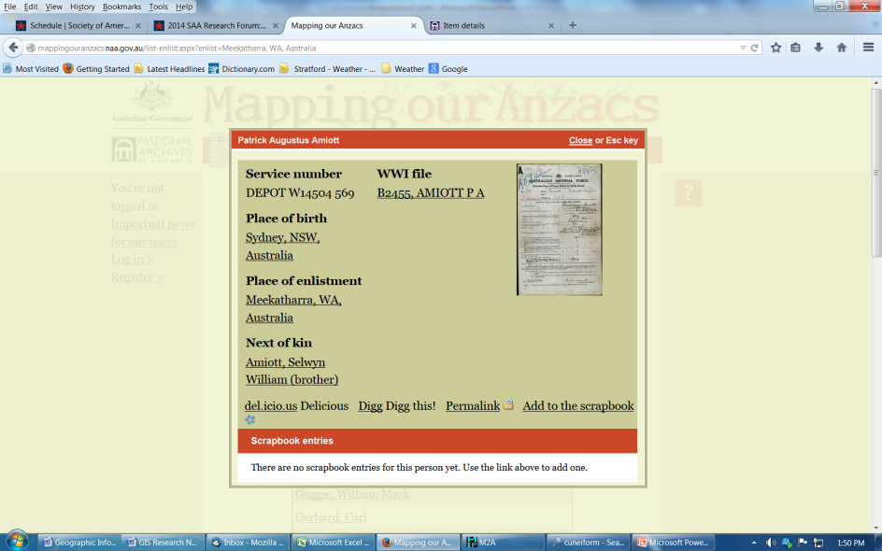
MAPPING OUR ANZACS http://mappingouranzacs.naa.gov.au

Slide 5
LITERATURE REVIEW SO FAR..
A few articles or conference papers about institutional initiatives
Some evidence of importance of place name in information seeking (e.g. 20% of 3000 queries at TNA EW in 2009)
Much work in progress or still hypothetical
Many locally developed and open source tools
Three distinct activities:
1) standardizing georeferences,
2) embedding georeferences in descriptive records and
3) installation of mapping layers on archives catalogues
Progress
Challenges

Slide 6
RESEARCH PROBLEM
What are the needs of particular archives patron groups with respect to georeferencing and access through maps?
Patrons
Genealogists
Environmental researchers
Needs
Relevance of place names?
Need for precise geographic coordinates?
Desire to search via map interface?

Slide 7
SECONDARY LINES OF INQUIRY
Technical feasibility for OPACs, archival software developers and aggregator sites
Standards development (e.g. EAD)
Implications for arrangement and description

Slide 8
PROPOSED METHODOLOGY
Initial Survey of Patron Groups
Focus Groups or Interviews

