Slide 1
Author Rights
Tom Adam
Monica Fazekas Bruce Fyfe Joanne Paterson
January 14, 2014

Slide 2
Context
Elsevier, Open Access and academica.edu
Upcoming Tri-agency (NSERC, SSHRC and CIHR) granting mandate on Open Access
The objective of this policy is to improve access to the published results of research funded by the Agencies, and to increase the dissemination and exchange of research results.
Changes in research assessment
Notes:
CARL, CAUT IP Advisory, http://www.nserc-crsng.gc.ca/NSERC-CRSNG/policies-politiques/OpenAccessFAQ-LibreAccesFAQ_eng.asp

Slide 3
Copyright
When you sign your publishing agreement, do you read the fine print?
Do you always retain your copyright when you publish?
Do you know your rights?

Slide 4
Outline
Learning Outcomes:
Understanding that publisher contracts can restrict authors rights to their own work
How to determine the restrictions prior to signing contract
What are your options
Contract examples
Identifying participants’ needs for support

Slide 5
What can I do with my published article?
Copyright & contract issues murky and (often) frustrating
Repositories and digital publishing are becoming core library services
For published literature, confusion over what can be deposited (post print, pre print, published version?)
Notes:
So, How can I address these consequences?
As Bruce mentioned – ceding copyright to publisher makes subsequent use of material a contractual matter
Also relevant is that the publishing environment is constantly evolving and business models are changing on an almost daily basis!
Especially for what they allow regarding “open access” publishing (traditional publishing models not sustainable and therefore institutional repositories and digital publishing core services
However there are ways to discover before publishing , and to negotiation after publishing what can be deposited on personal web page or institutional repository.

Slide 6
consequences
“Without copyright ownership, academic staff can lose control of their own work and may no longer be entitled to email it to students and colleagues, post it on a personal or course web page, place it in an institutional repository, publish it in an open access journal or include it in a subsequent compilation.”
-CAUT Intellectual Property Advisory, no. 1, July 2008

Slide 7
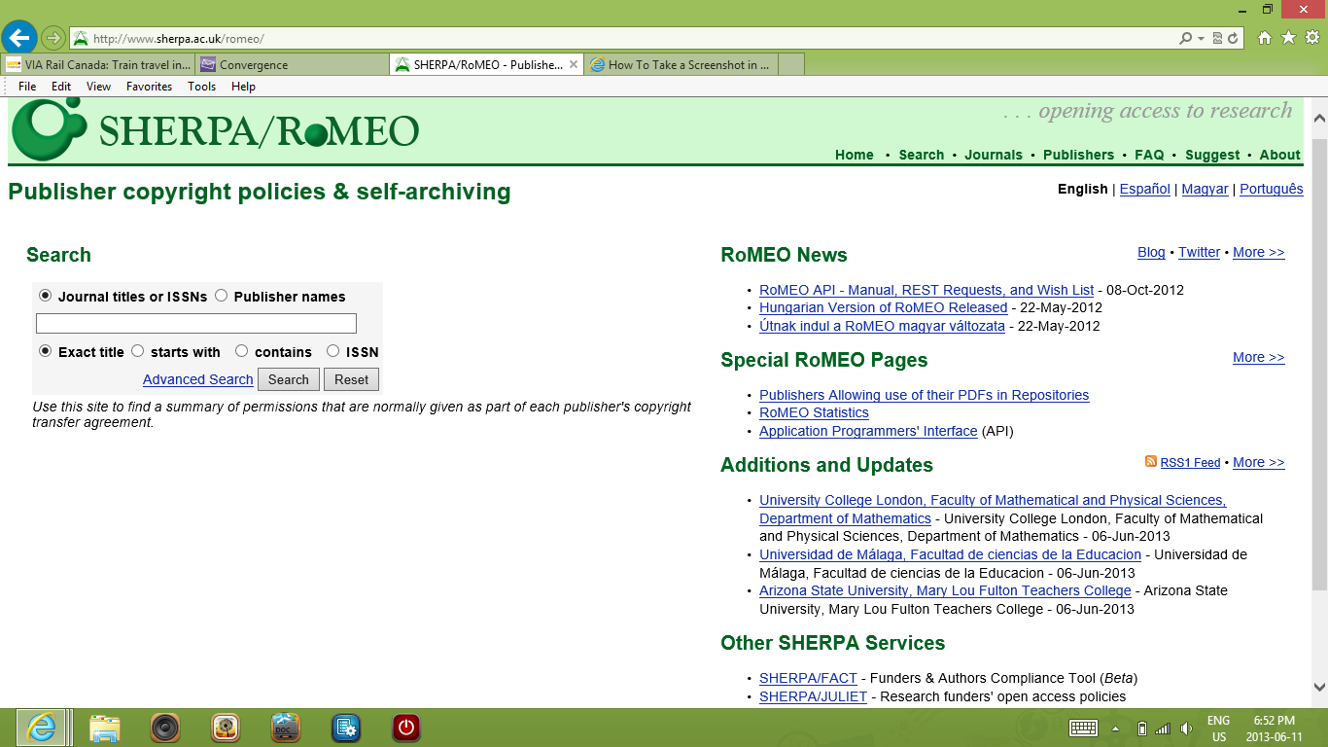
SHERPA/RoMEO
Notes:
Majority of authors retain right to self-archive in some fashion, subject to various conditions. But beginning to see policies explicitly designed to frustrate self-archiving
Sherpa Romeo website provides authors with information on which publishers/journals allow self-archiving.

Slide 8
SHERPA/JULIET
Notes:
Has section on open access requirements for different funding agencies in different countries

Slide 9
SHERPA/JULIET - Canada

Slide 10
JAMA Example

Slide 11
JAMA example

Slide 12
JAMA example

Slide 13
JAMA contract
Copyright Transfer/Publishing Agreement.
In consideration of the action of the American Medical Association (AMA) in reviewing and editing this submission (manuscript, tables, figures, video, audio, and other supplemental files for publication), I hereby transfer, assign, or otherwise convey all copyright ownership, including any and all rights incidental thereto, exclusively to the AMA, in the event that such work is published by the AMA.
__________________________________________________________
Your Signature Date Signed
Federal Employment.
I was an employee of the US federal government when this work was conducted and prepared for publication; therefore, it is not protected by the Copyright Act, and
copyright ownership cannot be transferred.
__________________________________________________________
Your Signature Date Signed
Notes:
As you can see – this is a highly restrictive contract

Slide 14
Publisher Agreement Exercise
At each group, look at publisher’s agreements and answer following questions:
Can you post article/book chapter on Scholarship@Western
Can you post article/book chapter on your personal web page?
Can you publish this work in another venue (e.g. an edited volume)
Can the publisher publish this work in another venue (e.g. an edited volume) without asking your permission
Notes:
Discuss which agreements are more or less favourable to authors

Slide 15
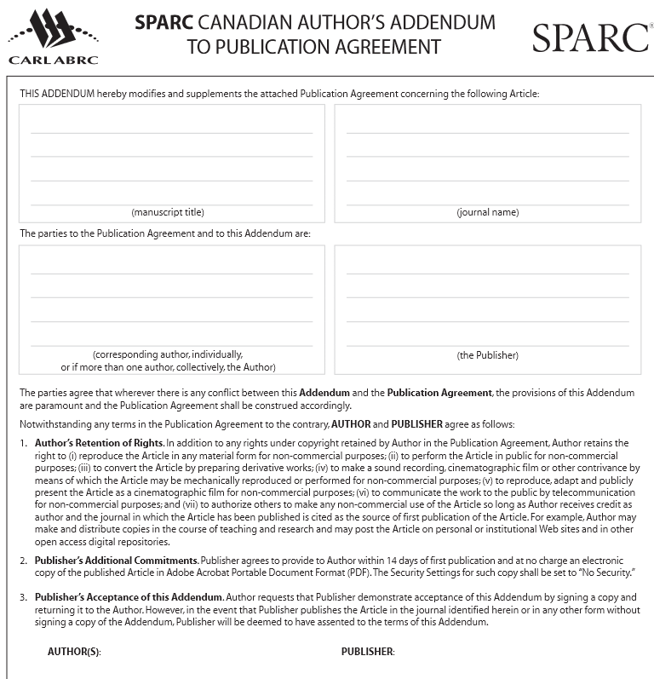
Author Amendments
Notes:
These agreements are negotiable, so faculty must read them carefully and, if necessary, amend their terms to ensure that journals receive only the minimum rights that are actually required to publish the work. Typically this is a simple statement of permission to publish, not a full transfer of copyright.
Author Amendments are legal instrument that modify publisher’s agreement and allows author to keep key rights to their articles.
The addendum allows, inter alia, the author to reproduce, perform, communicate by telecommunication, and create derivative works from the article in any material form for non-commercial purposes. This permits, for example, the author to make and distribute copies in the course of teaching and research and post the article on personal or institutional websites and in other open access digital repositories. The addendum also requires the publisher to provide the author an electronic copy of the published article.
SPARCs Author’s Addendum is one of many – it has Canadian version
Also: MIT Amendment to Publication Agreement, Scholar’s Copyright Addendum Engine & JISC Copyright Toolbox – see ARL/ACRL/SPARC handouts

Slide 16
Author’s Addendum
Consider how the agreements you just looked at might be modified through negotiation with an author addendum
Western Libraries Open Access Publication Fund

Slide 17
Support
How can Western Libraries help you?
Notes:
We have time to go through contracts and tools with you - play with Sherpa Romeo and Juliet – Tom Adam is here to answer copyright questions etc.
What about assessment?

