Slide 1
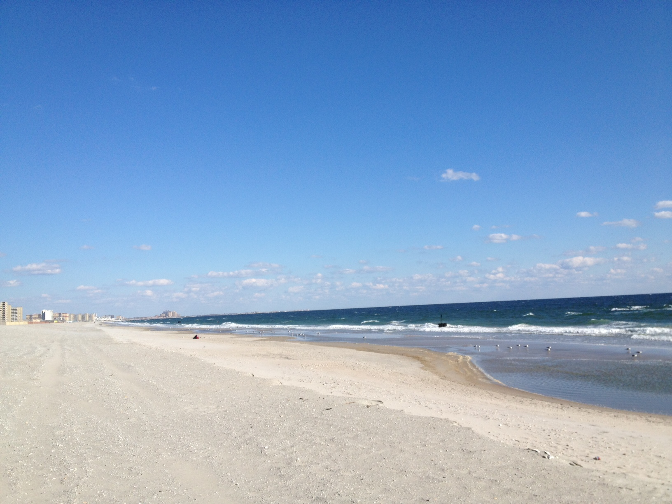
Librarian out of bounds
Ignite Talk, WILU 2014
Rosa Orlandini
Map and GIS Librarian (and Geography)
York University Libraries
rorlan@yorku.ca
Notes:
When I was a undergraduate student, I went on several field research courses. They were amazing. Years, later I pined for the experience, and wondered how can I as a librarian provide support and instruction in a field course and also go with them!

Slide 2
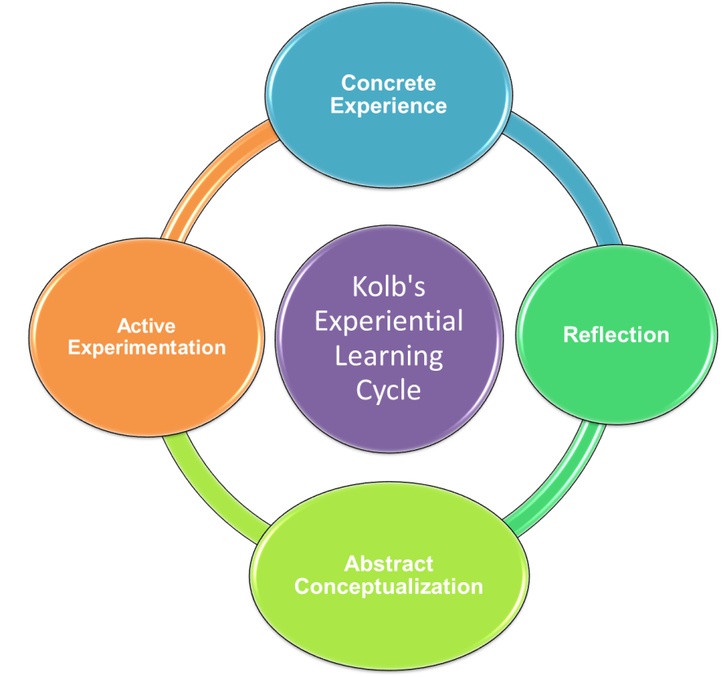
Source: http://eehealth.info.yorku.ca/files/2013/04/KolbCycle.png
Notes:
A field course is considered to be a form of Experiential Education. The students apply what they learned in the classroom to a real-life situation or scenario.

Slide 3
Stage 1:
Preparation
Proposal Writing
Stage 2:
Field Work
Field Site Visit
Data Collection
Stage 3:
Synthesis
Evaluation and Discussion of Results
Reflection
Experiment / Survey Design
Reflection
Reflection
Preliminary Research
On Site Research
Final Paper and Presentation
More Research
Notes:
Field research course is usually a semester long and is divided into three parts:
(1) Preparation
(2) Field Work
(3) Synthesis

Slide 4
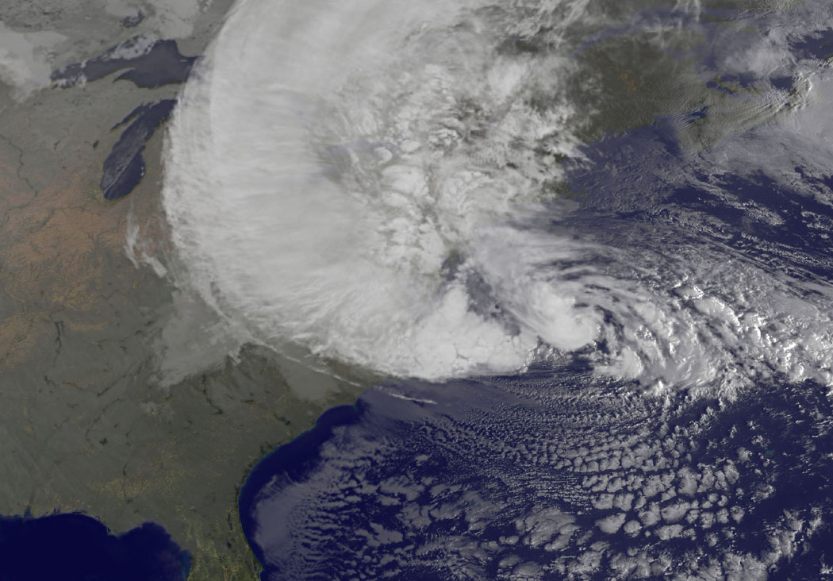
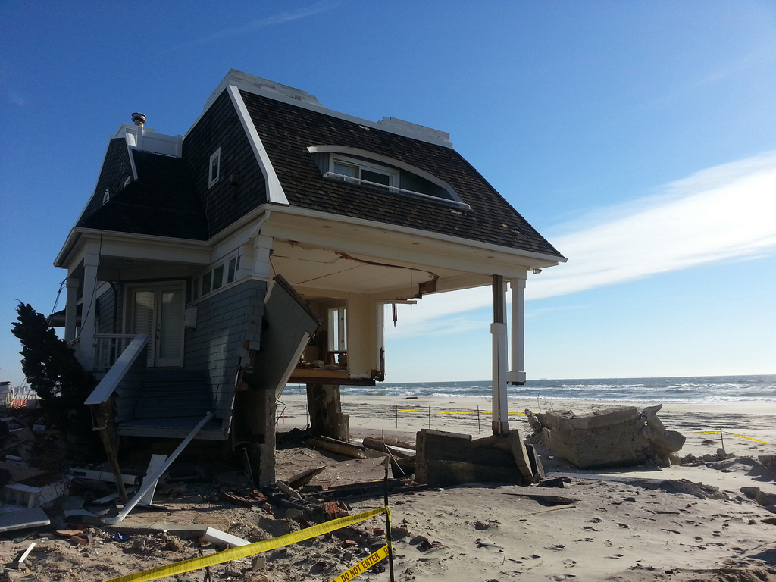
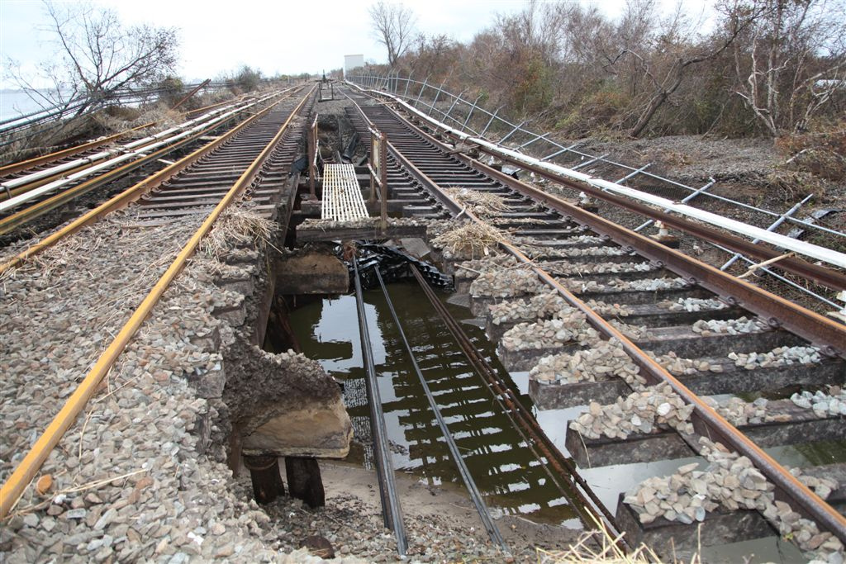
Credit: NOAA/NASA http://www.nasa.gov/images/content/701204main_20121029-SANDY-GOES-FULL.jpg
Source: https://flic.kr/p/e35Xwr (cc license)
Credit: Metropolitan Transit Authority Source: https://flic.kr/p/dpxEzq
Notes:
Enough of theory. Now for the story of how I went to the Rockaway Peninsula in New York City, with a Geography field research course studying the impact of Hurricane Sandy on the physical environment of the beach and the residents of the Rockaways.

Slide 5
Notes:
In April 2013, I saw the advertisement for the field course in NYC. I approached the profs and pitched my idea of supporting their course as a librarian. They were surprised at first, but once I explained how I could assist the course, they said sure, but what about funding ?

Slide 6
Source: www.SeniorLiving.Org cc 2.0 license
Notes:
Getting there! and starting early. If you are lucky, and you are early enough, you can be part of the grant writing. As for funding, the two profs had already applied for a grant and had just received it. So, I scrambled, using some of professional development funds and found a travel companion.

Slide 7
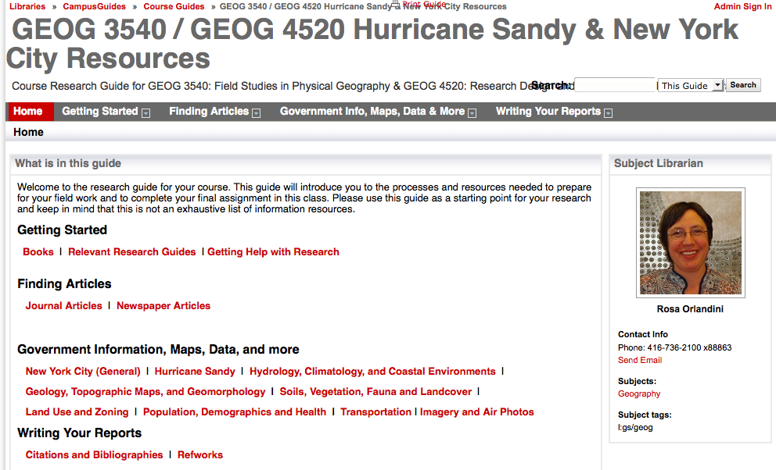
Source: http://researchguides.library.yorku.ca/sandy/
Stage 1
Notes:
In September 2013, I created a lib guide:
Finding information about the impact Hurricane Sandy, the Rockaway Penisula and Queens
Links to government documents, maps, data, local newspapers, research databases and much more

Slide 8
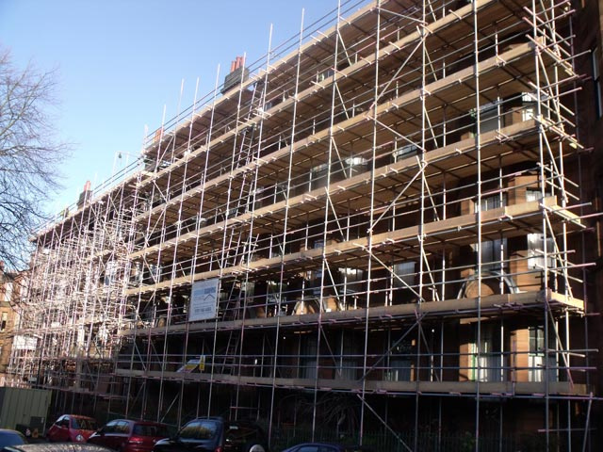
Source: https://flic.kr/p/9T2e1F cc 2.0 license
Stage 1
Notes:
I also scaffolded the In late September I conducted a 20 minute workshop in the classroom, I introduced myself, talked about my role in the course, and showed the relevant sections of the libguide they can use to find information for their proposals.

Slide 9
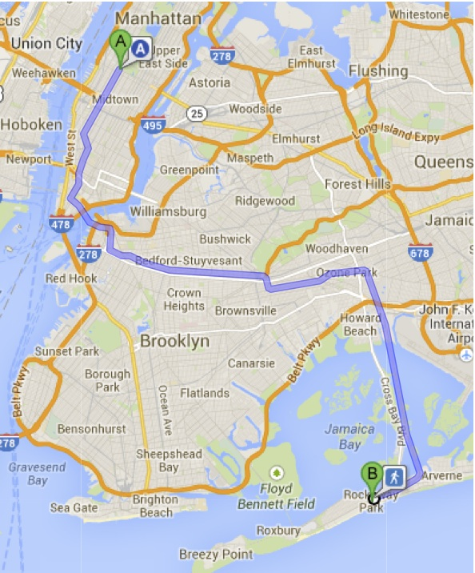
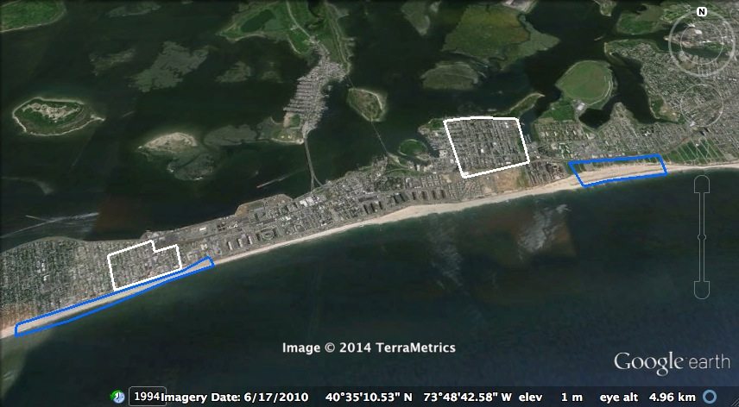
Stage 2
Credit: Google Maps and Google Earth
Notes:
Then in late October, we went to NYC. We arrived on the anniversary of Hurricane Sandy. The students had two intense days of data collection in the field, the cultural geography students hit pavement interviewing residents, and the physical geography students collected data on the beach

Slide 10
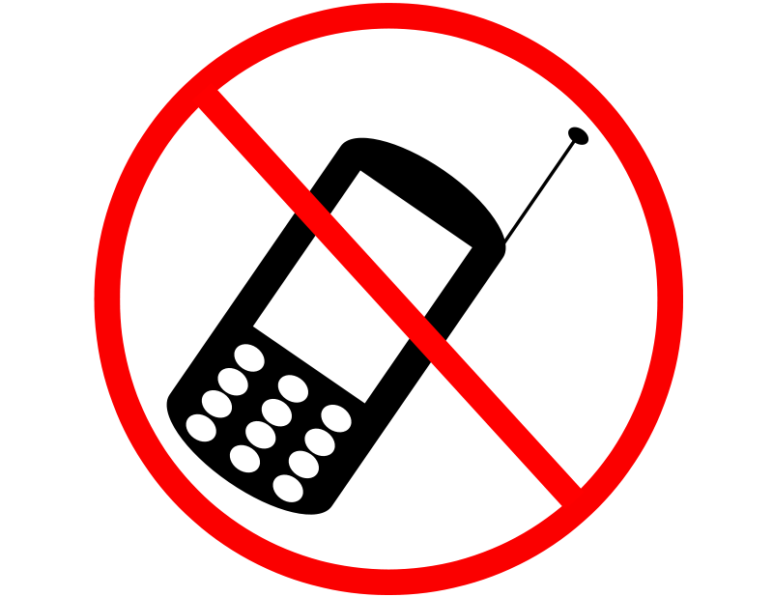
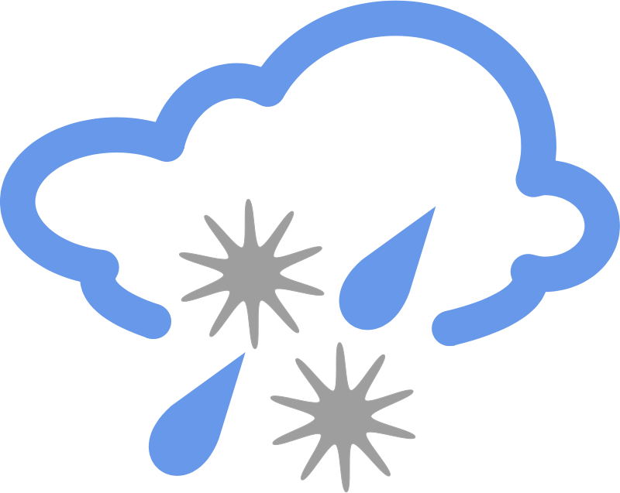
Stage 2
Source: OpenClipArt, http://openclipart.org/image/800px/svg_to_png/29050/MajinCline_Notepad.png
http://openclipart.org/image/800px/svg_to_png/70225/No_celular.png
http://openclipart.org/image/800px/svg_to_png/14711/Anonymous_simple_weather_symbols_10.png
Notes:
It is important to be prepared! We were lucky and we had great weather, only sunburns and blisters. I foresaw that internet access would be an issue, so I paid for a plan in advance, which came in handy on more than one occasion, especially when I found myself answering reference and factual questions in the field.

Slide 11
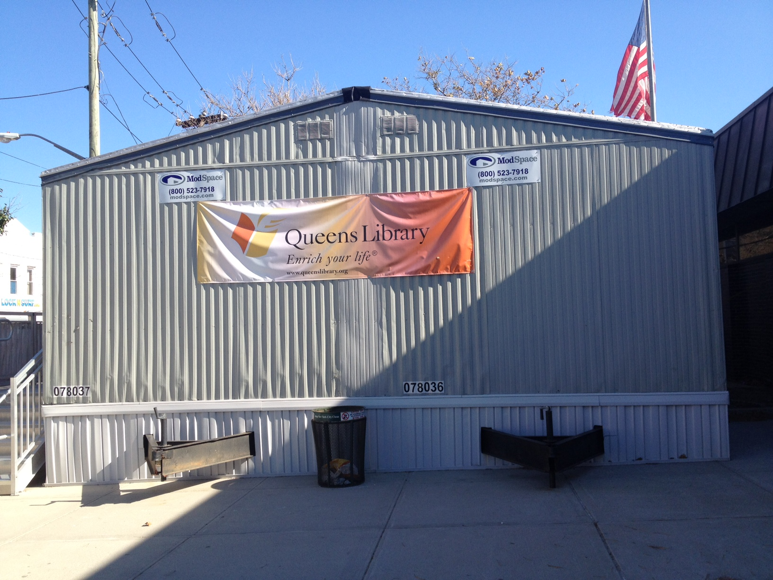
Stage 2
Notes:
While the students were busy doing field work, I explored the beach and neighbourhoods taking my own notes. I visited a Queens branch library that was destroyed by the storm and temporarily located to a portable.

Slide 12
Stage 2
Notes:
I also interacted with the students over meals, in the field and during the long commute I became a mentor. I provided encouragement, education and career advice. We exchanged stories about what we learned during the day. Several students even asked reference questions!

Slide 13
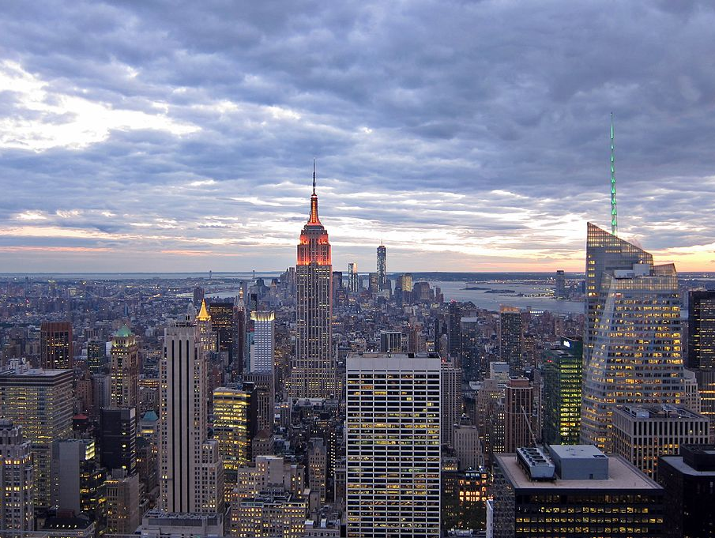
Central Park
Seinfeld’s Hangouts
Sex in the city
Tour
The Rock!
Bar Hopping
Really cool Library
The Highline
Times Square
Stage 2
Photo by Oscar Urdaneta [CC-BY-SA-3.0 (http://creativecommons.org/licenses/by-sa/3.0)],
via Wikimedia Commons
Notes:
Having Fun!!

Slide 14
Stage 3:
Synthesis
Notes:
Two weeks later, I was back in the classroom. The students and profs come prepared with questions. For 40 minutes, I was put on the spot answering questions from how to find articles from a local newspaper to finding satellite imagery of the field sites. When I was stumped, I emailed them back with the answer.

Slide 15
Original photo :
Photo of Helen in front of her research poster at the Undergraduate Research Fair
Stage 3:
Synthesis
Notes:
In December I was invited to view the student presentations and ate pizza with the class. In February, two of our students presented their paper at York’s Undergraduate Research Fair. This is Helen in front of the poster that she co-authored. She is in her final year of her studies. She told me that she went on three field courses in Geography and Urban Studies and they were the best courses she took during her studies.

Slide 16
Original photo :
Group photo of the field course participants and the faculty member on the Rockaway Beach boardwalk.
Notes:
She got to put the theory into practice, see tangible results, make new friends, and be on a first name basis with her profs. For myself I treasured the informal interactions with the students and profs, and I gained a better appreciation of the information needs of the students.

Slide 17
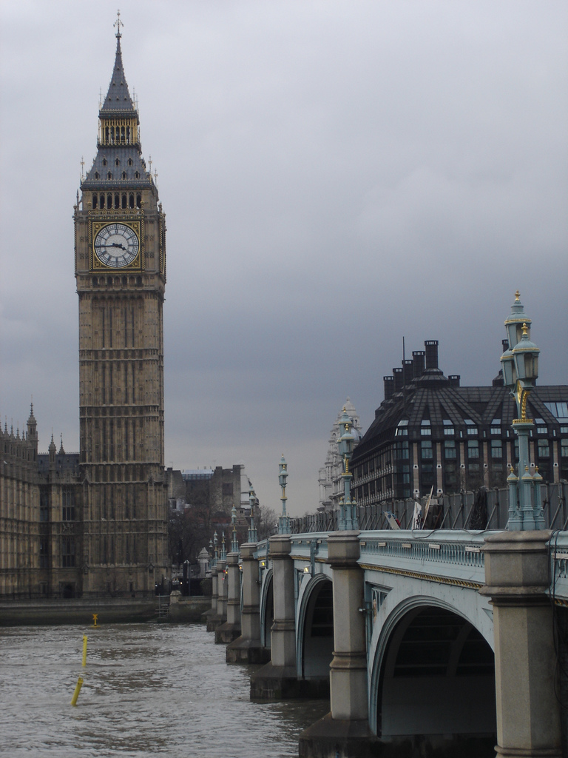
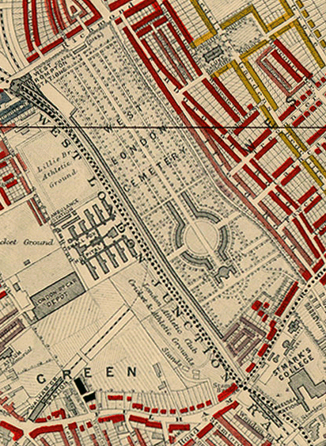
Source: Wikimedia Commons
http://commons.wikimedia.org/wiki/File:
Charles_Booth_1889_map_-_detail_showing_Lillie_Bridge.png
Source: https://flic.kr/p/xZtth - CC 2.0
Notes:
Will I do it again, for sure! But, I may not always be able to go into the field. Last week, I taught a map literacy instruction session for an English literature course going to the other London, my experience in NYC field course helped me prepare for the session and prepare a handout.

Slide 18
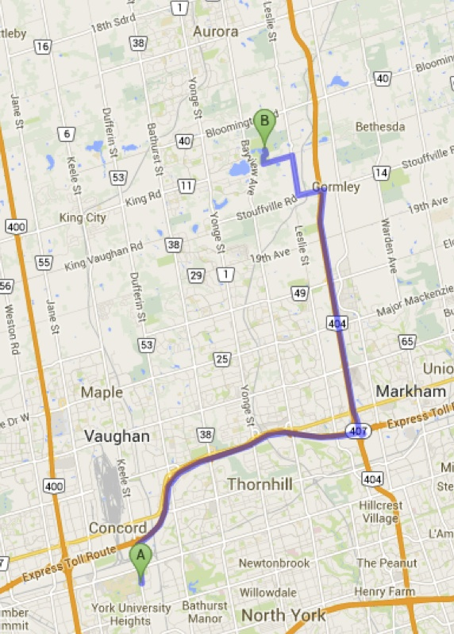
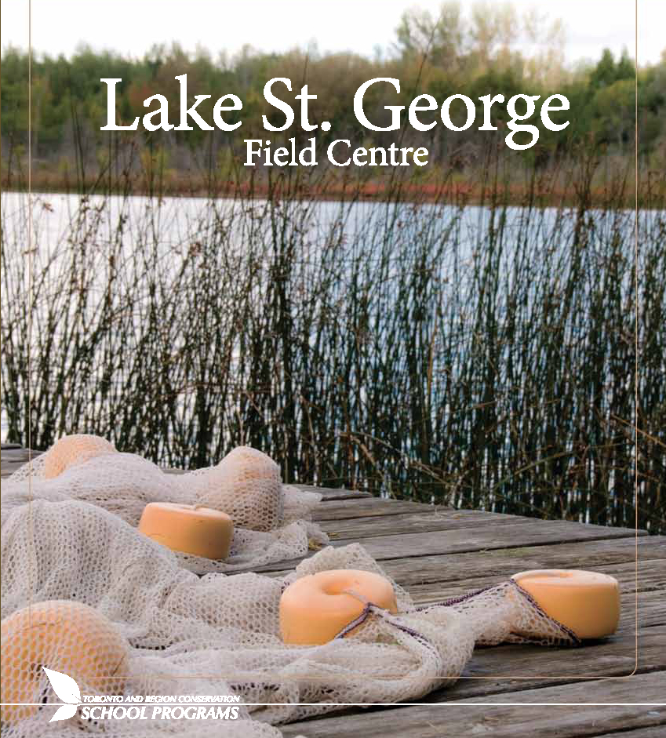
Source: Toronto Region Conservation Authority, http://www.trca.on.ca/dotAsset/168189.pdf
Map Source: Google Maps, http://maps.google.com
Notes:
And sometimes a field course is closer to home. Next fall, I am going to St. George Lake Conservation Area in exotic Richmond Hill with the physical geography field course.

Slide 19
English Literature
London (England)
Childhood Studies
Toronto & York Region
Urban Studies
Buffalo, Detroit, Toronto
Southeast Asia Studies
Thailand
Environmental Studies
Costa Rica,
York U Campus
& Jane/Finch
Biology
Algonquin Park,
Queen’s University
Biological Station
Notes:
And the one thing to know about field courses, is that it isn’t discipline specific. My colleague Dana Craig has been to Buffalo and Costa Rica as part of her liaison librarian work, and there are other courses with a field component!

Slide 20
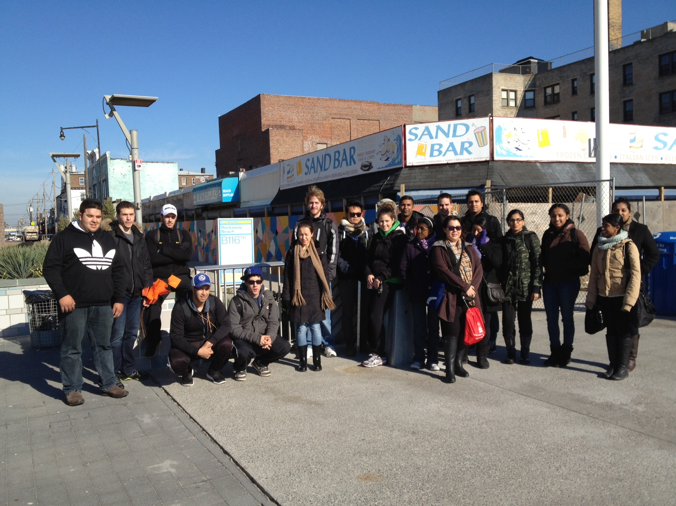
Now it is your turn !
Feel free to contact me!
Rosa Orlandini
Map and GIS Librarian (and Geography)
York University Libraries
rorlan@yorku.ca
Acknowledgements:
Students of GEOG3540 & GEOG4520
Dr. Kathy Elder & Dr. Lucia Lo
Mora Gregg & Dana Craig
Notes:
If you are a subject librarian, look at the course listings and contact the course coordinators. Research where they are going. My suggestion is to start early, scaffold, and if you have the funding, take the plunge and go along with the class!

