Slide 1
Developing Online Learning Tools
Strategies for Creating a Set of Best Practices for Your Library
Liz Johns | emjohns@vcu.edu | @emjohns1988
Teaching & Learning Librarian Virginia Commonwealth University, Richmond, VA
Notes:
Hello, my name is Liz Johns and I want to talk to you today about creating a set of best practices in online learning for your library. I’m going to use my project as an outline to help you go about developing your own best practices. I’m not going to focus very much on what the “best practices” are, because a lot of that will become special to your library. Instead, I want to show you how you can go about creating a set of best practices in developing online learning tools. What the best practices are might be different for every person in this room, but the methodology of creating them can be the same.

Slide 2
Challenges in Developing Online Learning Tools
USE BY
23JUL 09
Notes:
We want to make sure that our learning tools stay relevant and meaningful to our users. Your users will be different from my users, which is why our sets of best practices will be unique. Developing online learning tools can be pretty difficult. The rapid change in technology and information resources can make your tools go out of date pretty rapidly. If you have any online learning tools from 2009 up on your website, they are probably not the best tools for your users.

Slide 3
Challenges in Developing Online Learning Tools
Notes:
The second thing that might happen is that you have too many tools, which can cause numerous problems such as an information overload, and unorganized learning tools.

Slide 4
Challenges in Developing Online Learning Tools
Notes:
Lastly, and a lack of standardization and coordination can cause your tools to be confusing, repetitive, and even low-quality.

Slide 5
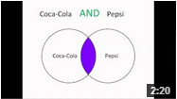
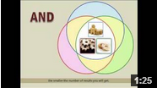
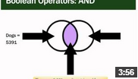
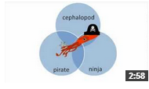
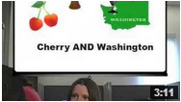
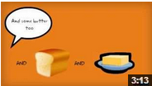
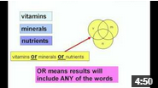
Challenges in Developing Online Learning Tools

Slide 6
Challenges in Developing Online Learning Tools

Slide 7
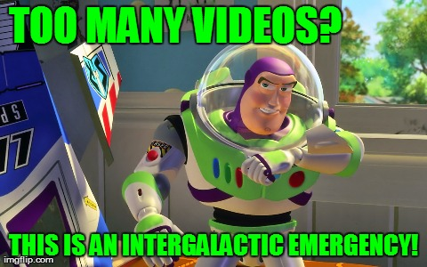
Challenges in Developing Online Learning Tools
Notes:
Another problem is that all your tools might be the same medium. Anyone have any kind of online learning tool besides videos?
I’ll get more into this a little later.

Slide 8
Challenges in Developing Online Learning Tools
What are some of your challenges?
Notes:
There are lots of different problems we can encounter. Is there anything I didn’t mention?
What are some of your problems in developing online learning tools?

Slide 9
Good online learning programs…
Are up to date
Facilitate active learning
Are comprised of tools that complement each other
Address skills in a strategic and coordinated way
Notes:
So what makes “good” online learning programs?
We want to create some variety and provide tools that are up to date, facilitate active learning, complement each other, and address information literacy skills in a strategic and coordinated way.
With that in mind, I wanted to talk about what my process was at VCU in creating best practices for our online learning program. I will say that this is still really in development, and we are actually holding off on publishing a lot of things until we move over to LibGuides 2.0. So, I got to VCU, and…

Slide 10
Problem at VCU
USE BY
23JUL 09
Notes:
The most critical problem was that our videos were grossly out of date. We were about to begin designing a new library website, and some videos still featured the old website.
We also encountered most of the other things I mentioned as well. We had some tools that were repetitive, there was no standardization, and everything was a video.
So I thought, okay, what do I do? First, no expired videos. Anything that used the old old website was removed, even if we didn’t have anything to replace it with. They were definitely not helping anyone at that point.

Slide 11
Strategy 1: Create a schedule for updating or replacing tools.

Slide 12
Research and Analysis: Video Hosting Platforms
Notes:
Most of our tools were videos, so I had to deal with that first. Before even looking at how they were created, we had to get them organized. We had videos everywhere, and we first needed to decide where our content was going to go.
We decided that YouTube and Screencast.com best fit our needs. YouTube for big impact videos only. Librarians encouraged to create their own youtube or screencast accounts for low impact videos.

Slide 13
Strategy 2: Research the Options to determine what’s best for you.
Strategy 3: Keep your tools organized and in logical places.

Slide 14
Research and Analysis: Learning Outcomes
What learning outcomes are most important for us to cover?
Prioritize
Notes:
This was helpful for the initial round of remaking tools, and for the future. We have a list of what is most important and needs to be maintained more regularly.

Slide 15
Strategy 4: Prioritize Learning outcomes.
Notes:
This will help when major things happen, like a web redesign, new search tool, etc.

Slide 16
Research and Analysis: Mediums
Does the medium match the learning goals?
Notes:
Librarians love videos. It’s cool, I get it. But there is so much more out there, plus, videos aren’t always the best.

Slide 17
Research and Analysis: Mediums
?
Notes:
A 2010 study showed that most students who only watched a video were unable to recreate the steps demonstrated (Mestre 2010, 821). This indicates that videos are lacking something, and we need to at the very least, supplement them with alternative or supporting tools to balance them out.
Not everything can or should be taught through a video. Think creatively to ensure that the content and audience is appropriate for the method of delivery. Just because something can be done a certain way, doesn’t mean that it should. What is the best media, or mix of media, to achieve the learning goals?

Slide 18
Evaluating Information
Videos
Notes:
For example, we had two videos related to evaluating information, one on how to evaluate websites, and one on how to identify scholarly articles. How many of you have videos that might be similar?
Assessment of these tools indicated that the videos could be supplemented, or even replaced with a different multimedia that better addressed the learning outcomes.

Slide 19
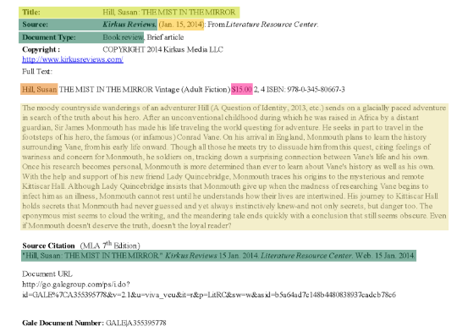
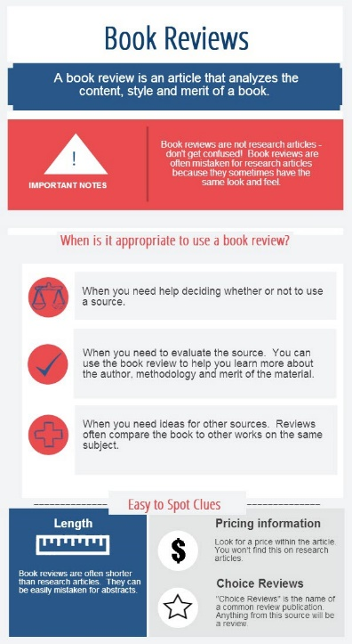
Hover maps
Infographics
Evaluating Information
Videos
Games
Notes:
So we created a plan to address the idea of evaluating information with multiple tools, and we created hover maps, infographics, and games to work with the videos.

Slide 20
Hover maps engage users
Notes:
Hover maps are files that have “hot spots” or areas that light up, change color, or display a pop up when a mouse is hovered over them. These tools will engage users, and allow users to actually practice, and learn on their own.
This hover map gives basic tips on how to spot a book review, and can serve as a stand-alone learning tool, or, since today we want to talk about coordinated online learning tools, can work in conjunction with something like an infographic,

Slide 21
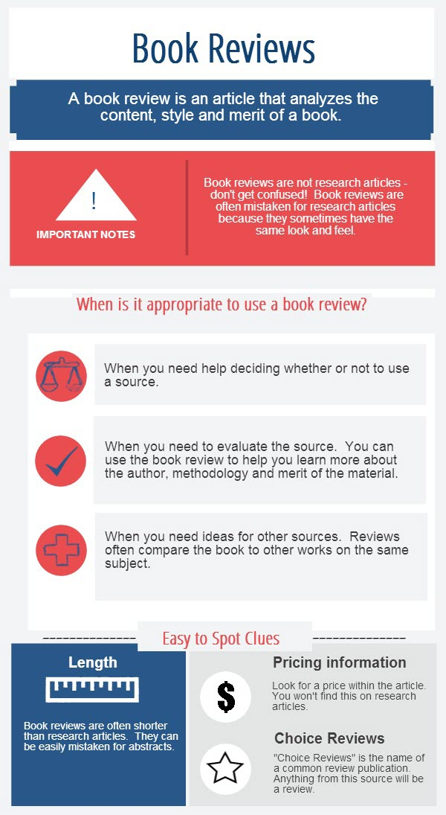
Infographics speed information processing
Notes:
Like this, which allows you to provide information as a combination of visuals and text. Assigning visuals to text will help users understand information more quickly and easily. Infographics are an interesting way to present content, and they are flexible in that they can be used on a PPT slide, printed as a handout, or viewed online, all with the same effect.
To take your infographics a step further, you can incorporate videos, turning this static media into animated media. You could even turn this into a hover map if you wanted to provide more information.

Slide 22
Games help practice skills and check knowledge
Notes:
You can also consider creating games that help students practice skills. So what we will eventually end up with at VCU (once I finish), is a set of tools that work together.

Slide 23
Strategy 5: Ensure the medium is appropriate for the Learning Outcomes.
Strategy 6: Create Tools that are Coordinated or Complement Each Other.

Slide 24
Design Aspects
Standardization helps minimize confusion, helps users recognize tools from your library over time, and creates a cohesive, coordinated look for your tools.

Slide 25
Design Aspects: What can be standardized?
Colors schemes
Fonts
Size, color, shape of graphics.
Eg. Wide dark red arrows vs. narrow light blue arrows.
Opening and closing of videos (standard PPT slides)
Size and length
Notes:
Consider referring to your university’s branding guidelines as a quick and easy way to set some standards

Slide 26
Strategy 7: Maintain consistency in design elements.
Notes:
This will help when major things happen, like a web redesign, new search tool, etc.
Show example: http://wp.vcu.edu/libstaff/creating-a-video/

Slide 27
Development
Encourage librarians to use the same software when developing similar tools.
Encourage librarians to go through the same processes when developing tools.
Use standardized language for your library, and avoid library jargon. Eg: Library service desk vs. front desk vs. circulation desk
Notes:
Less things for you to worry about in training.
Processes – scriptwriting, recording audio separately, and before recording the screen.
Using the same software allows you to ensure that certain accessibility guidelines are followed, as does script writing. Standardized language also helps with accessibility, and is helpful in general to anyone, really.

Slide 28
Strategy 8: Simplify development through common software, shared processes, and agreed upon language.
Notes:
This will help when major things happen, like a web redesign, new search tool, etc.

Slide 30
Strategy 9: Keep Accessibility in Mind
Notes:
This will help when major things happen, like a web redesign, new search tool, etc.

Slide 31
Implementation
Training!
Notes:
Workshops, individual consults with librarians.
All the information is easily accessible to our staff at all times.
Starting an online learning blog on our staff website.

Slide 32
Strategy 10: Make guidelines easy to access and understand.

Slide 33
Maintenance
Ongoing training
Surveying the field for changes and new developments
Continual assessment of tools
Notes:
The online learning blog on our staff web features new examples, changes, current trends, new things to consider, or just reminders of what’s in the guidelines.

Slide 34
Strategy 11: Don’t Stop the conversation.

Slide 35
Strategies
1: Create a schedule for updating or replacing tools. 2: Research the options to determine what’s best for you.
3: Keep your tools organized and in logical places.
4: Prioritize learning outcomes.
5: Ensure the medium is appropriate for the learning outcomes.
6: Create tools that are coordinated or complement each other.
7: Maintain consistency in design elements.
8: Simplify development through common software, shared processes, and agreed upon language.
9: Keep accessibility in mind
10: Make guidelines easy to access and understand.
11: Don’t stop the conversation.

Slide 36
Notes:
Creating best practices is helpful to both you and your students. We don’t want our students feeling like this when they are engaging with our online learning tools, so create your own set of best practices to help develop an online learning program that really is beneficial to your users.

Slide 37
References
Images
Association of College and Research Libraries. (2012). Characteristics of programs of information literacy that illustrate best practices: A guideline. Retrieved from http://www.ala.org/acrl/standards/characteristics
Bladek, M., & Okamoto, K. (2014). What's theory got to do with it? applying educational theory and research to revamp freshman library workshops. College & Undergraduate Libraries, 21(1), 19-36. doi:10.1080/10691316.2014.877730
Chen, C., & Sun, Y. (2012). Assessing the effects of different multimedia materials on emotions and learning performance for visual and verbal style learners. Computers & Education, 59(4), 1273-1285. doi:10.1016/j.compedu.2012.05.006
Chickering, A. W. and Gamson, Z. F. (1987). “Seven principles for good practice in undergraduate education.” American Association of Higher Education Bulletin, March, 3-7.
Gandhi, S. (2004). Faculty-librarian collaboration to assess the effectiveness of a five-session library instruction model. Community & Junior College Libraries, 12(4), 15-48.
Mestre, L. S. (2010). Matching up learning styles with learning objects: What's effective? Journal of Library Administration, 50(7), 808-829. doi:10.1080/01930826.2010.488975
Buzz Lightyear, [Digital image], USA, Buzz Lightyear Wallpapers. Retrieved May 5, 2014, from disneypictures.net/r-buzz-lightyear-202-buzz-lightyear-1920x1200-3864.htm
Buzz Lightyear, [Digital image], USA, Tumblr.com. Retrieved May 5, 2014, from crazycinephiles.tumblr.com/post/84522553944
Buzz Lightyear vs Adam Strange, [Digital image], USA, Comic Vine. Retrieved May 5, 2014, from comicvine.com/forums/battles-7/buzz-lightyear-vs-adam-strange-398713/
Information Overload, [Digital image], USA, Novell and Novell Counseling Services. Retrieved May 21, 2014. novellcounseling.org/overcoming-information-overload/
Justice Silhouette, [Digital image], USA, Pixabay. Retrieved May 6, 2014 from pixabay.com/en/justice-silhouette-scales-law-147214/
My eyeballs could have been sucked from their sockets! [Digital image], USA, A Buzz Lightyear Quote for Every Situation. Retrieved May 5, 2014, from blogs.disney.com/oh-my-disney/2013/09/10/a-buzz-lightyear-quote-for-every-situation/
Play button, [Icon], USA, Pixabay. Retrieved May 6, 2014 from pixabay.com/en/sign-dvd-music-video-icon-30619/

