Slide 1
Bite-Sized Assessment for the Library One Shot
Mary Snyder Broussard
Lycoming College

Slide 2
Problems with assessment in the one-shot
Notes:
Don’t know students’ names, abilities, class personality
May not know instructor well
We don’t create the assignment
We don’t see what students do with the information we teach
Assessment takes away from precious teaching/learning time

Slide 3
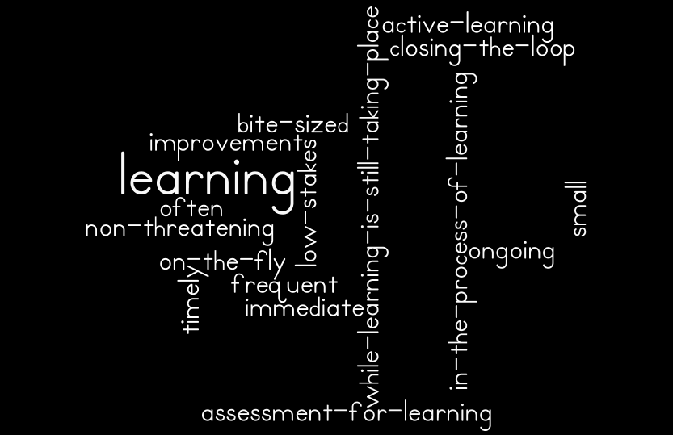
Formative assessment
Notes:
Formative assessments are in-the-process-of-learning assessments
Active learning… with a point!
We can use active learning activities to assess current student knowledge, learning, and understanding, then *immediately* close the assessment loop to improve learning during the time we have with them
Helps us make the most of our time with them, adapt to unfamiliar situations, etc.
This word cloud shows many of the other common traits of formative assessments
Also known as “classroom assessment techniques” or “assessment for learning” among other names

Slide 4
Formative assessment
Focus here on cognitive assessment of student learning
Notes:
Can also be used to become better teachers, but that’s for another day

Slide 5
Are librarians doing it?
http://www.vrml.k12.la.us/library/librarian_ar/vp_library.htm
Notes:
Large literature review (130+ articles and chapters)
Very infrequent use of “formative assessment” of student learning
Evidence of formative assessment in some articles on active learning
My conclusion: It’s happening, but often not consciously

Slide 6
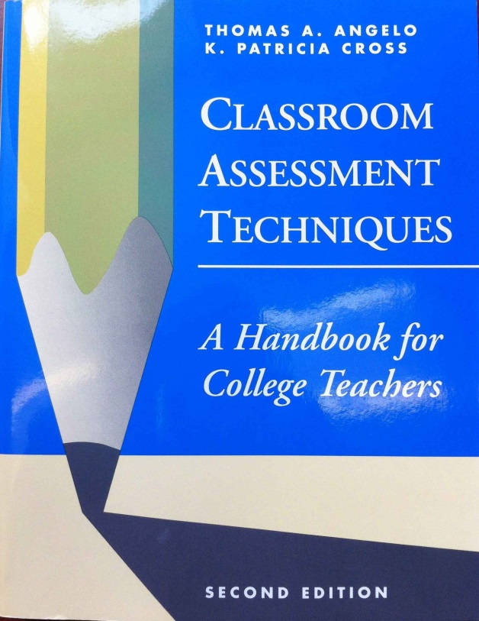
Translating to the one-shot
Notes:
Lots of information in the K-12 and general higher education literature

Slide 7
Translating to the one-shot
vs.
https://www.flickr.com/photos/waynet/8242914322/
Teachers:
Contact time
Relationship with students
Reflection Time
Grades
Librarians:
Contact time
Relationship with students
Reflection Time
Grades
Notes:
Problem is, librarians usually don’t teach like classroom professors:
Lack of contact time
Not knowing students
Lack of time to give feedback and “close the loop”
Absence of grades

Slide 8
Translating to the one-shot
Contact time:
Have less of it
FA activities can do double duty – teach AND assess!

Slide 9
Translating to the one-shot
Relationship with students:
We usually don’t know the students
FA can help us know the students & class

Slide 10
Translating to the one-shot
Reflection time:
Have A LOT less of it
We need to find short activities that can be immediately assessed individually or as a group

Slide 11
Translating to the one-shot
Grades:
We don’t usually grade
That is a benefit for FA

Slide 12
Translating to the one-shot
Formative assessment helps us make the most of the time we have with students

Slide 13
Extending beyond the One-Shot
Partnerships that extend beyond the library classroom
Formative assessment can be enhanced when more time is available
Results of formative assessments can serve as fodder for creating or strengthening such relationships

Slide 14
Example Activity: Before
Pre-Assessment
What is the primary database for scholarly articles on criminal justice at the Snowden Library?
What are newspaper articles food for when writing a scholarly paper?
What tool helps you find books at the Snowden Library?
Notes:
Can be done before or at the beginning of the class
Can be combined with technology

Slide 15
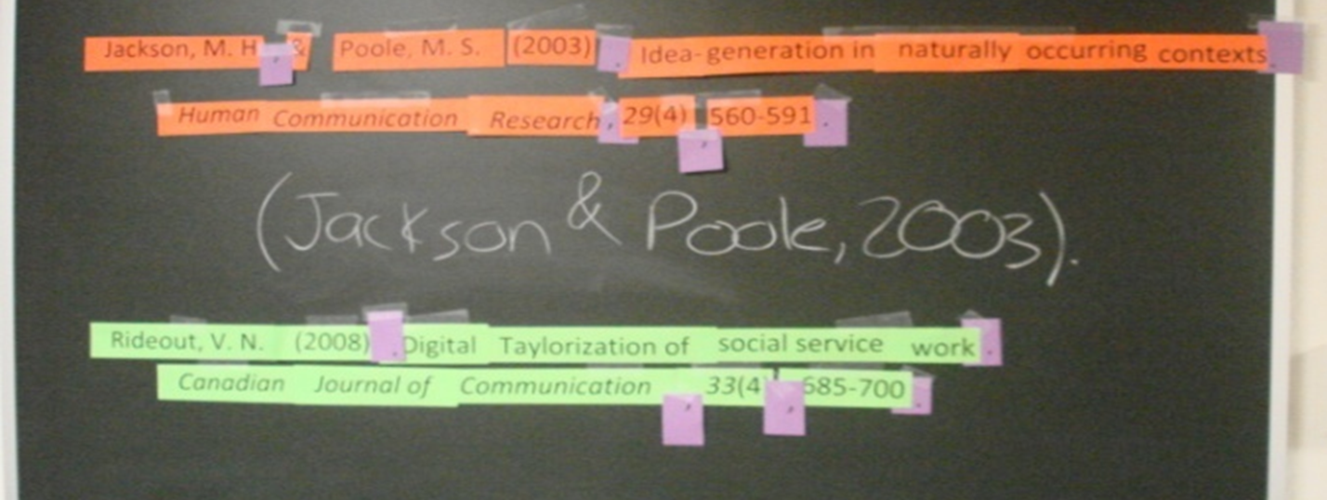
Example Activity: During
Citation on Walls
Notes:
Takes about:
At least an hour to prepare before class
20 minutes of class time
Each group of students given:
the actual resource (book, article, newspaper, etc.)
A copy of the relevant page from the citation manual with relevant example highlighted
Strips of the citation (each group a different color)
Tape
Central punctuation station shared between groups (always on purple)
After groups put them together, we talk about each as a class discussion and together come up with what an in-text citation should look like

Slide 16
Example Activity: After
Exit Slips
Before you leave the classroom, please show your responses to the following two questions to the librarian.
7. How might your keywords differ depending on which database you are using (PsycINFO vs. ERIC)?
8. How will you determine if an article you found in a database is peer-reviewed?
Notes:
A brief question or activity that can be quickly assessed individually as a “ticket” to leave the classroom.

Slide 17
Further Reading
Broussard, M.S., Hickoff-Cresko, R., Oberlin, J.U. (2014) Snapshots of reality: A practical guide to formative assessment in library instruction. Chicago: ACRL.
Dunaway, M.K., & Orblych, M.T. (2011). Formative assessment: Transforming information literacy instruction. Reference Services Review, 39, 24-41.
Angelo, T. A., & Cross, K. P. (1993). Classroom assessment techniques: A handbook for college teachers. San Francisco: Jossey-Bass.
Black, P., & Wiliam, D. (1998). Inside the black box: Raising standards through classroom assessment. Phi Delta Kappan, 80, 139-148.

