Slide 1
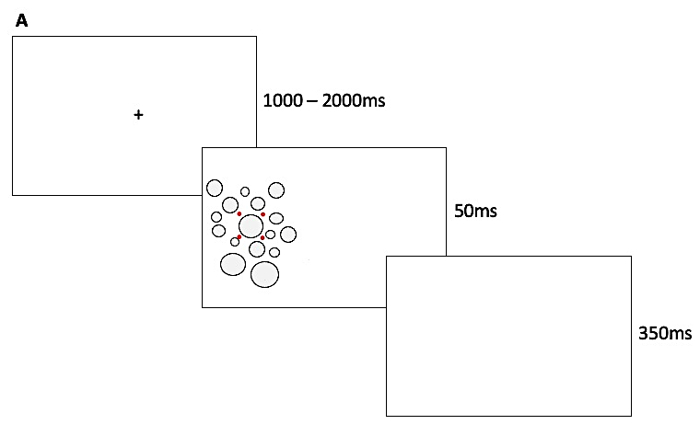
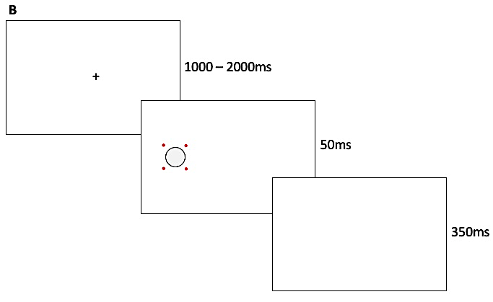

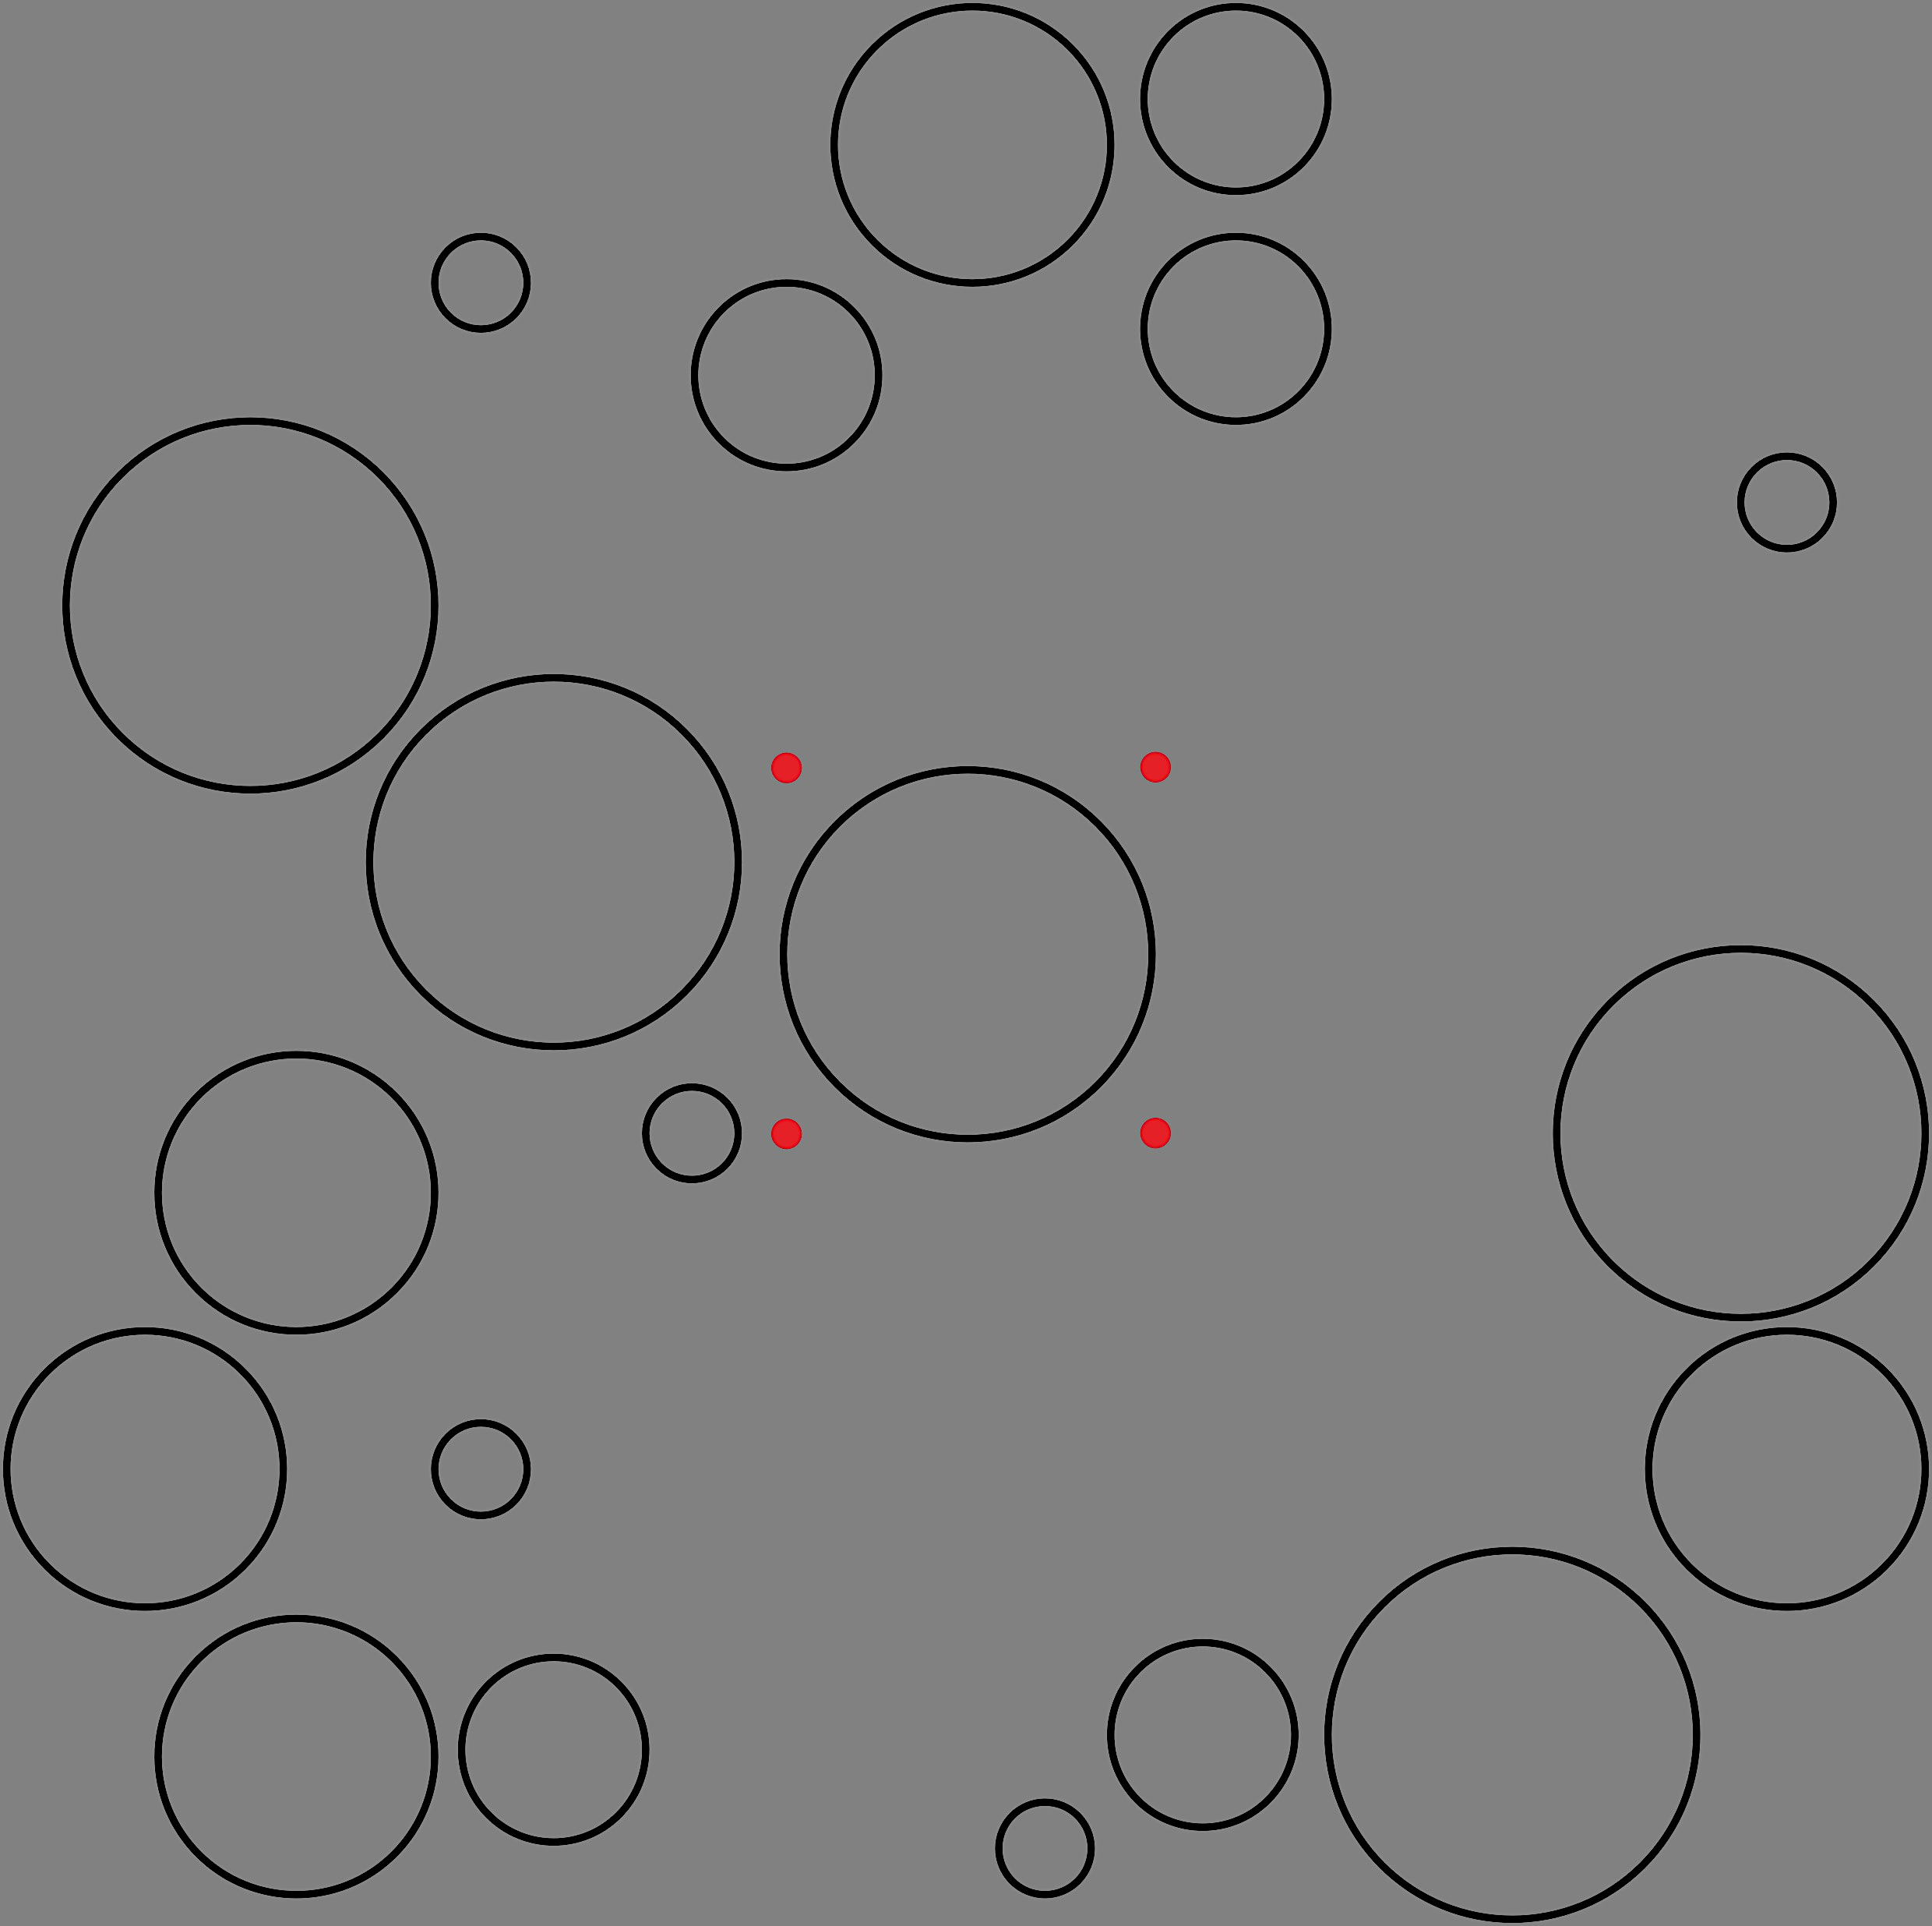
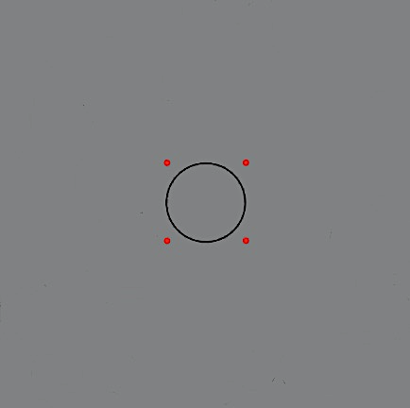
The influence of statistical summary representations on
stimulus-driven prosaccades
Faith Hedges, Matthew Heath
Faculty of Kinesiology, Western University, London, ON, Canada
Introduction
Next Steps
Prosaccades are voluntary eye movements that direct the fovea upon a target of interest[1].
A statistical summary representation is a phenomenon in which the perceptual average of a stimuli-set is used to judge a target property [2].
Purpose: To examine the potential influence of statistical summary representation on endpoint variability during goal-oriented prosaccades.
Hypothesis: It is hypothesized the variability of prosaccade endpoints will increase as a function of increasing target size.
Receive Ethics Approval
Pilot Study
Consolidate edits and revisions
Data Collection
Proposed Methods
A sequence of target array stimuli will be presented against a grey screen.
Target array stimuli will vary in size (1cm, 2cm, 3cm, 4cm).
Data will be collected by a video-based eye tracking system (Eyelink 1000 Plus; SR Research, Ottawa, ON, Canada).
Participants will be asked to participate in two sessions of 320 trials. Results will be compared between control and distractor conditions.
Data Processing
Quantitative Data Analysis
Completed Tasks
Acknowledgements
During the Undergraduate Student Research Internship, the following tasks were completed:
Fig. 1 Proposed display sequence for distractor (A) and control (B) conditions. Participants will fixate gaze on a fixation cross for a randomized foreperiod between 1000-2000ms before the target stimuli is displayed for 50ms. The target stimuli is denoted by four surrounding red dots.
I would like to thank Dr. Matthew Heath for making my involvement in this project and the USRI program possible. Thank you to Benjamin Tari and others for additional guidance through this process. Thank you to all those who have contributed to this wonderful program including Western Research, Western Libraries, and Student Experience.
Literature Search
Conducted a search and review of relevant literature.
A
B
Experiment Coding
Created an experimental code using MATLAB Psychtoolbox.
References
Protocol Development
Developed and refined experimental protocol.
Gillen, C., Heath, M. (2014). Perceptual averaging governs antisaccade endpoint bias. Exp Brain Res. 232:3201-3210.
Ariely, D. (2001). Seeing sets: representation by statistical properties. Psychol Sci 12: 157-162.
Professional Development
Engaged with professional development sessions.
Fig. 2 Example of target array stimuli for distractor (A) and control (B) conditions. Target sizes are 1cm, 2cm, 3cm, and 4cm, respectively.

