Slide 1
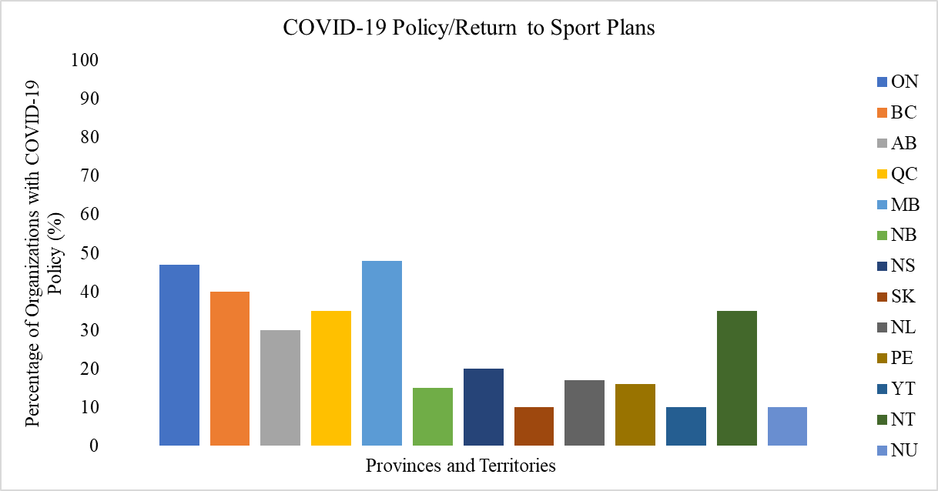
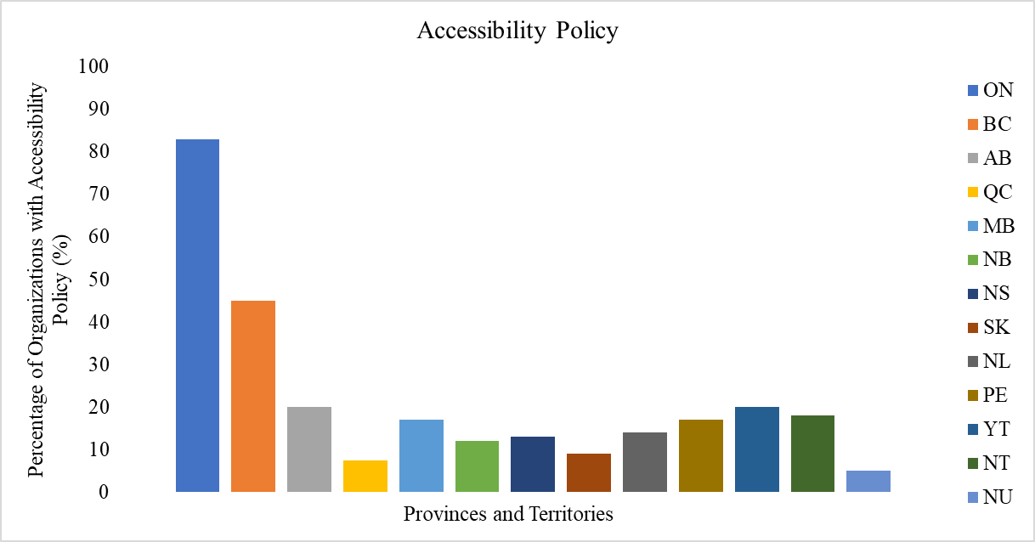
A Review of Accessibility and Return to Sport (COVID-19) Policy in Provincial and Territorial Sport Organizations across Canada
Elias Boussoulas, BSc Candidate, Laura Misener, PhD
Introduction
Accessibility Policy Review
COVID-19 Policy Review
Acknowledgements
Issues with lack of accessibility in sport for those with both physical and mental disabilities have been prevalent throughout Canada. In order to understand and address these concerns, we must first review the provincial and territorial sport structure as well as accessibility policy in each provincial/territorial sport organization across Canada.
As a result of COVID-19, many provincial and territorial sport organizations found challenges in returning to play successfully while following provincial and territorial phased plans.
The setbacks and restrictions put in place created a difficult environment for organizations to return to play, and without a sport-specific Return to Sport plan many COVID-19 related issues arose that could not be easily addressed.
Currently, sports restrictions have been lifted across Canada. However, COVID-19 still remains, and having updated COVID-19 policies would help address ongoing concerns.
The majority of organizations in each province and territory do not have adequate accessibility policies, with the main outlier being Ontario (Figure 1). This is due to the AODA (Accessibility for Ontarians with Disabilities Act) that mandates accessibility policies for each individual organization ²
BC is another outlier. BC’s organizations are mandated through VIAsport to provide proper accessibility to all sport participants. VIAsport oversees all provincial sport organizations in BC ¹
All other provinces and territories show a lack of accessibility policies.
Many organizations that do not include policies on accessibility also have poor language surrounding EDI. Organizations that have proper EDI policy and EDI language also consistently included proper accessibility policy and language surrounding accessibility.
While many organizations have a lack of accessibility policies, this can be explained in part by low pressure on the organizations to include any. In Ontario and British Columbia, pressure is put on the organizations through the province (AODA in Ontario, VIAsport in BC). In Alberta and Saskatchewan—there are no overarching organizations, and no provincial government mandates that require accessibility policies. When the process of implementation depends on grassroots implementers (in this case the organizations themselves), the implementation of these policies may either be rejected or failed to be implemented for various reasons ^{3, 4}
An example of policy that has had success being implemented on a national level is the Safe Sport policy. This policy addresses the issue of maltreatment of athletes in sport across Canada⁵. By using the Safe Sport implementation strategy as an example, we can start to understand why accessibility policy has not been implemented in the same way. The Safe Sport policy has found success due to several reasons:
1. It is mandated on a national level. Implementation of safe sport policy is a condition for all federally funded sport organizations. Accessibility policy is not the same. While accessibility policies are required of all national sport organizations, the frameworks for implementation have not trickled down to the provincial level ⁶
2. It is a core component of training for all coaches in Canada. It is required by the Coaching Association of Canada as mandatory training. ⁵
3. It is consistent across each sport. Challenges of accessibility include that each sport requires a unique action plan on how they will implement accessibility, and each disability is different.
Across all provinces and territories, the greatest percentage of COVID-19 policy or return to sport plans was in Manitoba, however this still fell below 50% (Figure 2).
Within the organizations that included COVID-19 return to sport plans, many had very general statements and policies and did not include specific step-by-step plans.
The organizations that included updated COVID-19 policies often had detailed return to sport plans in place.
Each province had different restrictions and mandates, and no organizations were required to have their own return to sport plans. They were recommended in several provinces, but no pressure was put on the organizations to implement them.
Guidelines for sport organizations that were provided by provincial and territorial governments were very general and non-specific to sport, let alone individual sport organizations.
Many websites throughout PEI, NL, NB, and the territories were not updated. Several were Facebook groups instead of websites. This impairs communication and policy development overall, and is not just specific to COVID-19.
I would like to thank Dr. Laura Misener for her support throughout the summer internship. I would also like to acknowledge and thank the USRI program for this incredible opportunity.
References
1. Inclusion. viaSport.. Retrieved August 15, 2022, from https://www.viasport.ca/inclusion
2. How to train your staff on Accessibility. ontario.ca. Retrieved August 15, 2022, from https://www.ontario.ca/page/how-train-your-staff-accessibility
3. Skille, E. Å. (2008). Understanding sport clubs as sport policy implementers. International Review for the Sociology of Sport, 43(2), 181–200. https://doi.org/10.1177/1012690208096035
4. Houlihan, B. (2005). Public sector sport policy. International Review for the Sociology of Sport, 40(2), 163–185. https://doi.org/10.1177/1012690205057193
5. Safe sport training. Safesport. Retrieved August 15, 2022, from https://safesport.coach.ca/
6. Heritage, C. (2022, July 11). Government of Canada. Canada.ca. Retrieved August 15, 2022, from https://www.canada.ca/en/canadian-heritage/services/sport-policies-acts-regulations/policy-persons-with-disability.html
Objectives
To understand the specific issues surrounding accessibility in sport across Canada by analyzing language and implementation of accessibility policies.
To review return to sport plan implementation and current COVID-19 policies in all organizations.
To compare provinces and territories to understand the variation in policy implementation between jurisdictions.
Figure 2. Percentage of organizations that have their own COVID-19 policy or updated return to sport plan in each province and territory
Figure 1. Percentage of organizations that have their own accessibility policy in each province and territory

