Slide 1
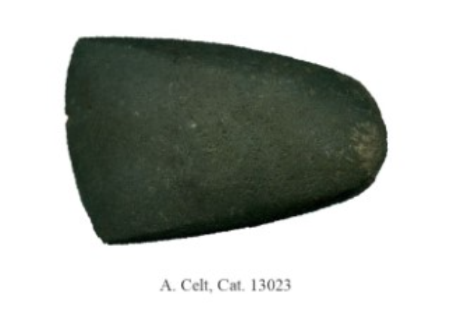
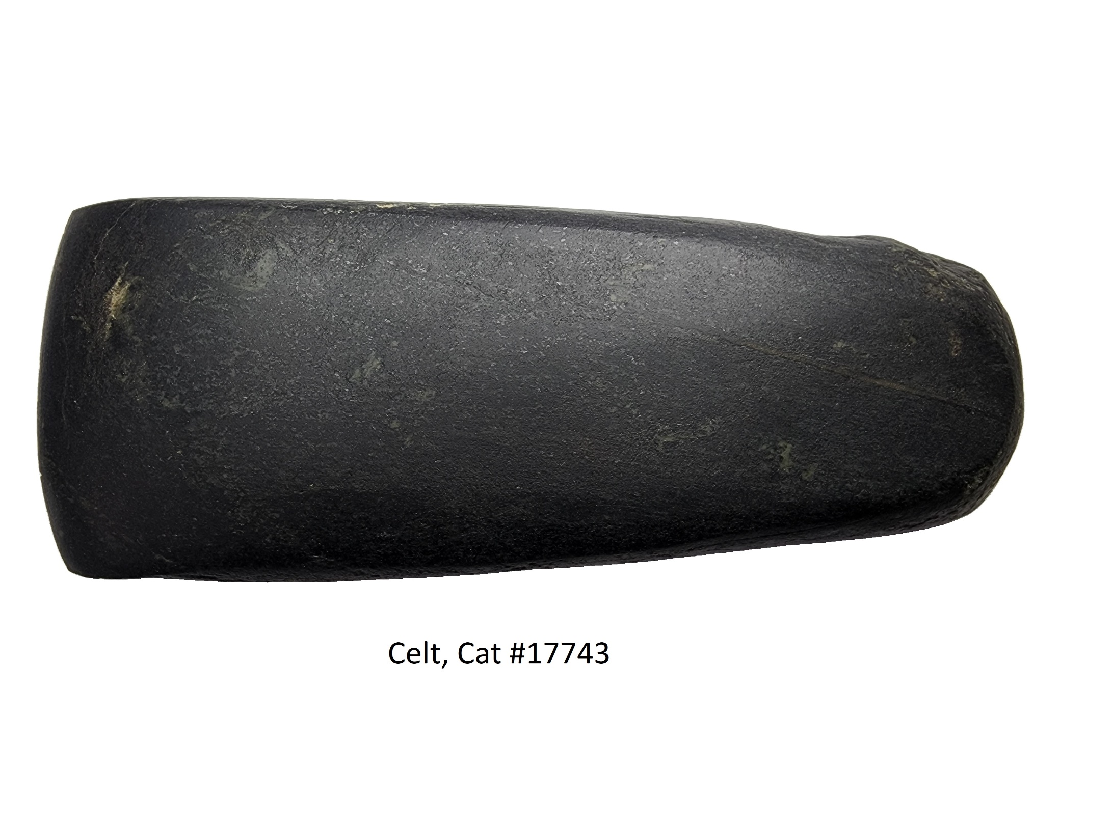
An Analysis of Ground Stone Celts on the Late Woodland Middle Ontario Iroquoian Dorchester Village Site (AfHg-24)
Patrick Seddon
Department of Anthropology, Western University, London, Ontario
Introduction
Research Methods
Results
Celts are an understudied artifact group despite their importance to sedentism and horticulture. The word “celt” is often used as a general term for chipped and ground stone tools with similar functions including adzes, chisels, or gouges. Celts are considered wood working tools and were likely used to chop and split trees.¹ Ground stone celts are created through a process of flaking and, “pecking and grinding” in which a hard stone is struck against a stone preform to remove small flakes forming the tool’s shape. A greater understanding of ground stone celts and similar tools may be attained through the identification of manufacturing and use-wear traits, the analysis of tool metrics, non-chert detritus produced during manufacture, intra-site spatial data, and the creation of typologies for tools that share similar characteristics. These analyses may allow us to reconstruct the development of ground stone tool technologies, the specific uses of these tools, and their function within greater site formation processes such as the construction and development of villages.
Each celt was assessed for several metric and non-metric traits. Metrics including maximum length, width and thickness, mid-section width, bit width, and bit thickness were measured using electronic calipers. Fragmentary celts were assessed according to their relative completeness. Bit thickness was measured 5mm from the bit end. To facilitate description, a celt’s dorsal face was determined to be the one more convex in shape, and a celt’s ventral face was determined to be flatter in comparison. However, some celts had both flat ventral and dorsal faces requiring the use of the angle of the bit and the tapering of sides to distinguish the dorsal face from the ventral face. In most cases, the dorsal face was the ascending angle of the bit, and the ventral face was non-angled.
Three categories were established based on several characteristics: ungrooved axes, adzes, or chisels. Although often a general term, celts have been defined by some as ungrooved axes.⁷ From 45 celts identified, 12 were classified as chisels, three were identified as adzes, five were identified as ungrooved axes, and two are either axes or adzes but could not be identified precisely due to broken bit ends. Metric tool ranges are summarized in Table 1. It’s likely some untyped tools are not chisels due to their large length, width, and weight.
Ungrooved axes are defined by a symmetrical bevelled bit. With sharp bit angles, celts are best suited for splitting or cutting thick wooden logs. Bit shapes of celts are largely straight. Use wear striations often occur longitudinally on both faces of the bit as it lodges itself in the wood.
Adzes have an asymmetrical bevelled bit edge hafted at an angle to the handle and would be effective for trimming and shaping timbers and hollowing out cavities such as those on dugout canoes. Adzes often had curved bit shapes with some having sharp bevelling or tapering on the ventral bit face. Use wear striations are often on the dorsal surface which contacts the wood.
Chisels have been defined in literature by several characteristics including small bits, smaller overall size, and lack of hafting. Chisels are woodworking tools used for shaping smaller pieces of wood. Chisels were often handheld and used in a percussive manner driven by a hammer. On the Kirche Site, A 16th century Huron village, five chisels were recovered each with a bit width of less than 30mm, maximum lengths ranging from 81.5mm to 104.0mm, and widths ranging from 23.0 to 35.0mm.⁸ However, the Dorchester chisels range from 13.1+mm to 42.2+mm in bit width. This would suggest chisels are not confined to rigid metric standards, but vary for use on different materials or sizes of wood. Chisel use wear striations are typically present on the ventral bit of the tool.
Type | Celts | Adzes | Chisels
Max. Length Range (mm) | 109.6 -149.6 | 84.4 - 176.3 | 71.7 - 168.9
Mean (mm) | 123.2 | 122.4 | 95.7
Width Range (mm) | 44.8 - 76.7 | 52.7 - 64.4 | 18.5 - 43.2
Mean (mm) | 58.5 | 55.5 | 34.6
Thickness Range (mm) | 22.4 - 33.8 | 21.8 - 42.2 | 6.8 - 20.5
Mean (mm) | 26 | 30.3 | 13.6
Bit Width Range (mm) | 40 - 63.6 | 42.4 - 52.7 | 12 - 42.2
Mean (mm) | 49.6 | 47.2 | 28.6
Bit Thickness Ranges (mm) | 7 - 9.4 | 6.2 - 7.9 | 3.2 - 6.7
Mean (mm) | 7.4 | 7.1 | 5
Table 1: Metric ranges and mean by tool type
Figure 4: Distribution of Celt Materials on the Dorchester Site
The distribution of celt materials across the Dorchester Site is shown in Figure 4. The two most common materials identified on the Dorchester Site are basalt (n = 15) and schist (n= 12). Basalt is an igneous rock that is common in the Canadian shield. Cobbles found in southwest Ontario may have been transported south by glaciers were likely transported south by glaciers. Schist is a metamorphic rock with a platy structure which makes it easy to chip and suitable for celt manufacture.⁹
It is possible that areas of high concentrations of non-chert detritus are likely areas in which ground stone tools were manufactured. It is notable that Houses 2 and 11, which have the most celts, also have high frequencies of non-chert detritus, suggesting a correlation between the locations of celts and the debris produced in their manufacture. However, Houses 12, 13 and 16 all have relatively few celts and relatively high frequencies of non-chert detritus, supporting the view that celts were not necessarily deposited near their locus of manufacture. As most were found in pits, spatial data suggests celts were likely deposited in storage areas.⁹
Figure 1: Bi-pointed chisel made from green slate, Dorchester Site
Background
The Dorchester Village Site (AfHg-24) is located within the modern community of Dorchester along the southern bank of the Thames River.² The site dates to the Middle Ontario Iroquoian period, between ca. 1330-1420 A.D.² Excavations of the Dorchester Site have uncovered the post moulds of 17 longhouses ranging in length from 17.01m to 72.14m and from 6.21m to 8.81m in width. There are lines of post mould indicating the former presence of palisades on the east and west areas of the site, suggesting that there were at least two distinct villages. The Dorchester Village contains numerous celts which were invaluable tools for the construction of the many longhouses and palisades.
Figure 3: Adze made from serpentinite, Dorchester Site
Ground Stone Tool Morphology
Haft wear on ground stone tools is another area of study that has received little archaeological attention.¹ Hafting is the means of attaching a stone tool to a handle. In wooden hafts, the poll end is inserted into the shaft leaving some room between the celt faces to prevent the celt acting like a wedge and splitting the handle. Hafting modifications on the Dorchester Site assemblage were observed on six celts. Three types of hafting modifications were present: Lateral shallow depressions, lateral roughness, and lateral tapering. Shallow depressions on the lateral margins of the tool were the most common hafting modification with all six hafted celts having notable depressions on one or both sides. The length of the depressions ranges from 15mm to 30mm.
Lateral roughness along the margins on roughly the same spot on hafted celts was another form of hafting modification noted. Roughness has been defined in archaeological literature as a means of improving the adherence of the haft to the tool. Lateral roughness has been noted as the only hafting modification on one sub-rectangular shaped tool and noted alongside lateral shallow depressions on a sub-rectangular celt.
Lateral tapering at the poll end was the last hafting modification noted amongst the Dorchester assemblage. Many celts exhibited tapering along their lateral margins, but only one was complete, or thick enough for hafting. The celt displayed pecking and grinding along margins close to the poll end creating a tapered poll end. This celt also had a lateral shallow depression which would have facilitated secure hafting.
Given the lack of hafting modifications observed amongst chisels, it’s possible their small length, small width, and thin cross-sections made them more prone to breakage.
Archaeological literature has identified three characteristics of celts and similar tools: A bit end (cutting edge), a mid-section, and a poll end.³ Ground stone celts were often created on coarse grained rocks making them ideal for grinding other materials.⁴ Celts and similar tools such as adzes, chisels, gouges, etc. are defined based on several characteristics including their: dimensions, bit end shape, and the presence of hafting modifications. Celts are considered multifunctional tools and it is likely that some served several different purposes. A celt was often polished by rubbing a fine-grained stone across the surface.⁵ Celt polish from wear is often the result of molecular processes from contact with various materials. Vegetal materials leave silicates on the surfaces of used tools. The polish is the result of tribochemical reactions activated through frictional or mechanical activation.⁶
Figure 5: Site Distribution of Celts and Preforms by House/Context
Acknowledgements
’d like to thank Dr. Peter Timmins for his supervision and feedback during this project as well as Timmins Martelle Heritage Consultants for excavating the Dorchester site in 2004 and providing the artifacts for analysis.
References
¹Gallo, T. A. (2022). Vibrant Stone: Ground Stone Celt Biographies Among the Ancestral and Historic Wendat in Southern Ontario from the 14th to mid-17th Centurie (thesis). University of Toronto, Toronto.
²Freeman, J. (2019). Exploring the occupational history of the Middle Ontario Iroquoian Dorchester Village site (thesis). University of Western Ontario, London.
³Brzezicki, A. (2015). Getting A Handle On Ground Stone: A Technological Analysis Of The Ground Stone Axes, Adzes, And Gouges In The George Frederick Clarke Collection (thesis). Mount Allison University, Sackville.
⁴University of Iowa. (n.d.). Ground Stone Artifacts Series in Ancient Technologies . Ground Stone Artifacts | The Office of the State Archaeologist. Retrieved August 14, 2022, from https://archaeology.uiowa.edu/ground-stone-artifacts-0#:~:text=Ground%20stone%20tools%20are%20usually,including%20plants%20and%20other%20stones.)
⁵Darwent, J. (2017). The prehistoric use of nephrite on the British Columbia Plateau. Archaeology Press, Simon Fraser University.
⁶Adams, J. L. (2014). Ground stone use-wear analysis: A review of terminology and experimental methods. Journal of Archaeological Science, 48, 129–138. https://doi.org/10.1016/j.jas.2013.01.030
⁷Krakker, J. J. (2011). A Hafted Stone Celt from Genesee County, Michigan and implications for ground stone tool use in the Eastern Woodlands. Midcontinental Journal of Archaeology, 36(1), 5–28. https://doi.org/10.1179/mca.2011.002
⁸Nasmith, C. (1981). The Kirche Site: A late prehistoric Huron village in the upper trent valley. McMaster University. ⁹Timmins, P (2022). Personal Communication.
Figure 2: Ungrooved axe made from basalt, Dorchester Site

