Slide 1
Assessing The Role of Integrins in Contact Guidance by substratum topography
Robin Hong
Supervisor: Dr. Douglas Hamilton

Slide 2
Introduction
The migration and survival of many mammalian cells are dependent on attachment to a matrix or other cells
Integrins are transmembrane receptors that facilitate attachment to a cell’s surroundings
It is believed that cells can respond to topographical or geometrical features in its environment via contact guidance which can determine its morphology, orientation and migration^{1.}
The goal of my project was to determine the role of different integrin subunits in contact guidance.
1. Hamilton, D. W., Oates, C. J., Hasanzadeh, A., & Mittler, S. (2010). Migration of periodontal ligament fibroblasts on nanometric topographical patterns: influence of filopodia and focal adhesions on contact guidance. PloS one, 5(12), e15129. https://doi.org/10.1371/journal.pone.0015129

Slide 3
Method – Cell Culture
Human PDL (hPDL) fibroblasts were cultured in DMEM + 10% FBS + 1% AA
Kept in incubator at 5% Carbon dioxide and 37°C
Media changed every two days
Cells were split when 80% confluent
Cells were viable in passage number 1 to 7
Alpha5beta3 integrin blocking antibodies and beta 1 integrin blocking antibodies were used to assess integrins’ role in contact guidance. IgG control antibodies were used as a negative control

Slide 4
Method – Topography
Glass topographies of pitches 600nm, 900nm, and 1200nm were used
Topographies were cleaned by submerging in 70% ethanol for 30 min and argon plasma cleaning

Slide 5
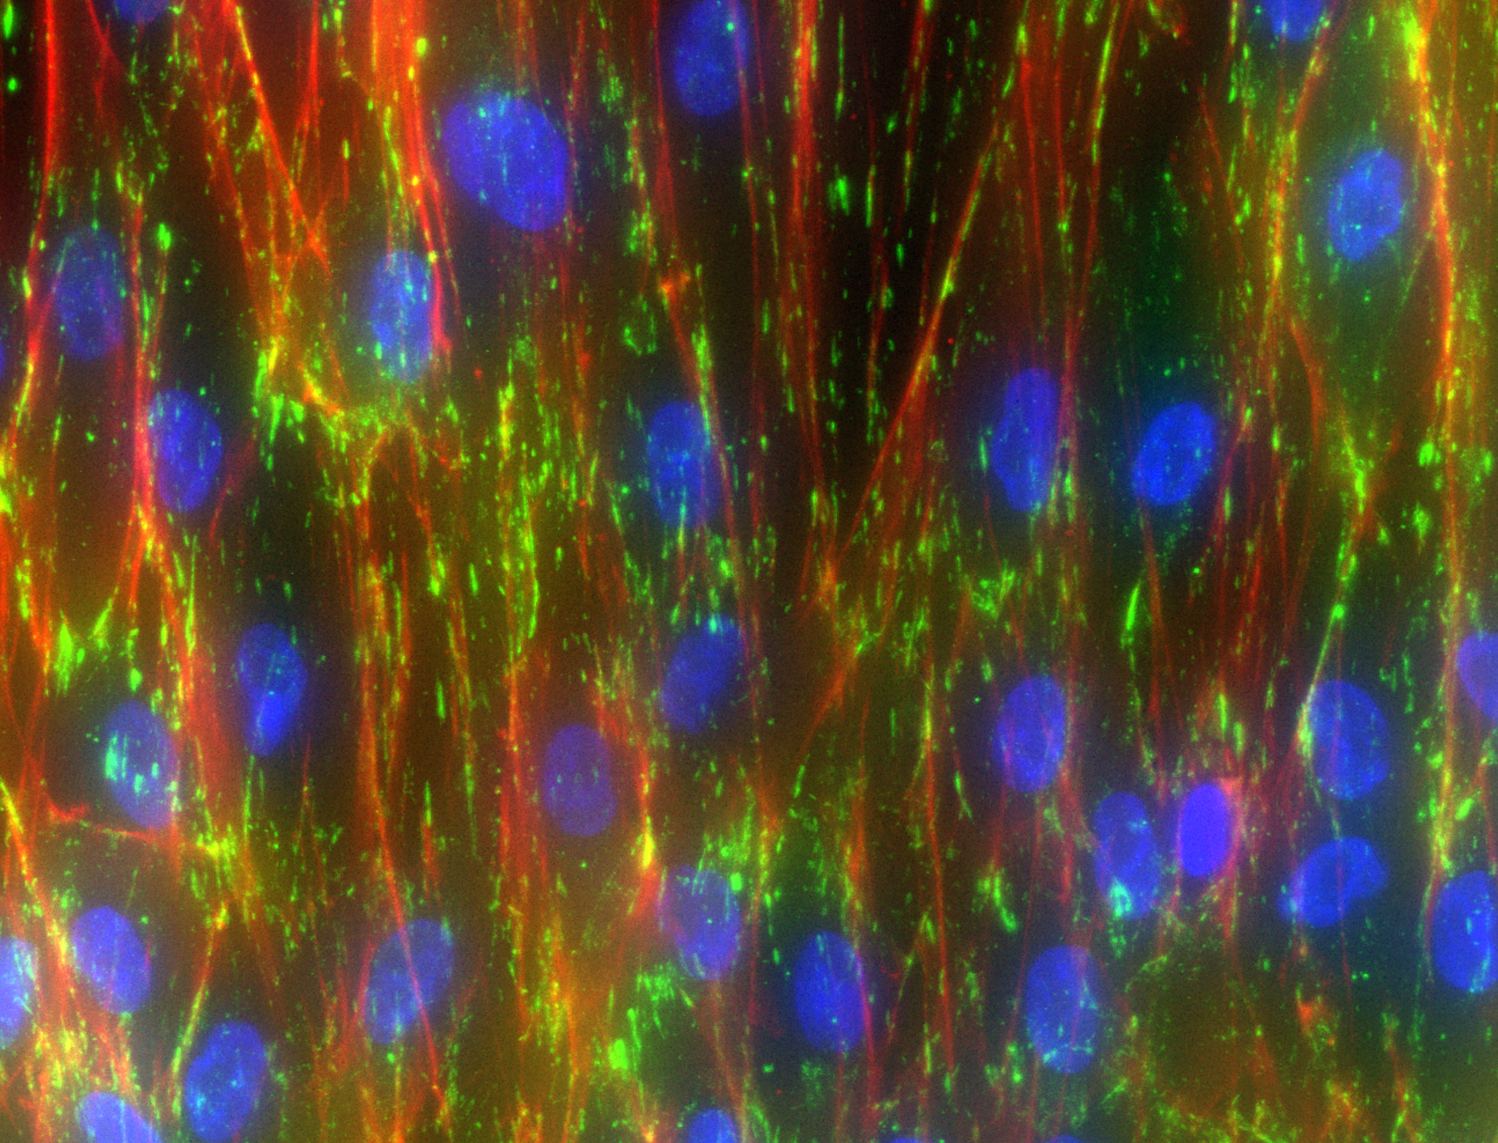
1200 nm Topography
IgG control non-blocking antibodies
hPDL M11 p7
Staining for Vinculin (Green) and F-actin (Red)
24 hours

Slide 6
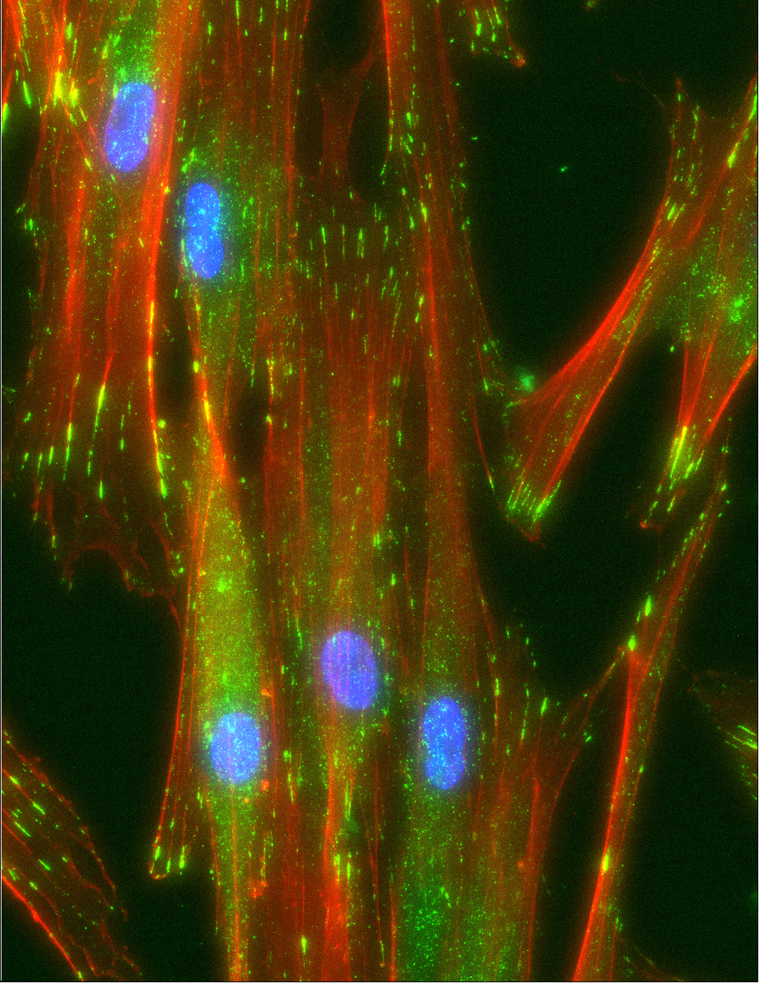
900 nm Topography
IgG control non-blocking antibodies
hPDL M11 p7
Staining for Vinculin (Green) and F-actin (Red)
24 hours

Slide 7
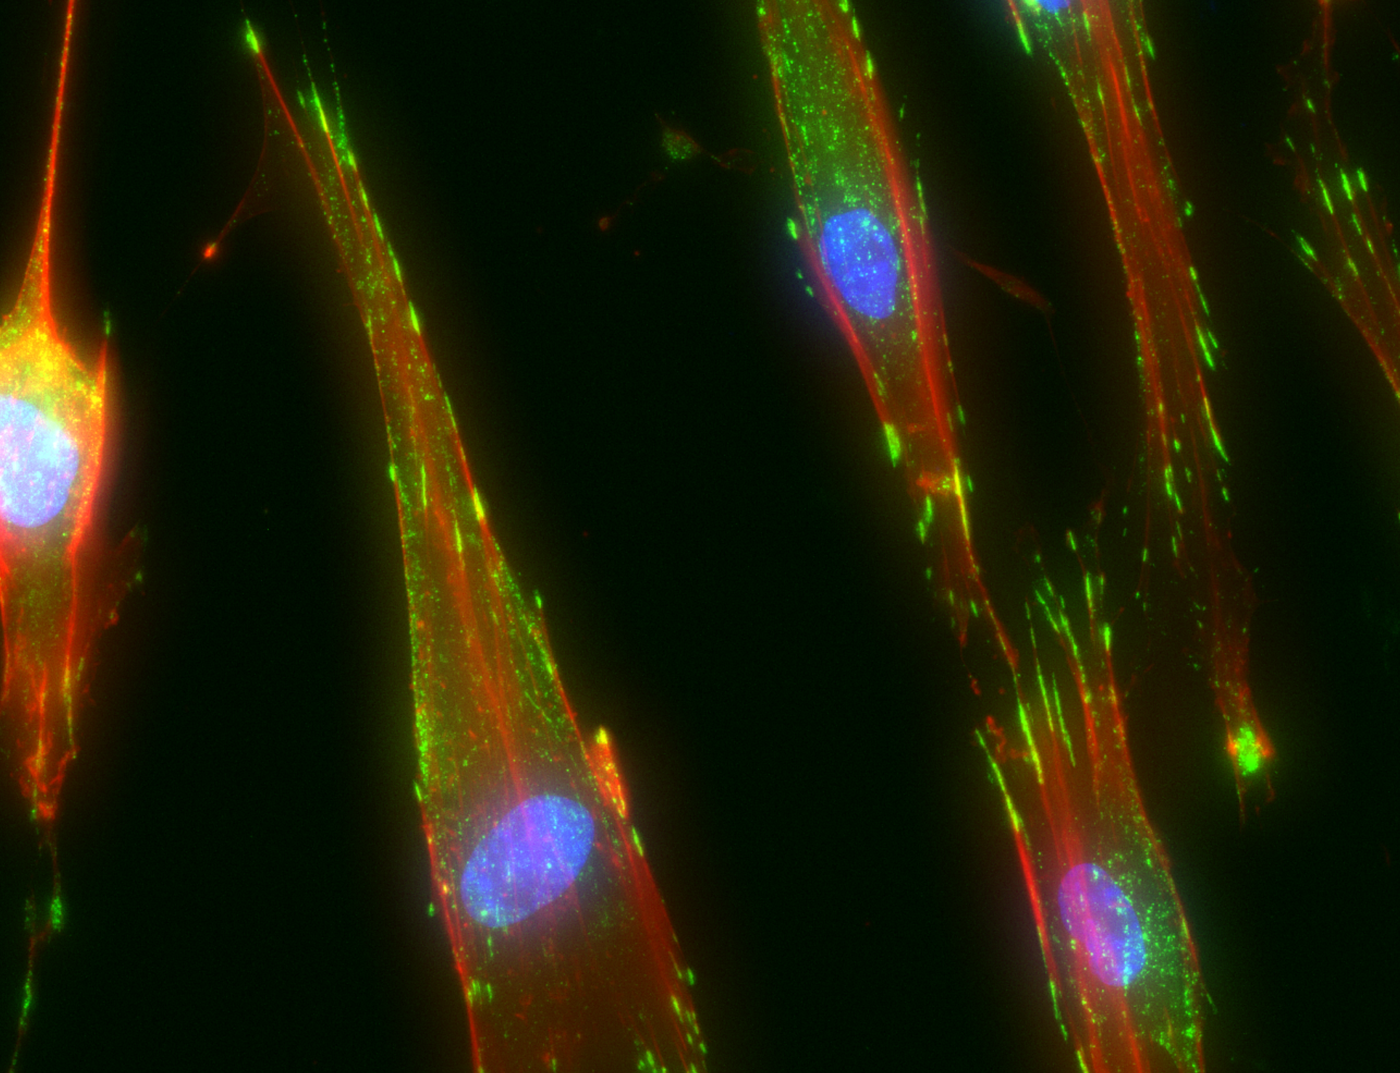
600 nm Topography
IgG control non-blocking antibodies
hPDL M11 p7
Staining for Vinculin (Green) and F-actin (Red)
24 hours

Slide 8
Timelapse
1200nm topography
hPDL M11 p6
IgG control antibodies
Timelapse over 17 hours.

Slide 9
Conclusion and Future Plans
Quantification and analysis of the data obtained must be done
Further imaging of hPDL cells with blocking of integrin subunits must be completed
USRI provided a great opportunity for myself to work in Dr. Hamilton’s lab. I plan to complete my project as a volunteer in the lab.

