Slide 1
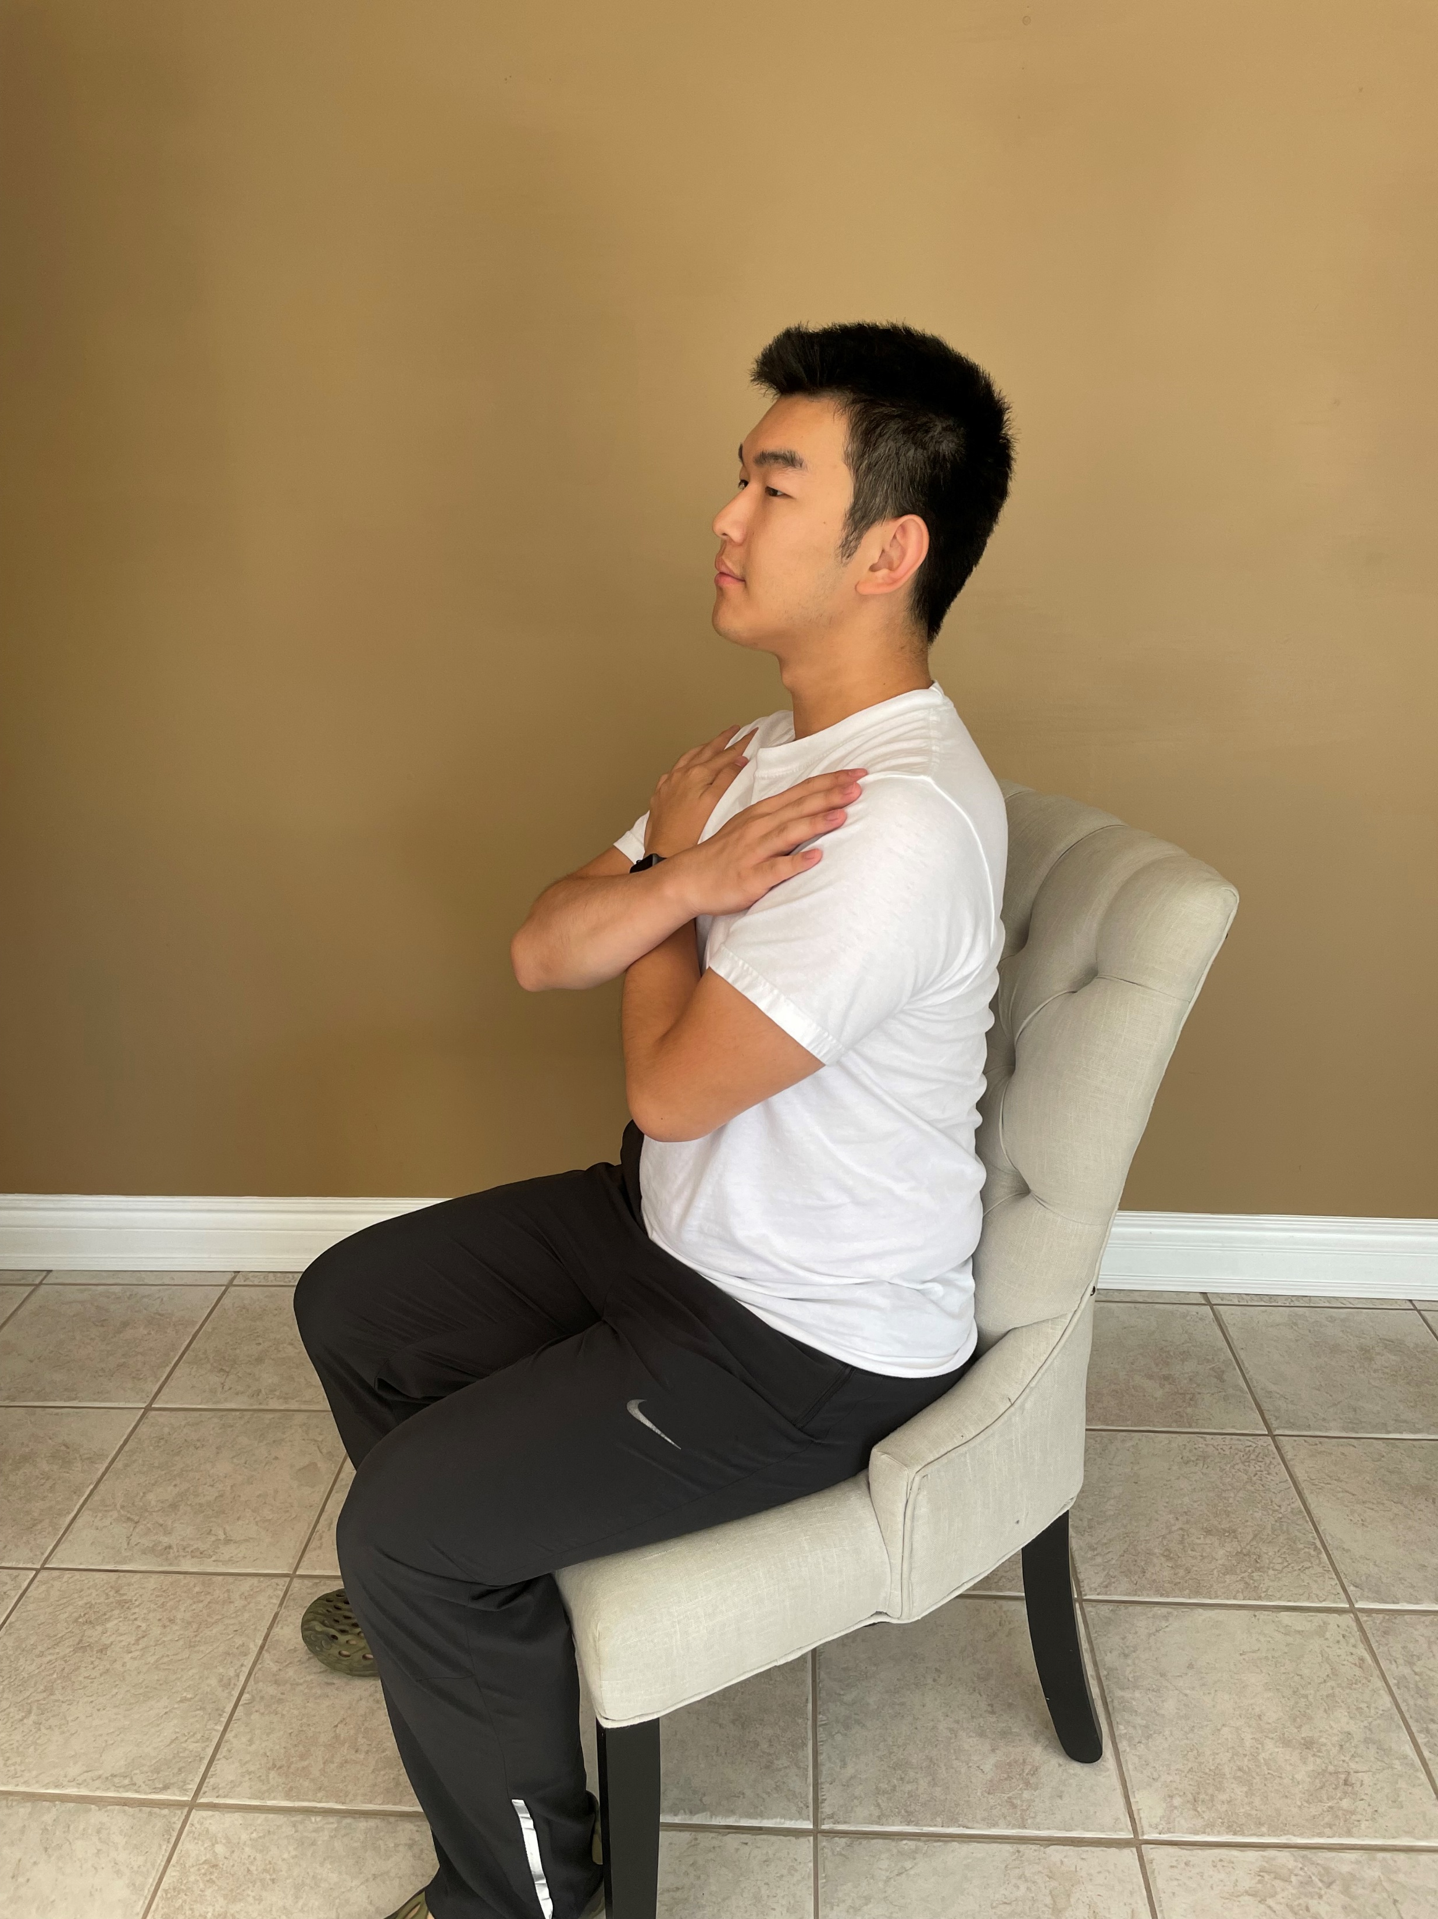
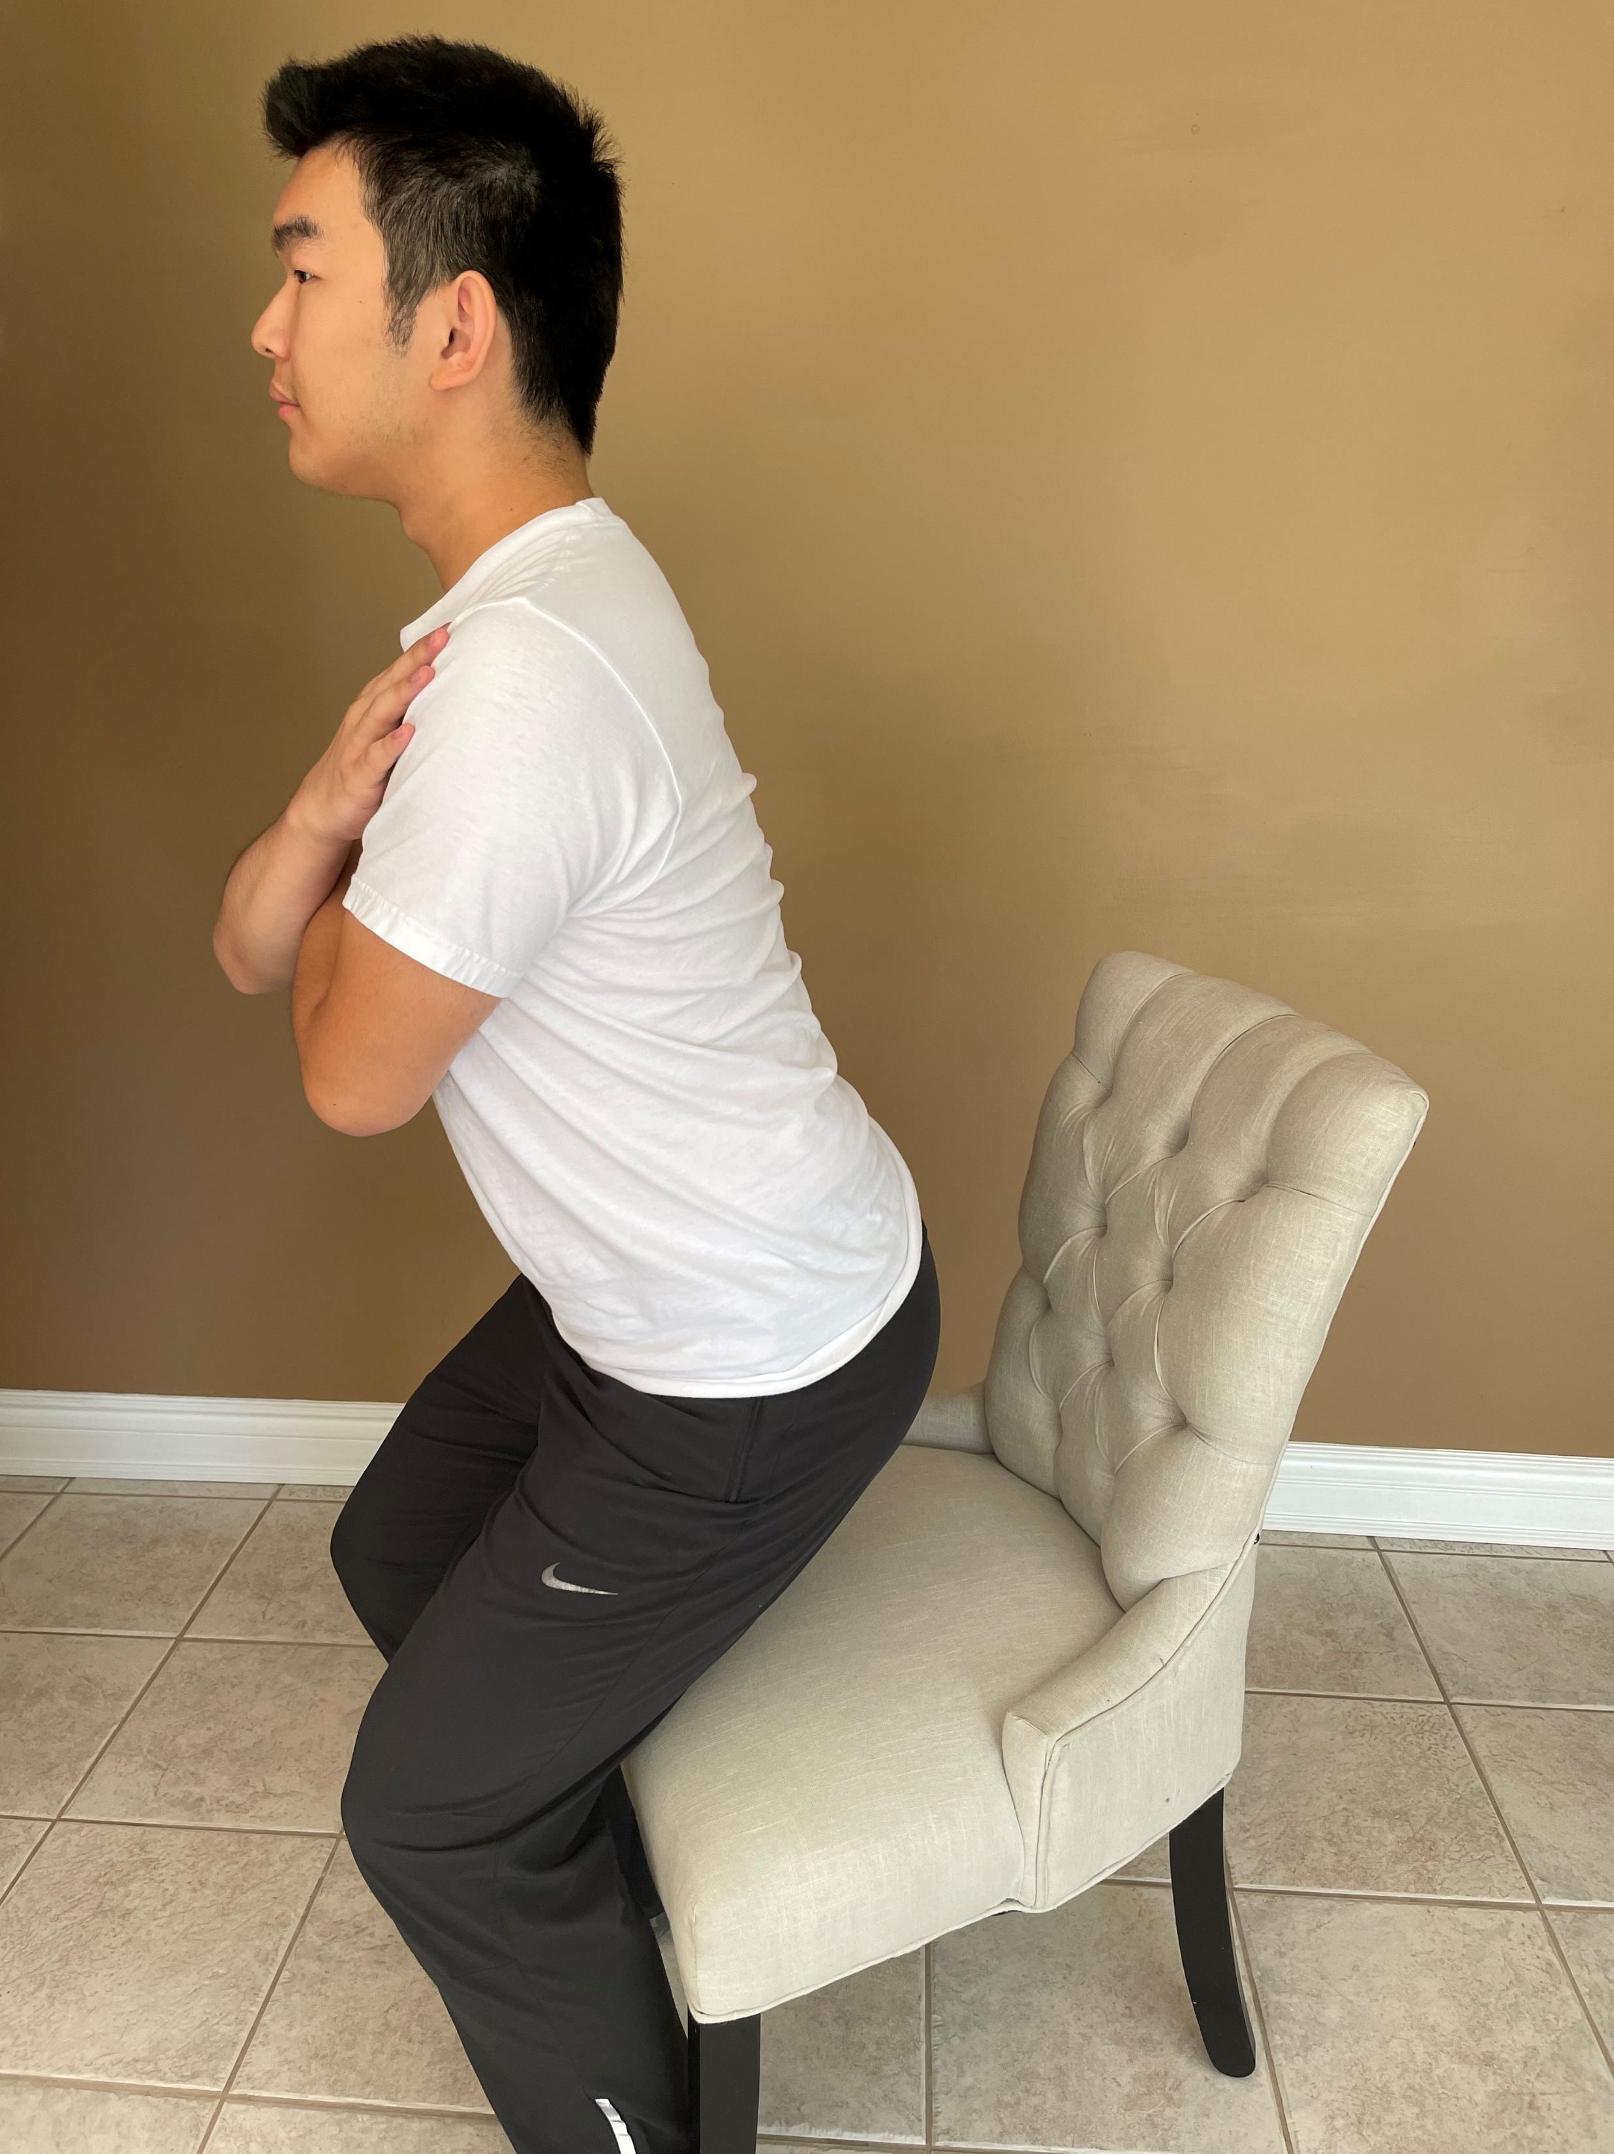
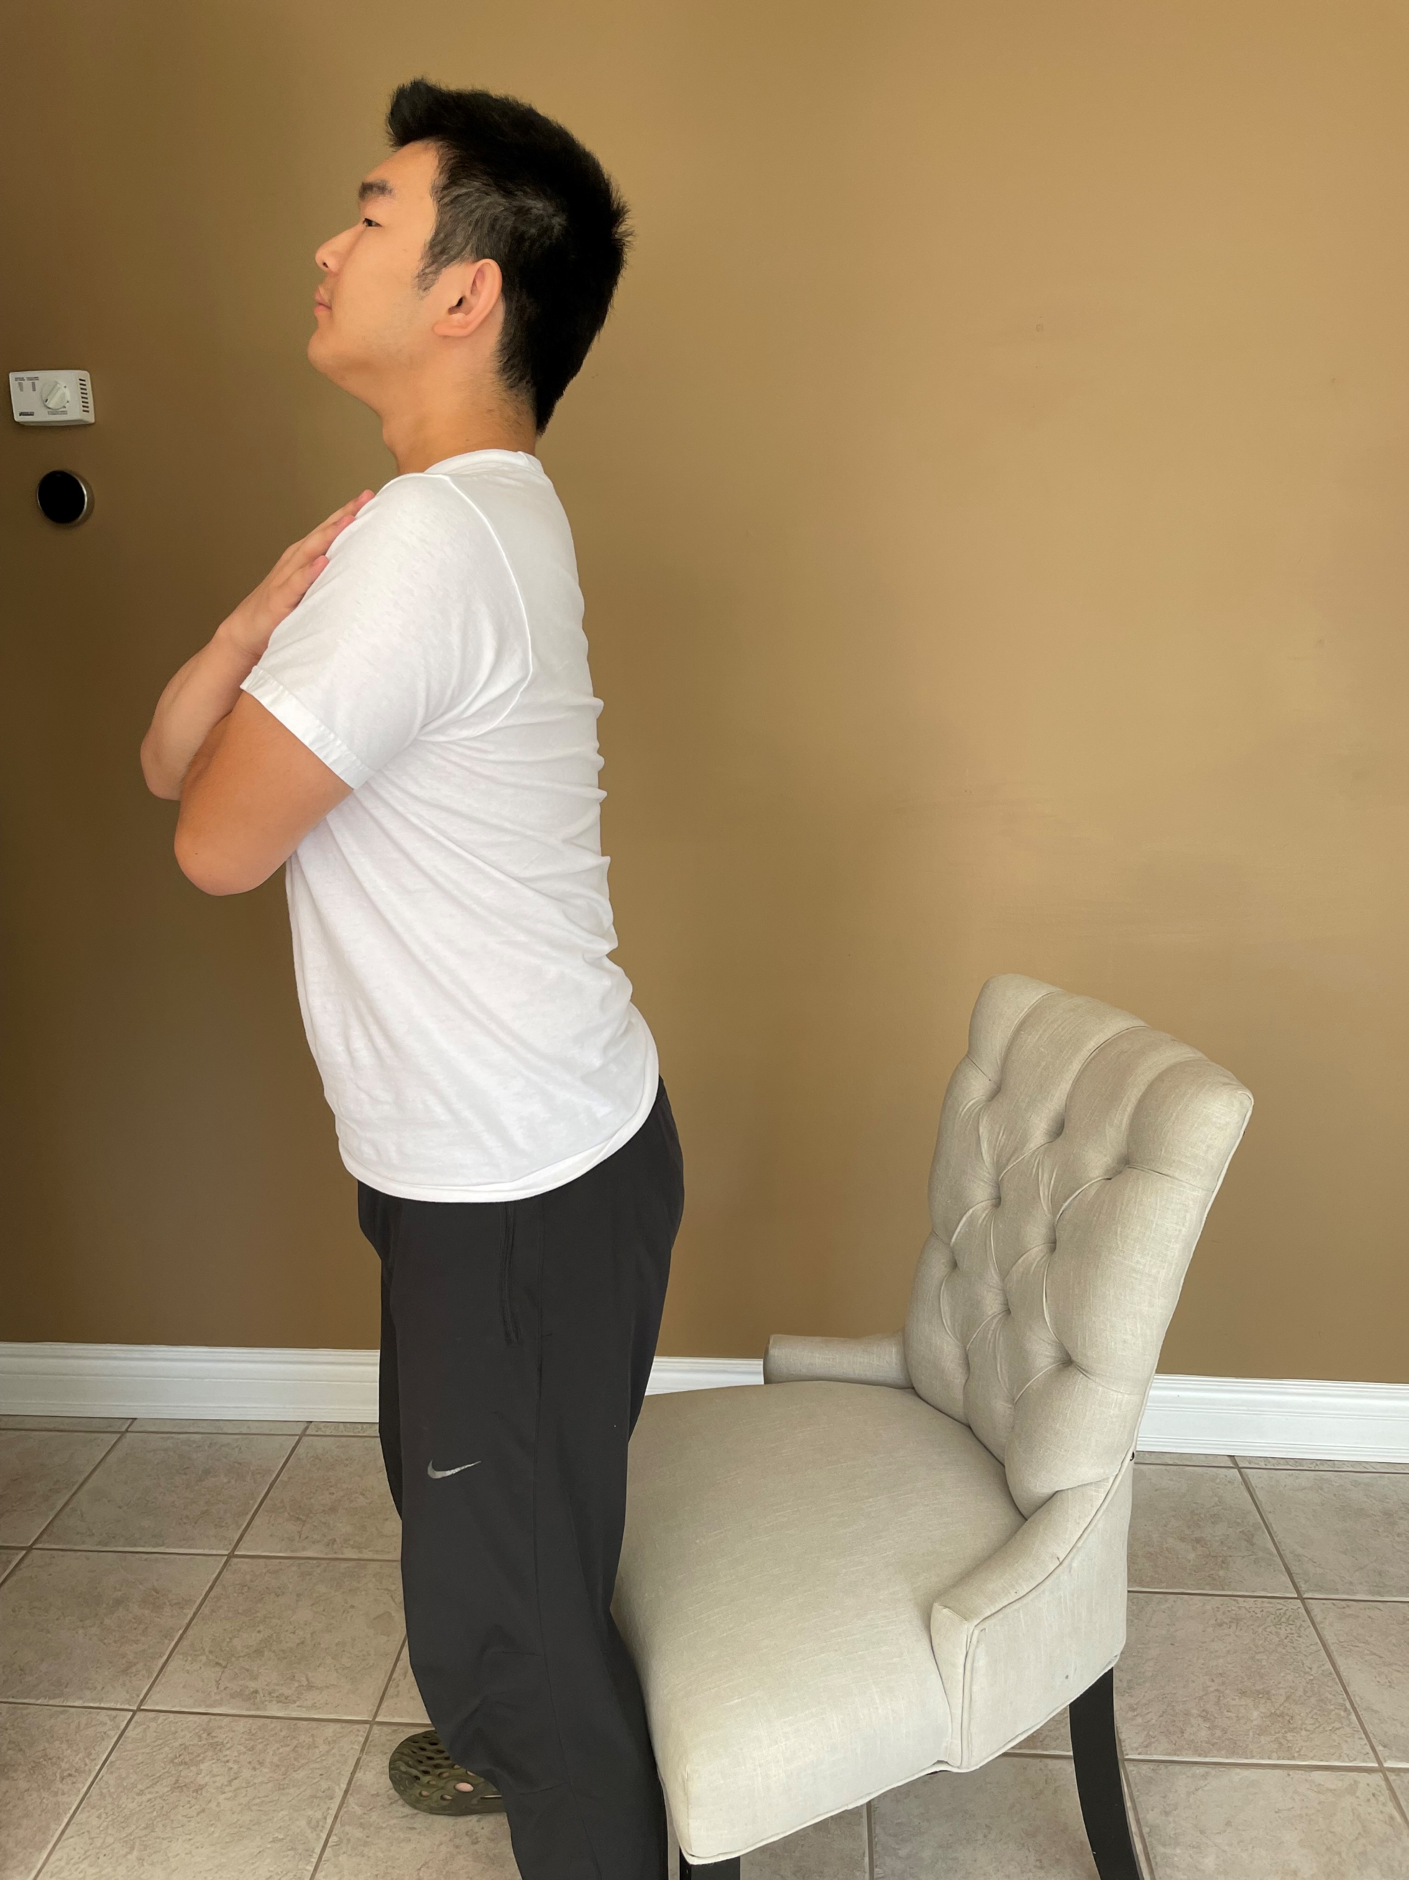
Return to Physical Activity post-Total Knee Arthroplasty and Total Hip Arthroplasty
BT Gao, BMSc Student, USRI Recipient, A Lowndes, PhD Candidate, DM Connelly, PT, PhD
Health & Rehabilitation Sciences, Bone and Joint Institute Collaborative Training Program in Musculoskeletal Research, University of Western Ontario
INTRODUCTION
Background
Total knee arthroplasties (TKA) and total hip arthroplasties (THA) are the recommended treatments for end-stage osteoarthritis in the knee joint and the hip joint respectively (Hawker et al., 2013).
Both the TKA and the THA rank among the top in the surgical interventions in their capacities to improve quality of life (Hawker et al., 2013).
The recovery process before the one-year post-surgery milestone for hip and knee replacements has already been widely documented and researched, but there is a gap in the literature regarding the long-term experience of recovery, return to physical activity and potential need for physiotherapy assistance
Currently, the government-funded physiotherapy and rehabilitation is focused on the short-term, usually 8 to 12 weeks immediately after surgery (Medical Advisory Secretariat, 2005).
Objective
To understand the experience of long-term recovery in mobility and function, as well as participation in meaningful activities for people post-TKA and THA.
METHODS
Inclusion Criteria/Participants
Participants must be between 55 and 70 years of age at surgery.
The knee or hip replacement was due to osteoarthritis (OA).
Procedure was approximately one year ago at University Hospital London.
Qualitative Interviews
Each participant completes a 30-minute in-depth personal interview.
Questions include asking participants about topics such as their personal definition of recovery, their reason to get the replacement, the activities they are looking forward to restarting, as well as their overall satisfaction.
OARSI Functional Tests
30-second Chair Stand Test (Pictured on right).
40m Fast Paced Walk Test.
Stair Climb Test.
Timed Up and Go Test.
Six Minute Walk Test.
Patient Reported Outcome Measures
WOMAC Osteoarthritis Index.
UCLA Activity Score.
Duke Activity Status Index.
Oxford Knee Score and Oxford Hip Score.
A Measure of Intermittent and Constant Osteoarthritis Pain (ICOAP).
Data Collection
Data Analysis
Changes in performance-based and self-report measures will be investigated using appropriate statistical analysis.
Using the constructivist grounded theory methodology informed by Charmaz (2006), the research team will code and categorize the findings identifying theoretical concepts/themes ‘grounded’ in the words of the participants into a representative theoretical framework emerging from interrelationships among the descriptions of participants.
Quotations from participants will be presented to demonstrate and substantiate the described themes and recovery process.
EMERGING INTERVIEW THEMES
THA participants discussed a quicker return to physical activity than TKA patients.
Most participants expressed that they still have physical activity goals and functional progress they wish to achieve during their second-year post-surgery.
Participants who have taken part in more sports and physical activity post-surgery feel they have experienced less pain and physical impairments.
Participants that have reported a more sedentary lifestyle have discussed feeling more pain or functional limitations.
Participants that have completed their physiotherapy and said that they have continued their assigned exercises post-treatment believe they have more range of motion in their replaced joint.
Participants who have stronger personal connections and support systems believe their outcomes to be better than those who go through the recovery process alone.
CONCLUSIONS
This research project is still ongoing – recruitment, data collection, and data analysis are concurrently taking place.
The long-term results of this mixed methods study will add to the existing literature on total hip and knee replacements and will provide a more holistic perspective on the long-term recovery process.
REFERENCES
Hawker, G.A., Badley, E.M., Borkhoff, C.M., Croxford, R., Davis, A.M., Dunn, S., Gignac, M.A., Jaglal, S.B., Kreder, H.J., & Sale, J.E.M. (2013). Which patients are most likely to benefit from total joint arthroplasty?. Arthritis & Rheumatism, 65(5): 1243-1252, https://onlinelibrary.wiley.com/doi/epdf/10.1002/art.37901
Medical Advisory Secretariat (2005). Physiotherapy rehabilitation after total knee or hip replacement: an evidence-based analysis. Ontario Health Technology Assessment Series, 5(8): 1-91, https://www.ncbi.nlm.nih.gov/pmc/articles/PMC3382414/
ACKNOWLEDGEMENTS
We would like to thank the Canadian Centre for Activity and Aging (CCAA) for allowing us to use their facilities to conduct in-person testing, as well as the University of Western Ontario for funding this project.
Set up for the functional tests
Obtain consent
Participants complete 5 patient reported outcome measures
Greet the participant
Participants complete 5 OARSI physical function tests
Participants complete an in-depth individual interview
Discuss follow-up in 6 months and guide the participant out of the building
Example of the 30-second Chair Stand Test

