Slide 1
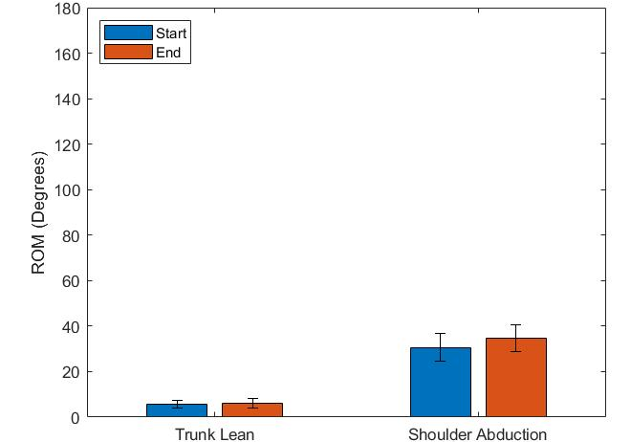
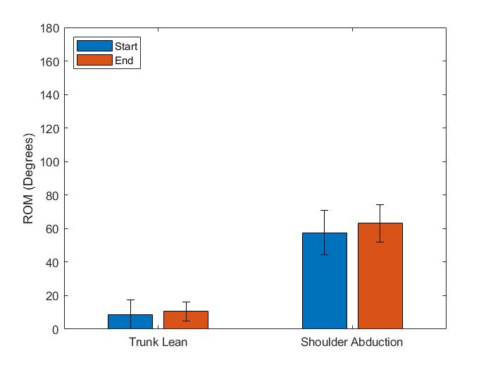
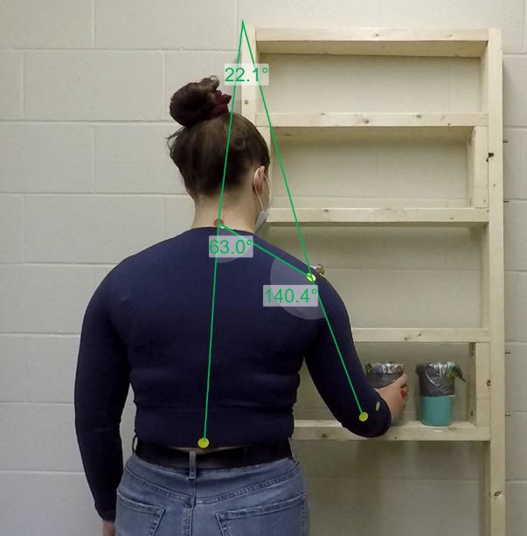
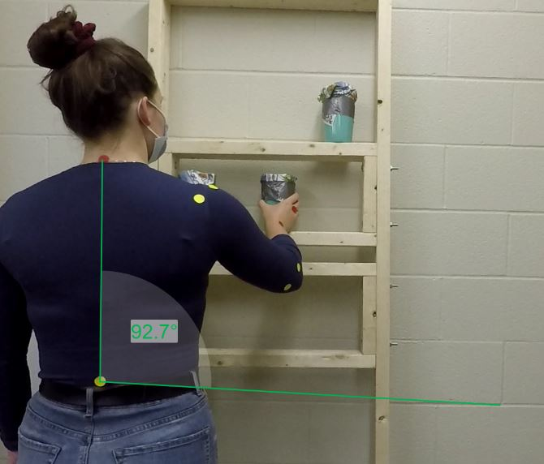
Normative Joint Angles and Compensation During FIT-HaNSA Test
Jennifer Villeneuve
Faculty Supervisor: Dr. Emily Lalone
Introduction
Repetitive motion such as working in a factory can lead to muscular fatigue which increases the chances of injury due to compensation
Another concern in this field is being able to identify when an individual is fully healed from an upper extremity injury
This has resulted in utilizing the FIT-HaNSA series which measures upper extremity performance throughout repetitive timed tasks
The FIT-HaNSA series causes the patient to enter extreme ranges of motion through common tasks of daily living
By analyzing the patients range of motion during the test, it could eliminate workplace injuries by detecting muscular fatigue before it results in compensation
It can help individuals who have upper extremity injuries to identify exactly where their muscular imbalances may lie to eliminate future risk of injury
Methodology
Seven young, healthy individuals completed the FIT-HaNSA series which is generally used by physicians to diagnose upper extremity injuries
Each trial was 5 minutes in duration, requiring the patient to move three weighted cups to replicate activities of daily living
The test was adjusted to their respective hip/eye height
Before completing the series, patients had stickers placed on respective bodily landmarks and recorded using two GoPro cameras recording from behind and the side of the dominant hand
These videos allowed for analysis of fatigue and range of motion to be analyzed using Dartfish software
Results
Figure 4: Hip trial range of motion
Objectives
The first objective of the study is to determine range of motion for healthy individuals specifically trunk lean and shoulder abduction during the FIT-HaNSA series
The second objective of the study is to utilize motion capture technology to determine what fatigue would look like in different individuals, when it may arise, and average ranges of motion across participants
Figure 5: Eye trial range of motion
Conclusions
Trunk lean has increased when comparing the trials, especially from the initial to final pass.
The range of motion for the hip and eye trial were 6° and 10° respectively
An effect on shoulder abduction has not been found due to the error bars overlapping, with the range of motion for the hip and eye trial being 34° and 63° respectively.
Figure 1: Hip trial shoulder abduction using Dartfish software
Figure 2: Eye trial trunk lean using Dartfish software
Figure 3: Eye trial alternate view using Dartfish software
The limitations of the experiment were that all patients were young, healthy individuals who did not have any previous upper extremity injuries and successfully completed the series
In the future, it would be beneficial to repeat this experiment using individuals of all different ages, flexibilities and fitness levels to better represent the entire population

