Slide 1
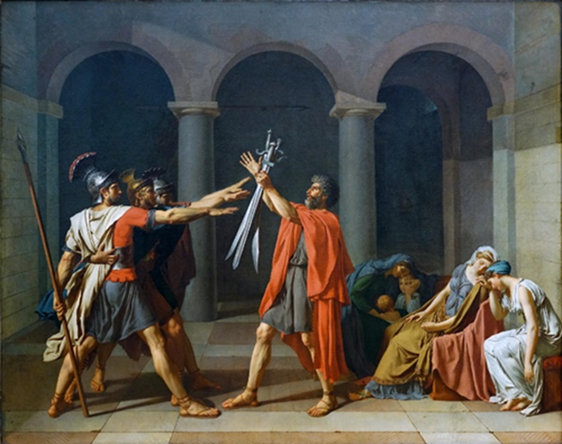
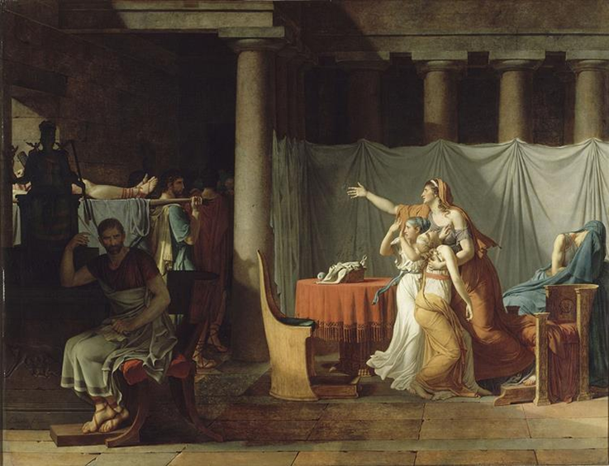
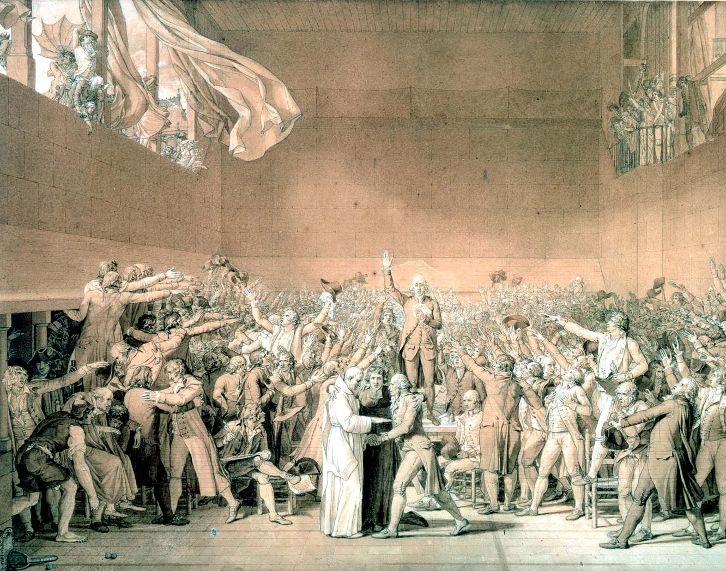
Classical Reception in the Pre-Revolutionary Art of Jacques Louis David
Christopher Neibert, USRI 2022 Research Output
Jacques Louis David was an 18th century French artist who was one of the leading adopters of the Neoclassical style, and the most renowned French painter in the years before, during, and following the French Revolution. Born in 1748, David hailed from an elite family, and was well versed in both the classical tradition and French high society. Painting during the rise of Neoclassicism and in the wake of the Enlightenment, David saw great success as a young artist. In his early career David attended the Royal Academy and spent time in Italy studying the Renaissance masters, where he visited Pompeii and also became introduced to neoclassical art.
Beginning with the Horatii, David painted a scene found in Livy’s Ab Urbe Condita (1.24-26) and Dionysus of Halicarnassus’s Roman Antiquities (3.19-21) in which three Roman brothers from the Horatii family go to war against three Alban brothers of the Curatii family. The premise of the story is that the brothers fight for the sake of Rome against the rival city, and two of the three die fighting for the eventual Roman victory. However, the scene of the brothers taking the oath to their father which David depicts is not located in any of the ancient sources, and instead appears to have been conceived based on Gavin Hamilton’s Oath of Brutus.
Moreover, the ancient world offered David a variety of stories and characters with whom he could use to communicate messages about contemporary France through allegory and inference. By using scenes from the past to obscure commentary about the present, David created separation between himself and possible punishment. Therefore, David’s use of classical reception in his neoclassical art, was the perfect medium for concealing contemporaneous political meaning. When David attempted to paint cotemporary scenes like his Tennis Court Oath in the early 1790’s, he encountered danger and censorship because of the hazardous and quickly shifting politics of the Revolution.
(David, The Oath of the Horatii, 1784, Louvre)
(David, The Lictors Bring to Brutus the Body of His Sons, 1789, Louvre)
(David, Ink Sketch of the Tennis Court Oath, 1791, Palace of Versailles)
The painting emphasizes the brother’s civic virtue and selfless duty to the state, during the Roman Monarchy, and the painting itself was commissioned by French royal authorities. Although this would seem problematic for an antimonarchical political interpretation, it does not mean that David did not veil tacit subversive meaning within the painting. The structure and style of the Horatii was received as extremely progressive by the 1784 Salon audience , and even considered dangerous by conservative critics (Crow, 1978). Moreover, it contains progressive references to Rosseau’s Social Contract, aligning with Enlightenment ideals such as civic virtue, fatherhood, and balance between citizen and state.
David’s Brutus appears as a more overtly political piece. Created closer to the tensions of the Revolution, the Brutus depicts another scene from Livy in which Lucius Junius Brutus, the legendary overthrower of Rome’s last king and founder of the Republic, is receiving the bodies of his dead sons who he condemned to death for their plot to reestablish tyranny. The implied, yet not completely blatant, Republican message in the painting accentuates antimonarchism and rejects tyranny. Thus, David’s composition of this scene was an aptly amenable allegory for the sentiments of progressives in 1789 France.
Both the Horatii and the Brutus demonstrate how David was able to imply political and progressive messages in his paintings by veiling them with classical scenes and subjects. The core argument of the paper is that because classical material had such a distant temporal connection, it provided David with the safety required to include subversive and political commentary in his art.
.
However, it was David’s 1784, Oath of the Horatii, which elevated him to prominence in the Paris Salon and reformed the Neoclassical style. In opposition to the opulence of the earlier Rococo style, David’s stark and stoic depiction of the legendary Roman story from Livy broke tradition and was viewed as extremely progressive. Consequently, David’s new style aligned with the budding French bourgeoisie because of its defiance of convention, modest aesthetic, and undertone of Enlightenment ideals.
In the aftermath of the Storming of the Bastille in 1789, the French Revolution had begun, and David soon became radically involved in Revolutionary politics. By 1793, he was a member of the Jacobin club, comrade of Robespierre and Marat, in charge of Revolutionary parades, and a supporter of the regicide of Louis XVI. He also served on the Committee of General Security in which he was directly involved with carrying out the Reign of Terror.
This poster is derived from an accompanying eponymous paper, which investigates the relationship between David’s pre-Revolutionary art and classical reception. The goal of the research project was to demonstrate how David used classical subject matter in his pre-Revolutionary paintings as a means of creating safe distance for political subversion within the art. Moreover, the second intention of the paper was to present a framework for reinterpreting David’s art using Fredrick Ahl’s model of ancient safe criticism. Nonetheless, before considering David’s use of classical subject matter for political purposes, the political nature of his pre-Revolutionary period work must first be established. There are two paintings from this period which have been subject to academic debate regarding whether they are political or not: The Oath of the Horatii (1784) and The Lictors Bring to Brutus the Body of His Sons (1789).
David’s neoclassical work can be further reframed by considering a more abstract manifestation of reception. While not deliberate, David’s practice of veiling meaning and political criticism behind art parallels the ancient practice of safe criticism (Ahl, 1984). By using tales and characters to represent current events and people, ancients involved in the creation of rhetoric, theatre, and poetry, often used art to make their own tacit political commentary. For example, consider the Roman rhetorician Quintilian assessment of figured speech:
“It is used under three sets of circumstances: 1. If it is not at all safe to
speak forthrightly. 2. If it is not in good taste to do so. 3. When it
is adopted only for pleasurable effect, and delights the audience by its
novelty and variations more than direct expression” (Inst. Or. 9.2.66).
If Quintilian’s model is applied to David’s Horatii or Brutus, we can see how the connection between the ideas of figured speech and artistic subversion align. An outright antimonarchical statement would not have been safe nor in good taste for David to make, and the novelty of both paintings created large reactions in the Salon audience. Thus, the obscure meanings of his neoclassical art seem to align well with what Quintilian would suggest figured speech should look like. While David was not intentionally modeling the ancient practice, his work and his use of classical subject matter, can be interpreted as even more nuanced when viewed with the ancient technique in mind. Not only was David using classical material, but his practice of concealing meaning also mirrors how the ancients used safe criticism in art and speech.
Select Bibliography
Crow, T. (1978). Jacques-Louis David’s “Oath Of The Horatii”: Painting And Pre-Revolutionary Radicalism In France. ProQuest Dissertations Publishing.
Ahl, Frederick. (1984) “The Art of Safe Criticism in Greece and Rome.” The American Journal of Philology 105, no. 2: 174–208. https://doi.org/10.2307/294874.

