Slide 1
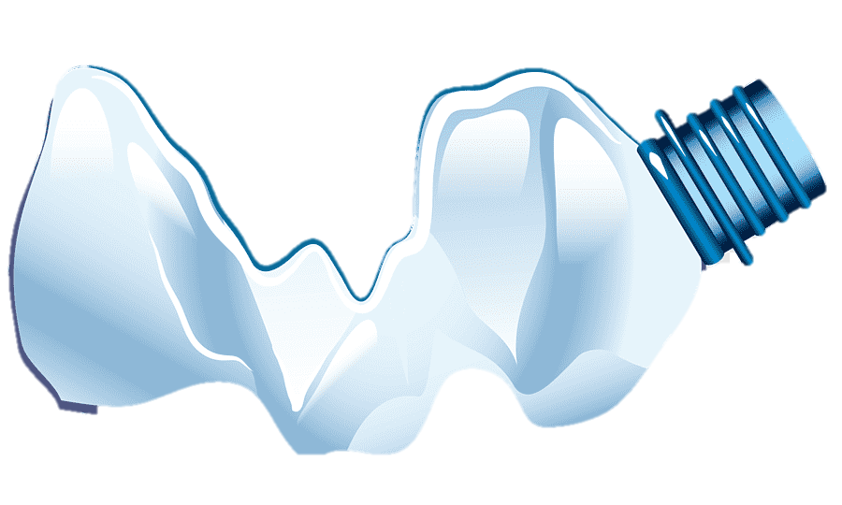
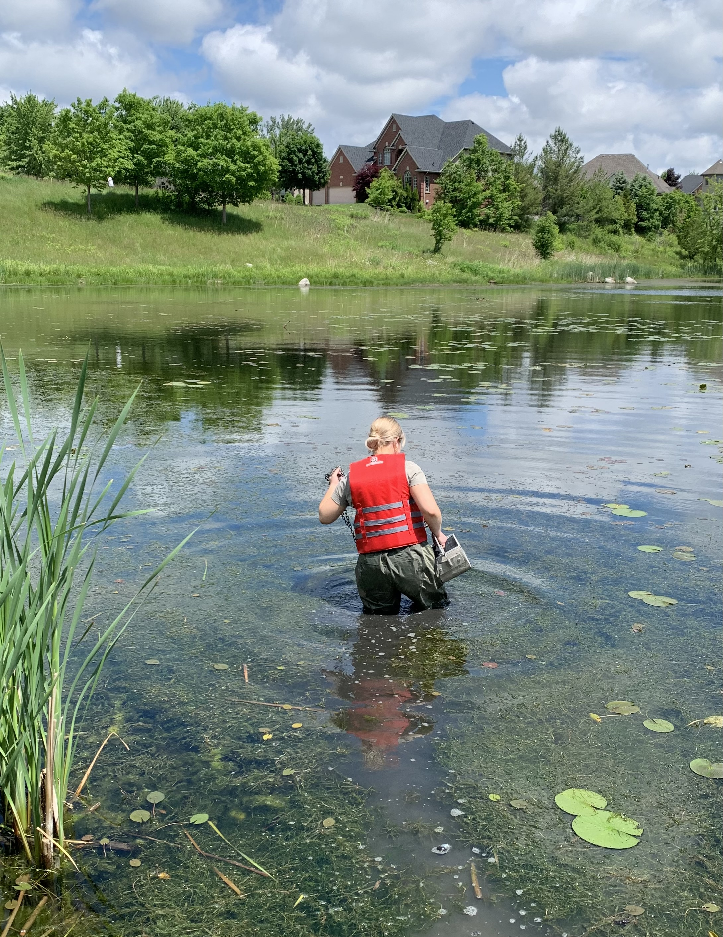
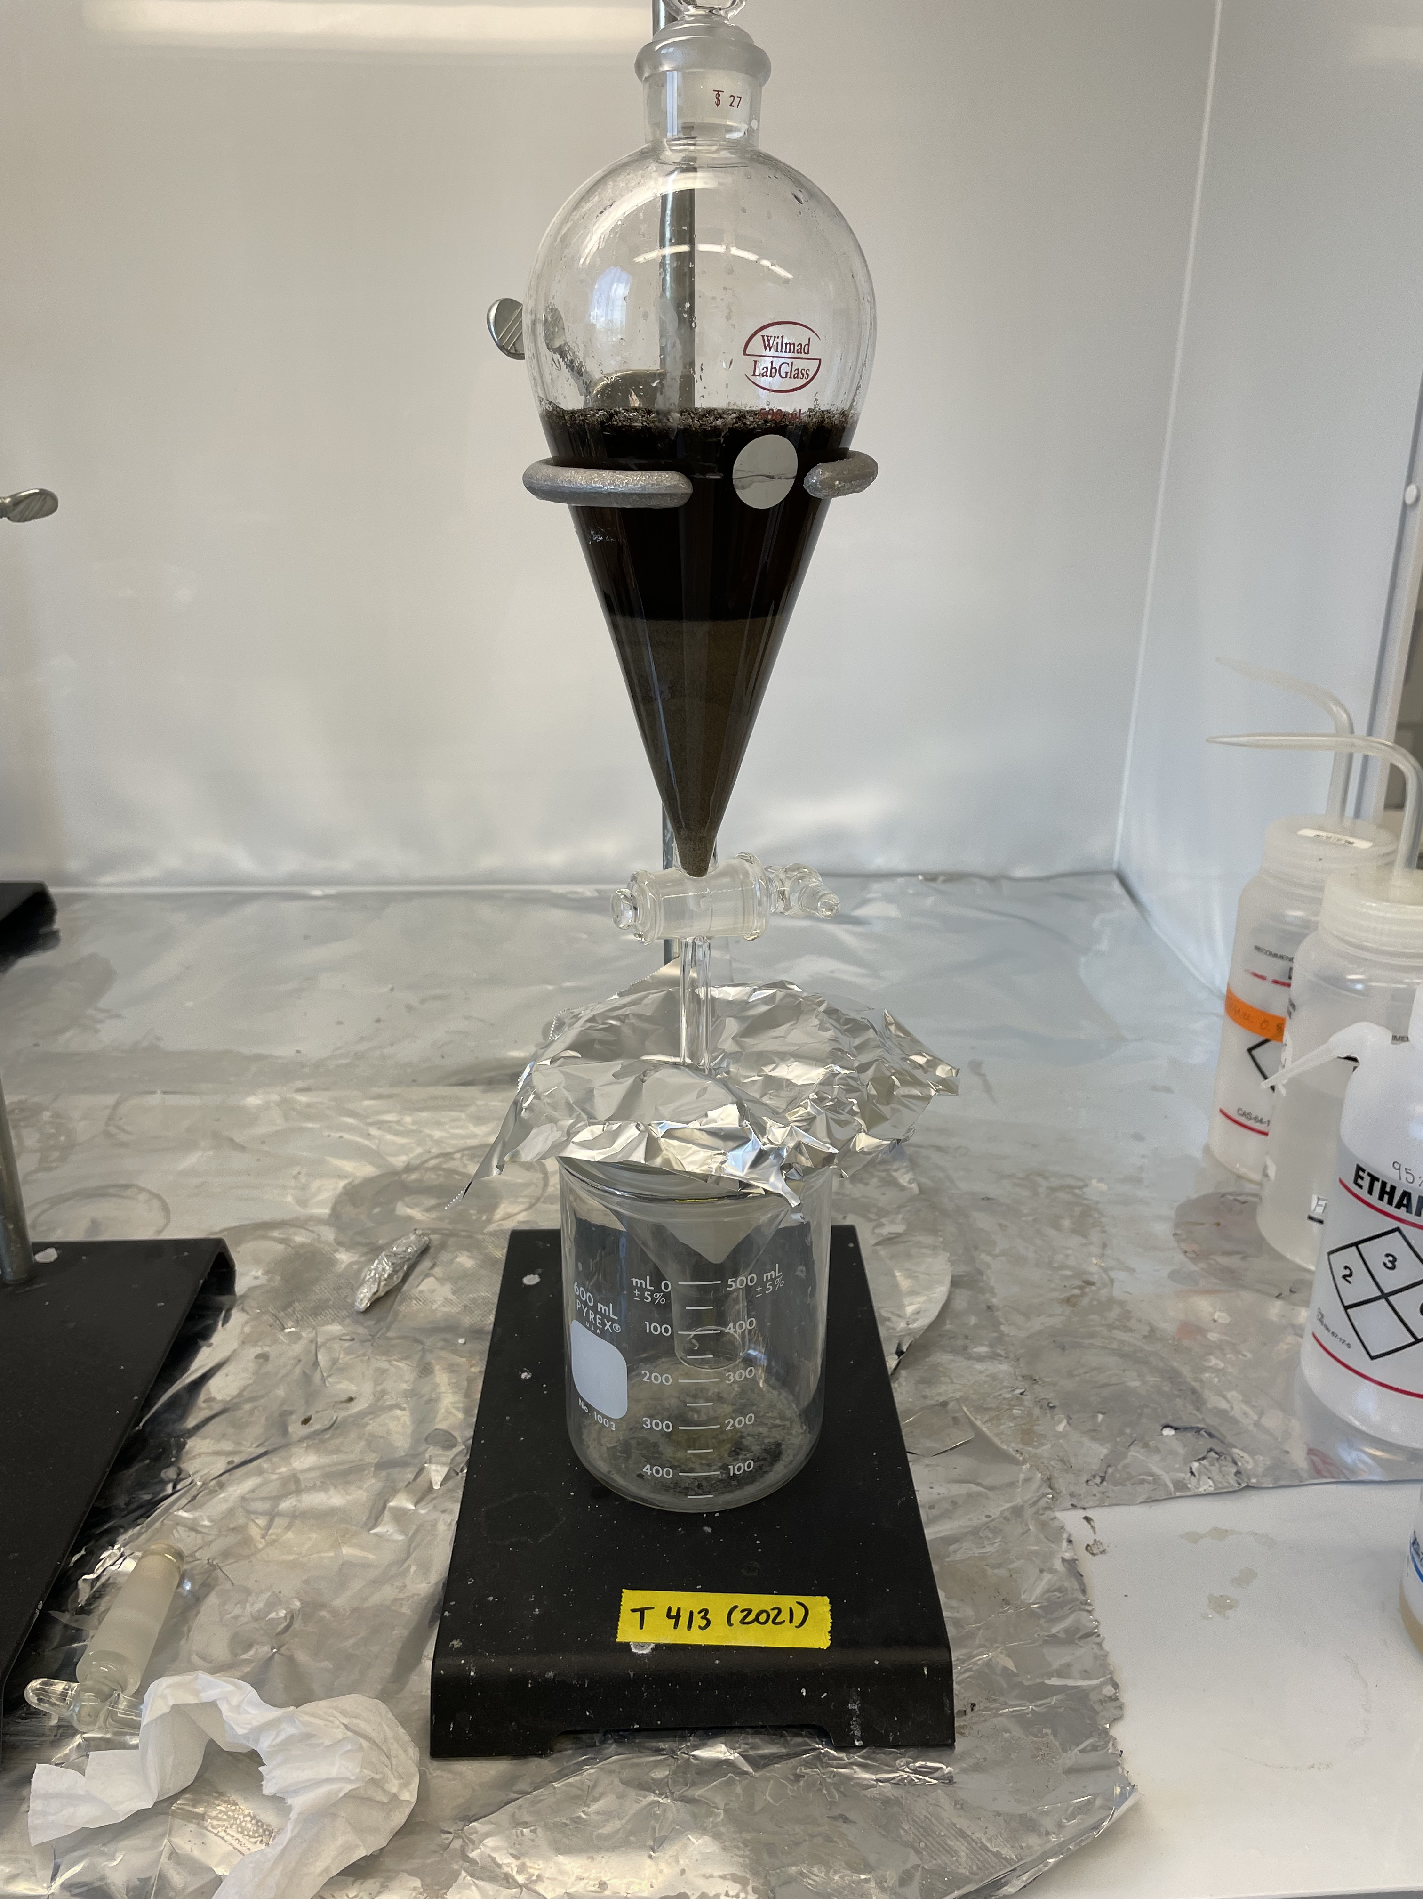
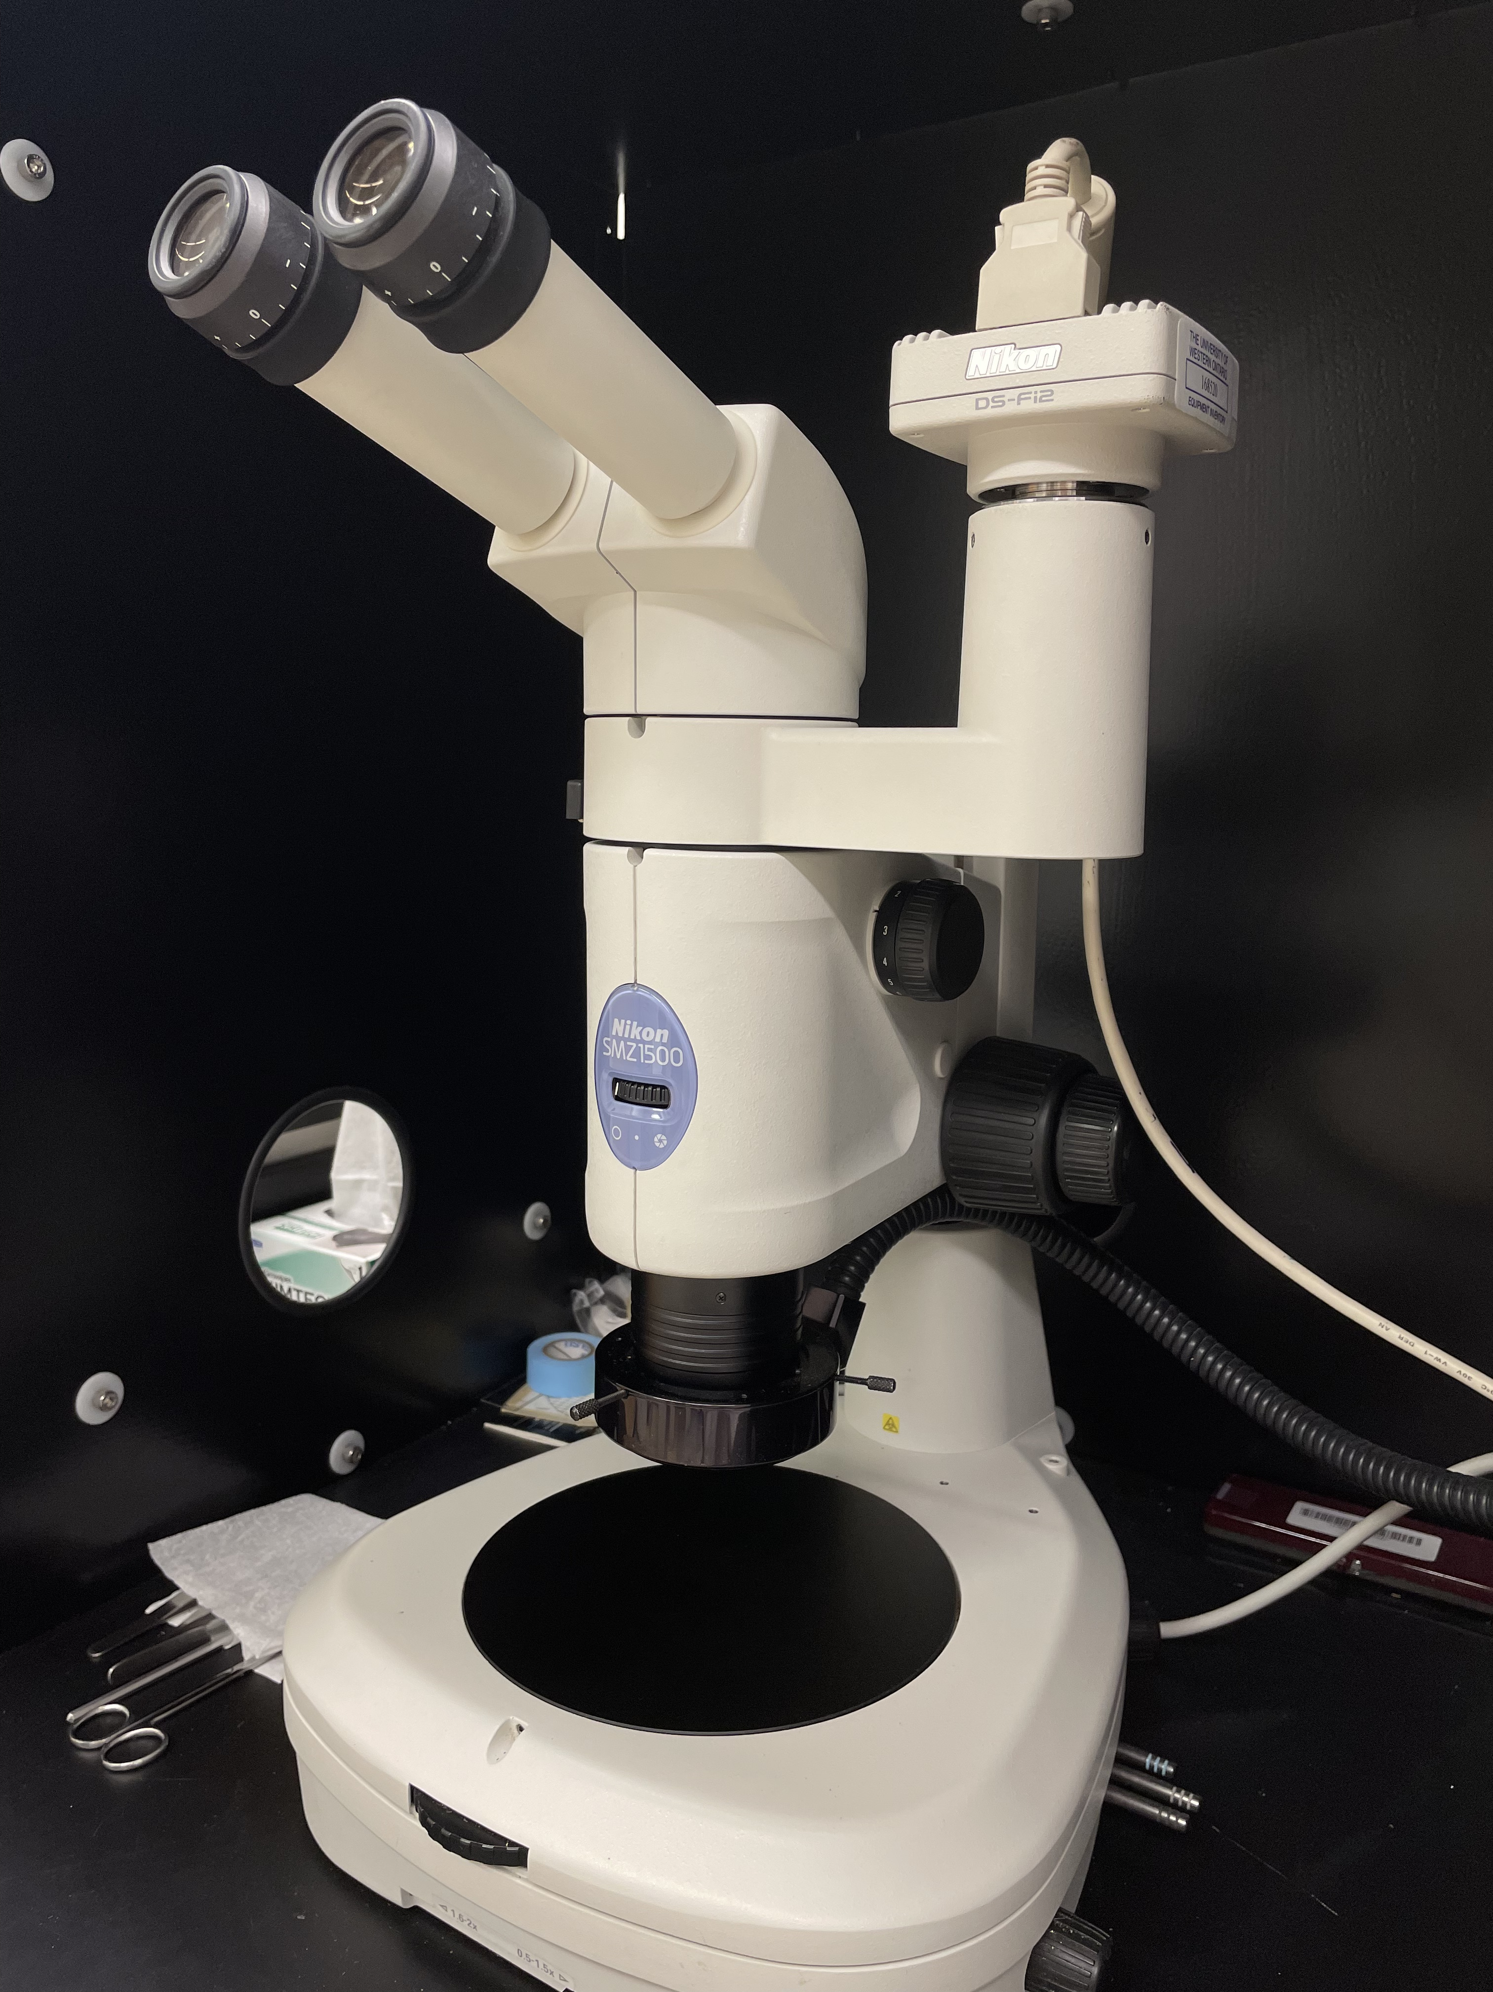
Uncovering the Mysteries of Retention Ponds:
Comparing the Abundance and Type of Microplastics in Stormwater Ponds
Natalie R. Minda and Dr. Patricia Corcoran
The University of Western Ontario, USRI Program Summer 2022
Introduction
Methods Diagram
Microplastics are plastics <5 mm (Liu, 2019; Arthur et al., 2009). They are created in two ways: Intentionally or from the fragmentation of larger pieces of plastic (National Ocean Service, 2021).
Microplastics can enter waterways through many sources, but some include travelling through drains and atmospheric deposition (WHO, 2019).
Microplastics can negatively impact human, wildlife and ecosystem health in many ways.
The negative impacts of microplastics in the environment depend on the level of exposure, type, size and shape of the microplastic (Campanale, 2020).
Retention ponds are often created in neighborhoods to collect water in order to prevent flooding. They also often serve as habitat for wildlife.
Sampling
Splitting
Processing
Analysis
SAMPLE X: Amount of each sample x mixed to yield one sample for each pond. Used for analysis
SAMPLE Y: Analysis
SAMPLE Z: Backup
Figure 1. Natalie with the petite ponar sampling in a stormwater pond.
Figure 2. Figure showing the three samples and their use in the experiment.
Figure 3. Separatory funnel with the sediment stirred with SPT solution and drained over fast flow filter paper.
Figure 4. Nikon SMZ1500 microscope.
Results and Conclusions
Microplastic abundance and type varied across the two stormwater ponds.
Microbeads were found only in the Warbler Woods pond, as well as a higher volume of fragments.
Fibers were found at a higher volume in the Cornlon pond compared to the Warbler Woods pond.
Retention ponds may need more attention regarding plastic pollution policies and removal of microplastics.
Potable water can be contaminated by stormwater in retention ponds. In addition, wildlife living in these ponds could be impacted by the abundance of microplastics in their habitat.
Materials and Methods
CONTAMINATION PROCEDURE:
Blanks were collected in the field, as well as during processing and microscope work. Any contaminants were subtracted from the final number of isolated microplastics in each sample.
Samples were collected and stored in air-tight containers with aluminum foil, and surfaces were wiped before and after with RO water.
SAMPLING:
6-7 sediment samples were collected from each pond (Warbler Woods [42°58'30.9"N 81° 22'07.7"W] and Cornlon [43°01'29.0"N 81°18'17.9"W]) using a petite ponar (Figure 1).
PROCESSING:
Each sample was sieved at 53 µm with RO water. Samples were dried at 70ºC in an oven.
Samples were dry sieved and then split into three samples (Figure 2).
Density separation was performed for Sample X and Sample Y using 25-50mL of sodium polytungstate (SPT) at 1.5 g/cm³, which was stirred and poured into a separatory funnel with 25 µm fast flow filter paper (Figure 3).
Dense grains were discarded, and the floating particles were sieved at 53 µm into a petri dish to be dried in the oven at 70ºC.
ANALYSIS:
Nikon SMZ1500 microscope used to isolate the microplastics (Figure 4). Abundance, type, color, and size of the plastics for each sample was recorded.
References and Acknowledgements
ACKNOWLEDGEMENTS:
Thank you to: The University of Western Ontario, Dr. Patricia Corcoran, Erica Stroud, Nina Kozikowski, Biotron, the City of London, Western Libraries, Western Research, Student Experience, and the Western USRI Program.
REFERENCES:
Campanale, C.; Massarelli, C.; Savino, I.; Locaputo, V.; Uricchio, V. F. A Detailed Review Study on Potential Effects of Microplastics and Additives of Concern on Human Health. Int J Environ Res Public Health 2020, 17 (4), 1212.
Liu, F.; Olesen, K. B.; Borregaard, A. R.; Vollertsen, J. Microplastics in urban and highway stormwater retention ponds. Science of the Total Environment 2019, 671, 992-1000.
What are microplastics?. National Ocean Service; NOAA, 2021.
Microplastics in drinking-water. World Health Organization; WHO, 2019.

