Slide 1
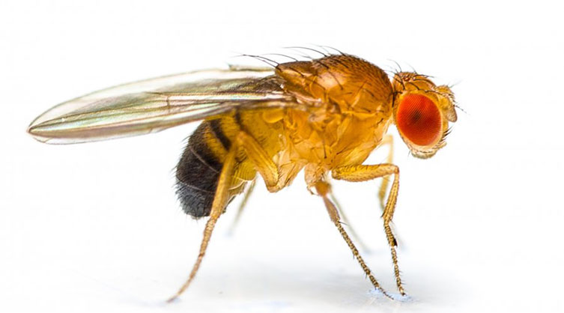
Examining the effect of social isolation on longevity in Drosophila melanogaster
Summer 2021
Shauna Morrell
Supervisor: Dr. Anne Simon
Department of Biology

Slide 2
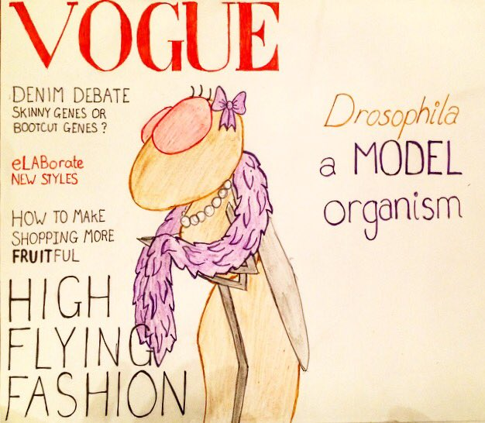
Drosophila melanogaster as a Model System
Short generation time
Small and easily maintained
Genome sequenced
Many conserved behaviours among species
https://twitter.com/DaniedmundsDani

Slide 3
Social Isolation
Can alter behaviour and induce physiological changes
Has been shown to increase the nlg3 transcript abundance¹
Increased social spacing
Does this affect longevity?
1. Yost et al., 2020
Notes:
- ASD: impairs the way the flies socially interact with each other and communicate

Slide 4
Neuroligin-3 (nlg3)
Neuroligin genes encode post-synaptic cell adhesion proteins required for synapse
nlg3 is important in social space and acts in a sex-specific manner¹
↑ social space in males (nlg3^{Def1})
↑ social space in females with age (nlg3^{Def1})
1. Yost et al., 2020
Notes:
- ASD: impairs the way the flies socially interact with each other and communicate

Slide 5
PGS (nlg3^{GS32})
A nlg3 mutant
Insertion to the nlg3 regulatory region (promoter)
Effects on nlg3 not clear
Modified from the original image: Yost et al. 2020

Slide 6
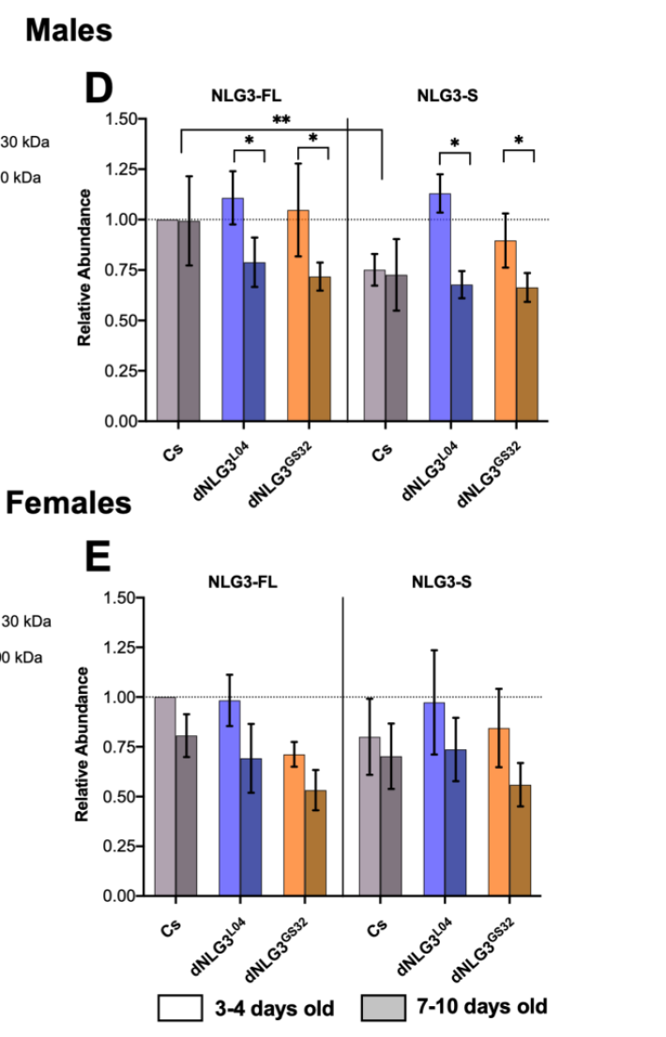
Autism-Associated Nlg3 Protein
Ageing does not affect Nlg3 abundance in CS males
Nlg3 abundance in PGS flies decreased as flies aged¹
In CS and PGS females, age did not affect Nlg3 abundance¹
Will isolation affect the amount of Nlg3 protein produced?
Yost et al., 2020
1. Yost et al., 2020

Slide 7
Hypothesis
Social isolation will affect the expression of nlg3 and will therefore alter the amount of protein that is produced
Changes in nlg3 expression will affect the lifespan of CS, PGS and nlg3^{Def1} mutants

Slide 8
Objectives
Assess longevity of Canton-S flies (control), along with PGS and nlg3^{Def1} mutants following isolation
Use this data to conduct a survivorship curve to analyze the effect of isolation on lifespan of each mutant

Slide 9
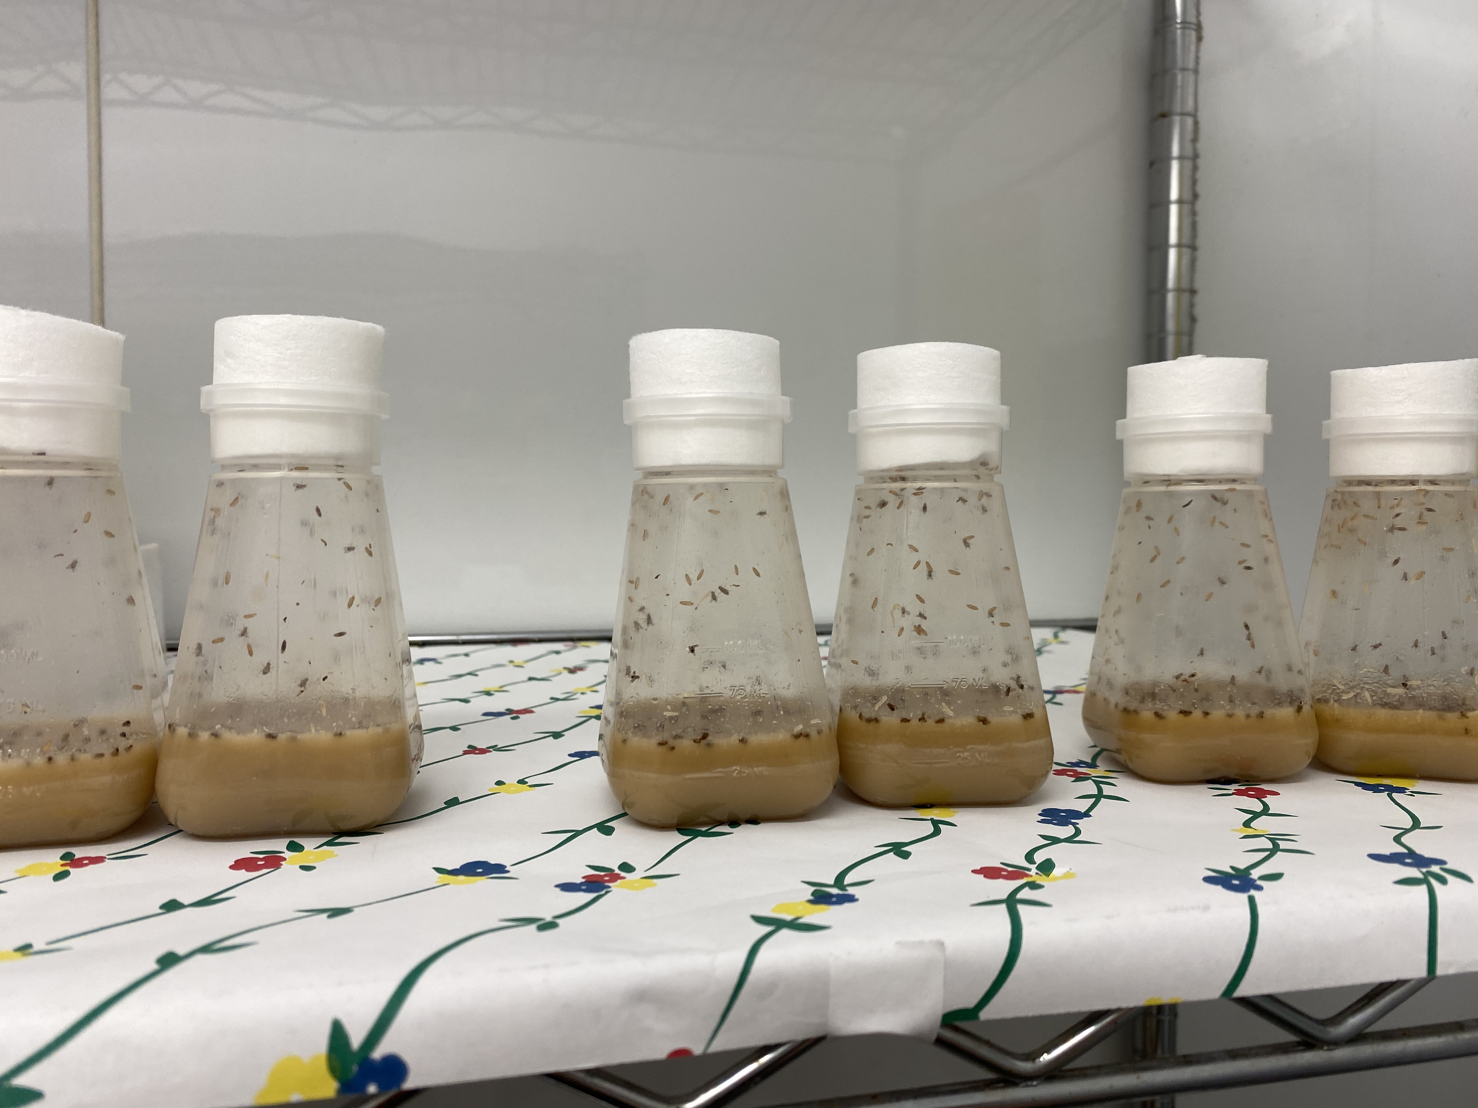
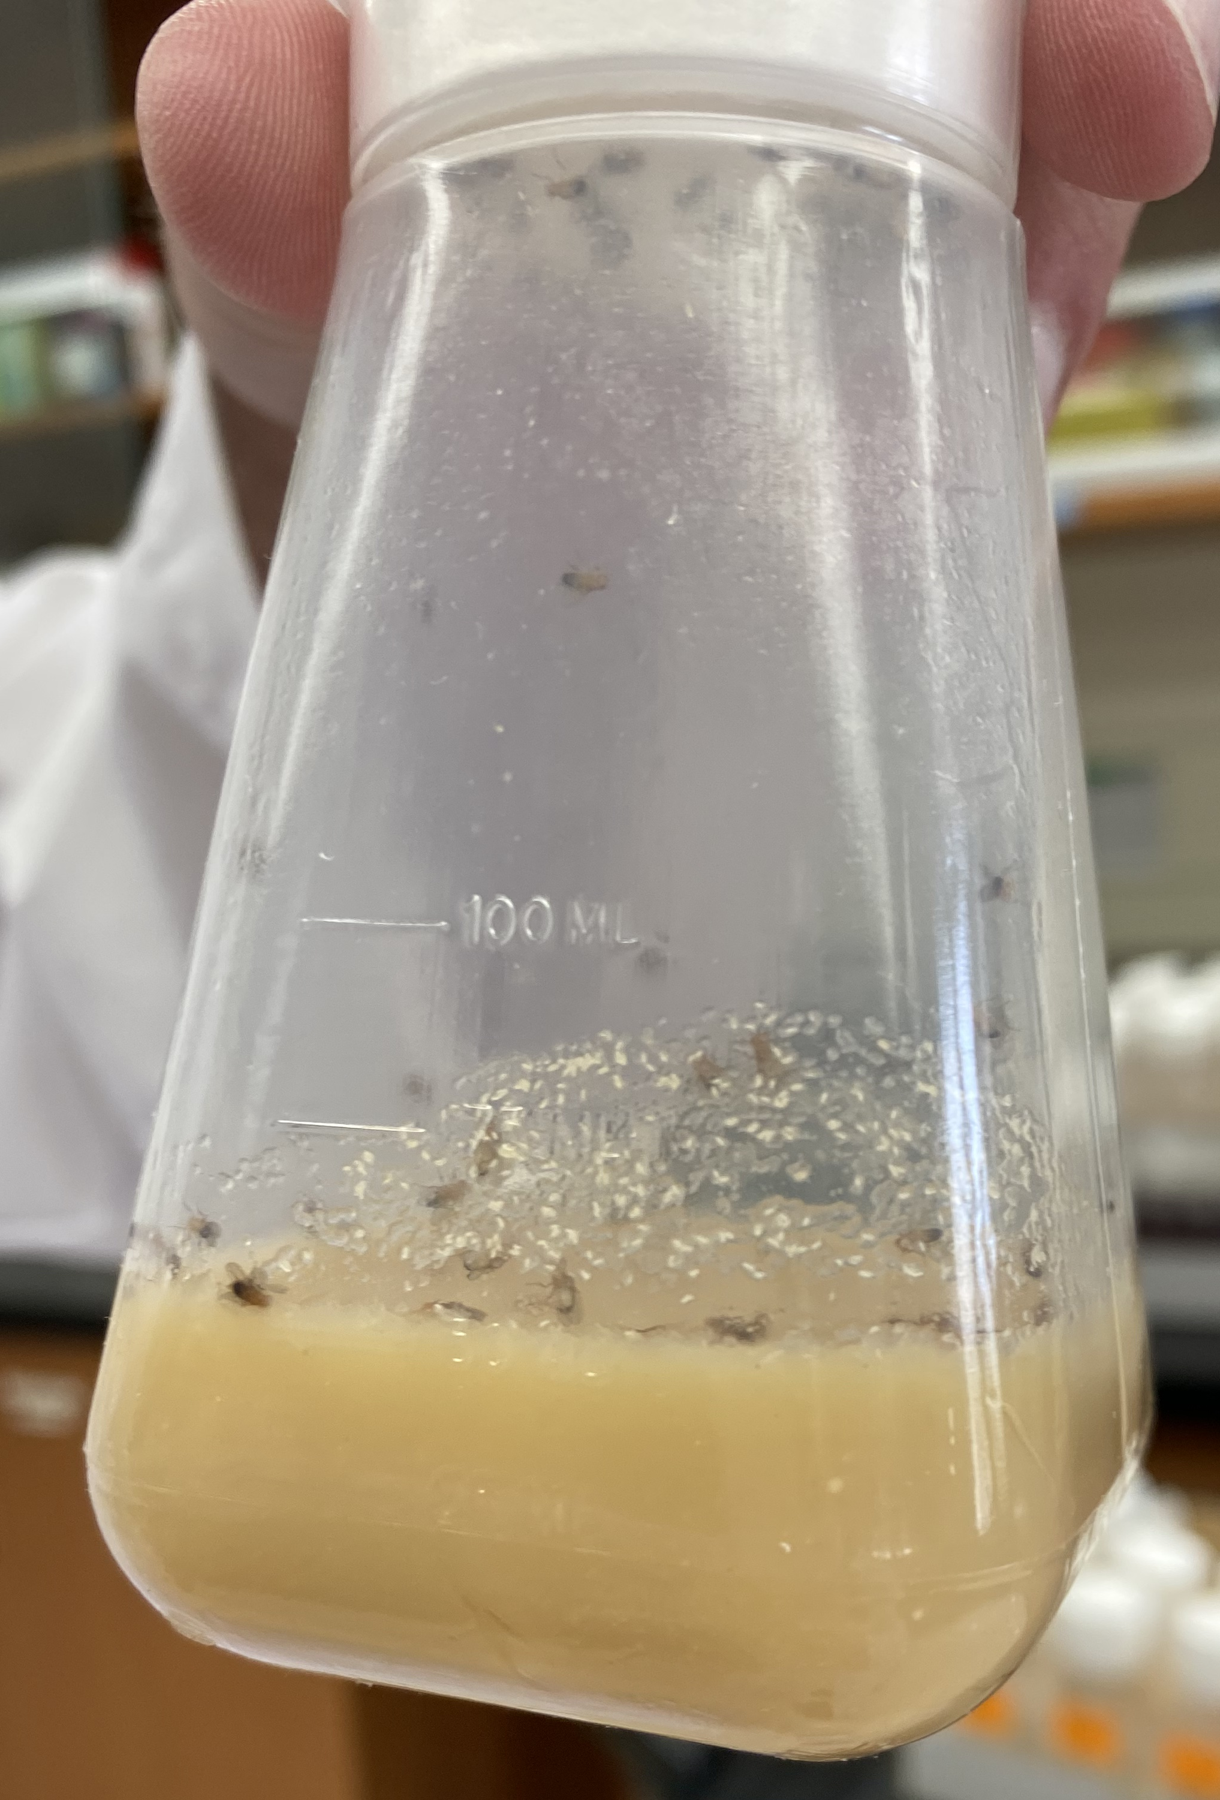
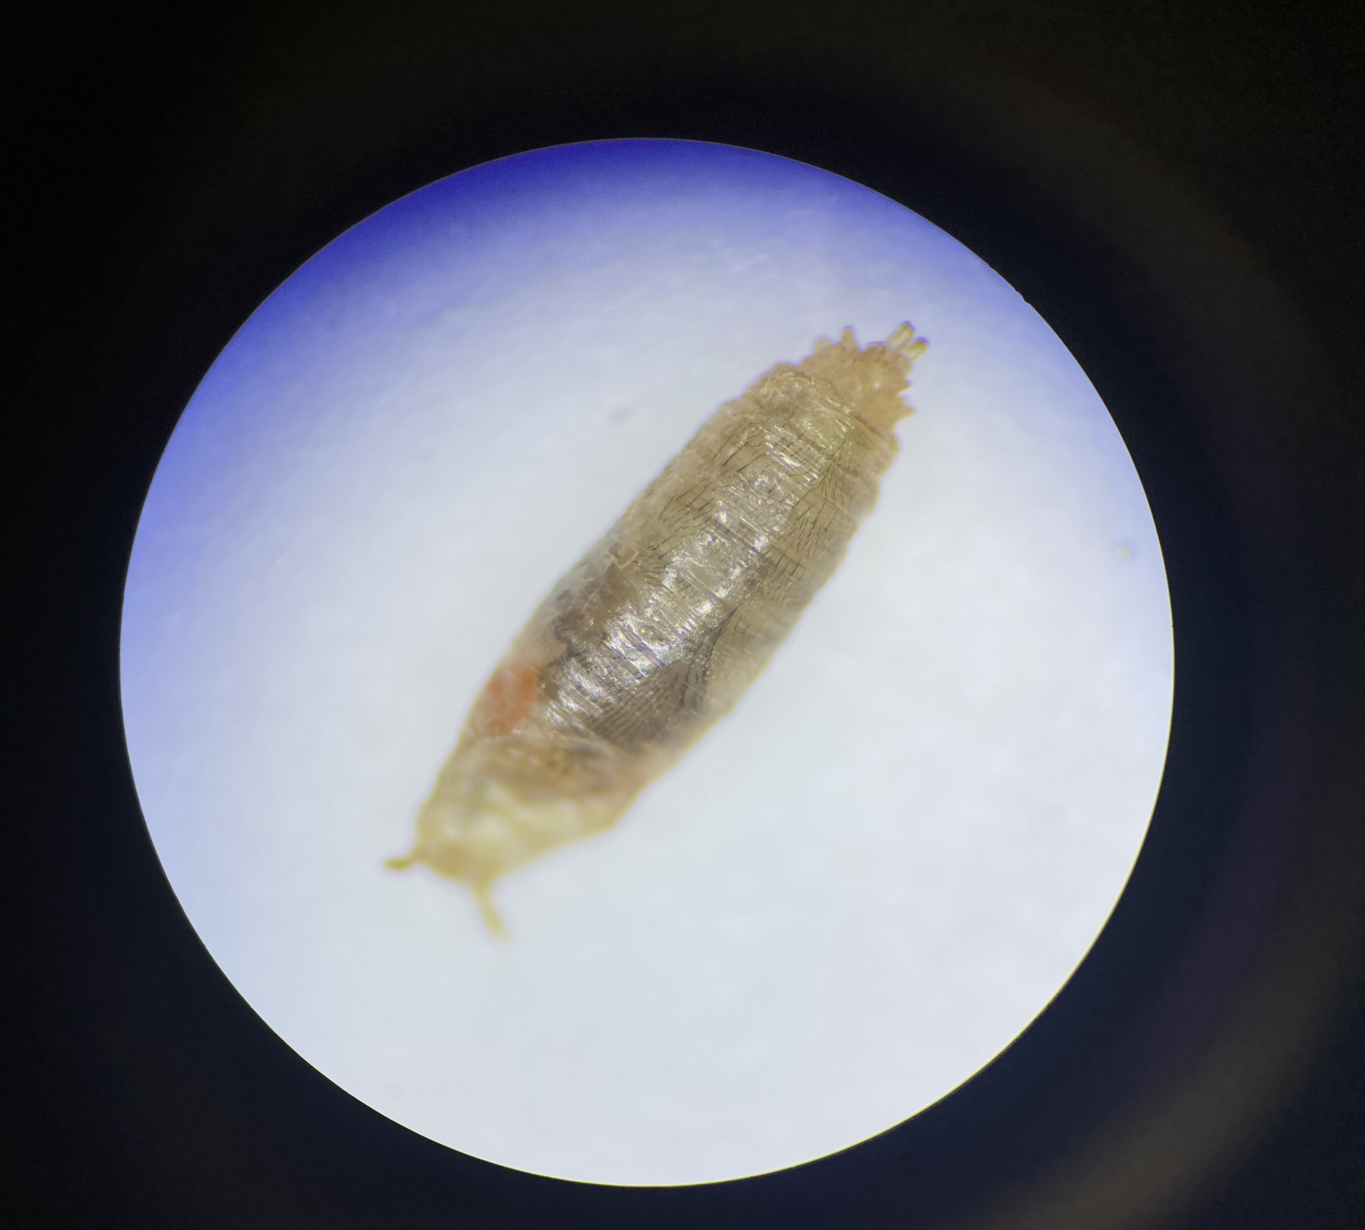
Methods
Longevity:
Cross between 20 virgin females and 10 males in bottles
Progeny collected (2-3 days following eclosion): males and females isolated and transferred to new vials every 2 days (25˚C and 50% humidity)
# dead flies scored each week
Survivorship curve generated to show differences in lifespan among the three lines

Slide 10
Results

Slide 11
Timeline
Month | Tasks
May | -Project outline -Assist graduate student projects -Begin Amplifying CS flies -PD sessions
June | -Begin Amplifying PGS and nlg3^{Def1} mutants -CanFly 2021 Conference -Assist graduate students (Social space)
July | -Re-amplify PGS and nlg3^{Def1} mutants -Complete the cross and begin transferring flies -PD sessions
August | -Continue transferring flies; record final scores -USRI presentation -Final PD sessions

Slide 12
Conclusion
Gained first-hand experience planning and executing a research project
Worked with graduate students to assist in their projects and broaden my knowledge
Attended a national conference to learn more about current research initiatives from experts within the field
Improved confidence working individually in a lab setting and performing new lab techniques

Slide 13
Future Work
Complete longevity by recording the final scores over the coming weeks
Address the hypothesis: Is isolation a factor that causes variation in lifespan?
4999E: September 2021
Examine the effect of isolation on social space of CS, PGS and nlg3^{Def1} Drosophila melanogaster

Slide 14
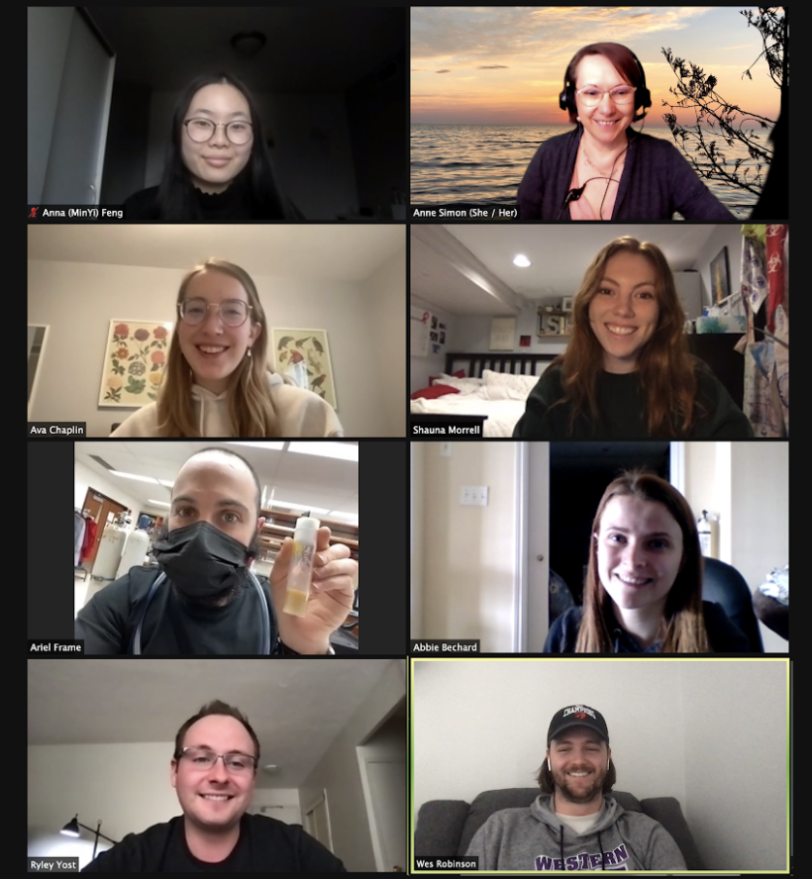
Acknowledgements
Simon Lab

