Slide 1
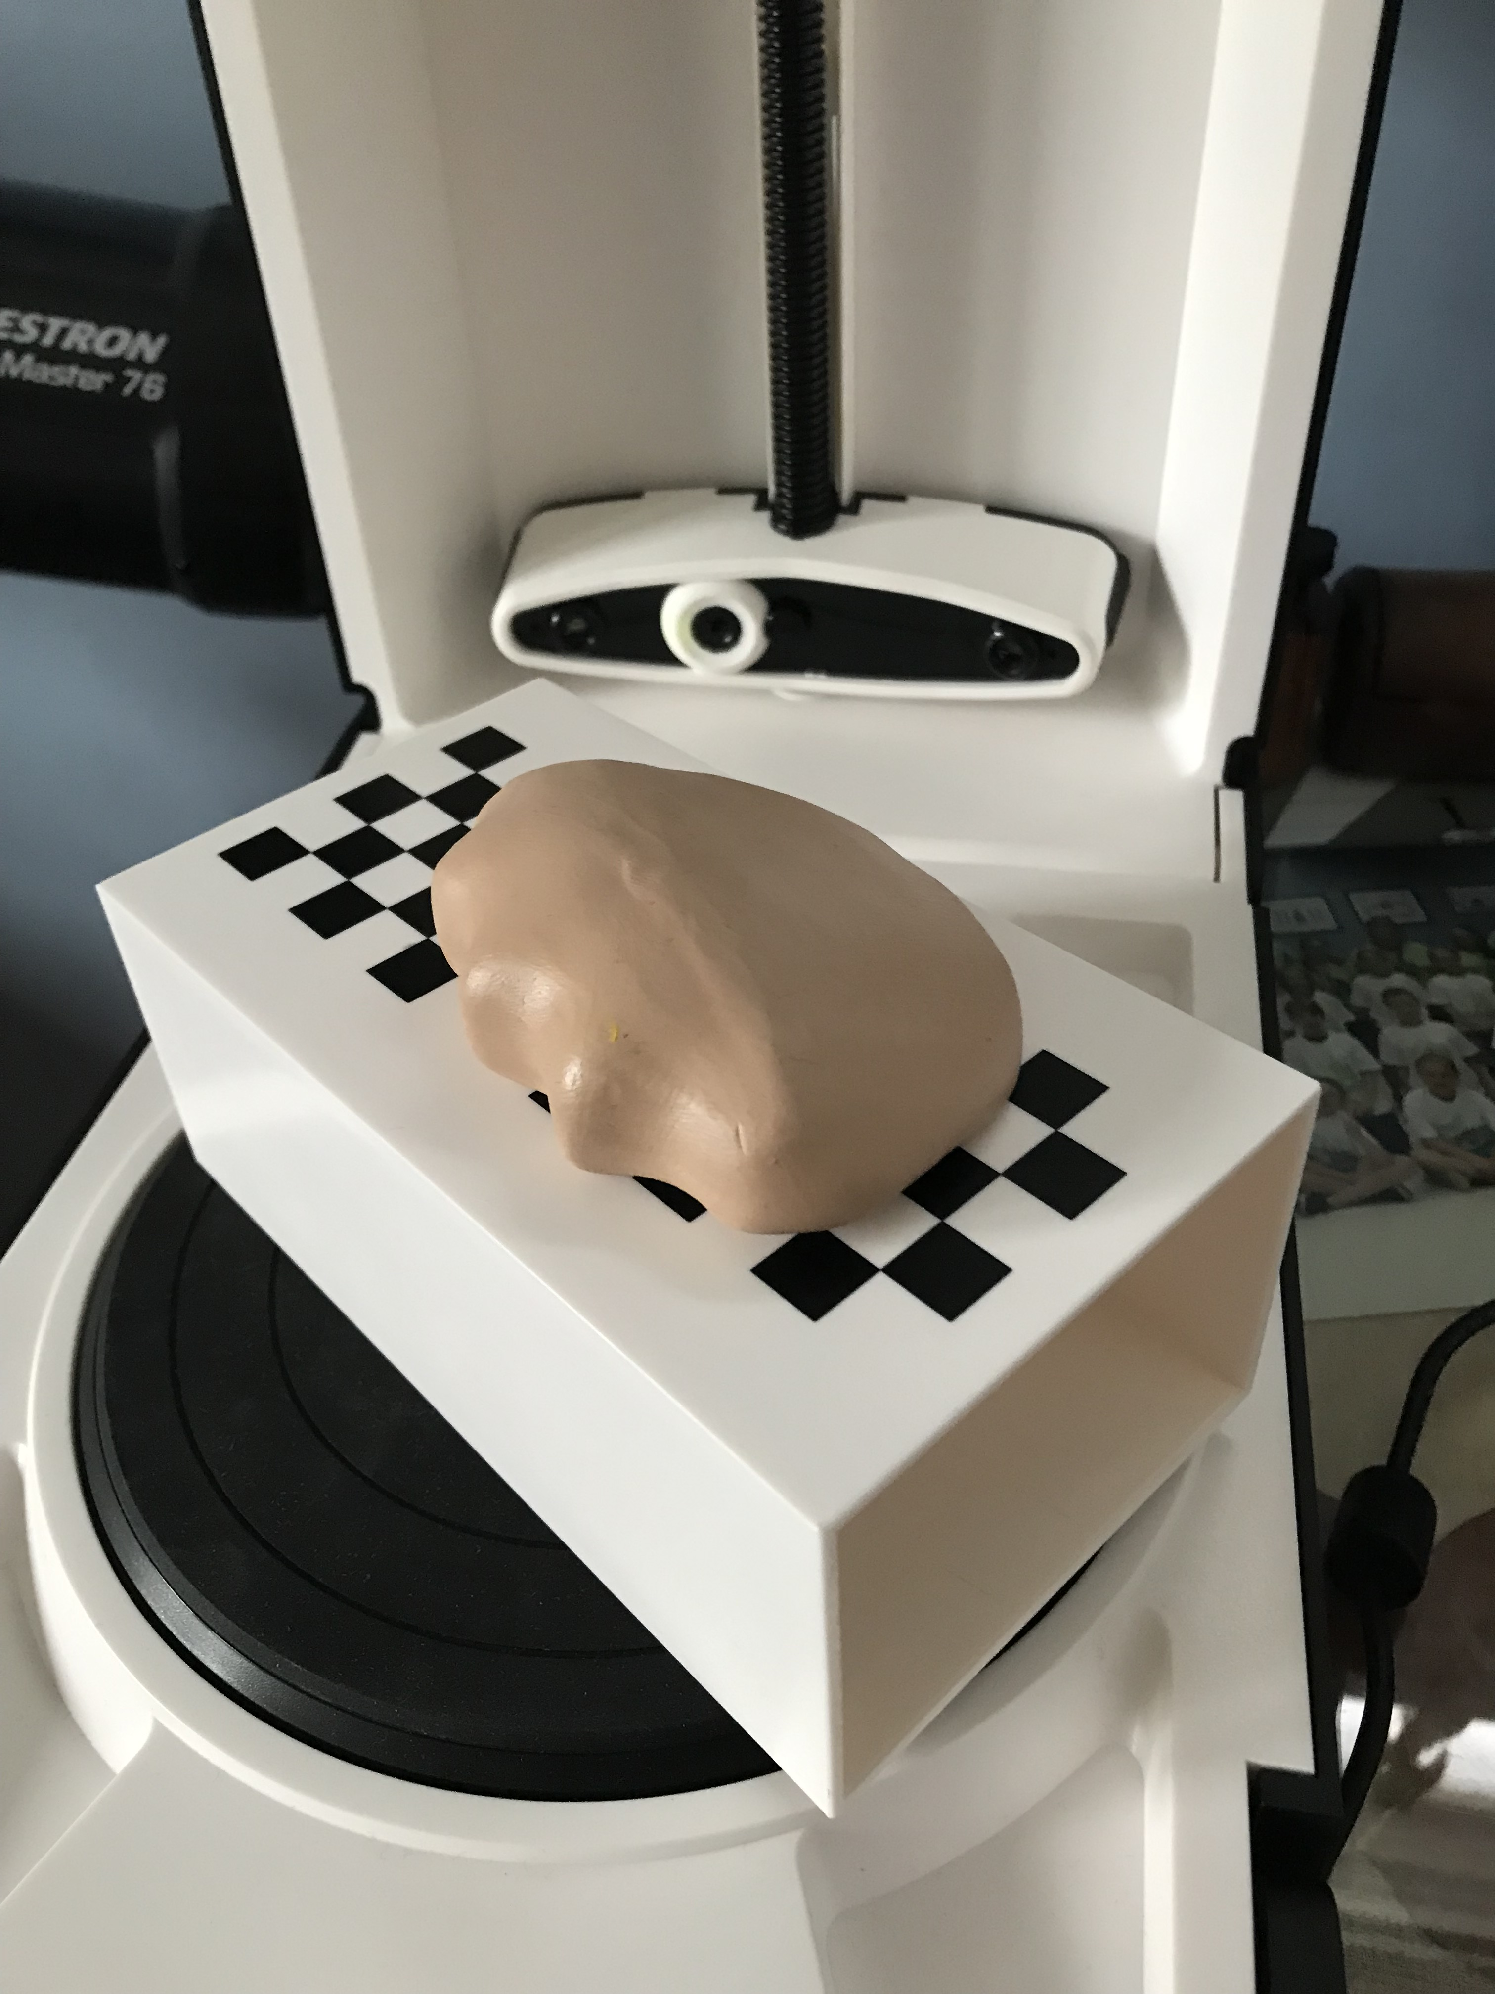
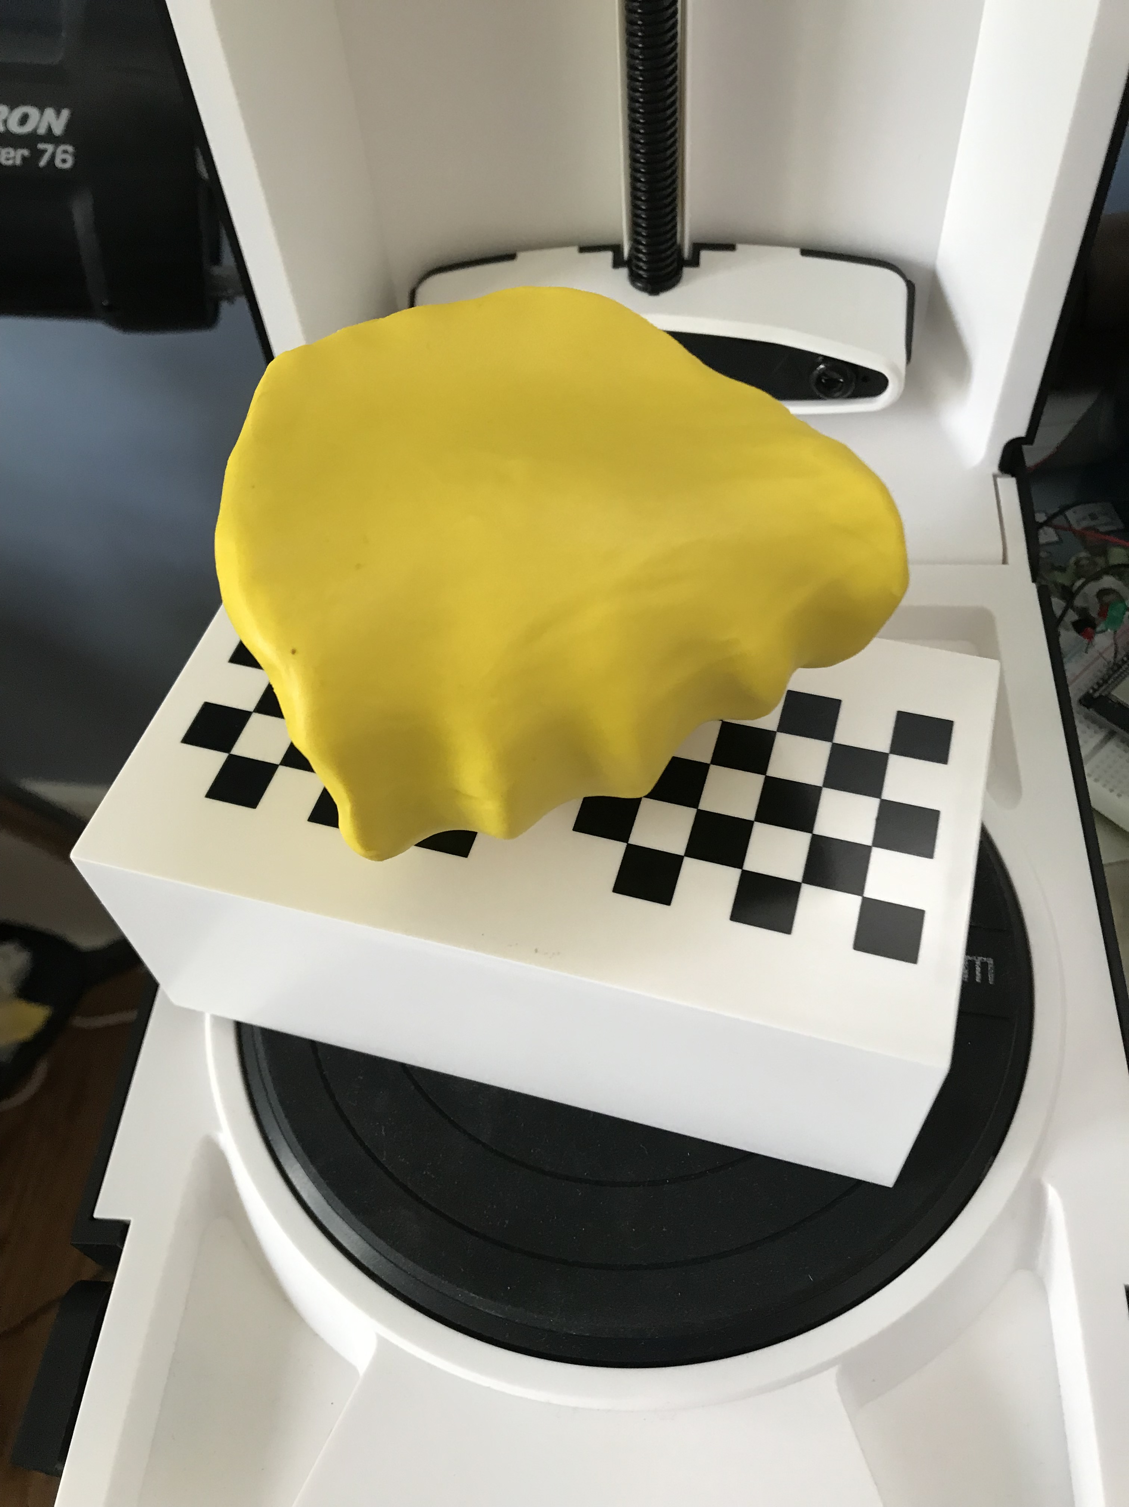
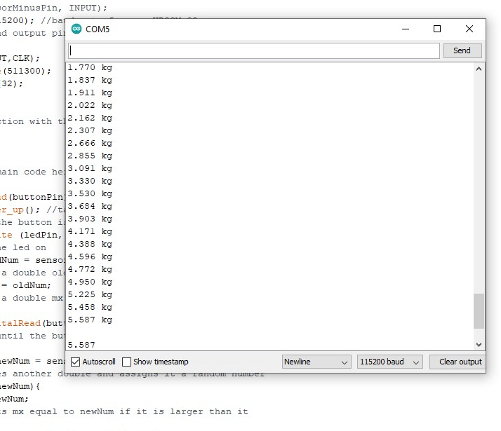
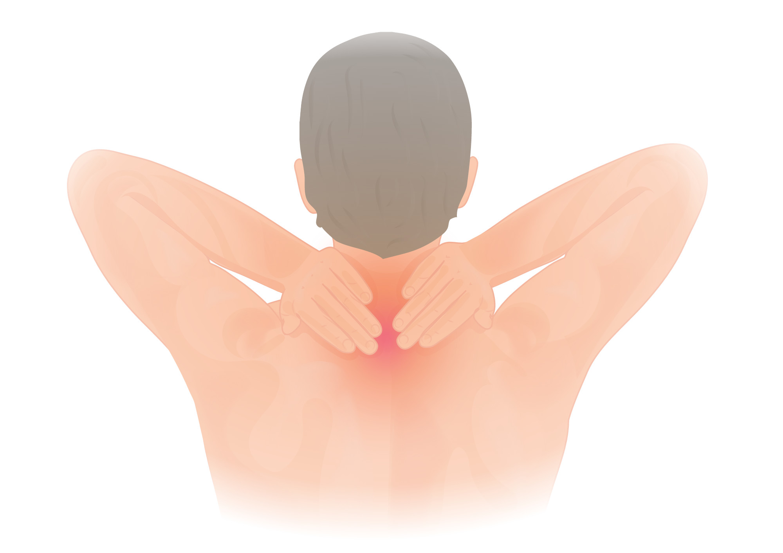
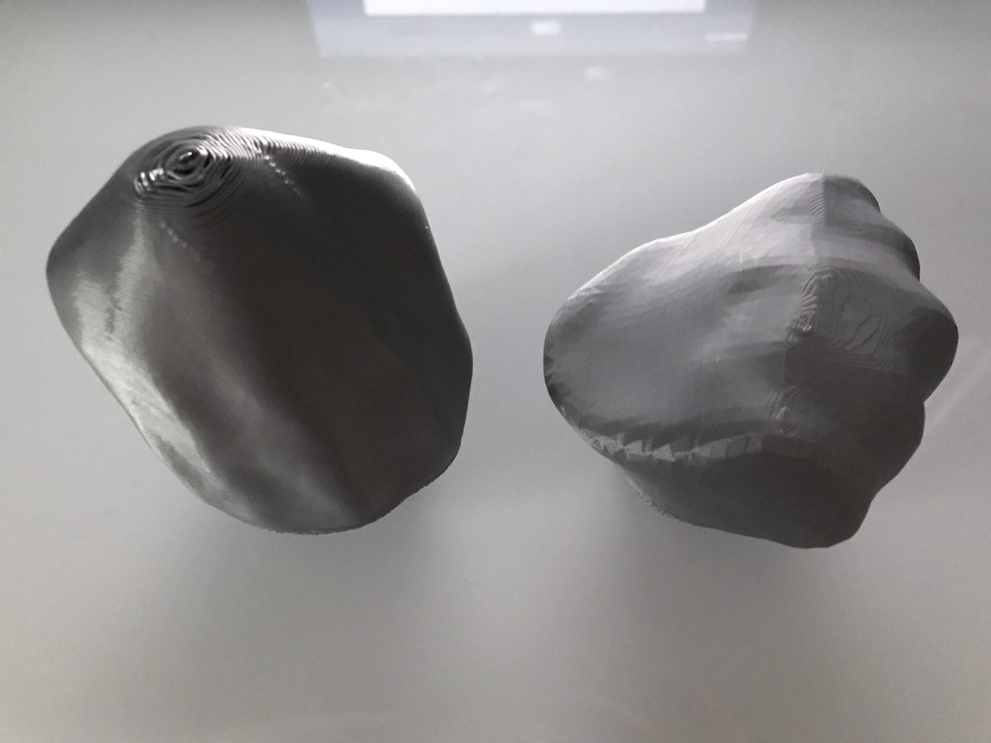
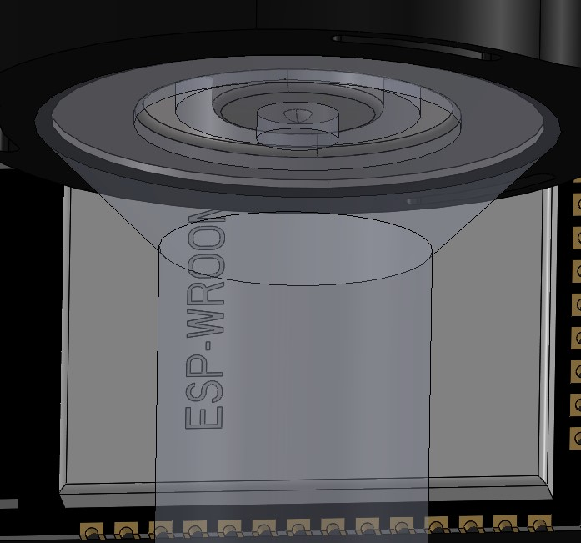
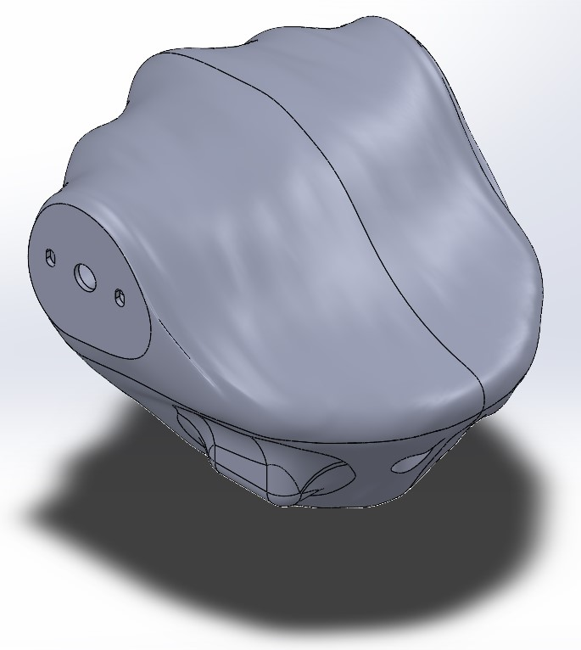
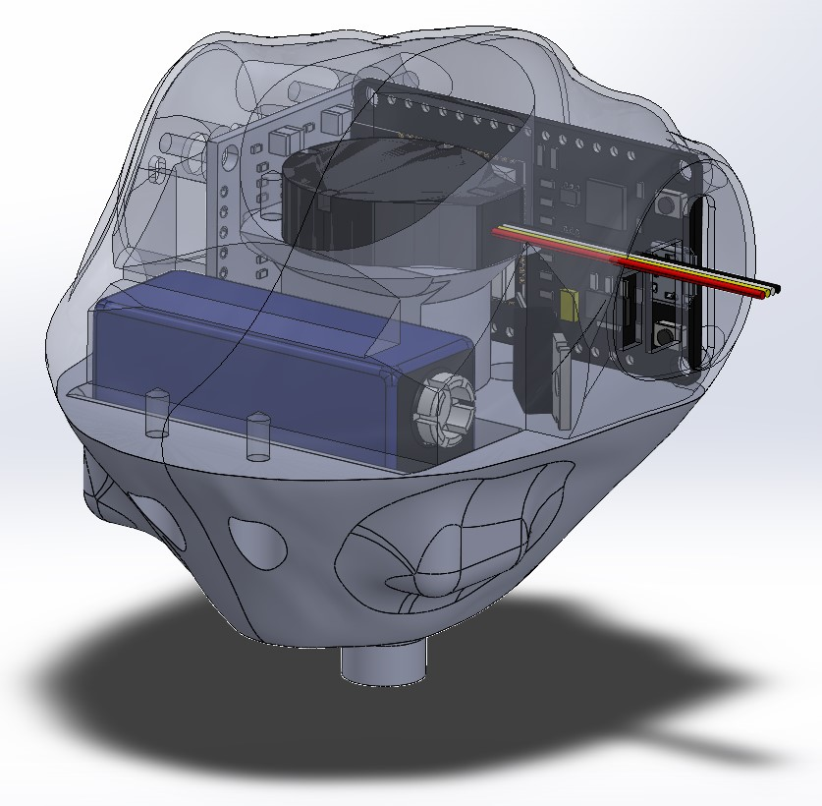
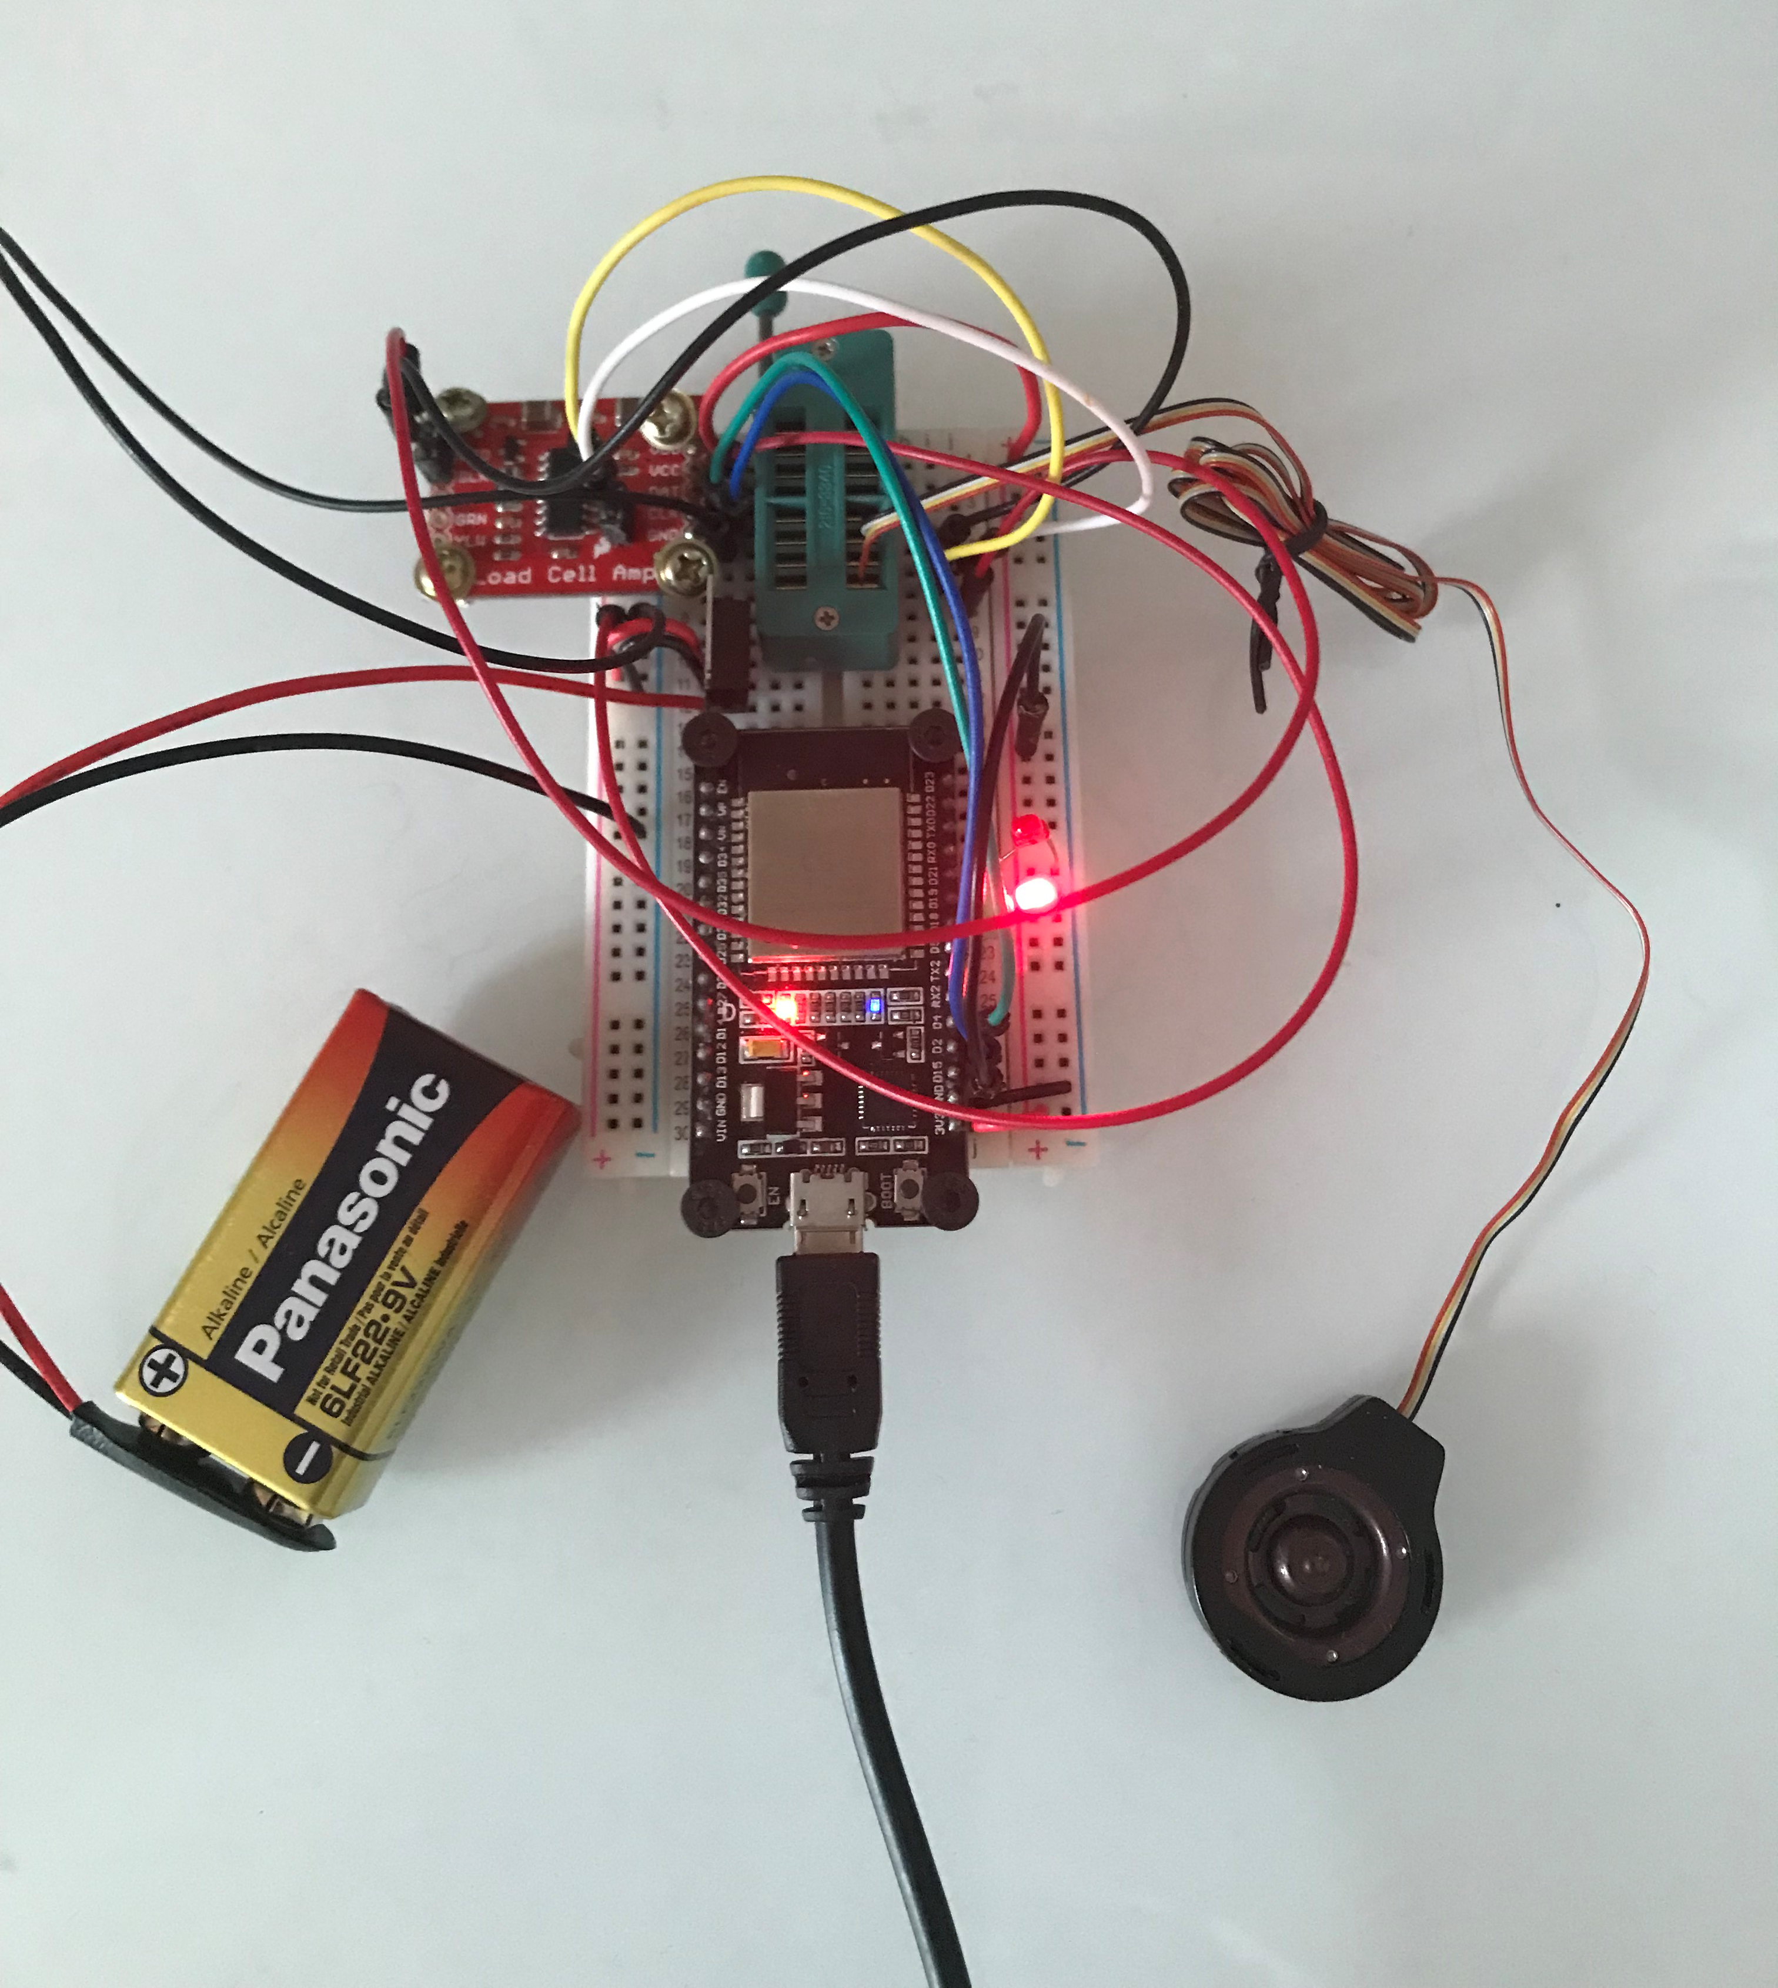
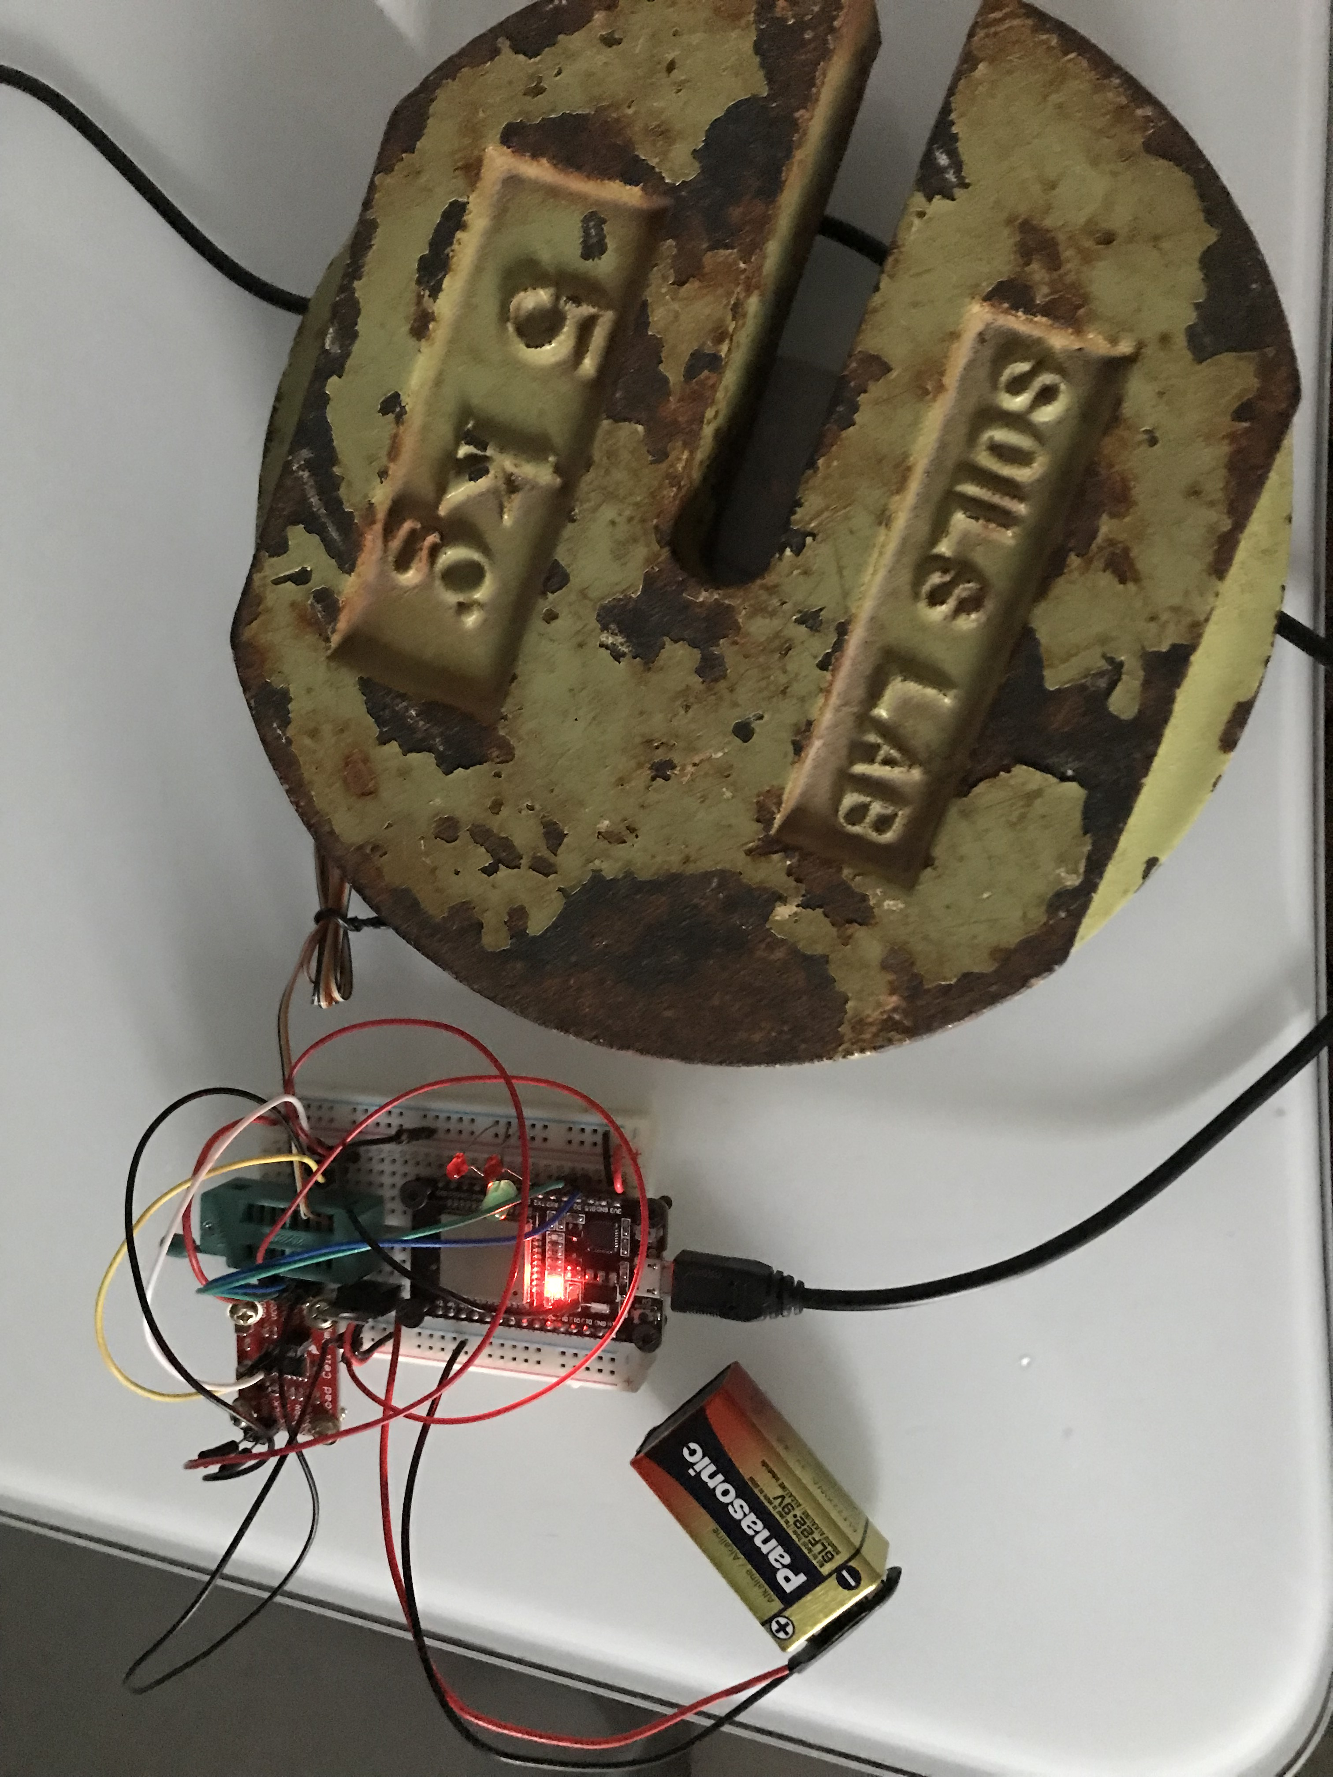
Development of a Low-Cost Algometer
T.D. Naish¹, A.L. Trejos², and D.M. Walton³
¹Mechatronic Systems Engineering Program, ²Department of Electrical and Computer Engineering, School of Biomedical Engineering, Faculty of Engineering, ³School of Physical Therapy, Faculty of Health Sciences, Western University, London, Ontario, Canada
Background
Mechanical System
Results
Many people suffer from chronic pain, the reasons for which are not always well understood. Algometers are instruments that can help clinicians understand the nature of pain by determining the force at which pain becomes noticeable, or the force at which the pain becomes unbearable. Algometers can also be used to determine the effects that external influences can have on pain tolerance in healthy people.
Early Grip Prototypes being Scanned
Printed Scans for Force Testing
Model of Finalized Grip
Example Results with Current Code
Interaction between Probe and Sensor
Complete Algometer Model
(Top transparent for visibility)
Overall:
Accuracy is about 0.05 kg at 5–10 kg (11–22 lbs)
Objectives
To develop an algometer that can measure up to 156 N with 0.1–0.5 N accuracy, can be made for $150–500, and is wireless.
Electronics & Control System
One MCU (ESP-WROOM-32)
One Load Cell Amplifier
One Load Cell
One 5 V Voltage Regulator
Algometer Electrical Components in a Breadboard for Testing
Experimental Setup
Load Calibration
This setup was used to calibrate the load cell amplifier using 5 and 10 kg weights and a function built into the Arduino library for the amplifier.
Load Cell with Plate for Holding Weights
Setup with Weight used for Calibration
HX711 Load Cell Amplifier
LM7805 5 V Voltage Regulator
Red and Green LEDs
Conclusions
The setup can measure forces beyond 156 N with an accuracy of around 1% beyond 50 N.
Although the setup is not currently wireless, the Bluetooth capabilities of the ESP-WROOM-32 were explored and tested, meaning that a wireless connection is possible with this setup.
Acknowledgements
This research was funded by the Natural Sciences and Engineering Research Council (NSERC) of Canada under grant RGPIN-2014-03815; by the Canadian Foundation for Innovation (CFI), by the Ontario Research Fund (ORF); and by the Undergraduate Summer Research Internships (URSI) of the Faculty of Health Sciences at Western University.
Neck pain image by Wikipedia Commons. Licensed under the Creative Commons — Attribution 4.0 International — CC BY 4.0 license.
DOIT Devkit V1 ESP-WROOM-32
FX1901 50 lb Load Cell

