Slide 1
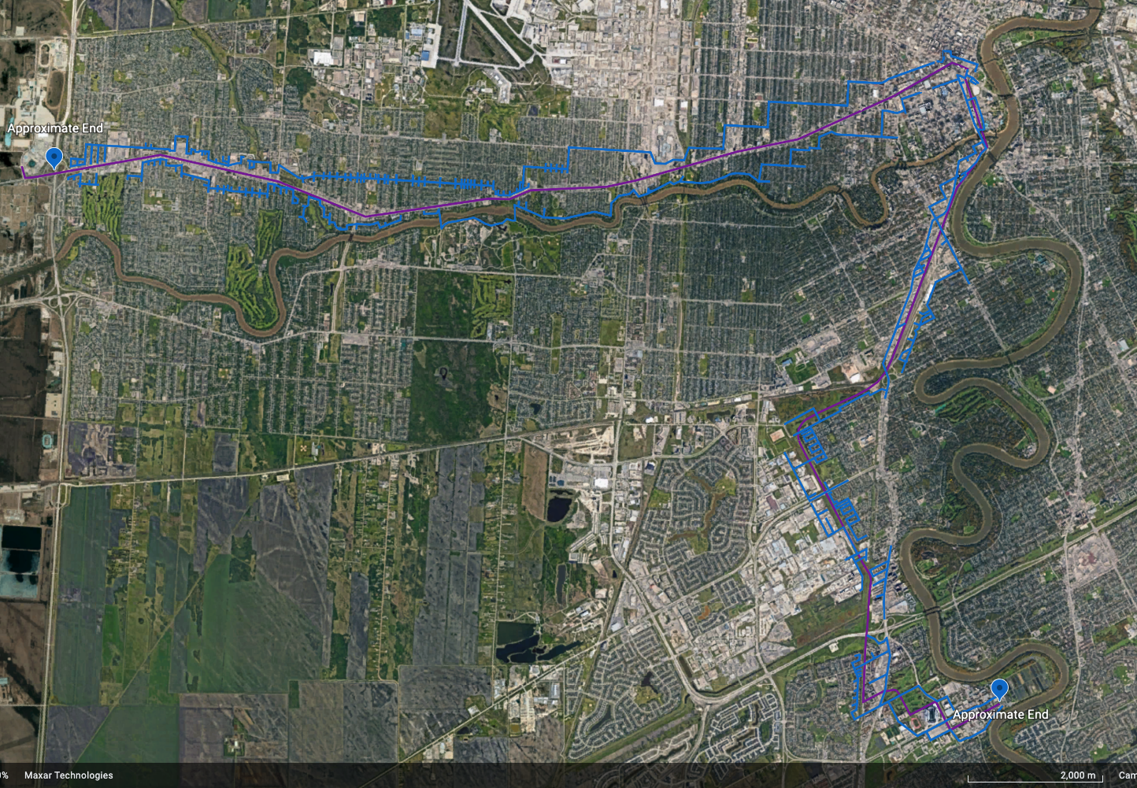
Analysis of Public Transit Services Accessibility and Development Impacts
Christian Undseth
Introduction
As populations increase and cities continue to grow, public transportation becomes increasingly more critical to the efficiency and functionality of cities.
Public transportation allows for more people to have greater and easier accessibility within an urban area.
Public transportation lines can also facilitate new/improved development in a city.
The analysis of current public transit services can reveal how accessible they are and if there are any areas where new/improved transit services can increase accessibility.
Shown in the image is a map of the data collection for the Portage – Southwest bus rapid transit (BRT) line in Winnipeg, MB.
The purple is the photo collection done along the actual transit route and the blue is the collection encompassing ~ one block to either side of the route.
Methods
This project is still in the data collection stage
Data collection so far consists of:
Capturing street view images from along the transit corridors in question
Pinpointing the location that each image covers
Noting the date that the image was taken
Marking any land uses that are found at that location.
For each transit corridor, images are first collected along the actual corridor and then the same process is followed for one block to either side of the corridor.
Discussion/Conclusion
Analysis of existing public transportation in cities is crucial as it reveals the accessibility cities have and how new transit initiatives would be able to improve it.
Areas along a proposed transit corridor such as vacant lots or underdeveloped parcels of land can be of particular interest as they can be promising areas to develop/redevelop
Acknowledgements
Special Thanks to Jinhyung Lee, Alexander Wray and the HEAL organization, and Western Research

