Slide 1
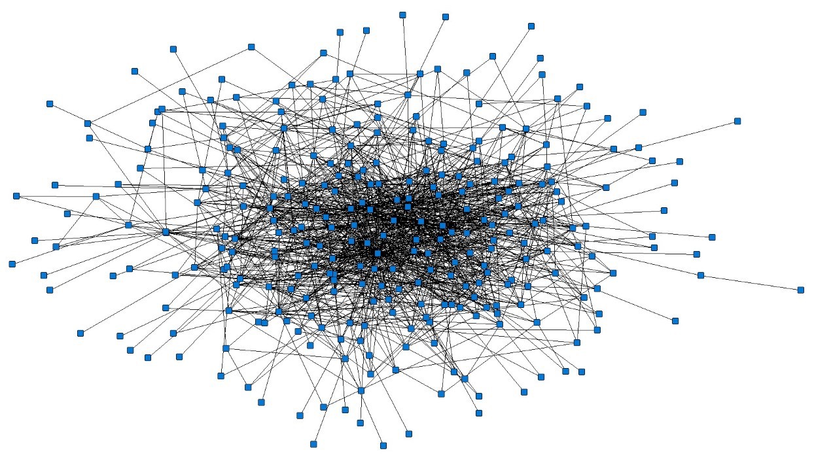
PEER MENTORSHIP AND SUPPORT PATTERNS AMONG PARAMEDICS
Student: Ting Hsueh; Supervisor: Dr. M. B. Evans
Western University, Department of Psychology
INTRODUCTION
,
CONTEXT: RESEARCH PARTNER (MLPS)
Middlesex-London Health Unit (MLPS) employs over 300 paramedics in 13 stations across London and the surrounding region.
Peer mentoring research has immediate implications for the MLPS as it is often embedded within training.
Paramedics form spontaneous relationships with their peers to access support and mentorship in the workplace, with social support spanning:
Instrumental support (e.g., standing in for a coworker’s shift)
Coworker mentoring (e.g., giving job-related advice)
Emotional support (e.g., sharing, listening, counselling)
Support is critical for educational initiatives, as paramedics must undergo constant professional and personal development to maintain of clinical skills and knowledge throughout their careers.
Peer mentorship is particularly vital and involves the exchange of support exchanged between peers where peers assist one-another in developing professional skillsets, knowledge, as well as personally.
Social network approaches to studying peer support and mentorship:
Peer mentorship and support are exchanged within a network of relationships known as a social network.
Staff foster a diverse web of connections. Studying network allows us to understand how people relate to each other within their network, investigate social influences on attitudes, and identify potential problems within the network.
KEY USRI OUTPUTS
LITERATURE REVIEW FINDINGS
In the literature, there is little consensus for the definition of social support.
Mentoring and social support are distinct, but closely related, concepts. Although mentorship and social support functions are very similar, we recognize that social support is a behaviour that could be exchanged more casually/broadly, whereas mentorship is an intimate relationship that often utilizes social support.
Social network analysis could construct a network and examine network density and centrality.
Mixed methods are extremely powerful. Qualitative data could offer more context, which is especially salient because mentorship and support are interpersonal processes that are reliant on people’s perceptions.
PURPOSE
Little is known about how peer mentorship does (or does not) play a role in a large regional Paramedic Service. Scholars and practitioners have argued for the need to study and promote peer mentorship and support among emergency services personnel.
My USRI project involved partnering with staff at a regional organization and a Western researcher to conduct a study with aims involving:
REANALYSIS OF PAST DATA
People who are central nominated one another frequently.
The network is very clustered.
People exchange a lot of support within the cluster, with members nominating each other readily.
Examine how staff at MLPS share information and support others in their network.
Identify key areas where organizations may want to intervene to foster an optimal peer network.
Figure. A visualization reflecting ties among staff in the MLPS 2020 survey
METHODOLOGY FOR RESEARCH IN PROGRESS
EMERGING THEMES FROM INTERVIEWS
PHASE 1. SOCIOMETRIC SURVEYS
PHASE 2. QUALITATIVE INTERVIEWS
Theme | Quote from Interview
Personal Connections | “I try to openly share where I am; I spent an hour one morning with a woman . . . My dad has Parkinson’s, her dad has Parkinson’s and she’s having a tough time because now her mom has Dementia, so I just sat with her, we both had a little cry, we talked about what’s going on.”
Relatedness | “I clicked with [my mentor] intellectually and we share a lot of the same views and values . . . I think we just bonded over like a mutual understanding. He's further into his career than me obviously he was higher up and he just kind of took under his wing and mentored me.”
Mentorship for women in EMS | Speaking of a female mentor: “I think a part of her support for me is that we can share a similar experiences that most of my other colleagues will not share just because she is a woman in leadership and we deal with the same attitudes, and the same people treating us the same way, or the same microaggression.”
Two waves of online surveys will be distributed to 300 paramedic staff in the MLPS.
Participants will complete a survey to nominate peers who they seek for support and mentorship.
Social network analysis will be conducted.
20 semi-structured interviews will be conducted over zoom/phone.
Participants will be compensated $20 for their time.
Example question: Can you tell me about a time when you had to learn something new at work? What did your co-workers do or say to support you?
STUDENT ACTIVITIES
Literature Review & Academic Writing. Ten-page paper reviewing relevant literature on peer mentorship and social support.
Stakeholder Engagement. Held weekly meetings with Dr. Evans and meetings with our partner from the MLPS.
Revision of Study Materials. Assisted in reviewing and revising study materials (e.g., ethics, grant submission, interview guide).
Training. Received training on qualitative research (e.g., USRI PD session on NVIVO use; guided readings about qualitative philosophy).
Conducted Interviews. Interacted with participants over e-mail and conducted semi-structured interviews. Five pilot interviews were conducted at this stage of the project.
Qualitative Analysis. Transcribed interviews and found emerging themes from the interviews.
DISCUSSION
Reflection on my USRI experience.
Collaborated closely with a Western researchers and gained exposure to the world of research including ethics submission and grant writing.
Learned about qualitative research, which was novel to me prior to this program.
Next steps.
Use pilot interviews to refine questions in order to pursue these themes in depth in future interviews.
Collect first wave of survey data this September.
Undergraduate Student Research Internship (USRI) Program, Summer 2021​

