Slide 1
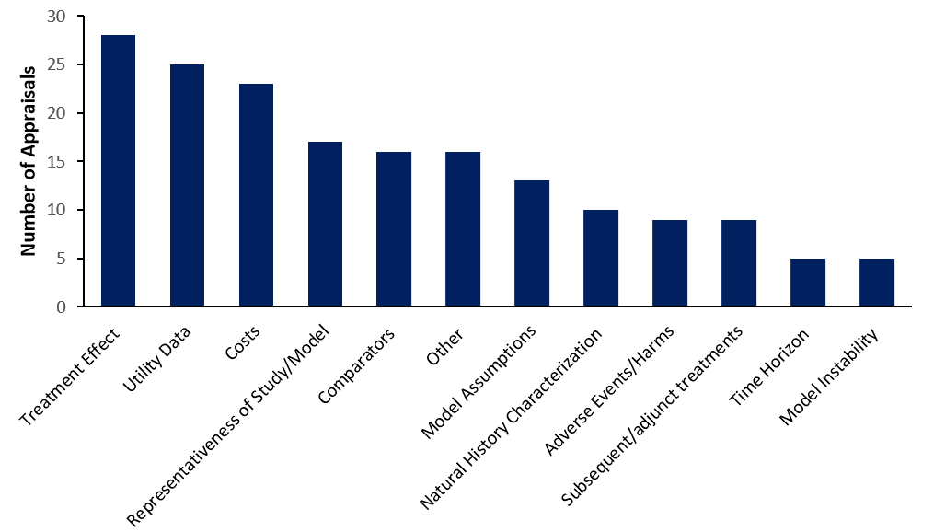
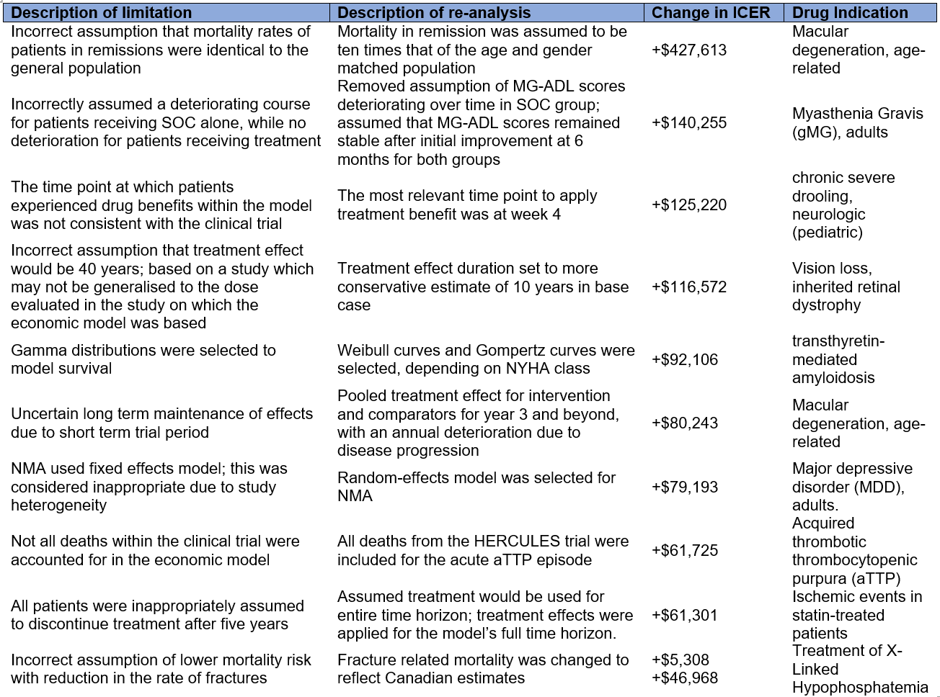
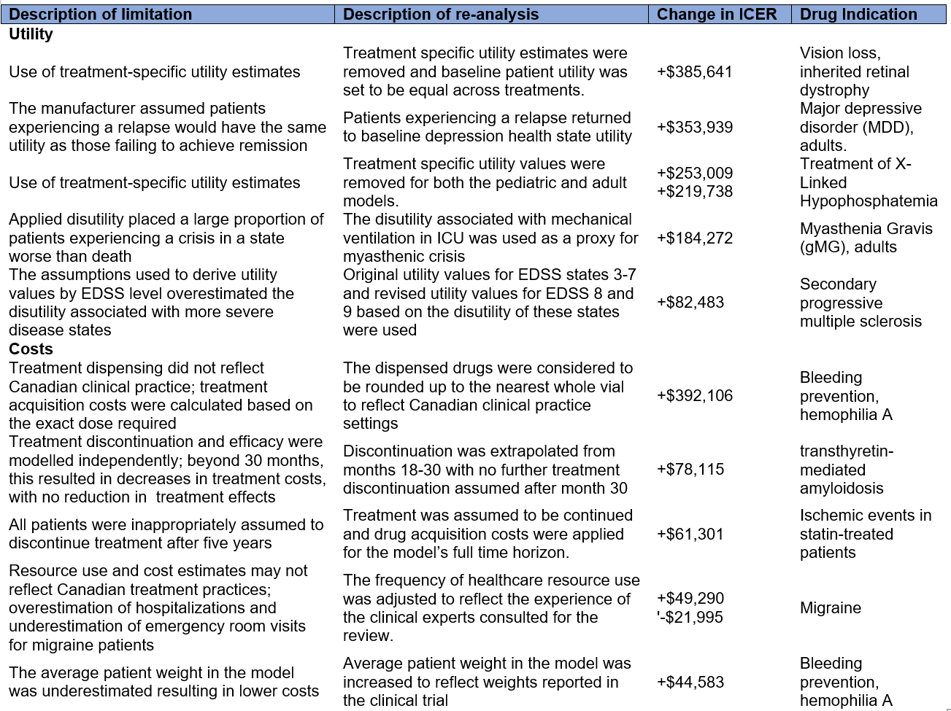
Catch Me If You Can: Questionable Modelling Assumptions and
Parameter Choices and Their Impact on Drug Reimbursement Decisions
Shehzad Ali and Lina Ghattas
Department of Epidemiology and Biostatistics, Western University, Canada
Background and rationale
Results
Results
Health Technology Assessment (HTA) agencies, such as the National Institute for Health and Clinical Excellence (NICE) in the UK and the Canadian Agency for Drugs and Technologies in Health (CADTH), make reimbursement recommendations based on decision models submitted to them [1].
Models use assumptions and parameters that are typically based on submitter-sponsored studies (e.g. randomized controlled trials and meta-analyses), other published clinical literature and clinical opinion.
The choice of assumptions and parameter values may favour one intervention over the other.
HTA agencies frequently identify challenges in submitted models and conduct re-analyses, when possible, to assess the impact of untenable assumptions and inappropriate parameter values.
Only a handful of published studies have assessed the limitations of economic models submitted for reimbursement [2,3].
Table 1. Disease course and treatment effect limitations and their Impact on the ICER following CADTH re-analysis
Figure 1. Thirty-two (n=32) technology appraisals conducted by the Canadian Agency for Drugs and Technologies in Health (CADTH) were systematically reviewed. Using a pre-made data extraction sheet, one reviewer identified limitations and incorrect assumptions made in a drug company’s submitted economic model, and categorized each limitation into one of twelve broad categories. Data shown are the number of appraisals for which at least one limitation or flaw in that category were identified by the CADTH appraisal committee.
Discussion and Conclusion
The impact of revising the submitted model on the ICER was as high as +427,613.
The most common modelling limitations were related to (1) the disease course and treatment effect estimates; (2) utility parameter(s); and (3) cost parameter(s).
With regards to (1), the challenges with the highest impact on ICER were related to: (a) inappropriate assumptions regarding disease deterioration and mortality rates; (b) timing and duration of treatment benefit; (c) timing of treatment discontinuation; (d) choice of distributional fit to extrapolate survival; and (e) choice of fixed vs random effects model in network meta-analysis;
With regards to (2) and (3), the key challenges were: (a) use of treatment-specific utilities; (b) worse utility values used for disease exacerbation; (c) cost of dispensing favoured the submitter’s drug; (d) incorrectly assumed treatment discontinuation which lowered cost; and (e) overestimation of hospitalization visits.
Identifying common limitations can help submitters avoid inappropriate modelling choices and help HTA agencies standardize the drug review process.
Limitations: (a) the issues identified were based only on publicly available information; and (b) the ICER values only reflect those limitations for which a re-analysis was feasible using data/information available in the submission.
Table 2. Utility and Cost Limitations and their Impact on the ICER following CADTH re-analysis
Goal and methods
In this study, we systematically identified, categorized and synthesized modelling limitations and evaluated their impact on incremental cost-effectiveness ratio (ICER).
We reviewed 63 pharmacoeconomic submissions made to CADTH in year 2020, under the category of ‘Common Drug Reviews’.
The review was based on publicly available pharmacoeconomic reports on the CADTH website.
We categorized key limitations in economic models and identified those that had the greatest impact on ICER values (and in turn on reimbursement decisions).
We assessed emerging patterns and themes to make recommendations for future submissions.
References
1. Wang T, McAuslane N, Liberti L, Leufkens H, and Hovels A . Building Synergy between Regulatory and HTA Agencies beyond Processes and Procedures—Can We Effectively Align the Evidentiary Requirements? A Survey of Stakeholder Perceptions. Value Health.2018.21: 707-714.
2. Massuci L, Beca J, Sabharwal M, and Hoch JS. Methodological Issues in Economic Evaluations Submitted to the Pan-Canadian Oncology Drug Review (pCODR). PharacoEconomics. 2017. 1:255-263
3.Yong JHE, Beca J, and Hoch JS. The Evaluation and Use of Economic Evidence to Inform Cancer Drug Reimbursement Decisions in Canada. PharmacoEconomics. 2013. 31: 299-236.

