Slide 1
Investigating stop codon readthrough in Saccharomyces cerevisiae
USRI Virtual Exhibition Presentation
August 24, 2021
Amy Kwon
Supervisor: Dr. Chris Brandl

Slide 2
Central Dogma
BioNinja. (n.d.). The Central Dogma of Molecular Biology. BioNinja. https://ib.bioninja.com.au/standard-level/topic-2-molecular-biology/27-dna-replication-transcri/central-dogma.html.

Slide 3
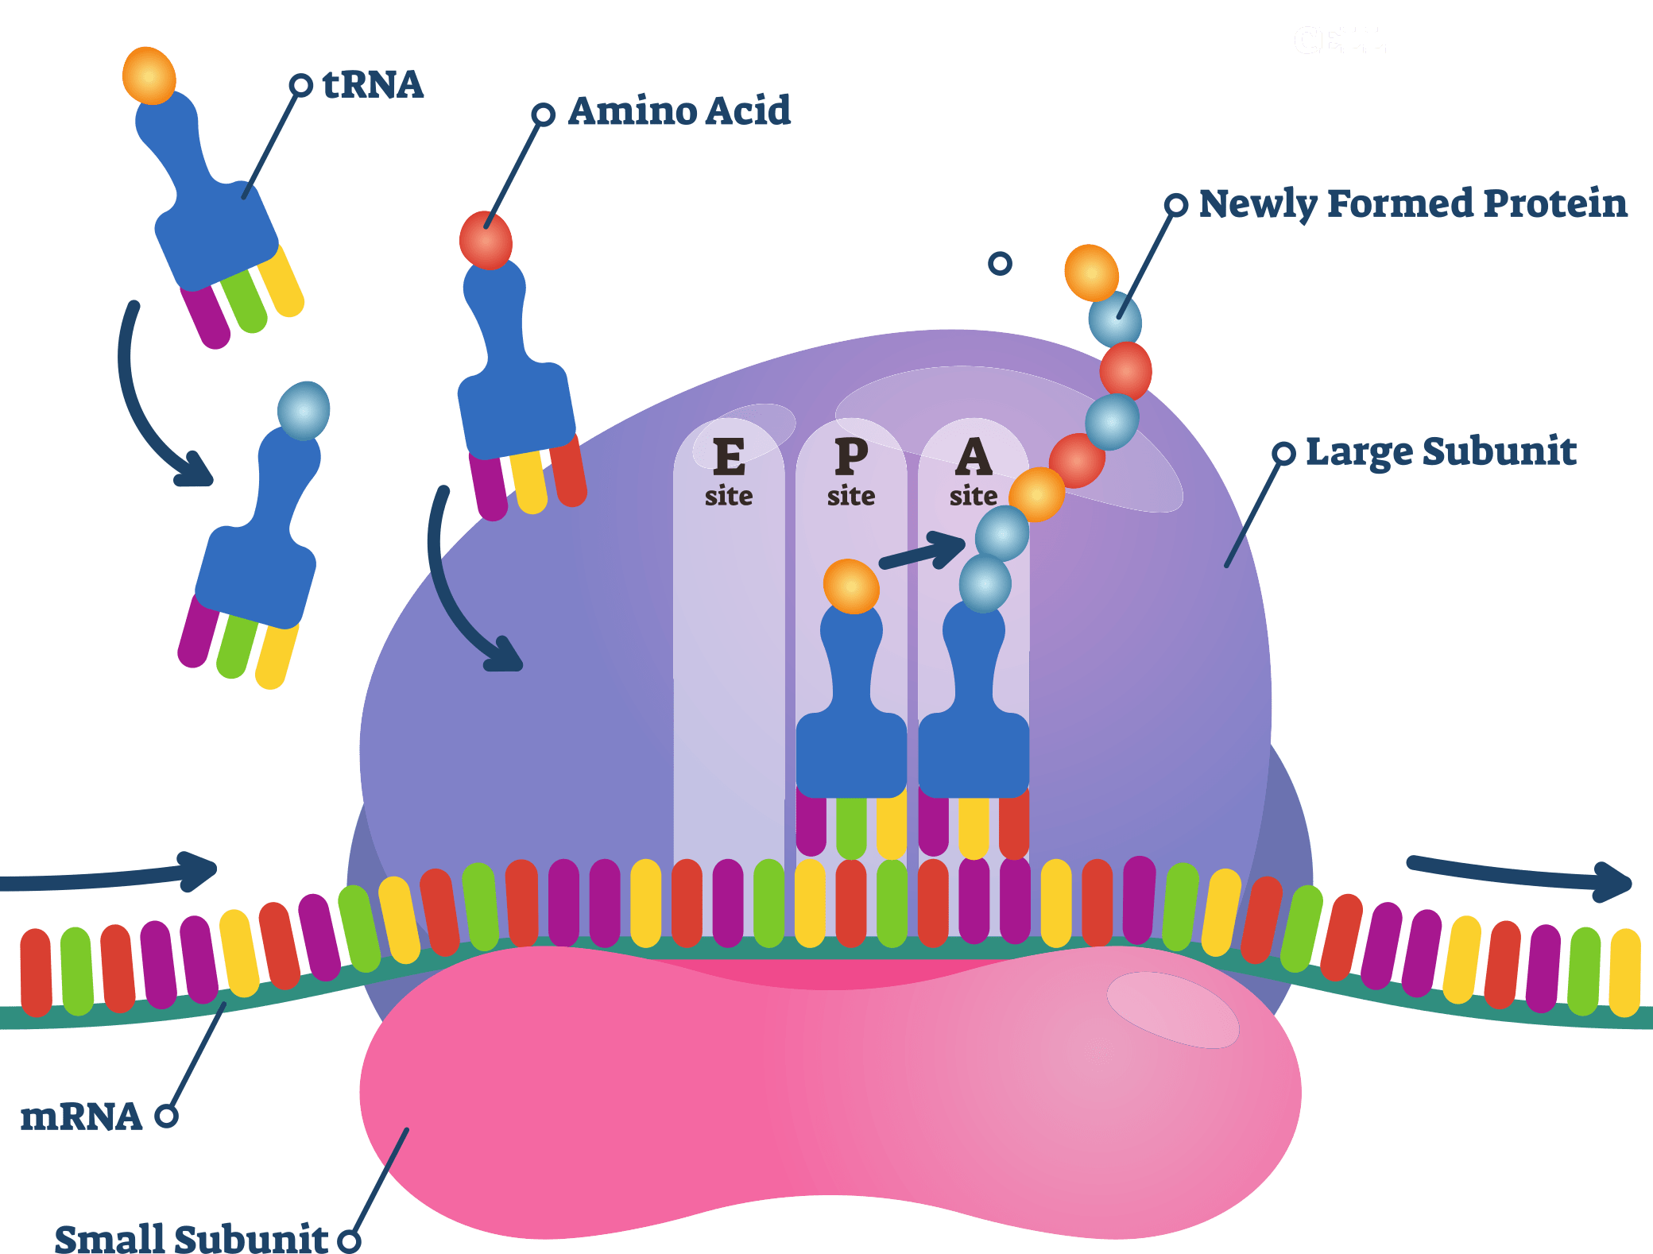
TRANSLATION
Proteins are translated, starting with a start codon and typically ending at a stop codon
Legrand, A. (2020). Protein Translation Step. e-Zyvec. https://www.e-zyvec.com/technical-applications/ez-101-protein-translation/.

Slide 4
Translational Termination

Slide 5
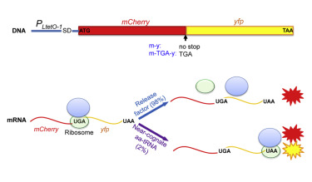
Translational Readthrough
Stop codon readthrough is observed in organisms and can increase the complexity of the genome

Slide 6
Project Summary
Investigate stop codon readthrough in yeast
Determine if some genes are more prone to readthrough
Determine sequences that enhance readthrough
Determine if environmental conditions influence readthrough

Slide 7
Approach
Insert marker gene after the “normal” stop codon of gene in plasmid
Check for occurrence of stop codon readthrough by observing
phenotypical changes
mRNA
~300bp
ATG
TGA
ATG
Promoter
9bp

Slide 8
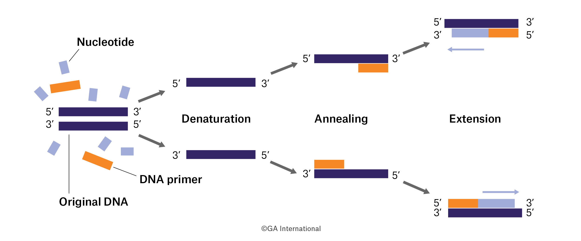
Steps
PCR required genes
- TRP1 for analysis
- URA3 as the reporter
Readthrough can be detected as it enables growth in medium lacking uracil
High levels of URA3 expression result in loss of growth in medium containing 5-FOA

Slide 9
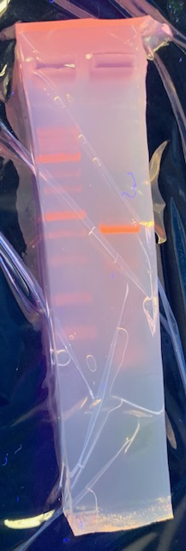
PCRs
3000bp
3000bp
1000bp
804bp
1000bp
675bp
TRP1
URA3

Slide 10
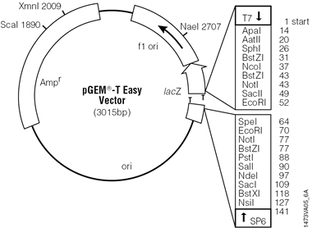
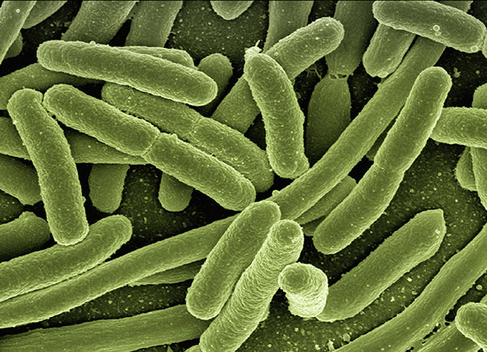
Steps
2. Ligate the PCR products of TRP1 and URA3 into T-vector
3. Transform E.coli
4. Prepare DNAs from each
Promega. (2021). Pgem®-T Vector Map and Sequence. Promega. https://www.promega.ca/products/pcr/pcr-cloning/pgem-t-vector-systems/?catNum=A3600.
Technology Networks. (2020). Using E. coli To Fight E.coli. Technology Networks. https://www.technologynetworks.com/immunology/news/using-e-coli-to-fight-ecoli-337138.

Slide 11
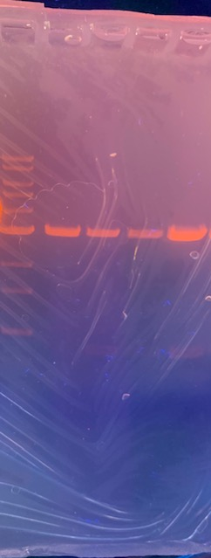
TRP1 Cloning
3000bp
vector
1000bp
insert
Insert cut with EcoRI

Slide 12
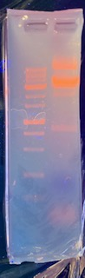
URA3 Cloning
3000bp
vector
1000bp
insert
Insert cut with EcoRI

Slide 13
Steps
5. Engineer fusion of TRP1 and URA3 in a vector compatible for both E. coli and yeast
TRP1 promoter
ATG
TGA
TRP1
URA3

Slide 14
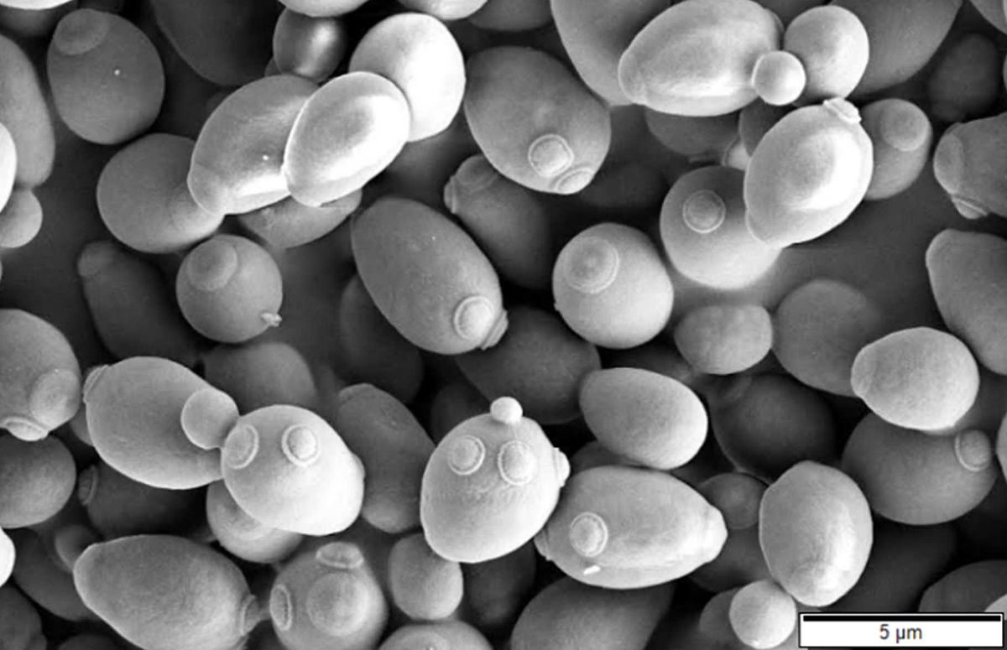
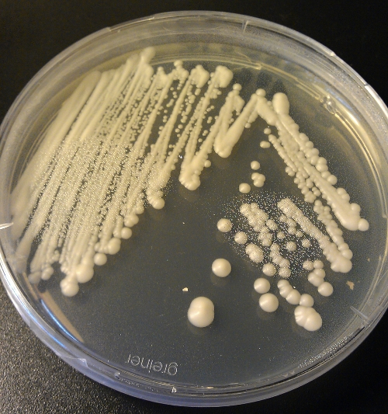
Steps
6. Transform TRP1-URA3 fusion into yeast
7. Determine growth in medium lacking uracil and in medium containing 5-FOA
Wikipedia. (2021). S. cerevisiae. Wikipedia. https://en.wikipedia.org/wiki/Saccharomyces_cerevisiae.
Medical Labs. (2015). Yeast colonies on agar. Medical-Labs. http://www.medical-labs.net/morphologic-features-of-yeast-colonies-2818/.

Slide 15
Steps
8. Determine if stress affects readthrough
ethanol stress
temperature stress
oxidative stress

Slide 16
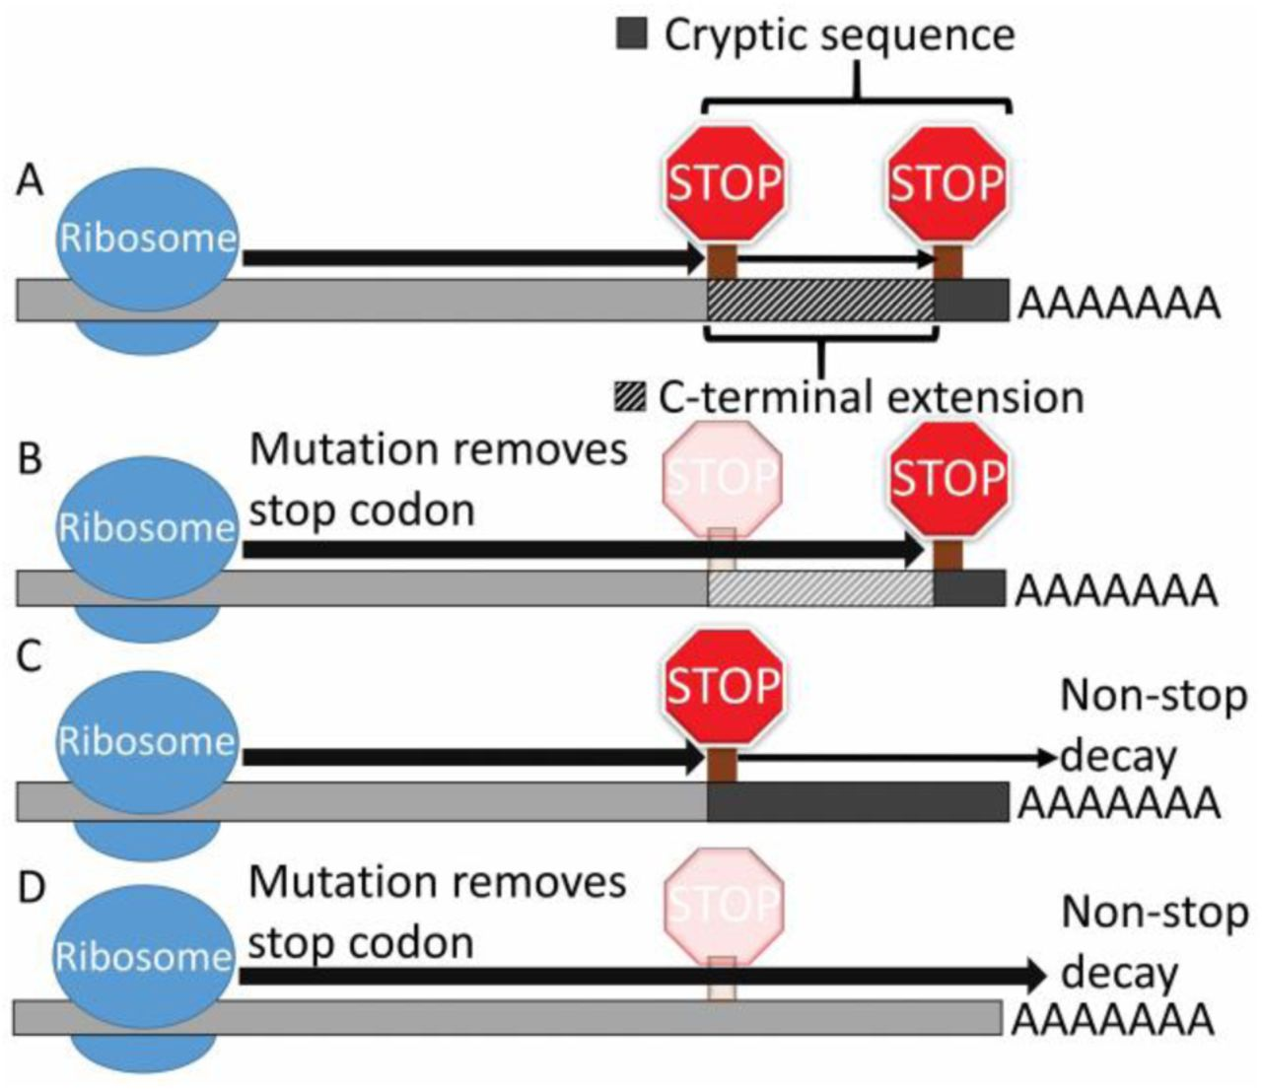
Summary
Stop codon readthrough increases the coding complexity of the genome
If regulated it may allow the production of novel proteins that provide an adaptive response
Perhaps an evolutionary mechanism
Konsinski, L., & Masel, J. (2019). Stop Codon Readthrough. bioRxiv. https://www.biorxiv.org/content/10.1101/737452v2.full.

Slide 17
Future Work
Analyze additional genes that proteomic analysis suggests are read through
YHB1
SPC19

Slide 18
Future Work
Alter stop codon to determine its impact on readthrough
UAA
UGA
UGG (literature suggests UGG is readthrough at higher frequency)

Slide 19
Future Work
Determine the amino acids inserted at the stop codon by mass spectrometry

Slide 20
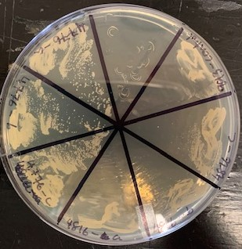
Phenotypic identification of mistranslation
Engineered alanine tRNAs (tA) – changed codon
Objective: prove mistranslation
Show they suppress missense mutation
Transform tA derivatives with Pro anticodons
Grow on regular and ethanol media
Results: tRNA^{Pro}_{UGG} showed increased growth compared to control

Slide 21
Acknowledgements
Dr. Chris Brandl
Julie Genereaux
Irina Petrovic
NSERC
Western University & USRI Program

