Slide 1
Plurilingualism in the FSL Classroom and beyond
Presented by: Rachel Wohlgemut
Under the direction of: Dr. Shelley Taylor

Slide 2
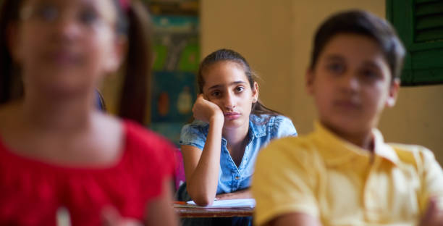

Slide 3
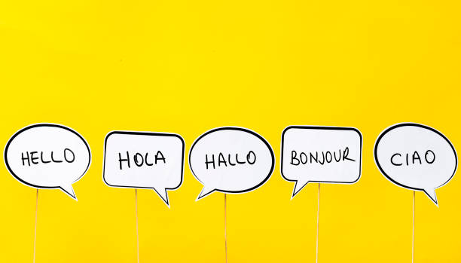
Le Plurilinguisme
“An approach to language learning that incorporates multiple competencies in different languages working in tandem to promote learning” (IGI Global, 2021).
“Instruction explicitly aims for transfer of knowledge and skills across languages” (Cummins, 2005, p. 42).

Slide 4
Benefits of plurilingualism in the classroom
-allows for the interconnectedness of knowledge, ideas, and feelings between languages
-allows for the interconnectedness of knowledge, ideas, and feelings between the home and school life
-validates student identities
-validates other languages and cultures

Slide 5
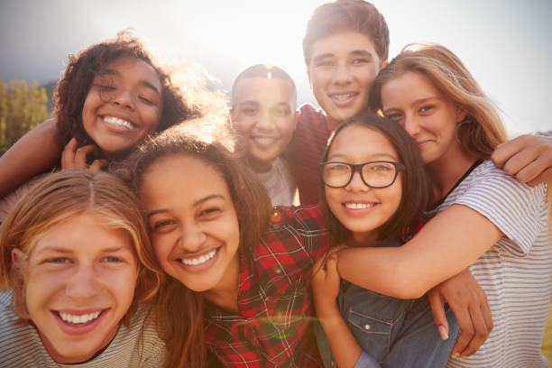
Les textes d’identité digitaux
-are autobiographical
-make stories more holistic and understandable (visuals, narration, subtitles)
-allow students to learn about each other
-enable students to learn about themselves
-validate students’ identities

Slide 6
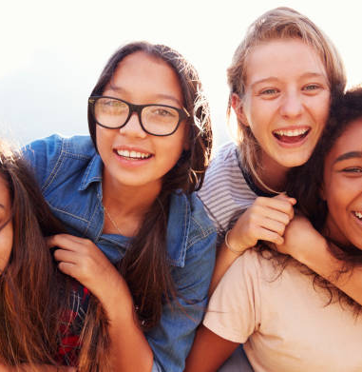
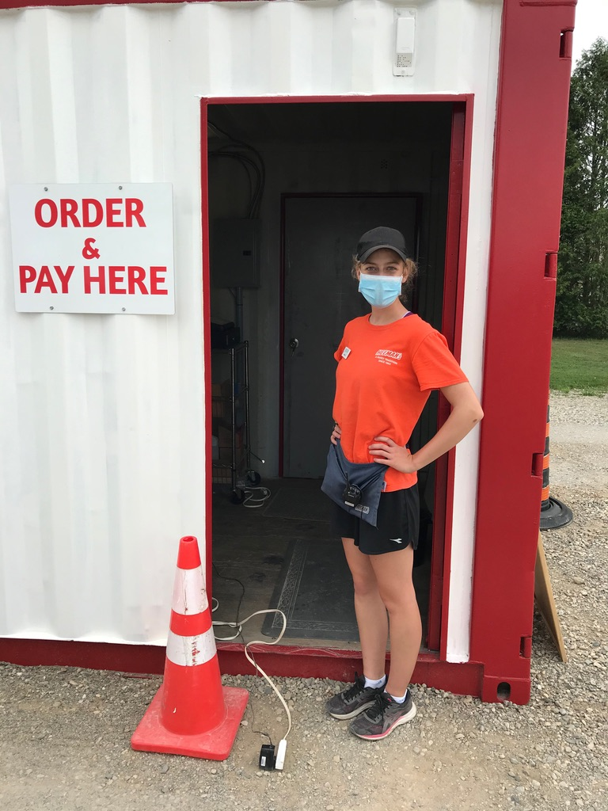
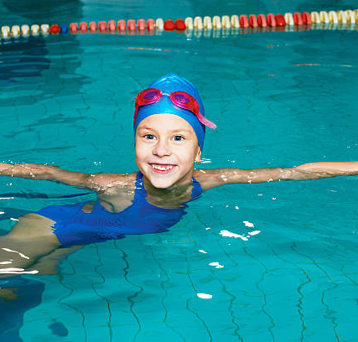
les exemples des textes d’identité digitaux pour la salle de classe
For beginner language learners:
1. A Day in the Life (English and French versions): A simple way in which students can share details about their daily routines.
For intermediate/advanced language learners:
1. Celebrating Diversity: My journey in becoming an advocate of diverse schools and plurilingual projects (English with French subtitles).
2. Le plongeon (French and English versions, with Arabic subtitles): A story of childhood perseverance.
3. Newcomer (Arabic with English subtitles): A young adult immigrates to Canada from Egypt and speaks about their first few weeks in Canada.
Created with Shaden Attia

Slide 7
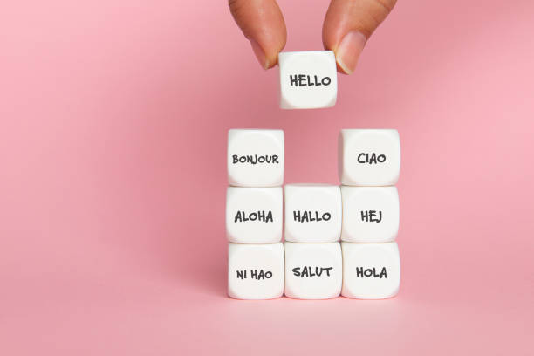
Le Plan d’unité: la narration plurilingue
-FSF 1D students (but can be adapted for different classes)
-includes the four strands (listening, speaking, reading, writing)
-evaluation: interactive conversation (listening, speaking), plurilingual video (speaking, writing)
-integrated grammar

Slide 8
Things to consider
1. Plan for longer planning sessions and longer student work periods.
2. Encourage students to make their stories less complex.
3. Find a balance between “teacher scaffolding and student autonomy” (Toohey et al., 2012, p. 89).
4. Show a model to allow for class discussion prior to individual creation.
5. Speak with mixed languages during instruction.

Slide 9
References
Cummins et al. (2005). Affirming Identity in Multilingual Classrooms. Educational Leadership, vol. 63 (1), 38-43.
Cummins, J., & Early, M. (2011). Introduction. Identity texts: The collaborative creation of power in multilingual schools (3-19).Trentham Books Limited: United Kingdom.
Dagenais, D. & Toohey, K. (2014). La production vidéo : une pratique multimodale pour tisser des liens entre l’école et les littératies hors scolaires. Nouveaux cahiers de la recherche en éducation, 17(2), 8-31. DOI: 10.7202/1030886ar
Dagenais D., Toohey, K., Bennett Fox, A., & Singh, A. (2017). Multilingual and multimodal composition at school: ScribJab in action. Language and Education, 31 (3). 263- 282. DOI: 10.1080/09500782.2016.1261893
IGI Global (2021). What is Plurilingualism. IGI Global https://www.igiglobal.com/dictionary/english-or-englishes/66027
Statistics Canada (2016). 2016 Census of Population (No. 98-400-X2016071).

Slide 10
Development of CETTE PRésentation
A summary of my work over the past four months:
-quotations and definitions from my readings
-plurilingual digital identity text examples that I created
A Day in the Life
Celebrating Diversity
Le plongeon
Newcomer
This presentation was written in a mix of French and English to demonstrate my commitment to and belief in a plurilingual classroom.

