Slide 1
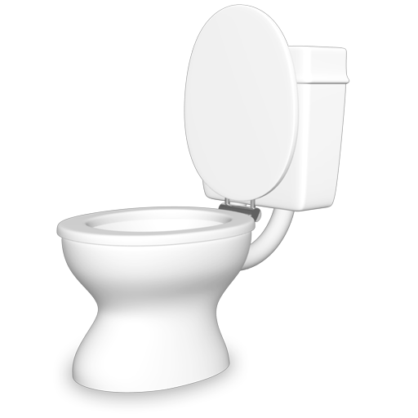
Toilet Leaks
Storyboard

Slide 2
What appliance do you think uses the most water in your home?
The shower?
The washing machine maybe?
Possibly the dishwasher?

Slide 3
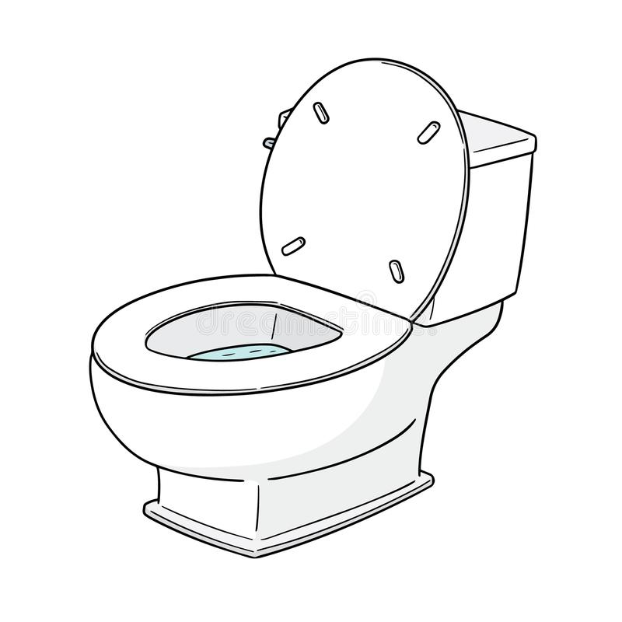
It’s actually the toilet!

Slide 4
Flushing a toilet is an essential part of everyday. Have you ever wondered how much water your toilet is actually using?

Slide 5
We need to consider a few things in order to determine how much water a particular toilet uses
Age of toilet
Type of Toilet
WaterSense
Map Testing

Slide 6
AGE OF TOILET
How do I check this?
The year your toilet was manufactured can have a big impact on how much water your toilet uses

Slide 7
Check inside your toilet tank for a label to find out what year your toilet was manufactured, or look up the make and model on the manufacturer's website

Slide 8
1 litre of water

Slide 9
Manufactured before 1980
26 L/flush

Slide 10
Manufactured between 1980-1996
13 L/flush

Slide 11
Manufactured after 1996
6 L/flush

Slide 12
We need to consider a few things in order to determine water usage
Age of toilet
Type of Toilet
WaterSense
Map Testing

Slide 13
Type of Toilet
There are many different types of toilets on the market that have an influence on water used per flush.
LET’S TAKE A LOOK

Slide 14
High-Efficiency Toilet
6 L/flush

Slide 15
Ultra-low Flush Toilet
5 L/flush

Slide 16
Dual Flush Toilets
4 L/flush

Slide 17
We need to consider a few things in order to determine water usage
Age of toilet
Type of Toilet
WaterSense
Map Testing

Slide 18
WaterSense
WaterSense is a program that certifies products that meet certain requirement such as:
Water efficient
Energy efficient
This program is set on preserving water and reducing wastewater

Slide 19
Look for this label to know that the toilet meets the WaterSense criteria

Slide 20
What does the label mean?
The label identifies water-efficient products that have been independently certified to meet the criteria for efficiency and performance.
So, when searching for a new toilet don’t forget to look for the label!

Slide 21
We need to consider a few things in order to determine water usage
Age of toilet
Type of Toilet
WaterSense
Map Testing

Slide 22
MaP Testing
Maximum performance testing was developed to see how well toilets work by grading them on performance.
The test results list models of toilets and their flushing performance.
This information is available for the public and very helpful when considering a new toilet!

Slide 23
To access more information regarding MaP Testing visit the site here: www.map-testing.com

Slide 24
On average a single person flushes their toilet 5 times a day
How much water does one person use per month due to flushing their toilet?

Slide 25
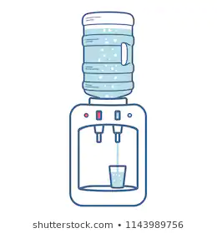
20 litres of water

Slide 26
When using a toilet manufactured before 1980 (at 26L/flush) one individual can use around 3900 liters of water a month, just from flushing their toilet.
X 195

Slide 27
When using a toilet manufactured after 1996 (at 6L/flush) one individual can use around 900 liters of water a month, just from flushing their toilet.
X45

Slide 28
Now that you know how much water a toilet uses, let’s take a look at how much water a toilet leak uses

Slide 29
An average toilet leak uses approximately 150 liters/day.
Over a month that adds up to 4500 liters.
Let’s take a look at how a toilet leak would impact your monthly water bill

Slide 30
A leak this size would increase your water bill by approximately $28.00 a month or $336.00 in a year!!

Slide 31
It is very common for leaky toilets to go unnoticed in the home for two main reasons:
Leaks are silent
There is no visible water around the toilet
Toilet leaks are so common that around 20-35% of all residential toilets have a leak.

Slide 32
Now that we have seen how leaks can have a substantial impact on your water bill let’s take a look at how to test for leaks and how to fix them!

Slide 33
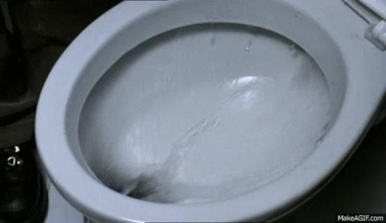
Common Leaks
Flapper valve
Float arm
Chain
Holes

Slide 34
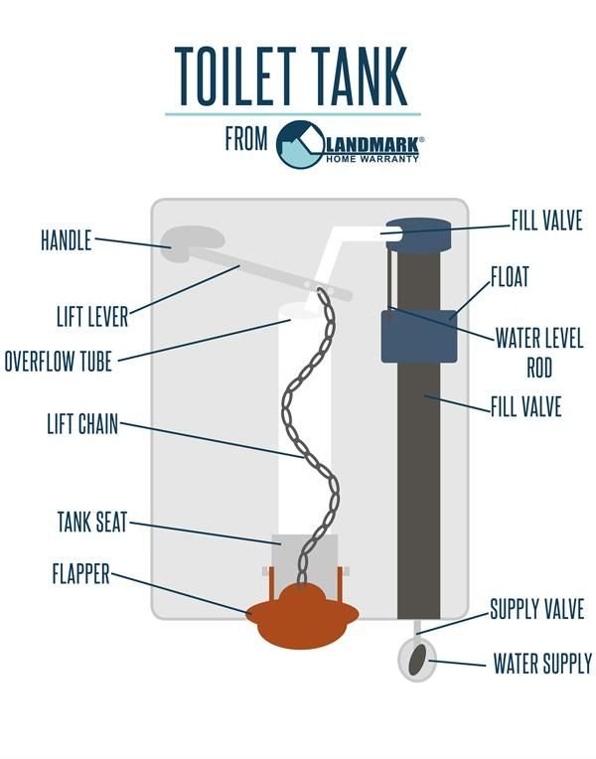

Slide 35
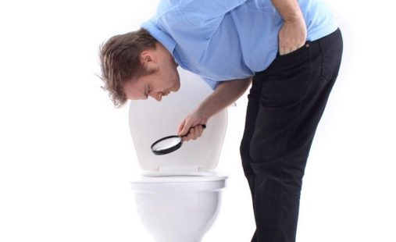
Steps for checking common leaks

Slide 36
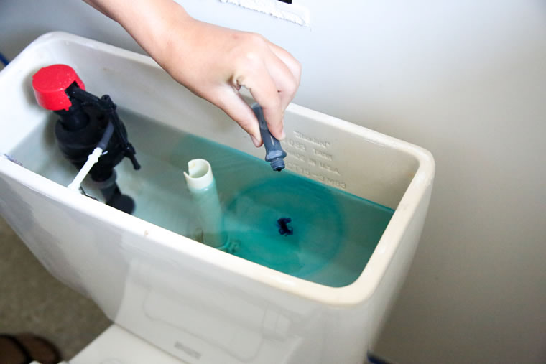
How to check for flapper valve problems
Flapper valve problems are the most common type of leak.
These types of leaks always leak directly into the bowl.
To check for flapper valve problems:
Add a few drops of food colouring, toilet dye strips, or tablets into the toilet tank.
Do not flush the toilet, and check back in 20 minutes.
If a leak exists, the water in the bowl will change colour.

Slide 37
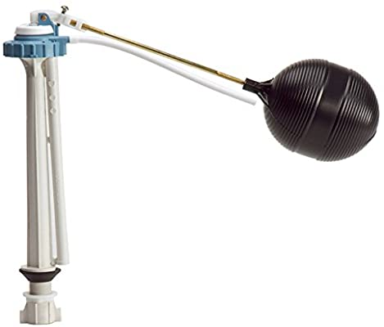
How to check for float arm problems
To check if the overflow tube and float ball are working properly:
Remove the toilet lid from the tank.
Flush the toilet, listen and watch the tank mechanism.
You should hear the water stop running. If it doesn’t, check the water level to see if it is above the overflow tube.
If the water level is above the overflow tube, the leak is caused by the float arm.

Slide 38
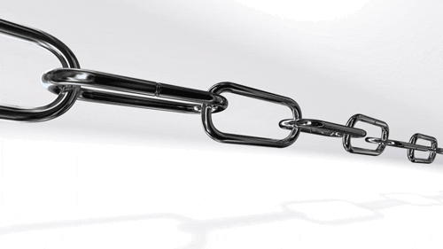
How to check the chain
If you have to jiggle the handle to stop the toilet from running, it may be a misaligned flapper, a loose handle or an incorrect length of chain.

Slide 39
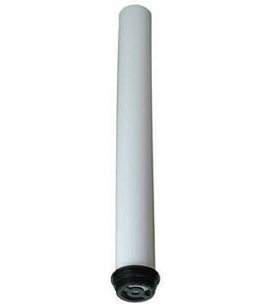
How to check for holes
A pinhole opening in the overflow tube could produce an invisible leak.
Check for this by:
Shining a flashlight down the overflow pipe.
If you see running water, the leak is likely caused by a hole.

Slide 40
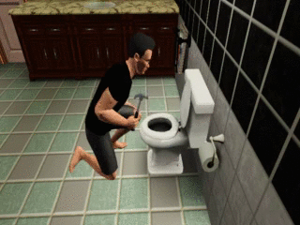
Steps for fixing common leaks

Slide 41
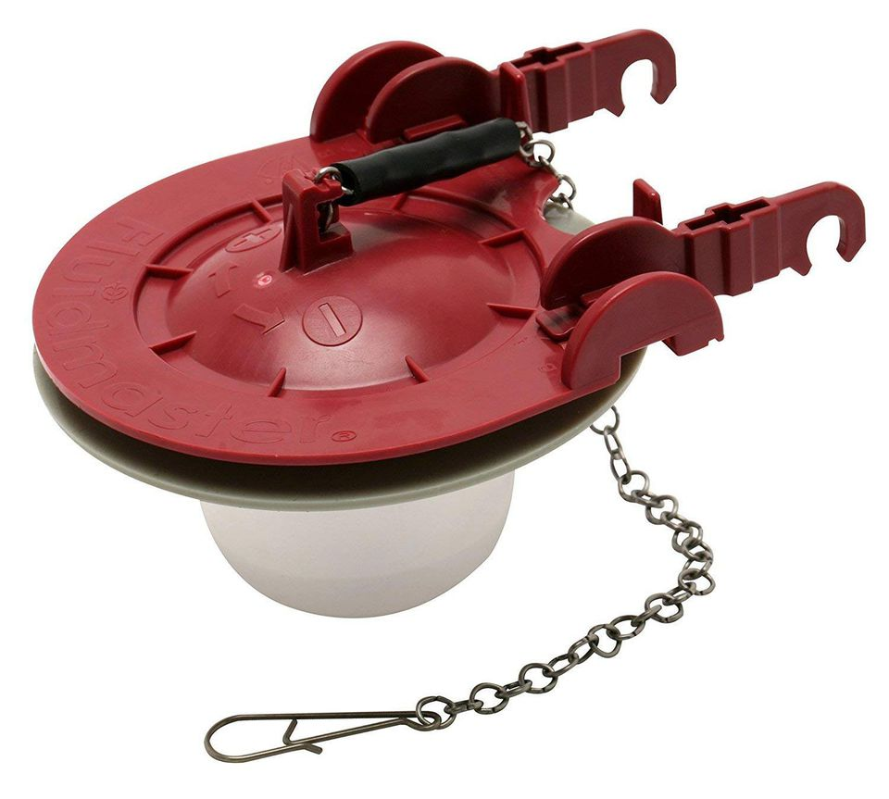
How to fix a flapper valve
To fix this silent leak, the flapper valve should be replaced, cleaned or realigned.

Slide 42
How to fix a float arm
If the water doesn’t stop running, check the water level to see if it is above the overflow tube.
If it is, gently adjust the float arm down and flush.
Set float arm height to the marked line inside the tank.
If there is no reference line, the ideal water level in the tank is 1-2 inches below the overflow tube and fill valve.

Slide 43
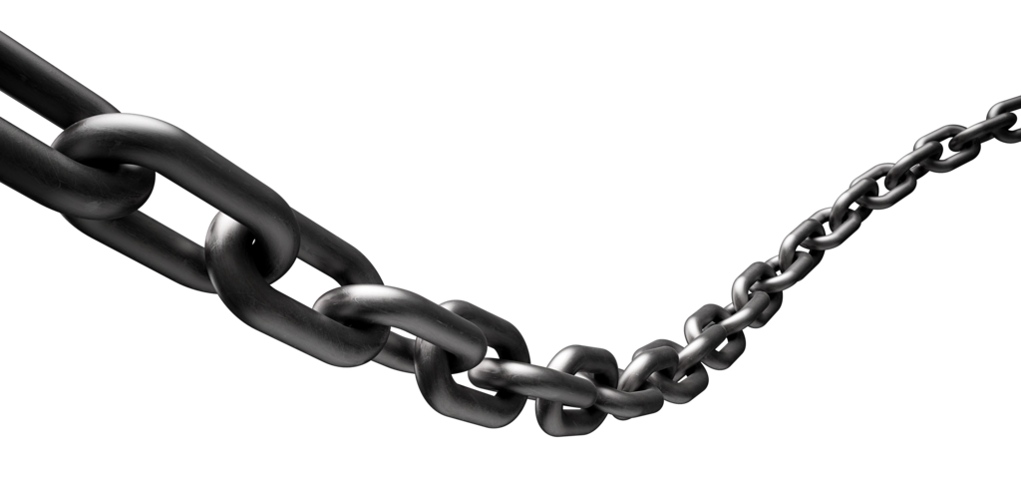
How to fix the chain
To fix this type of leak, clean and adjust the chain to ensure it’s not too long or short.
Tighten the nut that holds the toilet handle to the tank. If that doesn’t work, the handle may have to be replaced.

Slide 44
How to fix holes
This type of leak can be repaired by replacing the overflow tube.

