Slide 1
Leaky Faucet Storyboard

Slide 2
Have you noticed an increase in your water bill…
but you have not been using extra water to increase your consumption?

Slide 3
Have you noticed any leaky faucets in your home recently?

Slide 4
That slow drip from your sink or showerhead may seem insignificant
but it can really add up!

Slide 5
Be sure to check the faucets both inside your home and outside!

Slide 6
So how much does a leaky faucet actually cost you?

Slide 7
An average leak of a steady streak
is about 1/16” in diameter
which can add up to 387 L/day

Slide 8
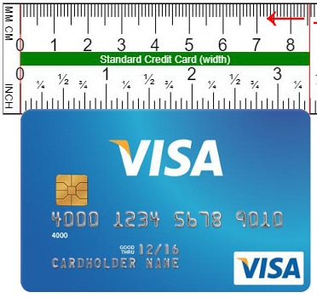
Source: Ginifab.com
What does a drip with a 1/16” diameter look like?
The space between the red line and the first black line is 1/16 of an inch!

Slide 9
An average leak of a steady streak
is about 1/16” in diameter
which can add up to 387 L/day

Slide 10
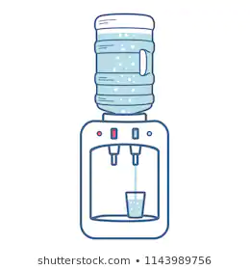
One of these water jugs is about 19 litres
Source: Shutterstock.com

Slide 11
20
Water
Cooler
Jugs
So 387 litres is
about

Slide 12
That becomes 11 610 L in leaks per month
Leaks increase a household’s monthly water usage to about 26 m³ or 26 000 L of water
An average, single-family household uses 14 000 L of water per month

Slide 13
Using the City of London’s Water Bill Calculator, consumption of 26m³ results in a monthly bill of $145.65
If the leak continued for a year, your annual water bill would be $1747.80

Slide 14
How much would your water bill be without the leaks?

Slide 15
With the 14 000 L monthly water usage, (14 m³), we see a monthly bill of $79.04 using the Water Bill Calculator.
That brings you to a grand total of $948.48 for the year.

Slide 16
On average WITH the leak:
$1747.80
On average WITHOUT the leak:
$948.48
vs.
Therefore if you had a leak like the one mentioned earlier, you would be spending an extra $799.32 on your water bill in one year.

Slide 17
X 493
Clearly, a small drip can really add up and make a dent in your expenses!
Think about it like this, you are spending the equivalent of 493
medium coffees, or an iPad Air, or almost a one year gym membership!

Slide 18
But fear not! Most leaky faucets have a quick fix!
You may be able to solve it on your own, or you may need to contact your local plumber to take a look at your fixture.
Either way, this investment could
save your literally hundreds of dollars a year!

Slide 19
If you want you want to try to fix the leak on your own, tools you must have include:
Adjustable wrench
Screwdriver
Optional tools:
Rag
Plumber’s putty

Slide 20
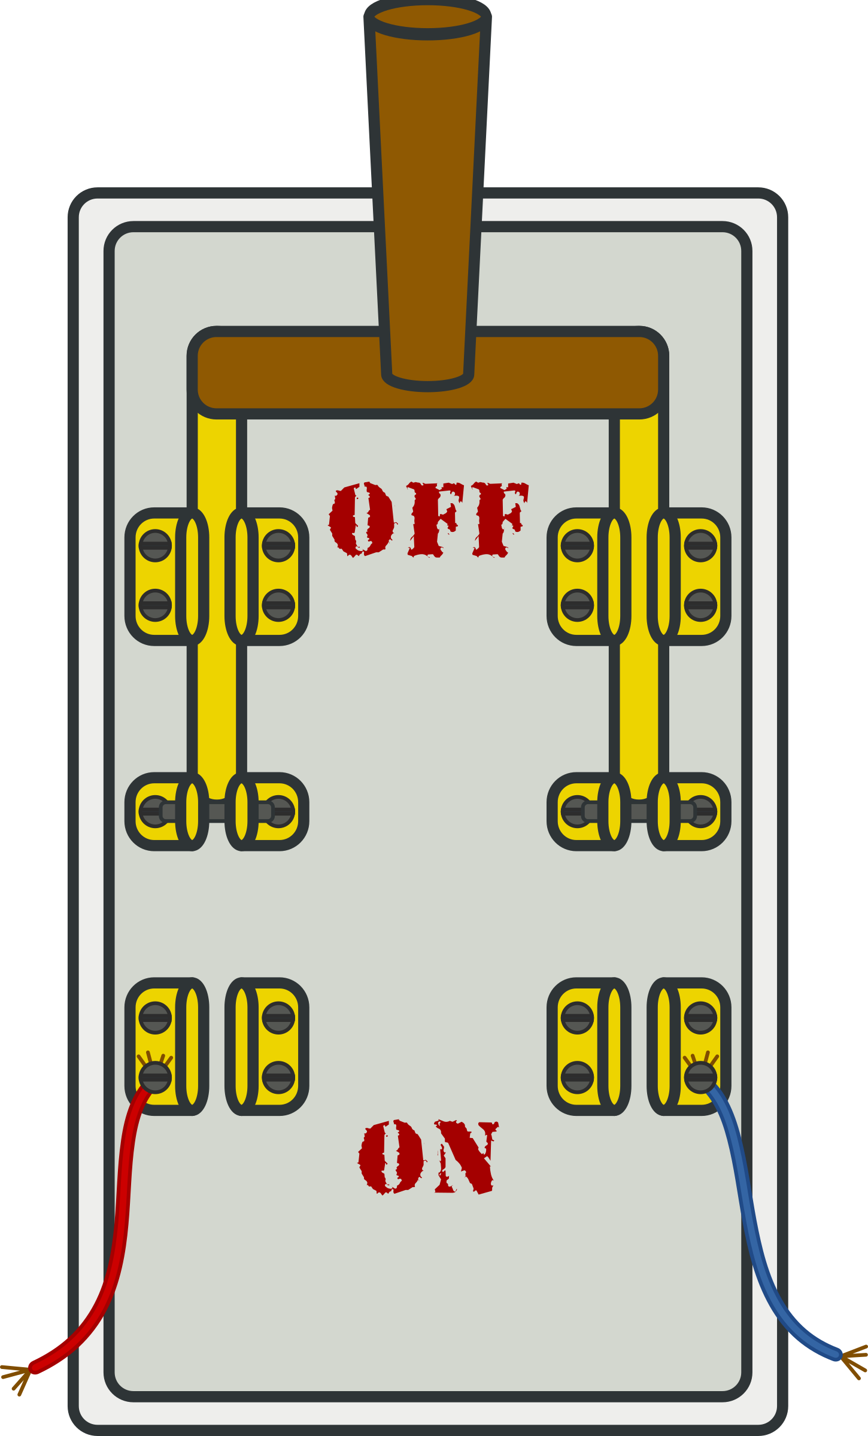
General Guidelines
Determine the source of the leak (leaky spout or leak at the base)
Turn off the valves for the sink or the main water valve for your home
Turn on the faucet to relieve any residual water

Slide 21
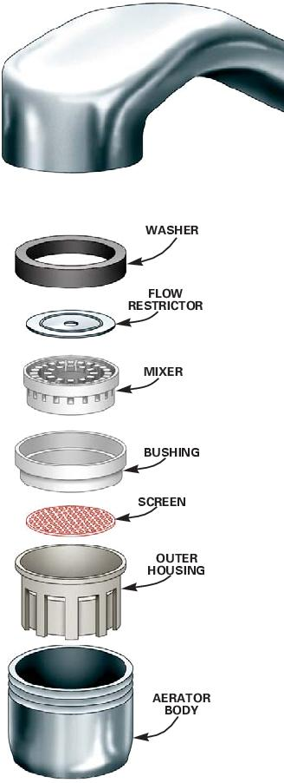
Remove the aerator and take apart the faucet
Lay them in order and take a picture (helps with reassembly)
Buy a specific part or a complete new kit for replacement
This Photo by Unknown Author is licensed under CC BY-SA

Slide 22
While taking apart the faucet, different types may require different procedures

Slide 23
We will talk about the 4 types that are most common in households

Slide 24
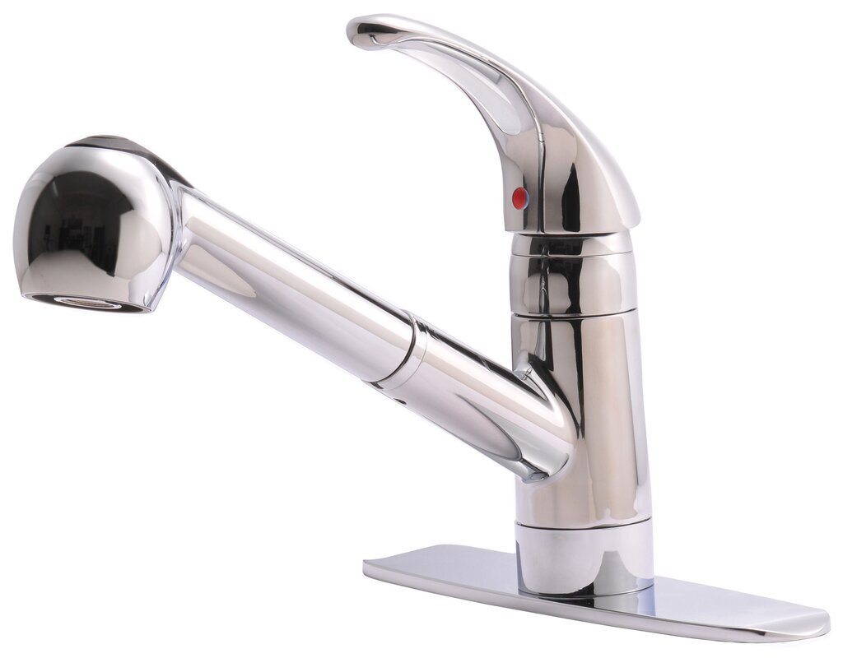
Ball Faucet
These faucets have their handle on top of a rounded surface
Loosen the set screw and take off the handle
Take off the cap
To repair a leaky spout, take off the spout and replace the O-rings
This Photo by Unknown Author is licensed under CC BY-SA

Slide 25
Ball Faucet
Replace the spout and put new seats on the new springs
Replace the ball and make sure the holes are lined up
Replace the water control cam
Reassemble the rest of the faucet
This Photo by Unknown Author is licensed under CC BY-SA

Slide 26
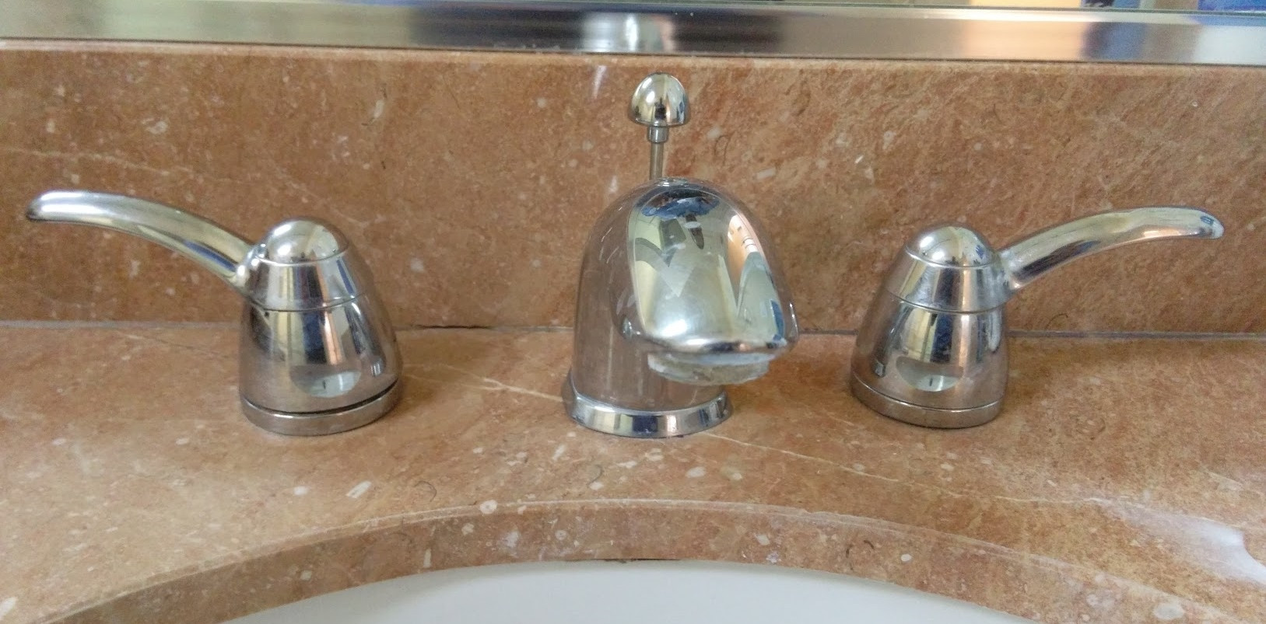
Cartridge Faucet (Two Handle)
Remove the cap and take off the screws and clip
Unscrew the retainer and pull the cartridge
Insert a new cartridge
Then reassemble the faucet
Take off the handle and trim ring
This Photo by Unknown Author is licensed under CC BY-SA

Slide 27
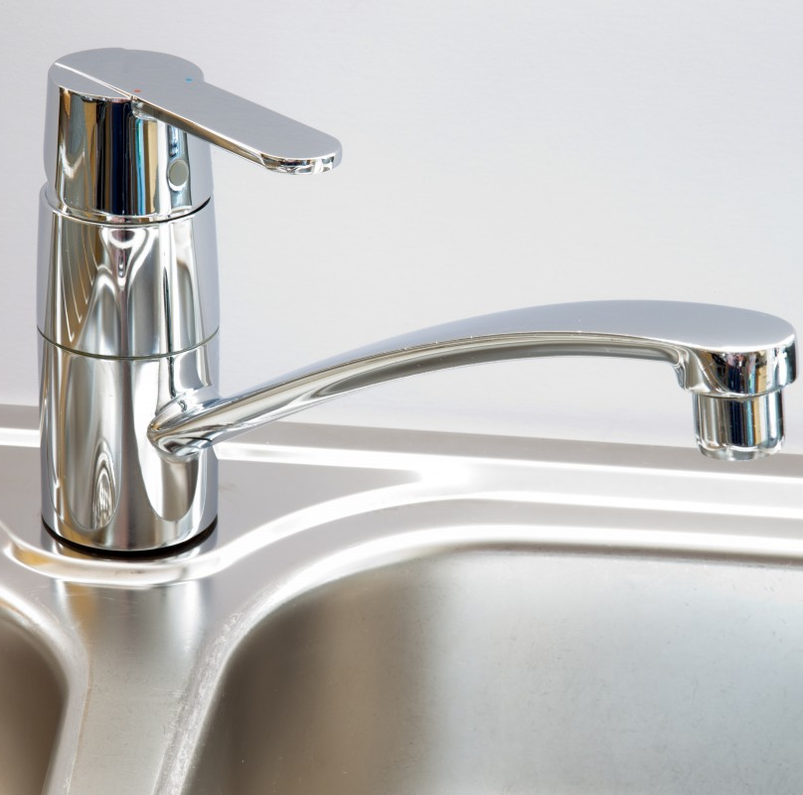
Disc Faucet
The handle will be atop a cylindrical base for this type
Remove the handle and the trim ring
Unscrew the retainer nut
Pull out the cylinder
Instead of repairing the disc at the bottom, it is best to install a new cylinder
Put the faucet back together and turn it on

Slide 28
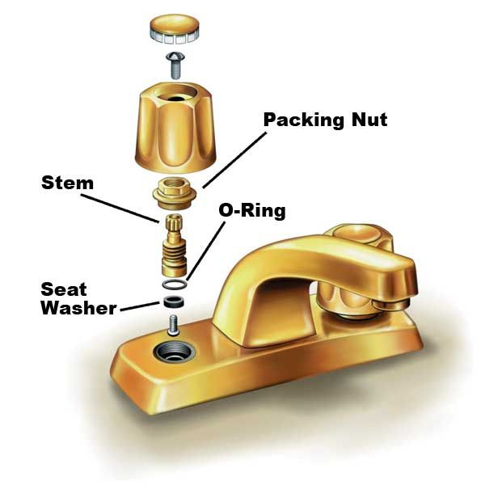
Compression Washer Faucet
Remove the decorative cap (if one is present)
Unscrew the screw on the handle
Use a wrench to tighten the packing nut (located at the base of the handle)
Source: https://www.thisoldhouse.com/kitchens/21097141/how-to-stop-kitchen-faucet-leaks

Slide 29
Compression Washer Faucet
If the previous step does not stop the leak, remove and replace the seat washer
Put everything back together
Source: https://www.thisoldhouse.com/kitchens/21097141/how-to-stop-kitchen-faucet-leaks

Slide 30
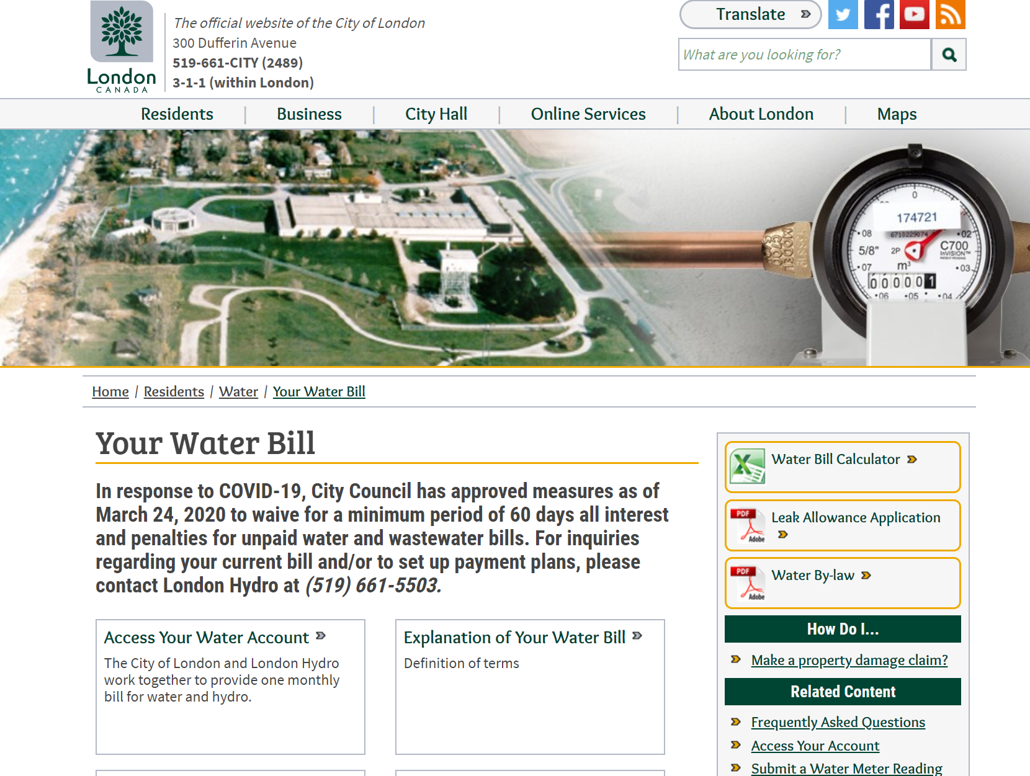
For more information on your water bill
Visit www.London.ca/water
For great educational resources to help you understand your water bill even more!

