Slide 1
Trinity Theatre Leadership Lab
SASAH Experiential Learning
Chantelle Ing
250918201

Slide 2
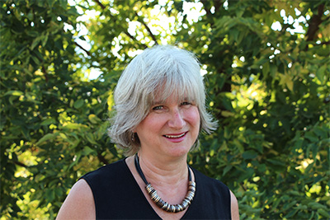
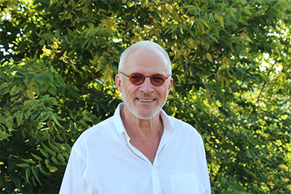
Trinity Theatre
Trinity Theatre is a Toronto-based charitable organization offered to the youth
Offers interactive programs for schools and communities
Uses the fundamental practices of theatre to empower youth and build community
Combines the arts and intergenerational interactions to facilitate the development of communities across Canada
The co-directors are Alan Richardson and Sandra Crockard (see left)
Notes:
Trinity theatre is a registered charitable organization founded in 1982 by Co-Directors Alan Richardson and Sandra Crockard
Their mandate = help youth develop resilience to overcome challenges and make successful transitions throughout their lives.
They have funding support from several school boards, including the Toronto District School Board, and other organizations such as the National Crime Prevention Strategy and Justice Canada Youth Justice Fund.
Trinity has over 35 years experience creating youth-led leadership programs in schools across Canada and America.

Slide 3
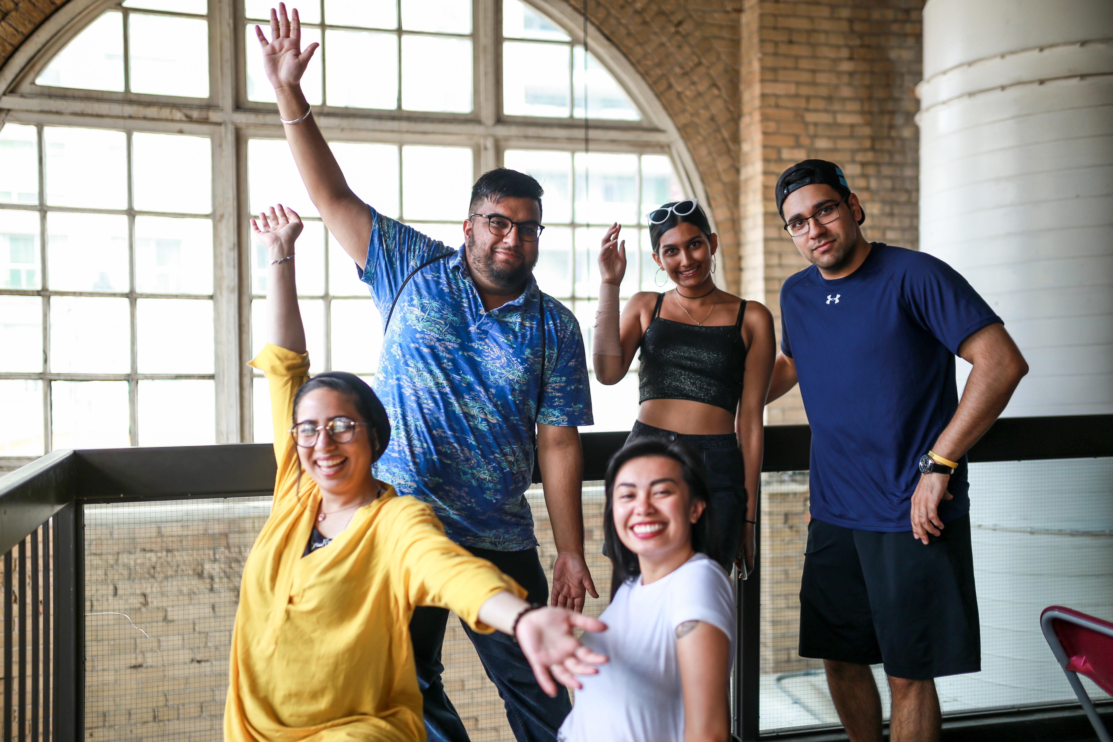
The Leadership Lab
6-week summer program
Intergenerational team of secondary students, post-secondary students, and retired educator volunteers
(e.g.) Post-secondary project leaders (see right)
Aims to facilitate the development of sense of person, sense of place, community, compassion and diversity
Notes:
The Leadership Lab is a 6-week intensive summer masterclass for youth.
Post-secondary students are hired for a variety of leadership positions to facilitate this program.
Project leaders for the different communities (Greenwood, Malvern, Rexdale, and Weston) → they are responsible for a group of youth in their respective area
Lead researchers → work closely with project leaders
Communications team → individuals with unique skillsets collaborate on various projects/tasks that the teams need (e.g. photography, videography, infographics, surveys, etc.)

Slide 4
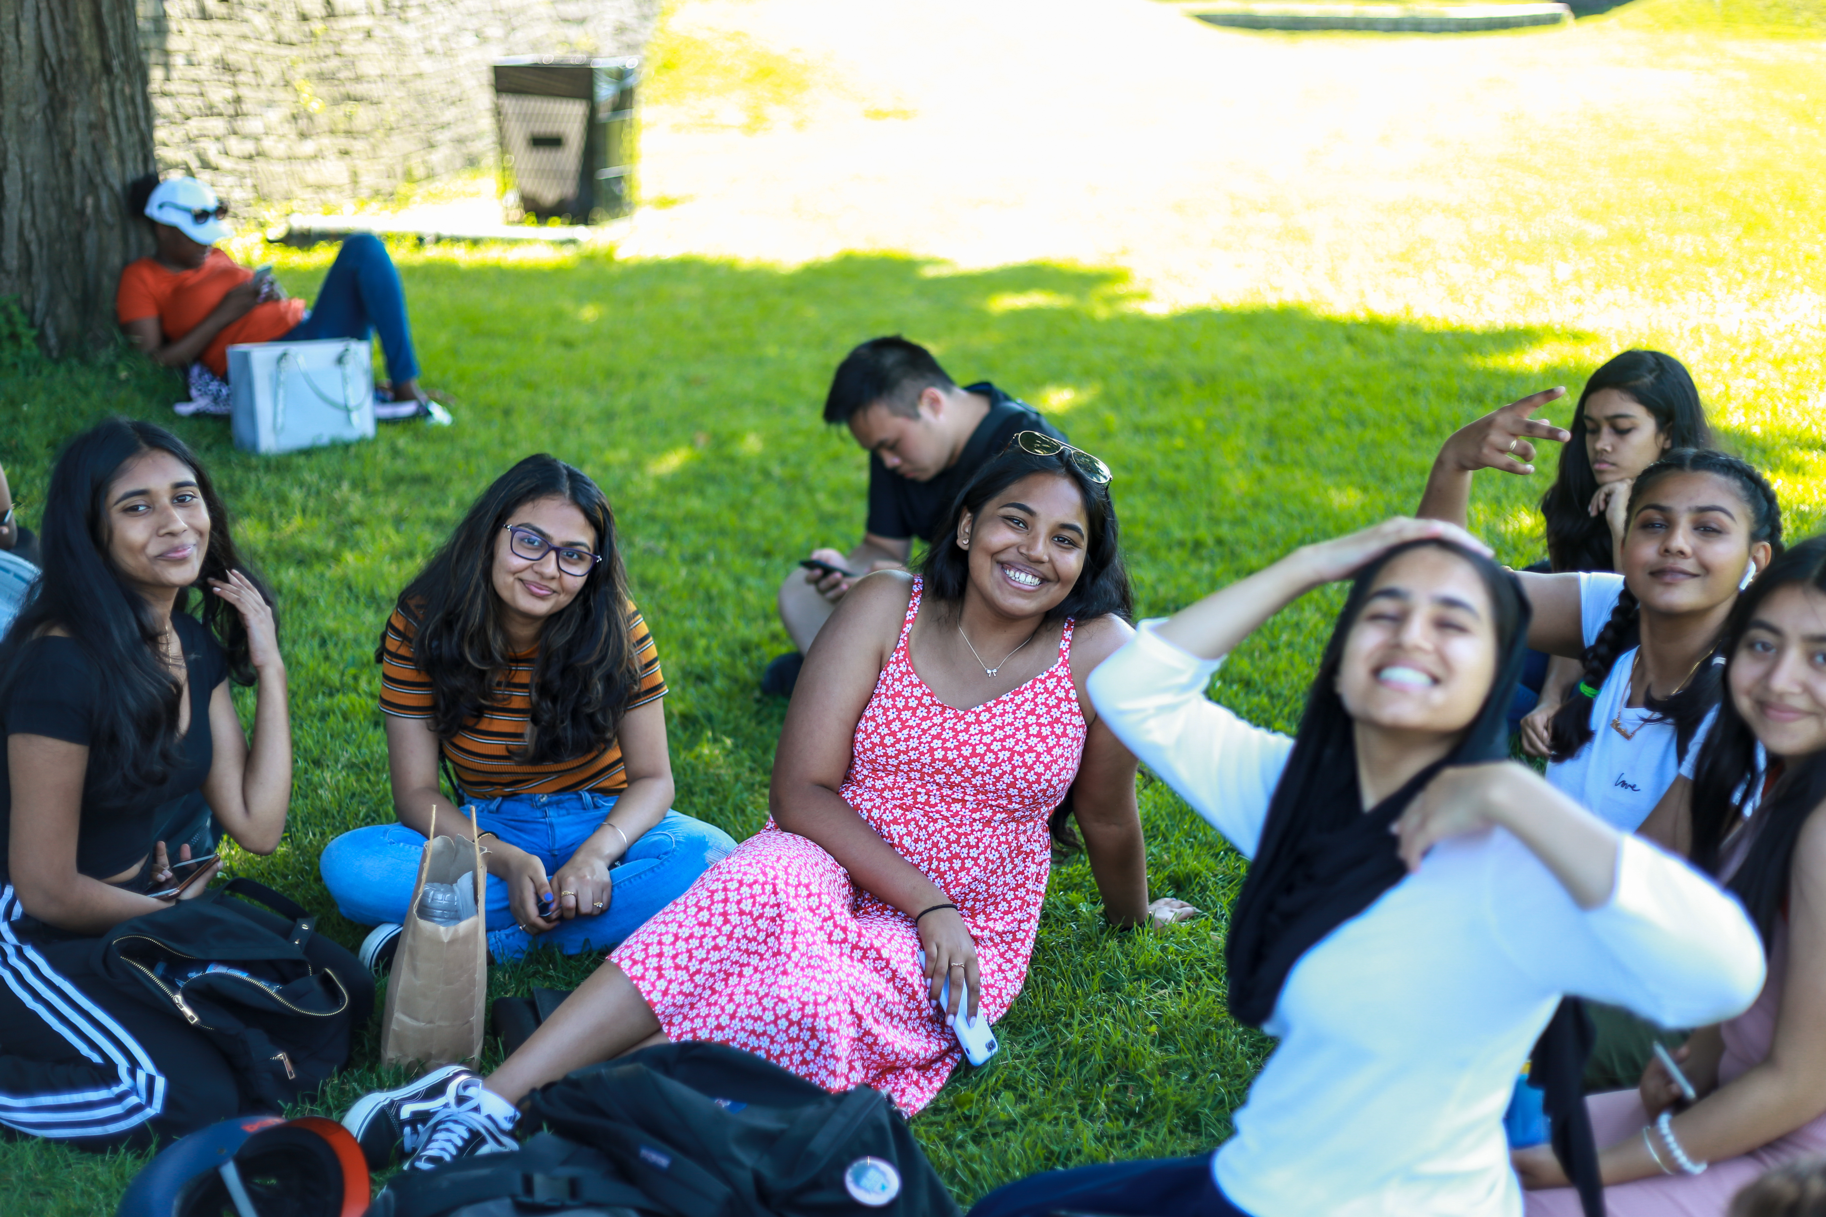
Leadership lab Field Trips
The Leadership Lab includes a variety of field trips into the community in addition to skills training.
This promotes exploration of the city’s infrastructure, history/heritage, civics, arts, healthy, the environment, and business.
Notes:
In addition to skills training and workshops, the program implements field trips to promote exploration of the community and city.
The aim is to promote an exploration and education on the city’s infrastructure, history of immigration, integration and inclusion, the arts, the environment, etc.
The goal is to root the participants in the broader community, work with diversity, develop civic awareness, and build a stronger sense of citizenship and belonging.

Slide 5
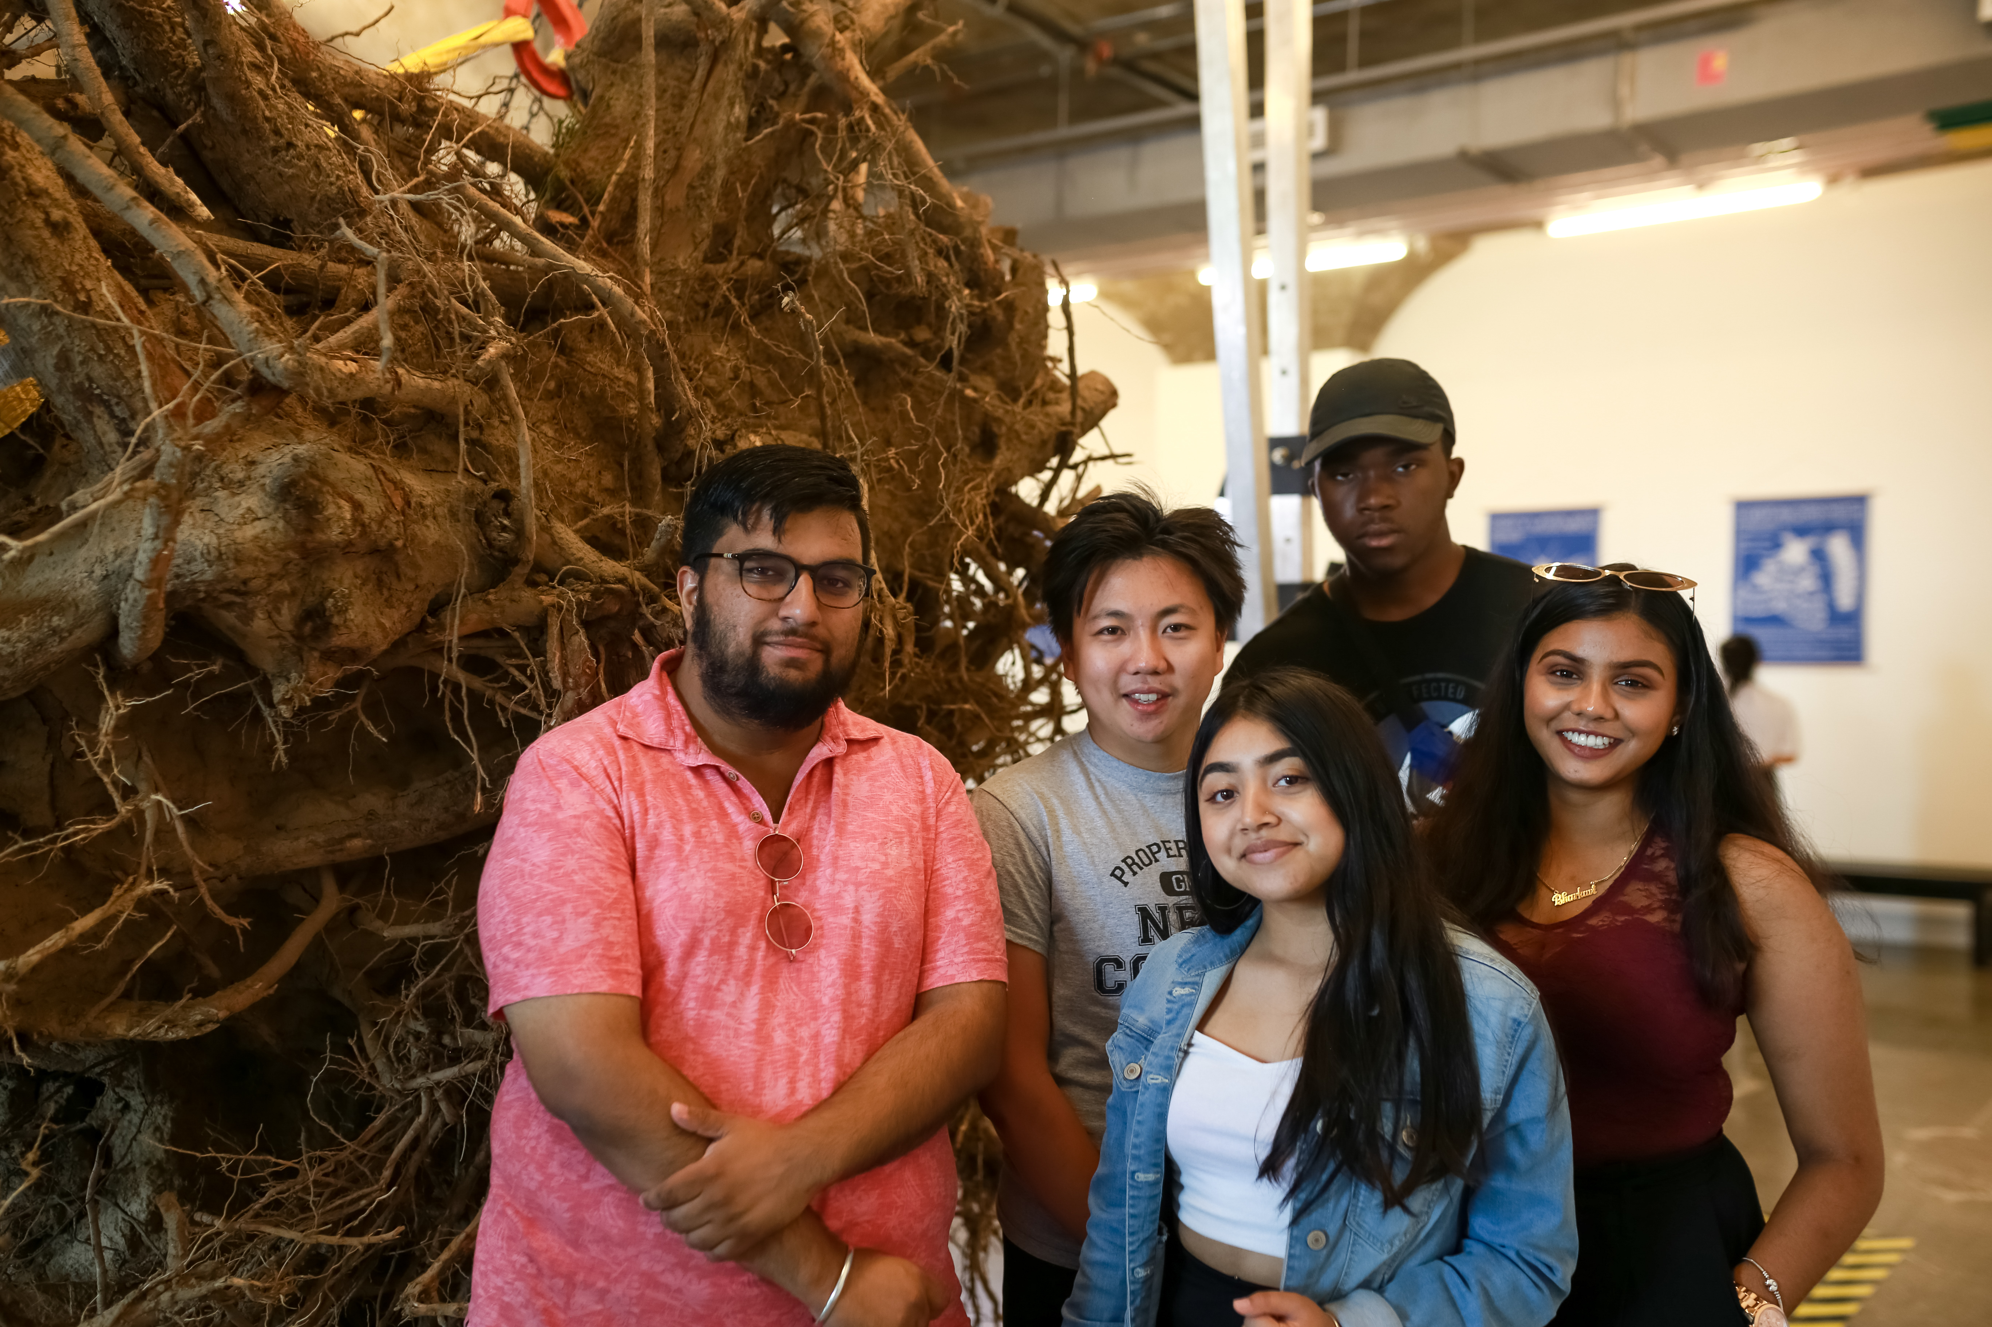
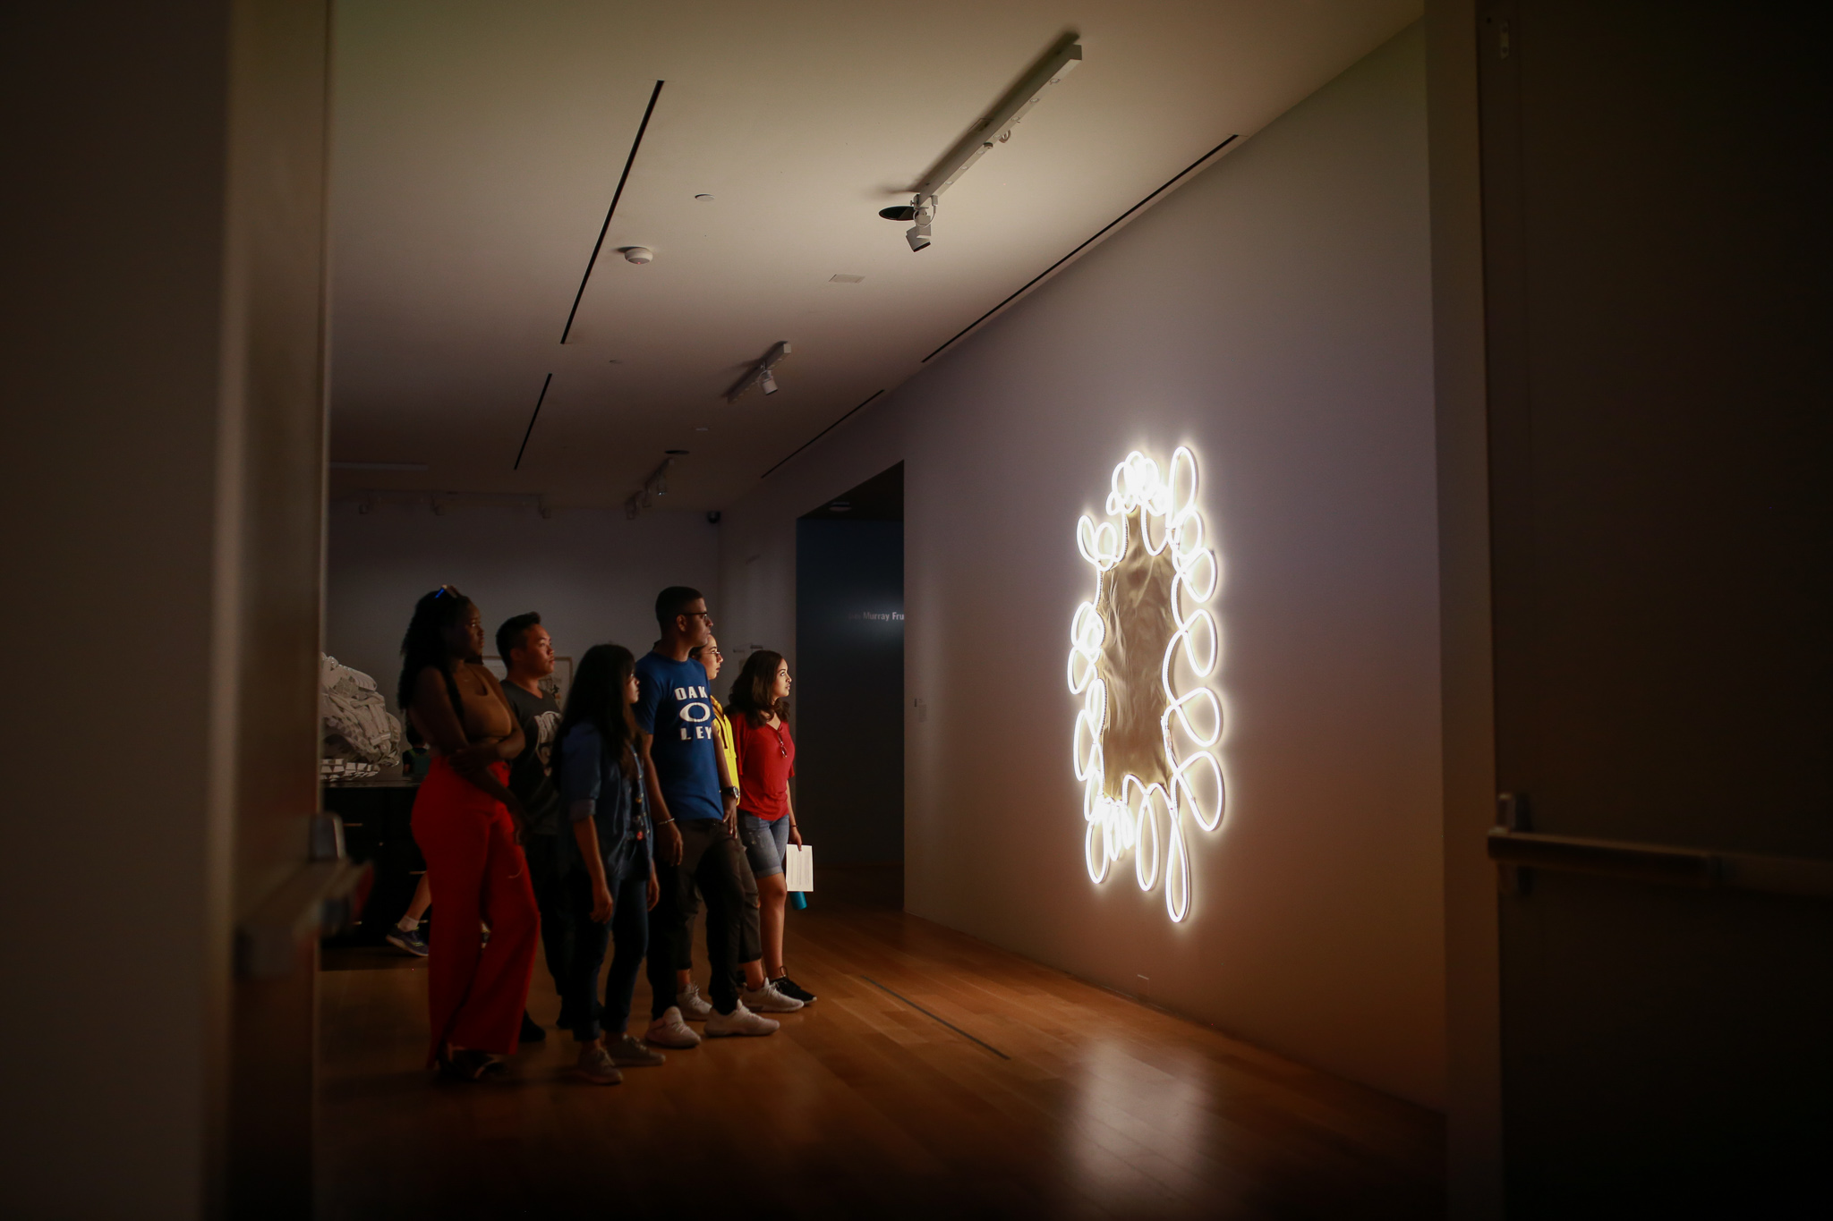
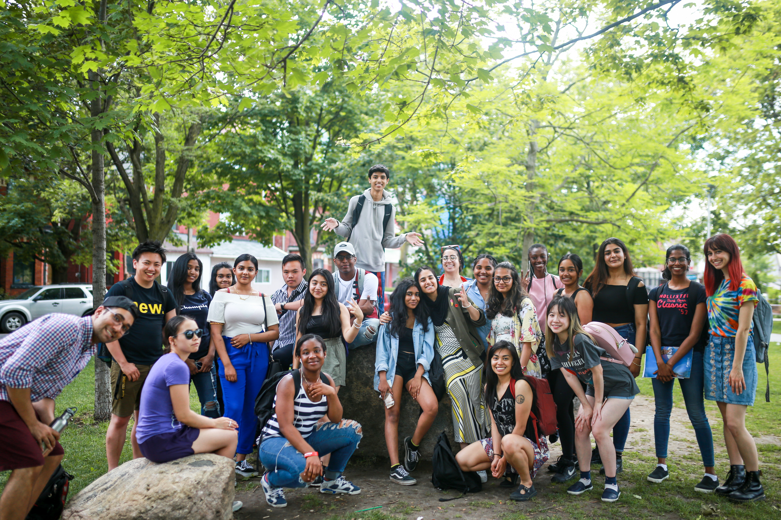
Examples of Field Trips
Top 2: art day at the MOCA and AGO
Bottom 2: Heritage days at Kensington market and fort york
Notes:
The Leadership Lab is engaging and exciting because it incorporates excursions rather than just have youth meet up at one designated building everyday.
This summer we visited places like St. Lawrence Market, the AGO, Toronto Archive, Old City Hall, and CAMH.
This provided the opportunity for the post-secondary hires to have their professional skills interact with their academic work, personal life, and community.
For example: St. Lawrence Market Gallery
I had the opportunity to see early Toronto artwork done by women → took inspiration from their art:
Inspired my personal creative work
Incorporated it into my academic work (I wrote a lot about art and its relation to the community and how it impacted me in my reflections)
Allowed me to reflect on the intersections and valuableness of art in the community as a whole.

Slide 6
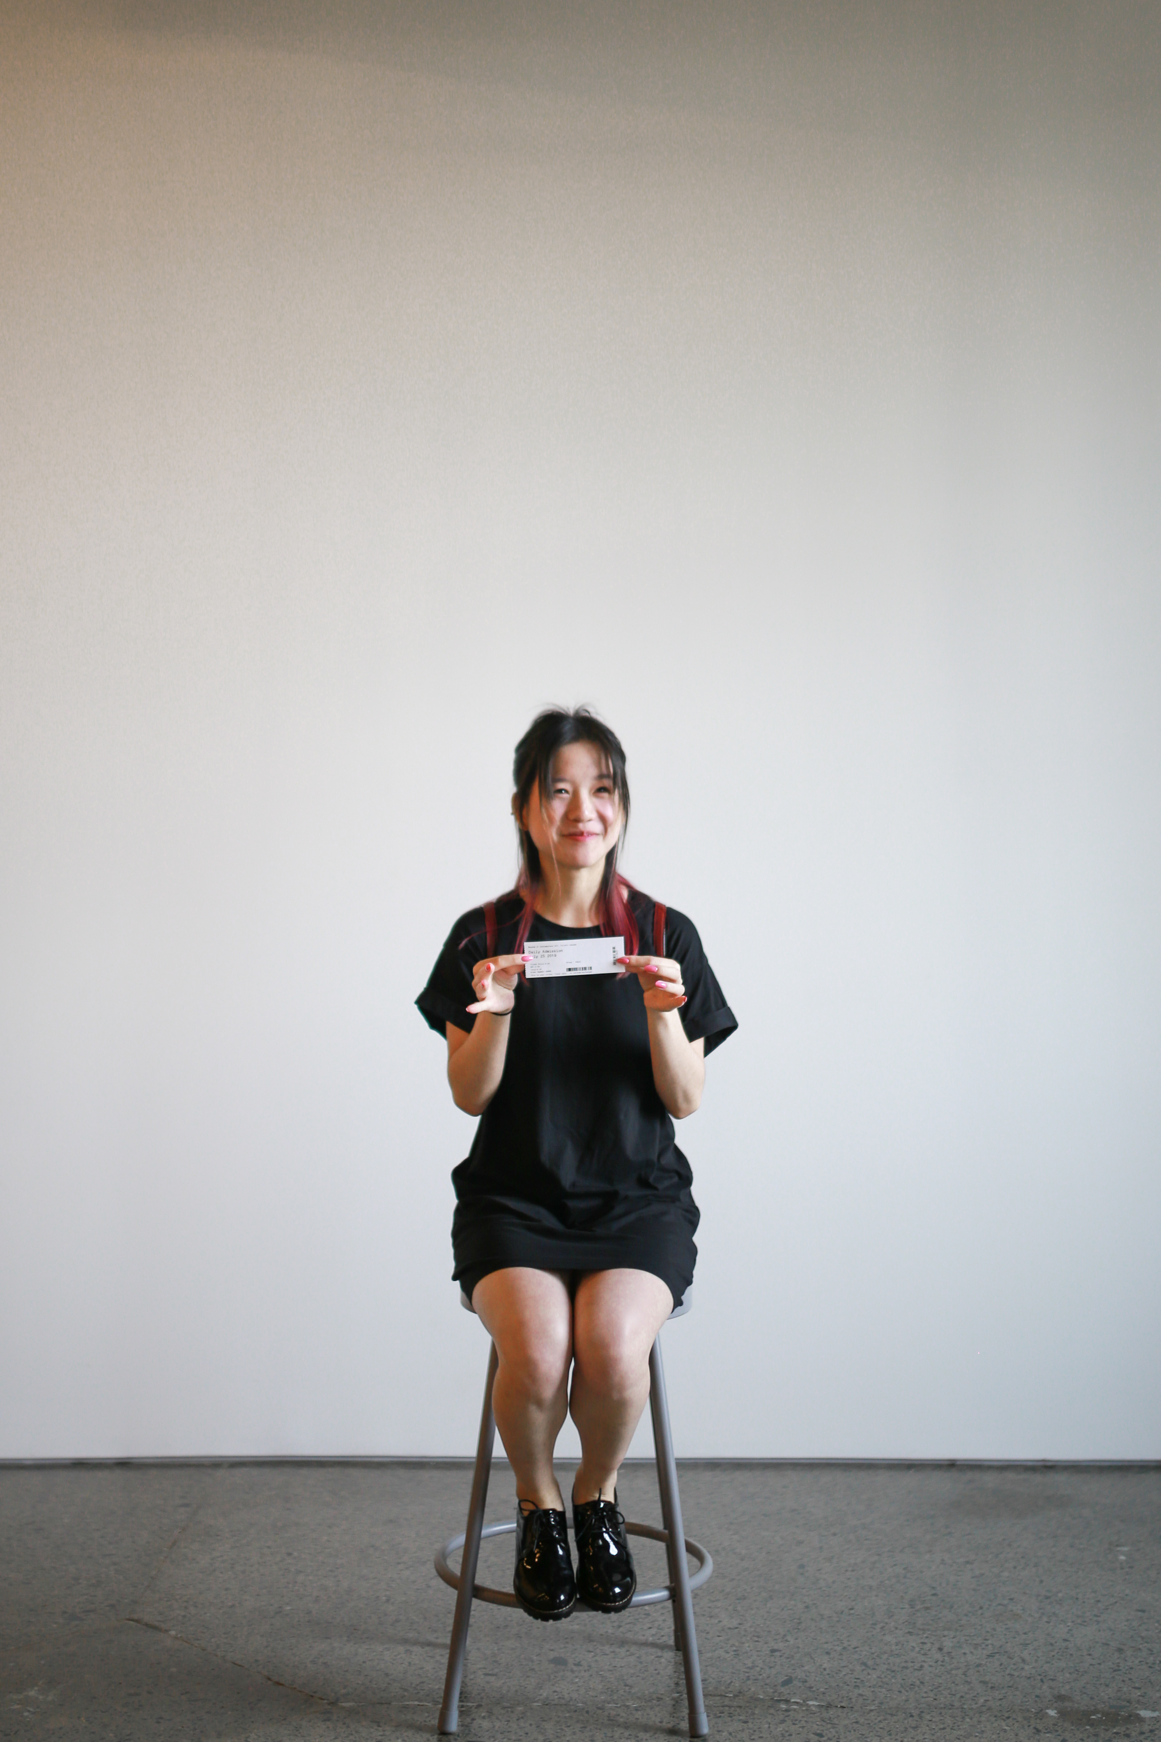
What I did – Communications Intern
What I did as a communications intern (focus: surveys and research):
Created and conducted surveys
Created infographics based on gathered research
Lead editor for digital magazine publication
Designed business cards for summer employees
Collaborated with communications team to rebrand Trinity Theatre and refresh their social media pages.
Notes:
There were 3 options for post-secondary summer hires:
Project/team leader
Lead researcher (works with a specific project/team leader and their group)
Communications intern (each have unique talents and specializations)
(e.g. photography, podcasting, marketing and analysis, etc.)
What I did as a communications intern (with a focus on research and surveys)
Helped with administration in conducting and creating surveys for both the secondary school participants and post-secondary summer employees
My work wasn’t just limited to research and surveys – the communications team and my supervisor valued my experience and education as an English major and appointed me as the lead editor for the summer publication (the very first digital summer magazine publication for Trinity Theatre!)
With my interdisciplinary education in SASAH, I also was able to use my creativity and design background to develop business cards for the summer employees and infographics for collected data from surveys.
As a team, we collaborated on re-branding Trinity Theatre, incorporating a new colour scheme and refreshing their social media pages.

Slide 7
https://www.instagram.com/trinitytheatre/
https://create.piktochart.com/output/40199553-tt-demographic-2019
https://drive.google.com/file/d/1YVnbmx_0UqmQGk6WXC364220D1jactAw/view?usp=sharing
Notes:
This is an infographic I created based on the demographic research I collected with my colleagues through a google survey.
It’s my way of creatively outputting the data I was given and making it into something visually pleasing.
There was quite a lot of diversity in the high school participants
This is Trinity Theatre’s Instagram page → you can see how there’s a cohesive theme and colour scheme now (compared to before)
It’s more visually pleasing
When social media pages are more aesthetically cohesive it usually creates more activity
This is their very first summer publication that I was the lead editor for → it’s a compilation of various written and art pieces by the high school students and the post-secondary students
This was really rewarding
I enjoyed having the opportunity to see the growth and develop a personal relationship with the students through their creative work.

