Slide 1
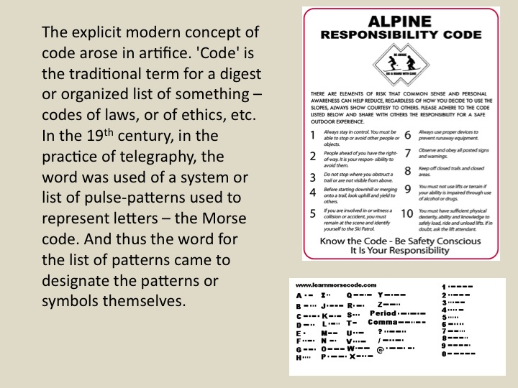
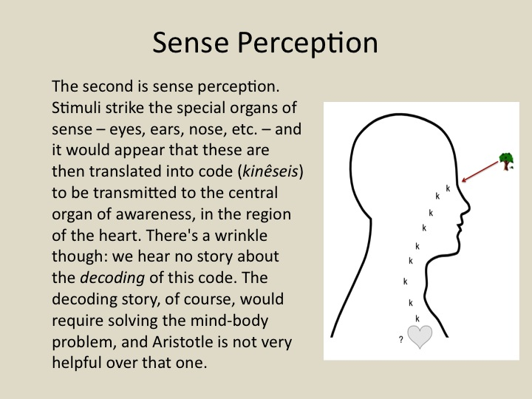
Aristotle and code
John Thorp, Rotman Institute of Philosophy,
& Department of Philosophy

