Slide 1
DOIs
What they are and why to use them

Slide 2
Digital Object Identifier
https://doi.org/10.5206/ls.2016.648
https://doi.org/ is the DOI prefix
10 is the CrossRef Directory Code
5206 is the code assigned to Western Libraries as a publisher member of CrossRef
ls.2016.648 is the suffix, determined by the journal team

Slide 3
Why use DOIs?
Persistent links: while URLs can change, DOIs don’t, even if content moves or a journal ceases publishing
Visibility and findability: metadata about the article is also stored with the DOI, and that metadata can then be shared with other systems
Sharing articles: a DOI is all that is needed to point someone to your article, and it will always work

Slide 4
How does it work in OJS?
We set up two plugins: CrossRef XML Export and DOI Public Identifier
When you publish articles:
you add the DOI to the final galley file
go to the CrossRef XML Export plugin to submit the DOIs to CrossRef

Slide 5
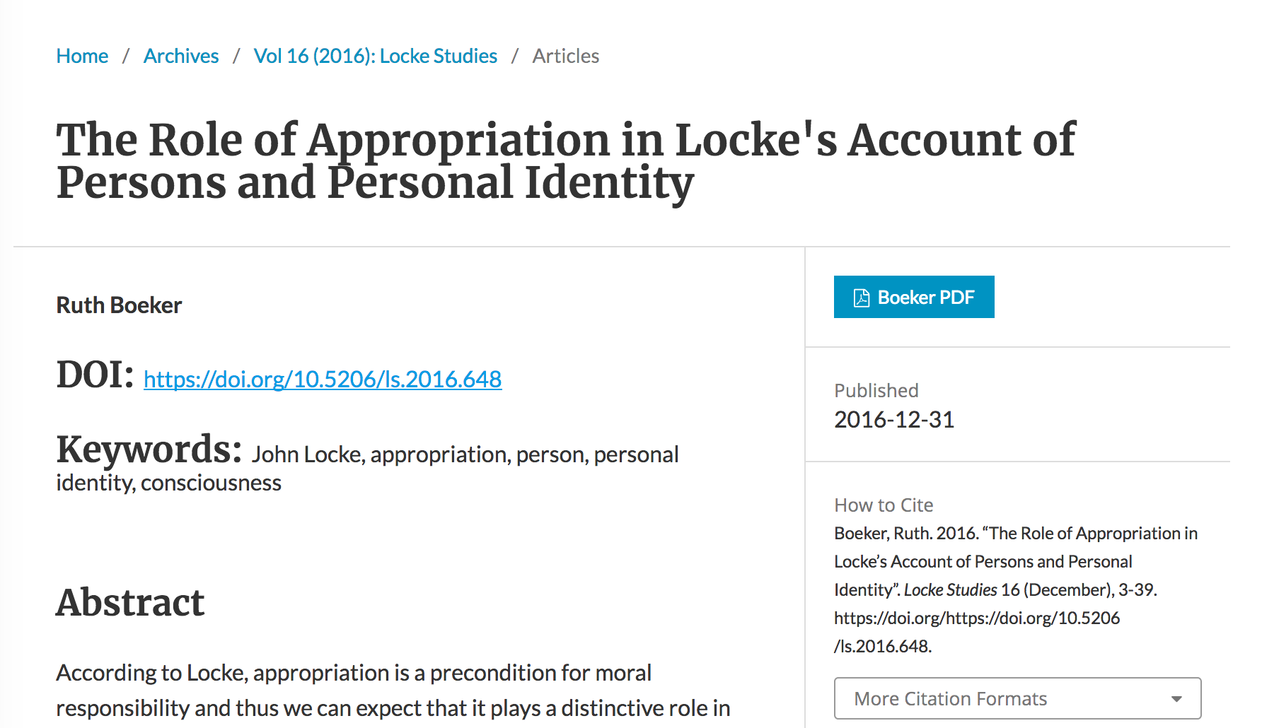

Slide 6
DOIs are
A Good Thing
and
Easy To Do

Slide 7
For more details
DOIs For Your Journal
https://www.lib.uwo.ca/scholarship/journal_dois.html

