Slide 1
Everything you wanted to know about Creative Commons Licenses
(But were afraid to ask)
“Everything You Wanted to Know about Creative Commons Licenses (But Were Afraid to Ask)” by Lillian Rigling is licensed under a Creative Commons Attribution 4.0 International License.

Slide 2
Notes:
How many folks recognize this symbol?
This is the copyright symbol. It indicates that a work has the protection of copyright law

Slide 3
All Rights Reserved
Notes:
Sometimes it comes with this tagline “All rights reserved.” That means that the author is holding onto all of the protections of their copyright. But what if they want to share a litte? How can you indicate as an author that your work is open and ready to be used?

Slide 4
Notes:
Has anyone seen this symbol?
This is the Creative Commons symbol. It’s an indicator that the creator of the work has chosen to grant a license to you to use the work in some ways. These licenses still work within the boundaries of copyright, but provide an easy way to share work with others.

Slide 5
Some Rights Reserved
Notes:
In other words, if copyright is “all rights reserved,” creative commons is “some rights reserved”

Slide 6
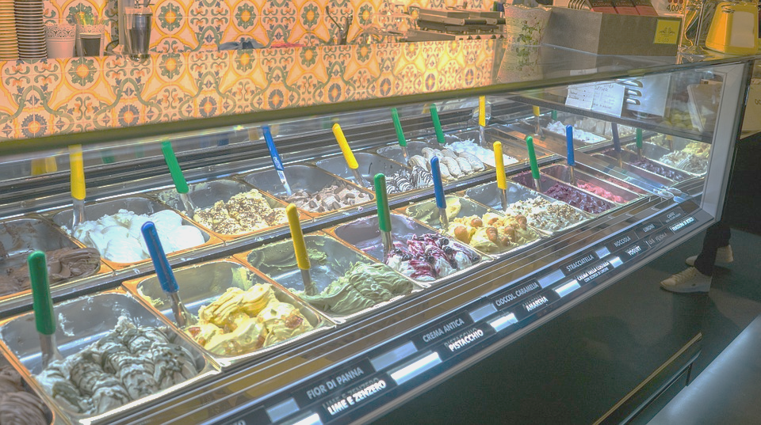
The many flavours of Creative Commons
Notes:
Creative Commons licenses come in many different flavours. They allow the creator to choose a license that suits their needs, allowing the creator to retain the rights they want, while still licensing the rights they want.

Slide 7
Notes:
Since, unlike ice cream, you can’t taste the different flavours of CC licenses, Creative Commons has four handy symbols that you need to know in order to identify what kind of license a work has. Each symbol indicates the a different condition for re-use.

Slide 8
BY: Attribution
Notes:
First, the little person or “BY” “By” indicates attribution. That is, if you want to use this work, you need to credit the original author. This symbol is saying “You can use this in any way you want, but you have to say it’s ‘by’ me!” All CC licenses have the “By” condition.

Slide 9
NC: Non-Commercial
Notes:
This is NC or Non-commercial. This symbol indicates that the work can only be used for a non-commercial purpose. That means that only the creator can make money using the work.
Keep in mind that this restriction is about the use, not the user. For example, a big for-profit corporation can use a Creative Commons Licensed work with the non-commercial condition in training materials for their employees, but not to sell their products.

Slide 10
ND: No-Derivatives
Notes:
This equals symbol means “no derivatives.” It’s saying “if you share your version, your version must equal mine.” A user can make small changes and re-share, for example, creating a physical copy of a digital copy, or fixing a typo. A user can also take a work licensed with the No-Derivatives condition and use it as a piece of a collection of works, as long as the licensed work itself is unaltered.

Slide 11
SA: ShareAlike
Notes:
The last possible condition is the ShareAlike condition. This is the condition that says, “If you want to share something you built using my work with others, you have to share it with the same license or a compatible license.” This shows that the user wants the work to stay openly licensed in some way.

Slide 12
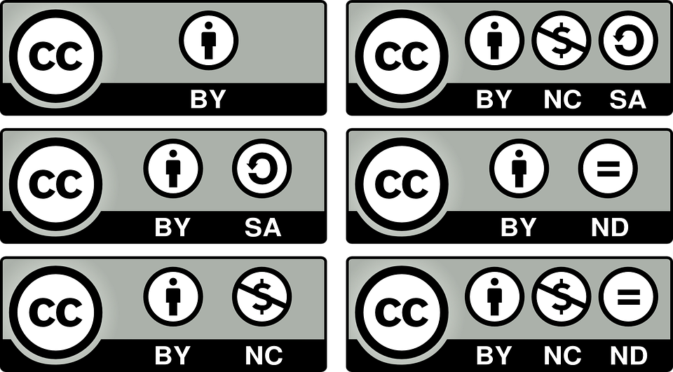
Notes:
There are six different ways to combine these four symbols to make creative commons licenses. You can see they all have the creative commons symbol in the left corner, followed by a series of other symbols, each representing the conditions we just talked about.

Slide 13
Attribution
Notes:
This is a CC-By License, it has just one condition: Attribution

Slide 14
Attribution
ShareAlike
Notes:
This is CC-BY-SA. It has two conditions: Attribution - You must Credit me - and ShareAlike - If you share, you must use the same or a compatible license.

Slide 15
Attribution
NonCommercial
Notes:
This is CC-BY-NC, which again has the attribution condition, as well as the non-commercial condition - use this, but only for non-commercial purposes

Slide 16
Attribution
No Derivatives
Notes:
And this is our last license with only two conditions: CC-BY-ND. This license still requires attribution, but it says that if you share, your version must equal the original.

Slide 17
Attribution + NonCommercial
ShareAlike
No Derivatives
Notes:
There are two licenses that have three conditions: CC-BY-NC-SA and CC-BY- NC-ND. They both have the attribution condition “You must credit me” and the noncommercial condition “You can use this, but only for noncommercial purposes.” CC-BY-NC-SA also has the share-alike condition, “you must share any adaptations of this work with the same or a compatible license” whereas the bottom license, CC-BY-NC-ND has the no derivatives condition “your work must equal mine.”
You’ll note here that there are no licenses with all four conditions because ShareAlike and No Derivatives are incompatible. No derivatives means no one can share adaptations of the work, whereas the sharealike condition only applies when a user is sharing an adaptation of a work/

Slide 18
To Recap…
Four symbols
Four possible conditions
Six Creative Commons Licenses

Slide 19
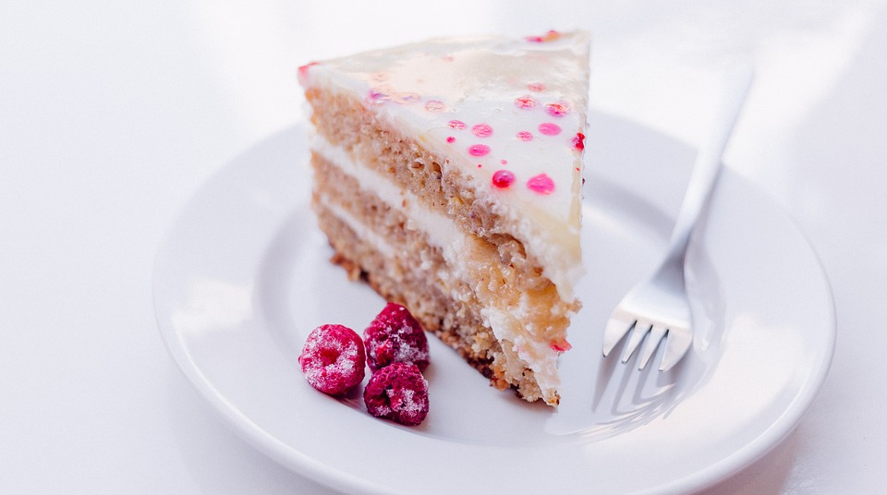
How do CC Licenses work?
Notes:
So now that we know how to figure out what kind of a license you’re looking at, it’s important to know how these licenses work.
Creative commons licenses are all kind of like a layer cake, and those symbols are the frosting. Inside, there are three different layers of Creative Commons cake that make this license enforceable and trustworthy

Slide 20
Layer 1: Human-Readable (Common Deeds)
Notes:
The first layer is the human-readable layer. This is a plain language summary of each of all of the terms of the license. These are not legally enforceable, but they make it easy for folks to get a sound summary of the terms of the license

Slide 21
Layer 2: Legal Code
Notes:
The second layer is just for lawyers. This is where the legally-enforceable terms and conditions are. This legal code is sound and designed to work within copyright law internationally. This is where the meat of the license is, and this is what makes it trustworthy.

Slide 22
Layer 3: Machine-Readable
Notes:
The final layer is a machine-readable layer. Since CC licenses are often shared using the web, this provides metadata that describes the conditions of the license so that users can search for openly-licensed works.

Slide 23
Notes:
Google even uses this metadata in their search tools to allow you to find Creative Commons images.

Slide 24
CC-0: Public Domain
Notes:
Finally, there’s one last Creative Commons tool. This CC Zero mark indicates that a work has been designated in the public domain. That is, the copyright has expired or the creator has decided to give up her copyright.This CC0 tool uses the same three-layers as the license, but it is not a license itself.

Slide 25
& copyright
Notes:
Creative Commons does not supercede copyright law under any circumstance. When copyright expires on a work and it enters the public domain, the creative commons license no longer applies. Additionally, no matter how a work is licensed, you can still make use of the fair dealing exception to use parts of the work without permission or attribution.

Slide 26
Questions?
For more information, visit https://lib.uwo.ca/scholarship/creative_commons_licensing.html

