Slide 2
Partner Meeting
May 5, 2023
Notes:
Mention successful mid-term report – meeting is a key moment for discussion of second half of our mandate.

Slide 3
Agenda
10:45 – 10:50am - Welcome
10:50 – 11:20am - Annual Report Highlights - Network Evolution - Data Collection - Key Activities and Research Outputs
11:20 – 11:50pm - Updates from Partners
11:50 – 12:15pm - Discussion
12:15 pm - Adjournment
Notes:
Goal of meeting is to help provide direction for the second half of our mandate.
-- note we amended agenda to include budget update.

Slide 4
C-Dem Network
C-Dem Network
Est. March 28, 2019
Academic
Western University, UQAM, Toronto Metropolitan University, Munk School of Global Affairs, CSDC, CORA, IIGR, LISPOP, LAPOP Lab, Electoral Integrity Project
Electoral Management Bodies
Elections BC, Elections Manitoba, Elections Saskatchewan, Elections Ontario, Elections PEI, Elections NB
Stakeholders: Elections Canada, Élections Québec
Civil Society Organizations
Samara Canada, CIVIX, Forum of Young Canadians, Apathy is Boring, Global Centre for Pluralism, GLOCAL
Other
IRCC, Democratic Reform Group, Tłıc̨ho Government
Innovative Research Group
Institute for Research on Public Policy
Vox Pop Lab
Notes:
Current C-Dem network includes integration of some new partners over first half of grant.
-- Should we integrate others? Are there key actors we are missing?
-- For some groups that have been less involved, is there any use in removing them from the network?

Slide 5
C-Dem Researchers
Co-Directors | Collaborators
Laura Stephenson (PI), Western | Christopher Alcantara, Western
Allison Harell, UQAM | John Beebe, Toronto Metropolitan University
 | Marc-André Bodet, Laval University
Co-Investigators | Jake Bowers, University of Illinois at Urbana-Champaign
Cameron Anderson, Western | Arnaud Dellis, UQAM
David Armstrong, Western | Victoria Esses, University of Western Ontario
Éric Bélanger, McGill University | Elizabeth Goodyear-Grant, Queen’s University
Loleen Berdahl, University of Saskatchewan | R. Michael McGregor, Toronto Metropolitan University
Amanda Bittner, Memorial University | Martin Papillon, Université de Montréal
Ruth Dassonneville, Université de Montréal | Dietlind Stolle, McGill University
Dominic Duval, UQAM | John Zoe, University of Alberta
Joanna Everitt, UNB– St. John | Matthew Lebo, University of Western Ontario
Holly Ann Garnett, RMC | Clifton van der Linden, McMaster University
Tania Gosselin, UQAM
Peter Loewen, University of Toronto | Advisory Council
Royce Koop, University of Manitoba | John Aldrich, Duke University
J. Scott Matthews, Memorial University | Keith Archer, Retired Chief Electoral Officer, Elections BC
Larry McNabb, Statistics Canada | André Blais, Université de Montréal
Valérie-Anne Mahéo, Université Laval | Patrick Fournier, Université de Montréal
Mark Pickup, Simon Fraser University | Elisabeth Gidengil, McGill University
Maryse Potvin, UQAM | Leonie Huddy, Stoney Brook University
Jason Roy, Wilfrid Laurier University | Shanto Iyengar, Stanford University
Daniel Rubenson, Toronto Metropolitan University | Richard Johnston, University of British Columbia
Jerald Sabin, Bishop’s University | Stuart Soroka, University of Michigan
Jared Wesley, University of Alberta | Elizabeth Zechmeister, Vanderbilt University
Notes:
Goal of meeting is to help provide direction for the second half of our mandate.
-- note we amended agenda to include budget update.

Slide 6
Data Collection
Completed
Upcoming
Canadian Election Studies – 2019, 2020
Democracy Checkups – 2019, 2020, 2021, 2022, 2023 (in field)
Provincial Election Studies – NB 2020, SK 2020, BC 2020, NL 2021, NS 2021, ON 2022, QC 2022, PEI 2023
Canadian Election Studies - ?
Democracy Checkups – 2024, 2025, 2026
Provincial Election Studies – AB 2023, MB 2023
Territorial Election Study - Tłıc̨ho Election Study 2025

Slide 7
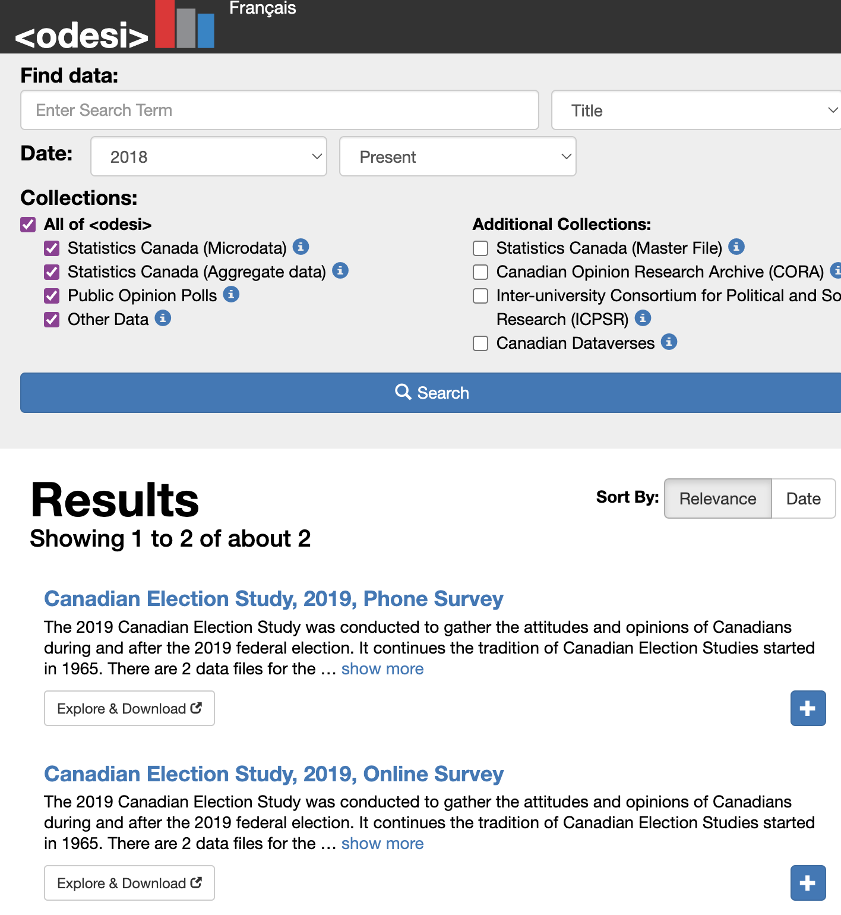
https://dataverse.harvard.edu/dataverse/C-Dem
C-Dem’s data is public
2 Canadian Election Studies, 3 Democracy Checkups (soon 4!), 5 Provincial Election Studies (soon 6!)

Slide 8
C-Dem Activities
Annual Forum: 2023 in Montreal, rotate with Toronto each year
Co-sponsorship of conferences and workshops
Toronto Political Behaviour Workshop (TMU/Toronto)
MapleMeth (Western)
TMU Behavioural Political Economy Series
Support of conference panels
ISPP panel in Montreal 2023
Atlantic Provinces PSA 2023
APSA pre-conference in Vancouver 2024
Partnered Research Programme (led by H. Garnett)

Slide 9
Annual Module Competitions

Slide 10
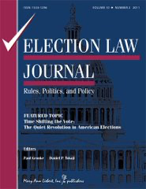
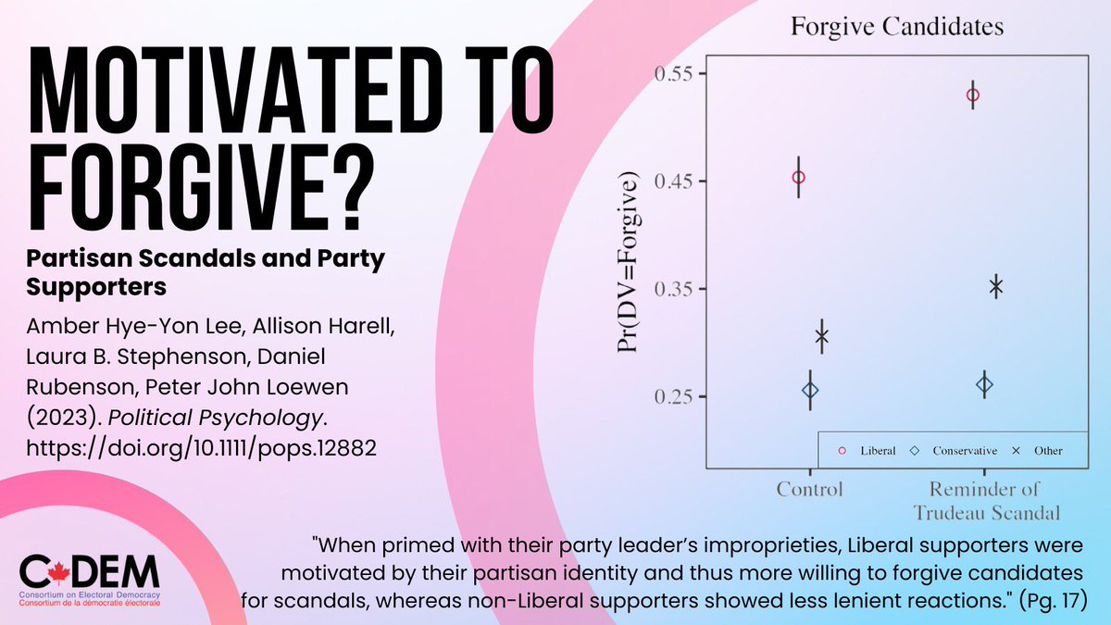
Research Output
In our midterm report:
5 books
23 articles
7 book chapters
14 articles under review
7 public reports (usually in collaboration with partners)
Research report contract with Elections Canada
Draft reports presented this afternoon!
Notes:
New publications
New working papers (with Q. Albaugh)
Measuring Transgender and Non-Binary Identities in Online
Surveys: Evidence from Two National Election Studies
From Gender Gap to Gender Gaps: Bringing Nonbinary People
into Political Behavior Research

Slide 11
Partner Updates

Slide 12
Discussion

Slide 13
What have we done well?
What new things should we try?
What should we do more of?
What can we do better?

