Slide 1
Notes:
Challenges for democracy:
Low levels of turnout comparatively
Populism is on the rise. Both a backlash to diversity as well as feeling that government is not affected. Good and bad to this, challenging for governments.
We don’t know how democracy will unfold in digital times. How people get information and how that matters for views of democracy are not yet known and need to be explored.
We don’t know enough about how democracy works between elections, and how it is changing. This is a black box we hope to explore.
We were ranked 7/25 in our field.

Slide 2
C-Dem Partner Meeting 2020 - Agenda
9-9:30 am - Introductions and Report from the Co-Directors
9:30-9:45 - Report from Elections Canada
9:45-10:00 - Report from Samara
10:00-10:20 - Report from Apathy / Democracy XChange
10:20-10:30 - Break
10:30 - Report from Elections Ontario
10:45-11:30 - Group discussion, next steps

Slide 3
C-Dem Network
Est. Mar. 28, 2019
Academic
Western University, UQAM, Ryerson University, Munk School of Global Affairs, CSDC, CORA, IIGR, LISPOP
Electoral Management Bodies
Elections BC, Elections Manitoba, Elections Saskatchewan, Elections Ontario, Elections PEI
Stakeholder: Elections Canada
Civil Society Organizations
Samara Canada, CIVIX, Forum of Young Canadians, Apathy is Boring, Global Centre for Pluralism
Other
IRCC, Democratic Reform Group, Tlicho Government
Innovative Research Group
Institute for Research on Public Policy
Notes:
C-Dem is a dynamic research network that addresses urgent questions about political engagement, underrepresentation, levels of government, and the evolution of public opinion between and across elections.

Slide 4
Academic Network
Co-Investigators
Cameron Anderson, Western
David Armstrong, Western
Éric Bélanger, McGill University
Loleen Berdahl, University of Saskatchewan
Amanda Bittner, Memorial University
Ruth Dassonneville, Université de Montréal
Joanna Everitt, UNB– St. John
Royce Koop, University of Manitoba
J. Scott Matthews, Memorial University
Mark Pickup, Simon Fraser University
Maryse Potvin, Université du Québec à Montréal
Jason Roy, Wilfrid Laurier University
Jerald Sabin, Bishop’s University
Jared Wesley, University of Alberta
Collaborators
Christopher Alcantara, Western
John Beebe, Ryerson University
Marc-André Bodet, Laval University
Jake Bowers, University of Illinois at Urbana-Champaign
Arnaud Dellis, Université du Québec à Montréal
Victoria Esses, University of Western Ontario
Elizabeth Goodyear-Grant, Queen’s University
Tania Gosselin, Université du Québec à Montréal
Valerie-Anne Maheo, Université de Montréal
R. Michael McGregor, Ryerson University
Martin Papillon, Université de Montréal
Dietlind Stolle, McGill University
John Zoe, University of Alberta
Advisory Council
John Aldrich, Duke University
Keith Archer, Retired Chief Electoral Officer, Elections BC
André Blais, Université de Montréal
Patrick Fournier, Université de Montréal
Elisabeth Gidengil, McGill University
Leonie Huddy, Stoney Brook University
Shanto Iyengar, Stanford University
Richard Johnston, University of British Columbia
Stuart Soroka, University of Michigan
Elizabeth Zechmeister, Vanderbilt University

Slide 5
Democracy Checkup (DC) |  |  |  | Canadian Election Study (CES) |  | Democracy Checkup (DC)
2019 |  |  |  | Campaign Period (CPS) | Post Election (PES) | 2020
May | June | July | Aug. | DC CPS | DC PES | March | May
n=1331 | n=1249 | n=1250 | n=1244 | N=2633 (51.9% RTS) | n=2037 (40.2% RTS) | n=1383 (27.3% RTS) | n≈1000
 |  |  |  | Online CPS | Online PES
 |  |  |  | Sept. 13-Oct. 21 | Oct. 24-No. 11
 |  |  |  | n=37,822 | n=10,337 (27.3% RTS)
 |  |  |  | Phone CPS | Phone PES
 |  |  |  | Sept. 12-Oct. 21 | Oct. 22-Nov. 22
 |  |  |  | n=4021 (5.6% RR) | n=2889 (71.8% RTS)
 |  |  |  |  |  | May | May
 |  |  |  |  |  | May 4 soft launch | ?
 |  |  |  |  |  | n≈8000 | n≈4000
n=5074 |  |  |  | n=44,476 | n=15263 | expected n≈14,383
Publicly released May 1, 2020
Project Dataverse
Soon available at CORA
Notes:
N=74,196 TOTAL including the 8k this week.
N=79,196 if include follow-ups.

Slide 6
Data-Related Activities in 2019-2020
Module Competitions
2019 Module Competition (June, Canadian Election Study) – 1 Postdoc, 1 Student
2020 Module Competition (January, DC or PTES-SK) – 1 Postdoc, 2 Students
Instrument Development
EMB Consultation Survey (Summer 2019)
Module Sales (20+ External Modules – Faculty, Students, NGOs)
Reporting
Researcher Meeting (November 2019)
Advisory Council Meeting (February, 2020)
CES Data Release I (May); Release II (November)
Notes:
Note that the research competitions have resulted in good uptake.

Slide 7
Planned Surveys 2020-2026
 | Democracy Checkup (N>8000) | Canadian Election Study | Provincial / Territorial Election Study (PTES) (N~1500)
2020 | ✓ |  | SK
2021 | ✓ | ? | BC, NS
2022 | ✓ | ? | NB, NL, ON, QC, Tłı̨cho Gov’t
2023 | ✓ | ? | AB, MB, PEI
2024 | ✓ | ?
2025 | ✓ | ?
2026 | ✓ | ?

Slide 8
Knowledge Mobilization Activities

Slide 9
Knowledge Mobilization, 2019-2020
C-Dem Partner Meeting at Global Centre for Pluralism, May 2019
14 non-university partners
CPSA Researcher Lunch, June 2019
APSA, “The Current State of National Election Studies”, September 2019
C-Dem Local Launch (UQAM), September 2019
November Researcher Meeting, November 2019
Debate Commission Report, December 2019
Various interventions by CES team in academic events:
MISC, Representation and Indigenous Peoples, Cybersecurity (UQAM, Ottawa); Ryerson Democracy Chair; Minority Groups in the 2019 Election (Memorial)

Slide 10
Knowledge Mobilization, 2019-2020
C-Dem website: https://c-dem.ca
Facebook page: https://www.facebook.com/CDemCanada
Twitter account: @C_Dem_Canada

Slide 11
Upcoming Knowledge Mobilization
VOTE19 Summit (April 30, Toronto) postponed until fall
C-Dem Forum (May 4, UQAM)
May 5: Elections Québec working group meeting on mobilization interventions cancelled
CPSA (June, Western) cancelled
Pre-workshop, “Working with the 2019 CES data” (June 1)
June 3: Lunchtime talk with Elections Canada on cyber security
Workshop, “Understanding Electoral Democracy: The 2019 Canadian Election in Perspective” (June 4)
C-Dem Reception (June 4)
Workshop, Survey Design Under Constraints: Best Practices (July, Western) postponed
APSA Roundtable, “How should we study elections?” (Sept., San Francisco)

Slide 12
Training Activities

Slide 13
Training Activities 2019-2020
2019-20:
Training Opportunities for HQP
Programmer (Ryerson) + Admin Staff (Western; UQAM)
2 Postdoctoral Fellows (Western – Joanie Bouchard; UQAM – Laura French Bourgeois)
3 PhD Students (Toronto) plus multiple research assistants across institutions
CPSA Training Workshop (postponed)
Development and Piloting of CES Teaching Tool
Planning for internship opportunities with 2 partners (Samara, Elections Ontario)
Upcoming training activities
Training Modules
Online Teaching Tool Release

Slide 14
Key Outputs

Slide 15
Key C-Dem Outputs
Electoral Management Body (EMB) Report
CES Teaching Tool (beta version)
Working Papers and Analyses
Policy Options
Debate Commission Report
New Collaborations

Slide 16
“In terms of fairness, 46% of Canadians believe that Elections Canada ran the 2019 election somewhat fairly, while 36% believe Elections Canada was very fair...Notably, among those who did not vote 23% did not know or preferred not to answer this question. “
Notes:
** We could add a figure or two here from the report.

Slide 17
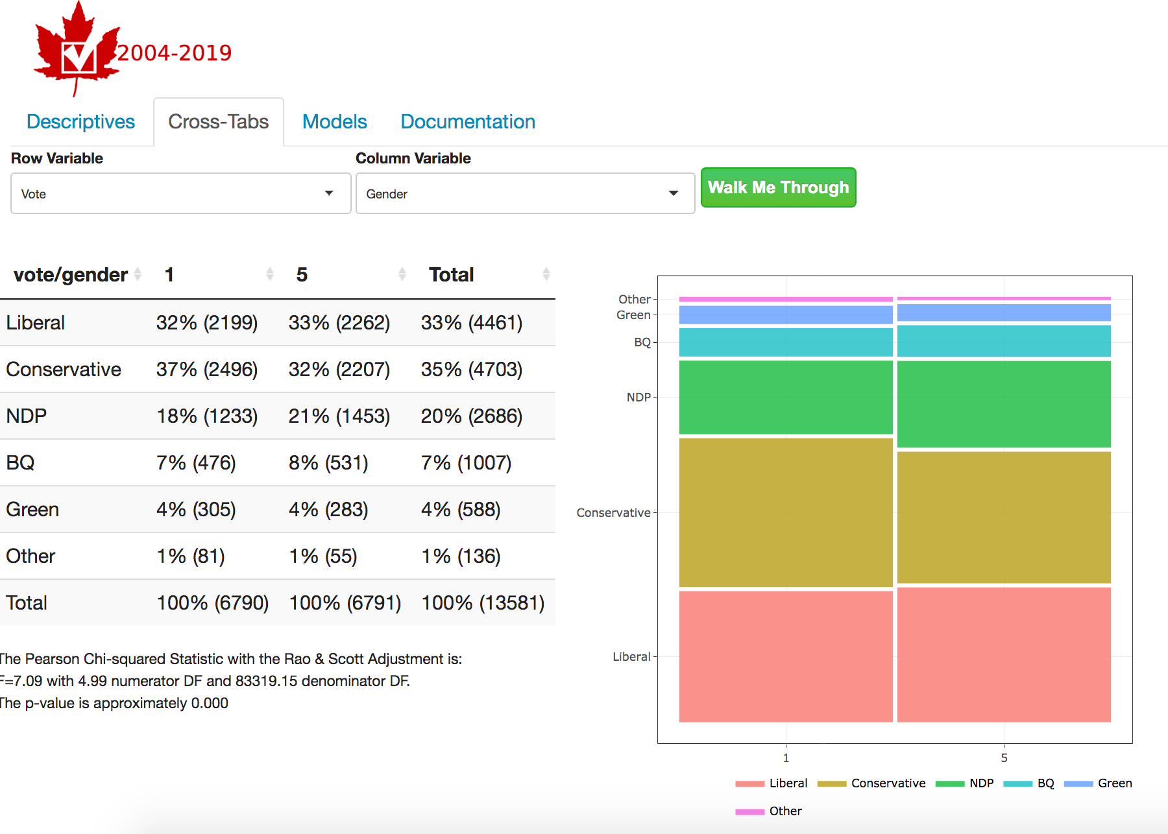
Notes:
https://quantoid.shinyapps.io/CES_2020/
Collaboration between : Centre for Computational and Quantitative Social Science and C-Dem

Slide 18
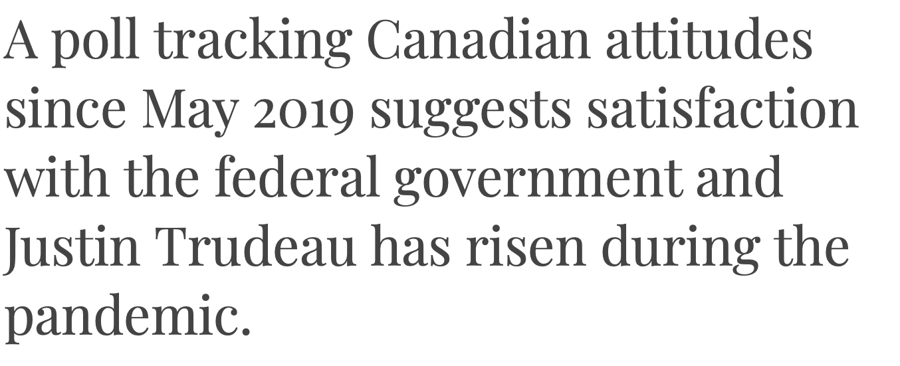

Slide 19
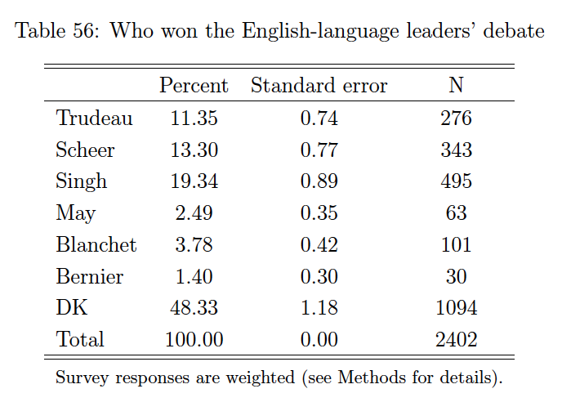
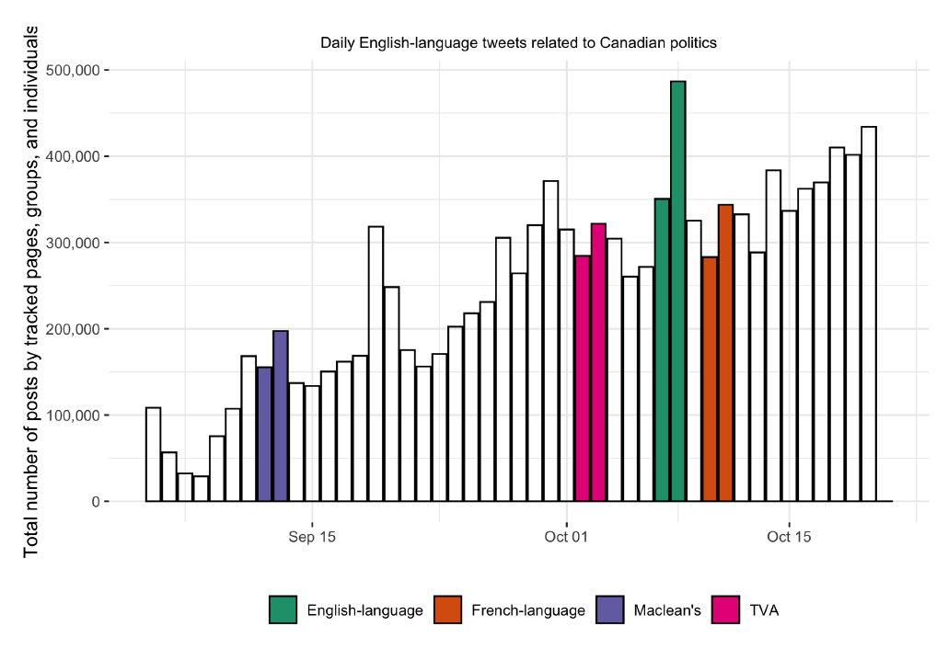

Slide 20
New Collaborations
Latin American Public Opinion Project (Vanderbilt)
Centre for Computational and Quantitative Social Science (Western)
Elections Québec
Mosaic Institute

Slide 21
Current Research Projects (selection)
Understanding the 2019 election in context
Social bases of partisanship in Canada
Comparing survey responses by sampling and mode
Impact of partisan cues on attitude formation
Social norms and voting behaviour
Political culture and provincial vote outcomes
Impact of COVID-19 on trends in attitudes toward diversity and inclusion
Voting blocs and heterogeneity in subgroup samples

Slide 22
Partner Reports

Slide 23
Discussion Period

Slide 24
Guiding Questions
Do other partners have activities they would like to share with the group?
What activities, tools, or data would be most useful in the coming 24 months for your organization?
Where do you see areas of growth or future collaboration possibilities?
What can we do better to foster communication in the coming year?

