Slide 1
Notes:
Challenges for democracy:
Low levels of turnout comparatively
Populism is on the rise. Both a backlash to diversity as well as feeling that government is not affected. Good and bad to this, challenging for governments.
We don’t know how democracy will unfold in digital times. How people get information and how that matters for views of democracy are not yet known and need to be explored.
We don’t know enough about how democracy works between elections, and how it is changing. This is a black box we hope to explore.
We were ranked 7/25 in our field.

Slide 2
C-Dem Network
Est. Mar. 28, 2019
Academic
Western University, UQAM, Ryerson University, Munk School of Global Affairs, CSDC, CORA, IIGR, LISPOP
Electoral Management Bodies
Elections BC, Elections Manitoba, Elections Saskatchewan, Elections Ontario, Elections PEI
Stakeholder: Elections Canada
Civil Society Organizations
Samara Canada, CIVIX, Forum of Young Canadians, Apathy is Boring, Global Centre for Pluralism
Other
IRCC, Democratic Reform Group, Tlicho Government
Innovative Research Group
Institute for Research on Public Policy
Notes:
C-Dem is a dynamic research network that addresses urgent questions about political engagement, underrepresentation, levels of government, and the evolution of public opinion between and across elections.

Slide 3
Academic Network
Co-Investigators
Cameron Anderson, Western
David Armstrong, Western
Éric Bélanger, McGill University
Loleen Berdahl, University of Saskatchewan
Amanda Bittner, Memorial University
Ruth Dassonneville, Université de Montréal
Joanna Everitt, UNB– St. John
Royce Koop, University of Manitoba
J. Scott Matthews, Memorial University
Mark Pickup, Simon Fraser University
Maryse Potvin, Université du Québec à Montréal
Jason Roy, Wilfrid Laurier University
Jerald Sabin, Bishop’s University
Jared Wesley, University of Alberta
Collaborators
Christopher Alcantara, Western
John Beebe, Ryerson University
Marc-André Bodet, Laval University
Jake Bowers, University of Illinois at Urbana-Champaign
Arnaud Dellis, Université du Québec à Montréal
Victoria Esses, University of Western Ontario
Elizabeth Goodyear-Grant, Queen’s University
Tania Gosselin, Université du Québec à Montréal
Valerie-Anne Maheo, Université de Montréal
R. Michael McGregor, Ryerson University
Martin Papillon, Université de Montréal
Dietlind Stolle, McGill University
John Zoe, University of Alberta
Advisory Council
John Aldrich, Duke University
Keith Archer, Retired Chief Electoral Officer, Elections BC
André Blais, Université de Montréal
Patrick Fournier, Université de Montréal
Elisabeth Gidengil, McGill University
Leonie Huddy, Stoney Brook University
Shanto Iyengar, Stanford University
Richard Johnston, University of British Columbia
Stuart Soroka, University of Michigan
Elizabeth Zechmeister, Vanderbilt University

Slide 4
C-DEM GOVERNANCE STRUCTURE
Advisory Committee (AC)
International experts, former CES investigators & strategic stakeholders
Executive Committee (EC)
Co-Directors: Laura Stephenson (Western), Allison Harell (UQAM)
Peter Loewen (University of Toronto), Daniel Rubenson (Ryerson University)
C-Dem Project Manager: Barbara Oram
Committee Roles
Advisory Committee: Strategic advice to EC
Co-Directors: Management and operations
Executive Committee: Strategic decision-making
Scientific Committee: Survey design
Knowledge Mobilization Committee: Event & activity planning
Training Committtee: Student, partner and stakeholder training
Data Collection Committees (CESC, DCC & PESC): survey implementation
Module Committees (MCC & SMRC): module competitions
Scientific Committee (SC)
Chair: Stephenson
Members: EC, methods experts, Innovative Research Group
Knowledge Mobilization Committee (KMC)
Chair: Harell
Members: Samara, CSDC, IRPP,
Apathy is Boring, 1 EMB/year,
C-Dem postdoc
Training Committee (TC)
Chair: Rotating
Dave Armstrong, Loleen Berdahl, Jason Roy,
C-Dem postdoc
c-dem.ca
admin@c-dem.ca
Canadian Election Study Committee (CESC)
Chair:
Stephenson
Democracy Checkup Committee (DCC)
Chair: Harell
Provincial Election Study Committee (PESC)
Chair:
Stephenson
Module Competition Committee (MCC)
Chair:
Dassonneville
Student Module Review Committee (SMRC)
Chair:
Harell
University of Western Ontario
Social Science Centre, Room 6228
London, ON, Canada N6A 5C2
Phone: 519-661-2111 ext. 86158
Université du Québec a Montréal
C.P. 8888, succursale Centre-ville
Montréal, QC, Canada H3C 3P8
Tél: 514-987-3000 poste
May 22, 2019

Slide 5
2019 Surveys
Democracy Checkup (DC)
Political Attitudes, Participation, Support for Democracy and Democratic Values, Attitudes toward Diversity
May
N=1331
CES Campaign Period
June
N=1249
July
N=1250
Aug.
N=1244
DC
Mar. ‘20
Online CPS
Sept.13-Oct.21
N=37,822
Phone CPS
Sept.12-Oct. 21
N=4021, 5.6% RR
Online PES
Oct.24-Nov.11
N=10,337, 27.3% RTS
Phone PES
Oct.22-Nov.22
N=2889, 71.8% RTS
CES Post-Election
DC CPS (Oct.)
N=2633, 51.9% RTS
DC PES (Nov.)
N=2037, 40.2% RTS
Notes:
Note instrument in packet.
Mention lots of opportunity for partner involvement. – modules, contracts with data, consultation on questions, oversamples, etc.

Slide 6
2019 CES: Phone Survey
20 Minute Survey: Pre/Post within Budget with ideal RTS 75% |  |  |  |  |  | $300,000.00
Survey Wave 1 - # of respondents | Survey Wave 1 - Unit Price (Cost Per Respondent) | Survey Wave 2 - # of respondents | Survey Wave 2 - Unit Price (Cost Per Respondent) | Additional Fees
5000 | $25.64 | 3000 | $12.42 | $26,300.00 |  | $191,760.00
3430 | $48.00 | 2401 | $40.00 | $4,750.00 |  | $265,430.00
3750 | $86.72 | 1500 | $82.67 |  |  | $449,205.00
6000 | $38.33 | 1500 | $43.33 |  |  | $294,975.00
2000 | $62.50 | 1500 | $38.67 | $105,000.00 |  | $288,005.00
2000 | $45.60 | 1200 | $35.10 | $57,500.00 |  | $190,820.00
2000 | $58.80 | 1500 | $63.93 | $49,200.00 |  | $262,695.00
1850 | $95.59 | 1388 | $44.05 | $25,350.00 |  | $263,332.90

Slide 7
2019 CES: Phone Survey
Firm: Advanis
Restricted to citizens
Quota for region (20% each ON, QC, BC, MB/SK/AB, NL/PE/NS/NB)
N= 4021 (targeted 308/day)
Random selection from phone number lists and RDD
70/30 cell/landline
Integrated phone/web option for PES
Bilingual questionnaire
20 min pre / 20 min post
Pre was restricted set of base, Post was largely CSES
Notes:
FYI, I just got some clarity on the phone data collection. It’s not all RDD. They purchased a list of landline working phone #s and supplemented it with 10% RDD to catch unlisted #s. Supposedly this 90/10 is industry standard and far more efficient because they do not call #s that don’t exist. Their wireless list is based on a master list they have compiled over years that also excludes non-working #s. They do RDD to make the list and then sample from that. Just wanted to put it out there so we’re all on the same page and don’t claim RDD.
5.6% response rate

Slide 8
CES 2019: Phone Survey
Province |  | CPS Completes | Email First |  | Total Completes | Phone Completes | Web Completes |  | Response Rate to Date
Newfoundland and Labrador |  | 201 | 51 |  | 145 | 112 | 33 |  | 72%
Prince Edward Island |  | 201 | 58 |  | 153 | 114 | 39 |  | 76%
Nova Scotia |  | 200 | 54 |  | 147 | 112 | 35 |  | 74%
New Brunswick |  | 201 | 59 |  | 145 | 111 | 34 |  | 72%
Quebec |  | 802 | 280 |  | 565 | 402 | 163 |  | 70%
Ontario |  | 807 | 286 |  | 562 | 381 | 181 |  | 70%
Prairies |  | 805 | 269 |  | 600 | 431 | 169 |  | 75%
British Columbia |  | 804 | 271 |  | 572 | 404 | 168 |  | 71%
Total |  | 4,021 | 1,328 |  | 2,889 | 2,067 | 822 |  | 72%

Slide 9
CES 2019: Phone Survey
Notes:
Response Rates, compared to 2015
(This is blurry – do we have a better image?)

Slide 10
CES 2019: Phone Survey
Notes:
Response Rates, compared to 2015
(This is blurry – do we have a better image?)

Slide 11
CES 2019: Online Survey
CES Public Data
17 minutes
CORE SURVEY
Base
Core CES
CES Split Samples
CES Split Samples
Restricted
4.5 minutes
MODULES
Internal (17)
Competition (2)
External (18)

Slide 12
CES 2019: Online (Qualtrics)
Vendor | Initial Survey | Completes | %Completes
PID | 15649 | 6412 | 40.97%
viga | 8869 | 1110 | 12.52%
rid | 3763 | 1157 | 30.75%
r | 3029 | 2129 | 70.29%
gid | 902 | 646 | 71.62%
id | 240 | 2 | 0.83%
uig | 236 | 34 | 14.41%
vid | 208 | 145 | 69.71%
cintid | 196 | 196 | 100.00%
ppsid | 165 | 0 | 0.00%
As of Nov. 8, pre-cleaning

Slide 13
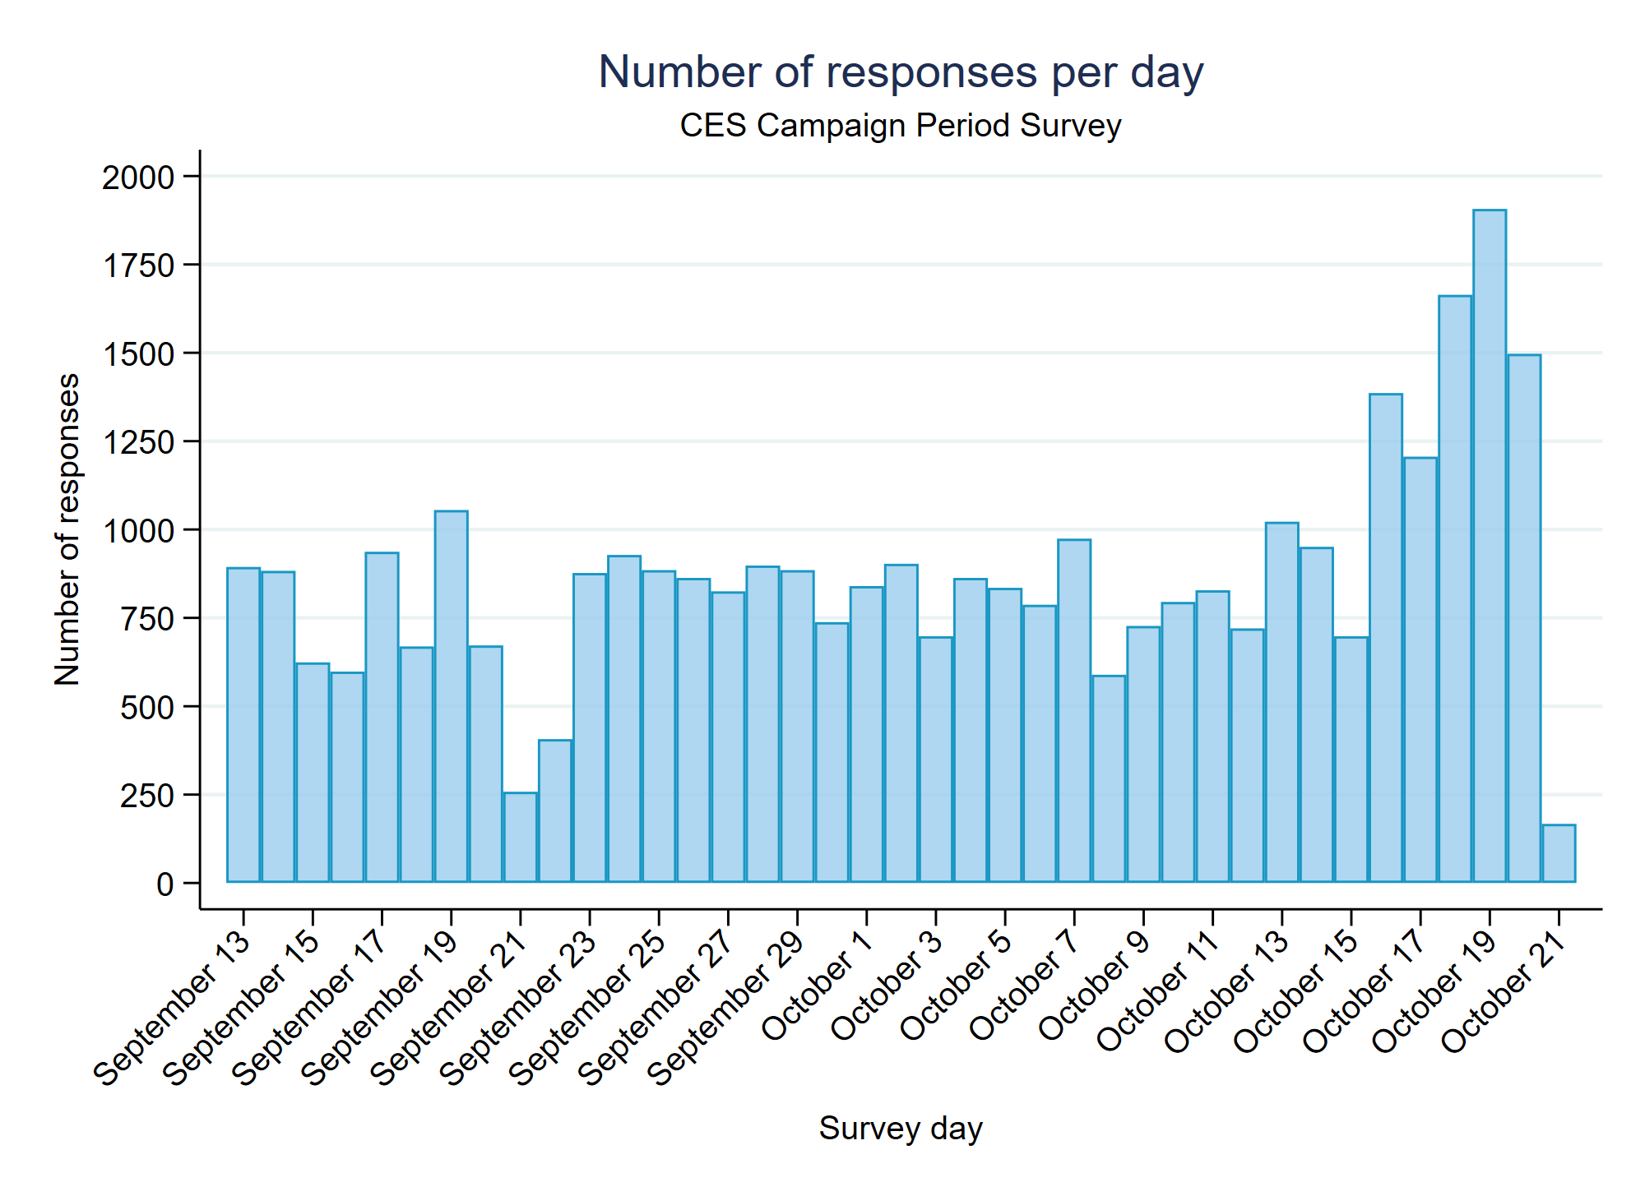
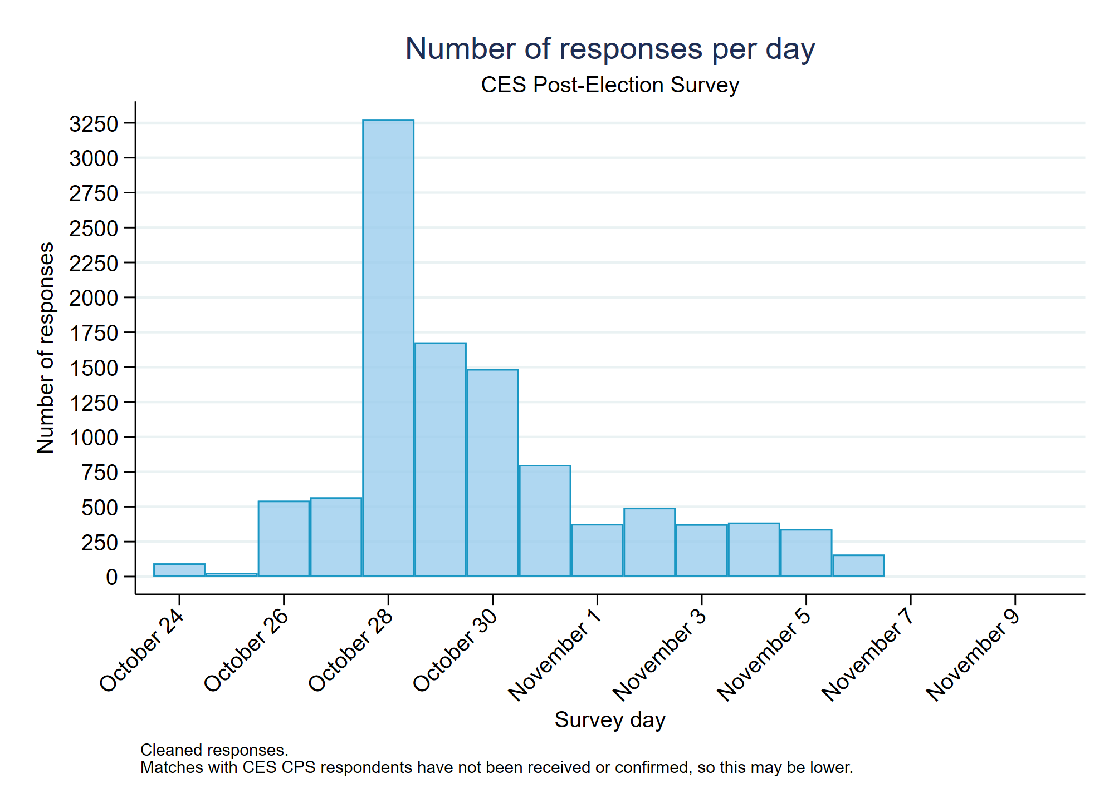
CES 2019: Online
Notes:
Update pes table if Ben gets to it.

Slide 14
CES 2019: Online Modules
Peer-Reviewed Module Competition
Researcher Stream: Dassonville (chair), Rubenson, Soroka
PhD Student Stream: Harell (chair), Roy, Bélanger
External Modules (purchased space)
Coordinated through Ryerson using 2015 LPP model
20 modules
17 faculty, 2 postdocs, 4 students
17 Canadian, 3 US

Slide 15
CES 2019 Post Mortem
Strengths
Weaknesses
Challenges
Opportunities
Mode and importance of sample quality?
Size of sample versus oversampling subgroups?
What analyses need done?
How to promote data use?

Slide 16
Planned Surveys
 | Democracy Checkup (N>8000) | Canadian Election Study | Provincial / Territorial Election Study (PTES) (N~1500)
2020 | ✓
2021 | ✓ | ? | Saskatchewan
2022 | ✓ | ? | Nova Scotia, BC, Tłı̨cho Government
2023 | ✓ | ? | Ontario, Quebec, New Brunswick
2024 | ✓ | ? | Manitoba, Alberta, PEI, Newfoundland
2025 | ✓
2026 | ✓

Slide 17
Activities in 2020 : Data
Annual Module Competition (January) – 12 Faculty/Other, 7 Student
Advisory Council Meeting (February)
How can we take full advantage of collective wisdom of this group?
Future meetings?
2020 Democracy Checkup (March/April)
CES Data Release I (April); Release II (November)
PTES Studies : SK, possibly NB

Slide 18
Activities in 2019 : KM Activities
C-Dem Partner Meeting at Global Centre for Pluralism, May 2019
14 non-university partners
CPSA Researcher Lunch June 2019
Module Competition June 2019
APSA 2019 “The Current State of National Election Studies”
C-Dem Local Launch September 2019
November Researcher Meeting Nov. 2019
Debate Commission Report
Various interventions by CES team in fall 2019 academic events:
MISC, Representation and Indigenous Peoples, Cybersecurity (UQAM, Ottawa); Ryerson Democracy Chair

Slide 19
Activities in 2020 : KM Activities
VOTE19 Summit (April 30, Toronto)
C-Dem Forum (May 4, UQAM)
May 5: Elections Québec working group meeting on mobilization interventions
CPSA (June, Western)
Pre-workshop, “Working with the 2019 CES data” (June 1)
June 3: Lunchtime talk with Elections Canada on cyber security
Workshop, “Understanding Electoral Democracy: The 2019 Canadian Election in Perspective” (June 4)
C-Dem Reception (June 4)
Workshop, Survey Design Under Constraints: Best Practices (July, Western)
APSA Roundtable, “How should we study elections?”

Slide 20
Year to Year Funding (SSHRC and Partners)
SSHRC | 2019-20 | 2020-21 | 2021-22 | 2022-23 | 2023-24 | 2024-25 | 2025-26 | TOTAL | NOTES
PG Funds | $ 499,050 | $ 246,330 | $ 298,600 | $ 499,210 | $ 499,330 | $ 224,000 | $ 233,480 | $ 2,500,000
Insight Funds | $ 128,606 | $ 73,144 | $ 73,144 | $ 44,797
PARTNERS
RYERSON UNIVERSITY
Cash | 25,000 | 25,000 | 25,000 | 25,000 | 25,000 | 25,000 | 25,000 | $175,000 | Participation of Student Programmer
 | $25,016 | $25,016 | $25,016 | $25,016 | $25,016 | $25,016 | $25,016 | $175,112 | Participation of Research Assistants at Ryerson
 | $5,000 | $5,000 | $5,000 | $5,000 | $5,000 | $5,000 | $5,000 | $35,000 | Travel costs of Dr. Rubenson & students to C-Dem events
 | $2,000 | $2,000 | $2,000 | $2,000 | $2,000 | $2,000 | $2,000 | $14,000 | Cost of meeting space and project communication
Total cash |  |  |  |  |  |  |  | $399,112
UNIVERSITÉ DU QUEBÉC À MONTRÉAL (UQAM)
Cash | $4,000 | $4,000 | $4,000 | $4,000 | $4,000 | $4,000 | $4,000 | $28,000 | Annual contribution to C-Dem activities
 | $11,900 |  |  |  |  |  |  | $11,900 | Teaching reduction re: Dr. Harell's C-Dem responsibilities
 | $700 | $700 | $700 | $700 | $700 | $700 | $700 | $4,900 | Annual student scholarship for 2 students @ $350
 | $10,000 | $10,000 | $10,000 |  |  |  |  | $30,000 | 3-year research grant for PhD student re: C-Dem Project
Total cash |  |  |  |  |  |  |  | $74,800
In-kind | $10,500 | $10,500 | $10,500 | $10,500 | $10,500 | $10,500 | $10,500 | $73,500 | Provision of C-Dem office space at UQAM for 7 yrs
 | $15,000 |  |  |  |  |  |  | $15,000 | Provision of office, e.g., install telephone line
 | $465 | $465 | $465 | $465 | $465 | $465 | $465 | $3,255 | Provision of access to video-conferencing for 7 yrs
 |  |  |  |  |  |  |  | $16,310 | Other in-kind support over 7 yrs
Total in-kind |  |  |  |  |  |  |  | $108,065
UNIVERSITY OF TORONTO
Cash | $10,000 | $10,000 | $10,000 |  |  |  |  | $30,000 | Provision of 0.5 FCE research leave for P. Loewen
 | $12,000 | $12,000 | $12,000 | $12,000 |  |  |  | $48,000 | Support studentship in the C-Dem Project for 4 yrs
Total cash |  |  |  |  |  |  |  | $78,000
Total in-kind | $12,000 | $12,000 | $12,000 | $12,000 |  |  |  | $48,000 | Provision of C-Dem related office and meeting space
WESTERN UNIVERSITY
Cash | $57,245 | $57,245 | $57,245 | $57,245 | $57,245 | $57,245 | $57,245 | $400,715 | Support of C-Dem Project
 |  |  |  |  |  |  |  | $1,339 | Contribution to cost of workshop hospitality over 7 yrs
Total cash |  |  |  |  |  |  |  | $402,054
Total in-kind | $52,860 | $52,860 | $52,860 | $52,860 | $52,860 | $52,860 | $52,860 | $370,020 | Support of training, knowledge mobilization & project administration

Slide 21
Budget Overview
EXPENSES 2019-20 | Projected | Actual
Meetings
Partner Meeting May | $ 5,000 | $ 1,343
APSA Meetings | $ 625 | $ 1,491
Researcher Meeting TPBW | $ 10,000 | $ 15,702
CPSA Workshops/Meetings | $ 750 | $ 3,318
Advisory Meeting | $ 6,000 | $
Montreal (UQAM funds) Events | $ 2,000 | $
Toronto (RU funds) Events | $ 2,000 | $
Other C-Dem Event Travel | $ 10,000 | $ 2,198
Data Collection
CES Phone Survey | $ 300,000 | $ 180,345
Online CES | $ 120,214 | $ 148,910
Online DC | $ 47,702 | $ 46,644
Contracts |  | $ 30,550
Personnel
Western Postdoc | $ 47,385 | $ 47,385
UQAM Postdoc/Administrator | $ 47,385 | $ 47,385
Ryerson Postdoc/Programmer | $ 28,000 | $ 28,000
Western Project Manager | $ 36,504 | $ 27,378
Sponsored Events
TPBW | $ 5,000 | $ 5,000
Polidocs Contribution | $ 6,000 | $ 6,000
Students
Western | $ 7,000 | $
UQAM | $ 7,000 | $ 7,000
Ryerson (RU Funds) | $ 25,000 | $ -
Toronto (PG) | $ 15,000 | $ 15,000
U of T (student funding) | $ 12,000 | $ 12,000
U of T (contract funding) |  | $ 37,500
Office Supplies (printing, etc.) | $ 500 | $ 105
Overhead and Space Expenses |  | $ 32,773
TOTAL EXPENSES | $ 741,065 | $ 696,027
OPERATING BUDGET
SSHRC PG Funds | $ 499,050
SSHRC Insight Funds (as of 12apr) | $ 128,606
Western Cash | $ 40,000
UQAM Cash | $ 2,000
Ryerson (meetings) | $ 2,000
Ryerson (student funding) | $ 25,000
Toronto (student funding) | $ 12,000
TOTAL OPERATING FUNDS | $ 708,656
DEFICIT/SURPLUS OPERATING FUNDS | $ 12,629
RESTRICTED/OTHER FUNDS TO BE USED
Module Sales | $ 118,225
PG Contracts | $ 99,500
TOTAL DEFICIT/SURPLUS | $ 230,354

Slide 22
Training
2019-20 :
Programmer (Ryerson) + Admin Staff (Western; UQAM)
2 Postdoctoral Fellows (Western – Joanie Bouchard; UQAM – Laura French Bourgois)
3 PhD Students (Toronto) plus multiple research assistants across institutions
2020-21
CPSA Training Workshop
Opportunities for Visiting Students – SSHRC/FQRSC/Fulbright but also short-term visits
Training Modules and Online Tool

