Slide 1
Notes:
Challenges for democracy:
Low levels of turnout comparatively
Populism is on the rise. Both a backlash to diversity as well as feeling that government is not affected. Good and bad to this, challenging for governments.
We don’t know how democracy will unfold in digital times. How people get information and how that matters for views of democracy are not yet known and need to be explored.
We don’t know enough about how democracy works between elections, and how it is changing. This is a black box we hope to explore.
We were ranked 7/25 in our field.

Slide 2
Overview of the Project – Goals
Research Questions
Project Objectives
(Dis)engagement
Political Inequality
Multilevel Governance
Campaign and Overtime Effects
Best Practices for Data Collection
Long-term for the Canadian Election Study
Provincial level and inter-election period
Innovations in data collection
Close collaboration among academics, government and civil society
Train a new generation of HQP
Pool resources for survey collection
Make data and analysis accessible
Notes:
AH: Can we put less text here, and then while we talk, explain what each item means? I changed to just headers (but the original text is below). Also, I think we should do this before we get into the specific objectives so I moved this slide before the next one.
What explains (dis)engagement in electoral politics?
How do underrepresented groups feel about democracy in Canada?
How do Canadian feel toward the federal and provincial governments and democracy?
Are citizen attitudes toward government constant or do they fluctuate with election cycles?
How do you best collect empirical data about political behaviour?

Slide 3
DATA & ANALYSIS REPORTS
Analysis for partner projects
Public access to data
OUTREACH
Democratic Engagement Exchange; workshops; conferences; PoliDoc; Conversation Canada;
C-Dem teaching tool;
Policy Options
SURVEYS
Annual Democracy Checkups
Canada Election Studies (CES)
Provincial and Territorial Election Studies (PES)
ANNUAL FORUM
Survey results reporting
C-Dem business meeting
Stakeholder presentations
TRAINING
Data literacy webinars
Online training
Methods workshops
Partner internships
May, 2019

Slide 4
2019-2020 Surveys
Democracy Checkup (DC)
May
CES Campaign
June
July
Aug.
DC
Wave 4
Large N Online
RDD Telephone
Large N Online
RDD Telephone
CES Post
Wave 2
Wave 3
Notes:
Note instrument in packet.
Mention lots of opportunity for partner involvement. – modules, contracts with data, consultation on questions, oversamples, etc.

Slide 5
Democracy Checkup, May 2019
Field dates: May 21-24, 2019
Sample from Dynata (formerly SSI-Research Now)
Quotas: Age, Gender and Province
Restricted to Citizens and PR
Bilingual Questionnaire
Topics:
Political Attitudes
Participation
Support for Democracy and Democratic Values
Attitudes toward Diversity
Notes:
* Note instrument in packet.

Slide 6
C-DEM GOVERNANCE STRUCTURE
Advisory Committee (AC)
International experts, former CES investigators & strategic stakeholders
Executive Committee (EC)
Co-Directors: Laura Stephenson (Western), Allison Harell (UQAM)
Peter Loewen (University of Toronto), Daniel Rubenson (Ryerson University)
C-Dem Coordinator: James Howard
Committee Roles
Advisory Committee: Strategic advice to EC
Co-Directors: Management and operations
Executive Committee: Strategic decision-making
Scientific Committee: Survey design
Knowledge Mobilization Committee: Event & activity planning
Training Committtee: Student, partner and stakeholder training
Data Collection Committees (CESC, DCC & PESC): survey implementation
Module Committees (MCC & SMRC): module competitions
Scientific Committee (SC)
Chair: Stephenson
Members: EC, methods experts, Innovative Research Group
Knowledge Mobilization Committee (KMC)
Chair: Harell
Members: Samara, CSDC, IRPP,
Apathy is Boring, 1 EMB/year,
C-Dem postdoc
Training Committee (TC)
Chair: Rotating
Dave Armstrong, Loleen Berdahl, Jason Roy,
C-Dem postdoc
c-dem.ca
admin@c-dem.ca
Canadian Election Study Committee (CESC)
Chair:
Stephenson
Democracy Checkup Committee (DCC)
Chair: Harell
Provincial Election Study Committee (PESC)
Chair:
Stephenson
Module Competition Committee (MCC)
Chair:
Dassonneville
Student Module Review Committee (SMRC)
Chair:
Harell
University of Western Ontario
Social Science Centre, Room 6228
London, ON, Canada N6A 5C2
Phone: 519-661-2111 ext. 86158
Université du Québec a Montréal
C.P. 8888, succursale Centre-ville
Montréal, QC, Canada H3C 3P8
Tél: 514-987-3000 poste
May 22, 2019

Slide 7
Responsibilities as a provincial or territorial lead on C-Dem are as follows:
developing the provincial questionnaires from the core survey approved by the Scientific Committee;
consulting with the provincial electoral management body or territorial government on the survey instrument;
conferring with various stakeholders about the survey instrument; and
providing a post data collection report to the Scientific Committee.
~90% core questions, 10% province-specific
Centralized programming
RA funding provided
Survey modules will be sold.
Province | Provincial Election Lead
BC | Mark Pickup
AB | Jared Wesley
SK | Loleen Berdahl
MB | Royce Koop
ON | Cameron Anderson
QC | Éric Bélanger
NB | Joanna Everitt
NS | Jason Roy
PEI | Amanda Bittner
NL | Scott Matthews
NWT | Jerry Sabin

Slide 8
Next Steps
CES Consultation with Stakeholders (Summer 2020)
You will receive an email for a couple minute survey
Module Competition (June 2020)
Deadline June 15
Outreach and Training Events
Election Roundtables (Fall 2019)
CPSA @ Western (June 2020)
Researchers Meeting (Sun. Nov. 10, post TPBW)
C-Dem Forum (May 2020)

Slide 10
Additional Slides

Slide 11
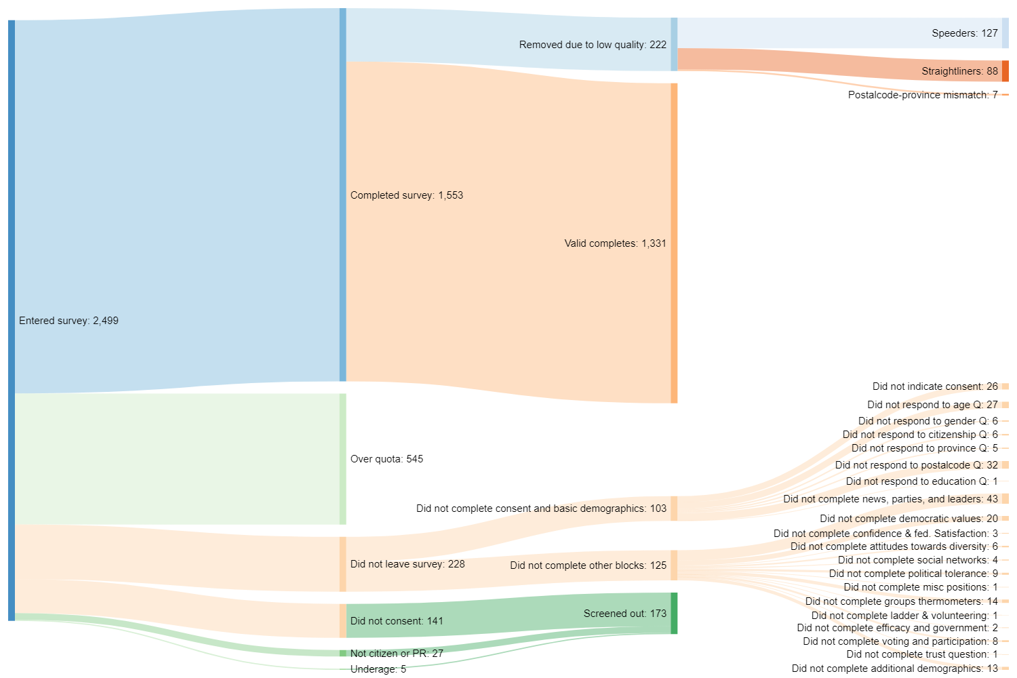

Slide 12
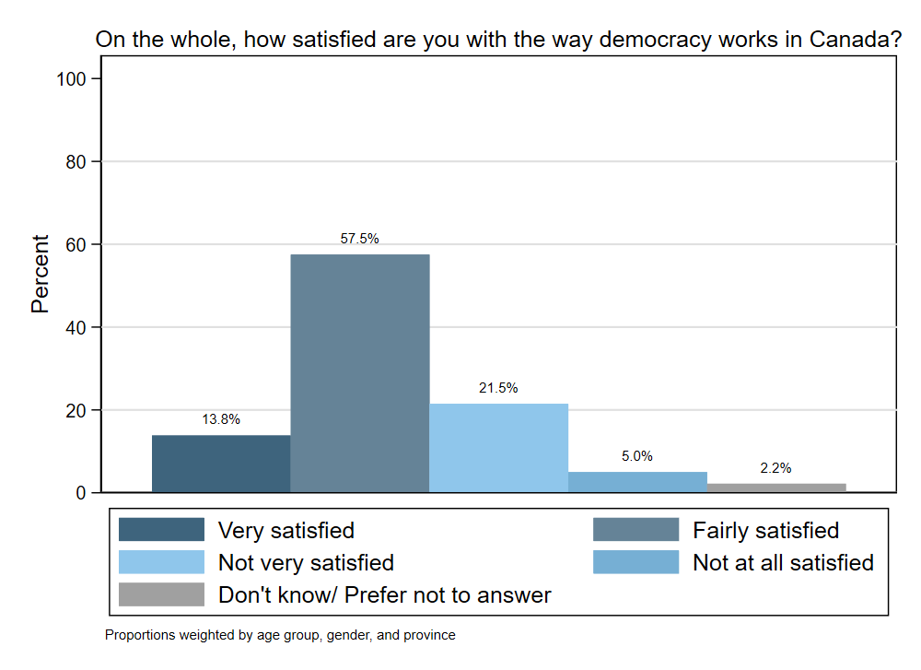

Slide 13
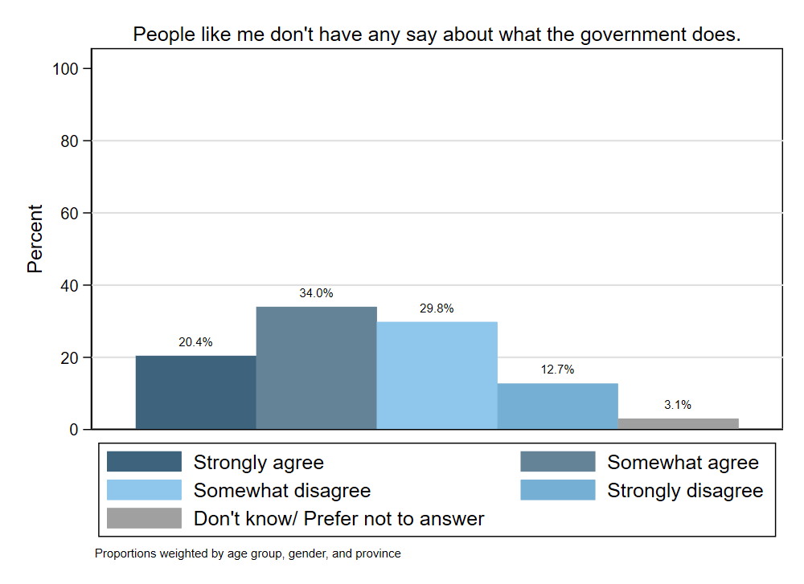

Slide 14
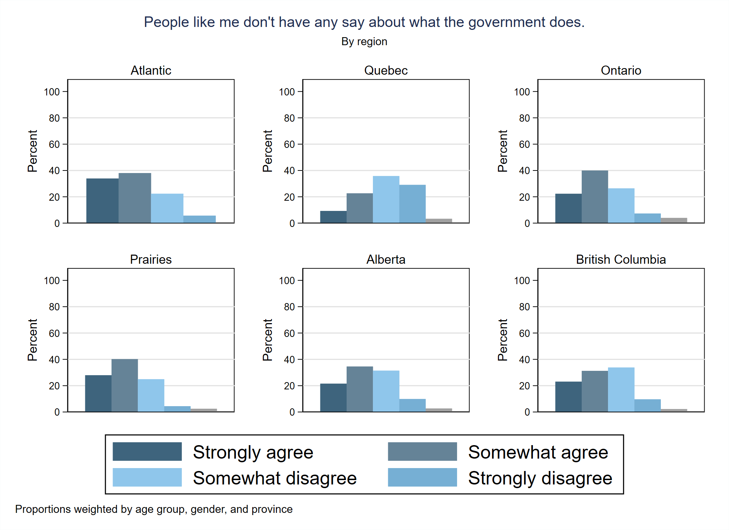

Slide 15
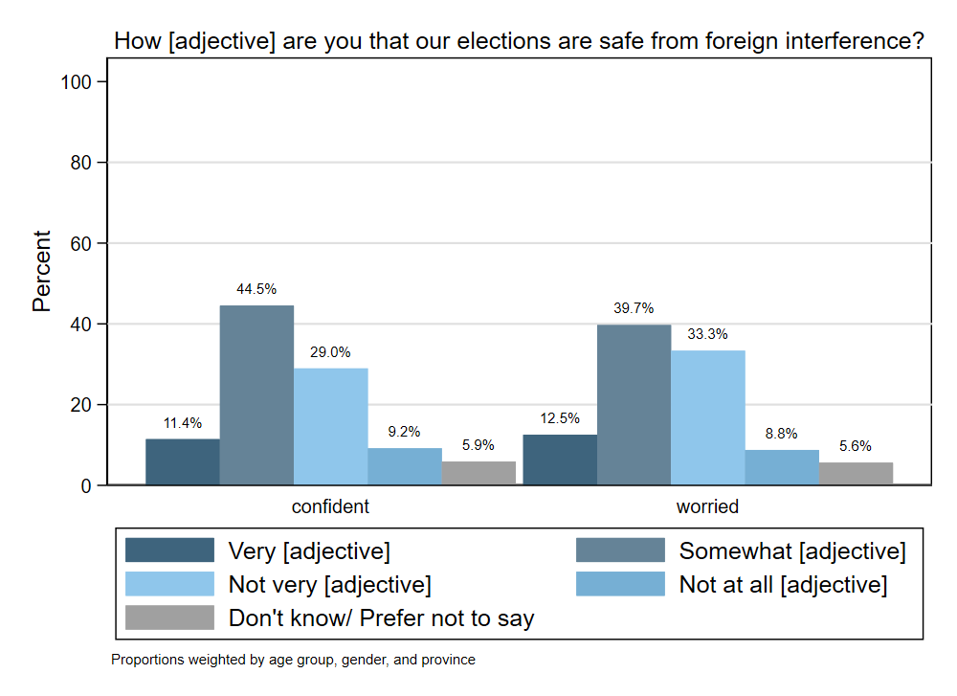

Slide 16
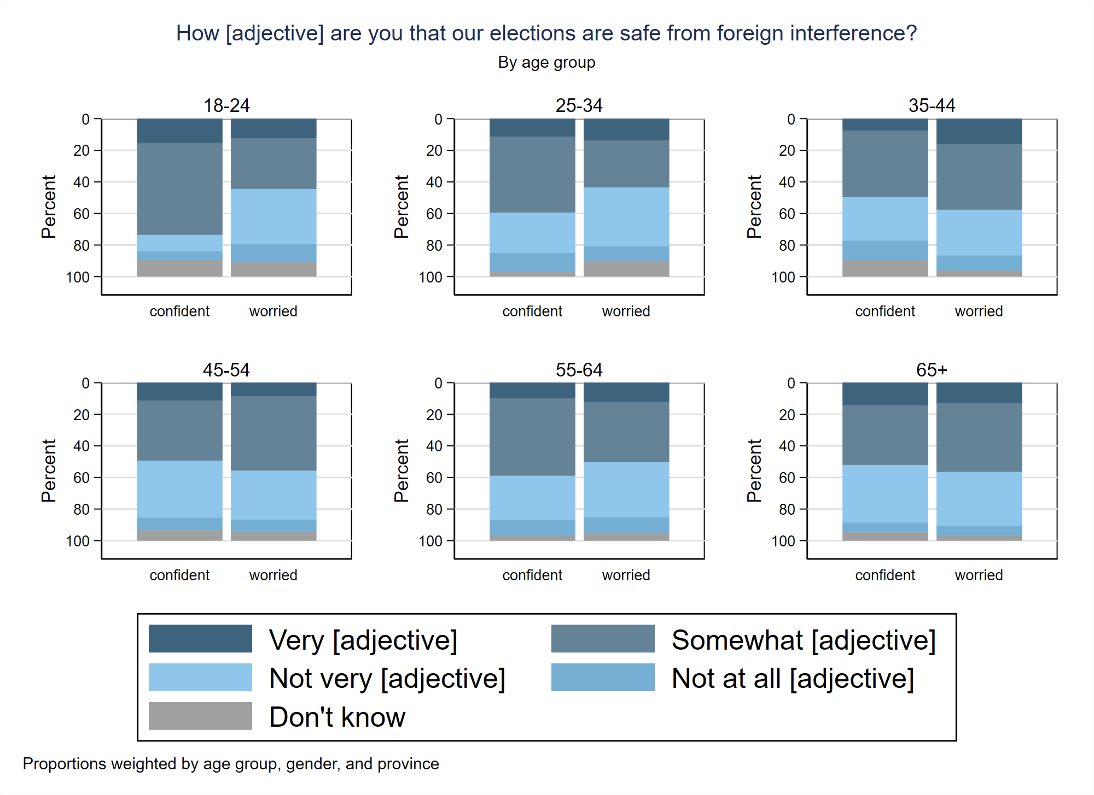

Slide 17
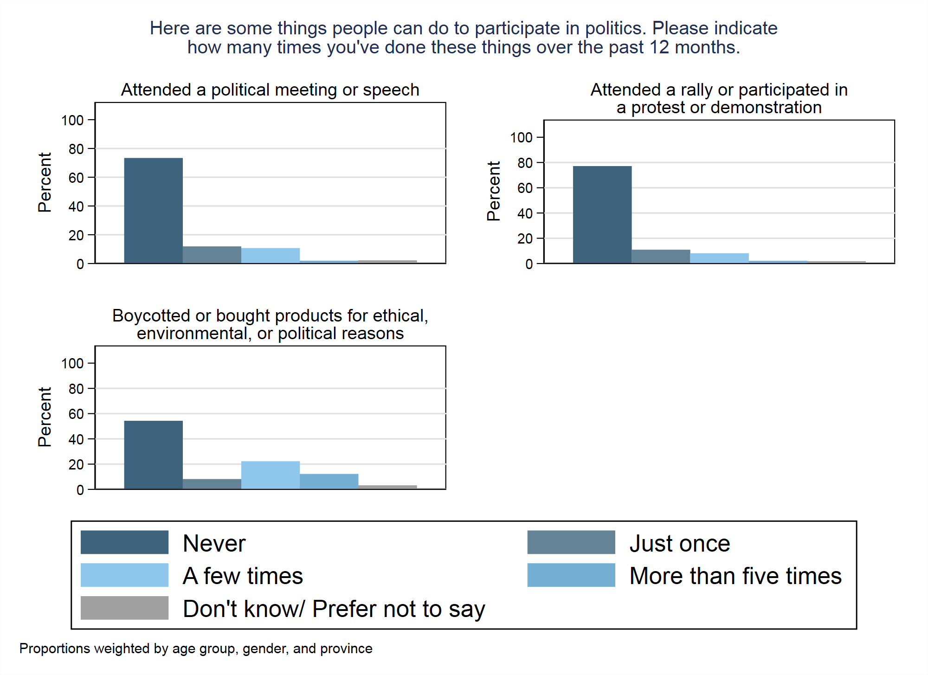

Slide 18
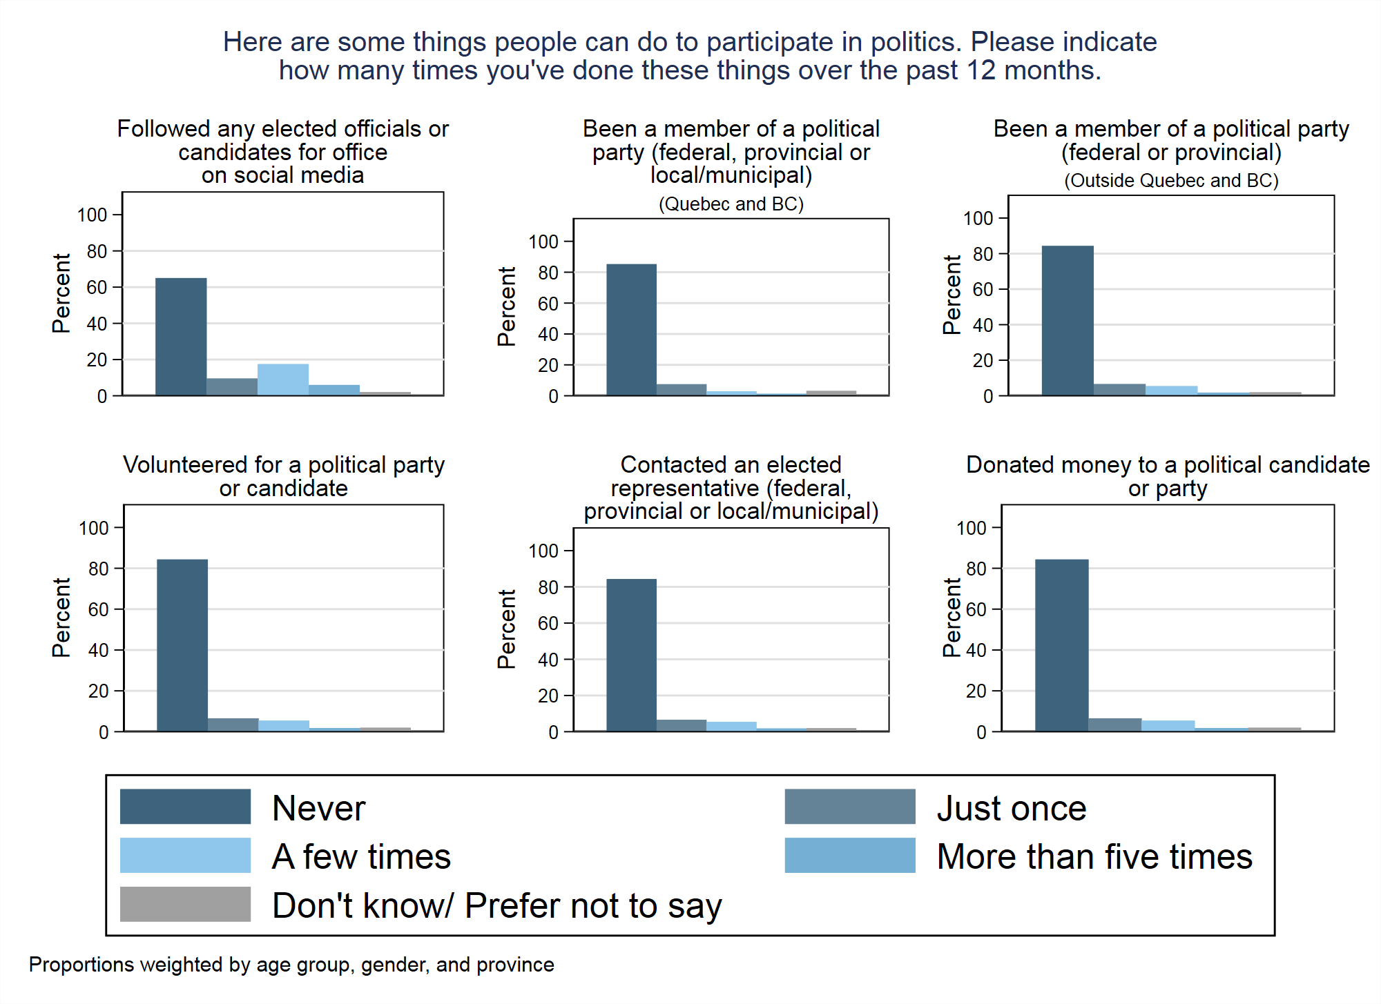

Slide 19
