Slide 1
Altmetrics
Concepts and Practices
December 17, 2015
Janice Winkler

Slide 2
What are they?
Research impact metrics
Use cases
Researchers: promotion and tenure, and funding
Librarians: collection management
Institutions: identify strengths and weaknesses
Publishers: marketing
Metrics work at different levels of measurement (article, researcher, journal, institution)

Slide 3
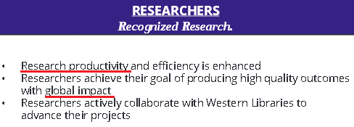
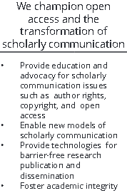
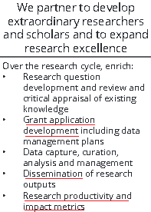
What is the library’s role?
Library involvement with many traditional metrics
Research support
Impact metrics can act as barriers to open access publishing
… or they can facilitate it

Slide 4
Traditional Bibliographic Impact Metrics
Based on citation counts
Examples
Journal Impact Factor (JIF)
H-Index

Slide 5
Traditional Bibliographic Impact Metrics
Pros
Cons
Standard, comparable
Measure impact on scholarship
Do citations always mean what we think they mean?
Disciplinary differences
Many bibliometrics have been heavily criticized

Slide 6
Altmetrics
Based on other indicators of impact, usually harvested online from social or mainstream media
Examples
Social media discussions
Downloads/saves to reference managers
News articles
References in policy documents, patents, etc.

Slide 7
Altmetrics
Pros
Cons
Talk about impact in a broader way
Available much faster than citations
Incentivize open access
Incentivize digital scholarship
Helps to access qualitative data
Gaming?
Rewarding sensationalism?
Collection is inconsistent
Differences in discipline, type of research output
What do they mean?

Slide 8
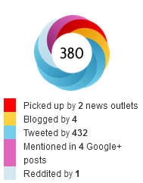
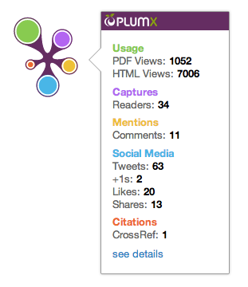
Altmetrics in practice

Slide 9
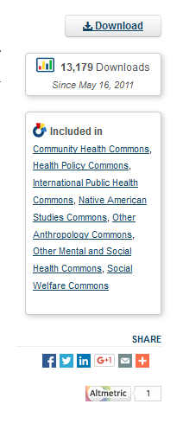
So many potential data sources!
Scholarship@Western
Harvesters aggregate data from dozens of sources
Impact Story
Altmetric.com
PlumX Analytics
PLoS ALM / PLoS Reports

Slide 10
Impact
Story
Notes:
Impact Story is a not for profit corporation and its product is a profile service that’s marketed to individual researchers with the tagline: “Your CV, but better.”

Slide 11
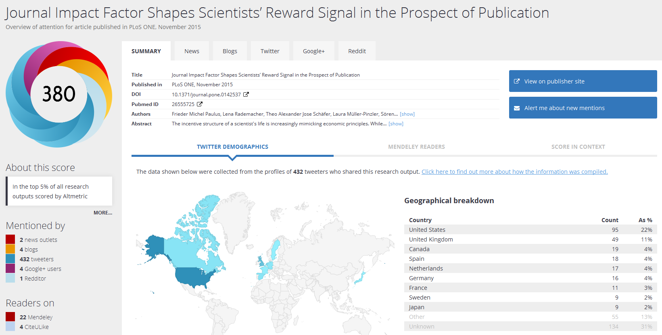
Altmetric.com

Slide 12
PlumX Analytics

Slide 13
Strengths of each product
Altmetric.com
PlumX Analytics
Better coverage of relevant social sources (except Mendeley) ¹
Unique sources include policy documents, extensive news coverage
Context/data normalization
Business model
Tracks more sources; better Mendeley coverage ¹
Unique sources include US patents, EBSCO data
Tracks books!
¹Peters, I., Jobmann, A., Hoffmann, C. P., Künne, S., Schmitz, J., & Wollnik-Korn, G. (2014). Altmetrics for large, multidisciplinary research groups: Comparison of current tools. Bibliometrie-Praxis Und Forschung, 3. Retrieved from http://www.bibliometrie-pf.de/index.php/bibliometrie/article/view/205

Slide 14
Trends
Development of standards
Increasing adoption
Tools
Continued improvement of data collection techniques
Continued expansion of sources covered

Slide 15
Conclusions
Rapidly evolving field
Altmetrics can be used to market Scholarship@Western
Western Libraries can play a role in appropriate altmetrics usage on campus

