Slide 1
Find support in

Slide 2
What is Open Access?
Open Access is the free, immediate, online availability of research, coupled with the rights to use this research fully in the digital environment.
Open Access | SPARC www.sparc.arl.org/issues/open-access
Notes:
the right of users to "read, download, copy, distribute, print, search, or link to the full texts of these articles"as mandatory for a journal to be included in the directory.

Slide 3
Budapest Open Access Initiative
From the BOAI definition of 'open access' … right of users to "read, download, copy, distribute, print, search, or link to the full texts of these articles“
With attribution

Slide 4
Did you know?
Western Libraries spends
over $3 million each year for access to Wiley, Taylor & Francis, Springer and Elsevier Journals
And about $10 million in total to license access to Journals annually

Slide 5
Where can I publish?
Consider

Slide 6
Deposit your data, too!

Slide 7
Scholarship@Western
the University’s Open Access Repository
showcasing Western’s research
to the world.

Slide 8
Scholarship@Western
What’s in it for me?
Wide dissemination of your work
More citations means more impact
Raises your profile, your department’s profile, the institution’s profile
Alt Metrics: monthly download counts

Slide 9
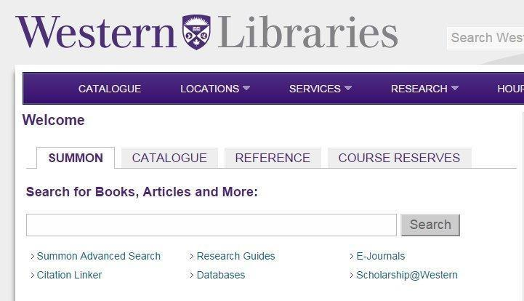
Scholarship@Western
indexes your work in Google and
Google scholar
and Summon, Western Libraries
discovery tool

Slide 10
Mapping Scholarship@Western :
2 hours compressed into 35 seconds

Slide 11
More Citations, More Impact
11,828 digital items
1,886,943 total downloads
55,329 downloads in December 2014

Slide 12
Popular Research
Traditional Indigenous Approaches to Healing and the modern welfare of Traditional Knowledge, Spirituality and Lands (362 downloads)
The Structure of Aboriginal Child Welfare in Canada (284)
The Comparison of GEV, Log-Pearson Type 3 and Gumbel Distributions in the Upper Thames River Watershed under Global Climate Models (156 downloads)
December 2014

Slide 13
Fulfill your Open Access obligations to Granting Agencies
by publishing your research in Scholarship@Western, the University’s Institutional Repository
“Submit your manuscript to a journal that does not offer open access, but will permit you to archive the peer-reviewed manuscript in a central or institutional repository within 12 months of publication.”
-CIHR Open Access Policy
The final version of the Open Access Policy still to be announced by the Tri-Agency

Slide 14
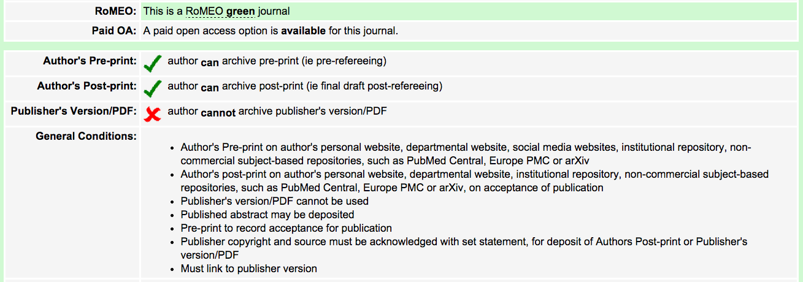
Notes:
Pre-print Definition: A preprint is an author’s own write-up of research results and analysis that has not been peer-reviewed, nor had any other value added to it by a publisher (such as formatting, copy editing, technical enhancement etc...).
Accepted Author Manuscript (AAM) Definition: An accepted author manuscript (AAM) is the author’s version of the manuscript of an article that has been accepted for publication and which may include any author-incorporated changes suggested through the processes of submission processing, peer review,

Slide 15
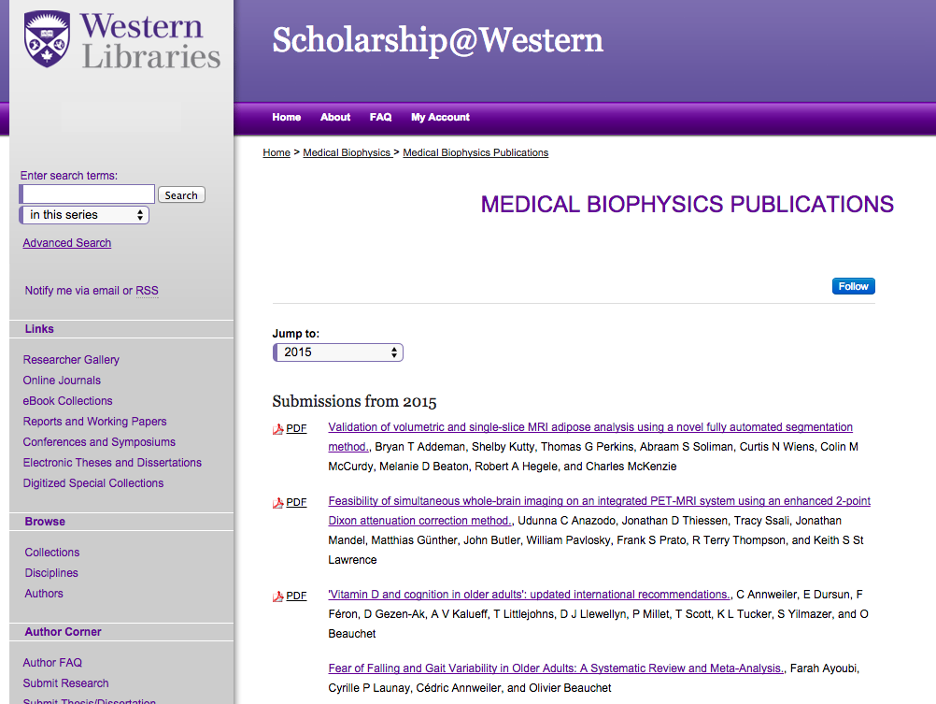
Notes:
Publish to a department site ; or

Slide 16
In 2014
IIPJ has surpassed 100,000 readers and our data indicates we have approximately 3,500 to 4,000 new readers per month.
Notes:
This is one of the Open Access journals that is published here using the IR software. This is the platform for publishing as well as for dissemination. The editorial and blind peer review process is fully managed by the software.

Slide 17
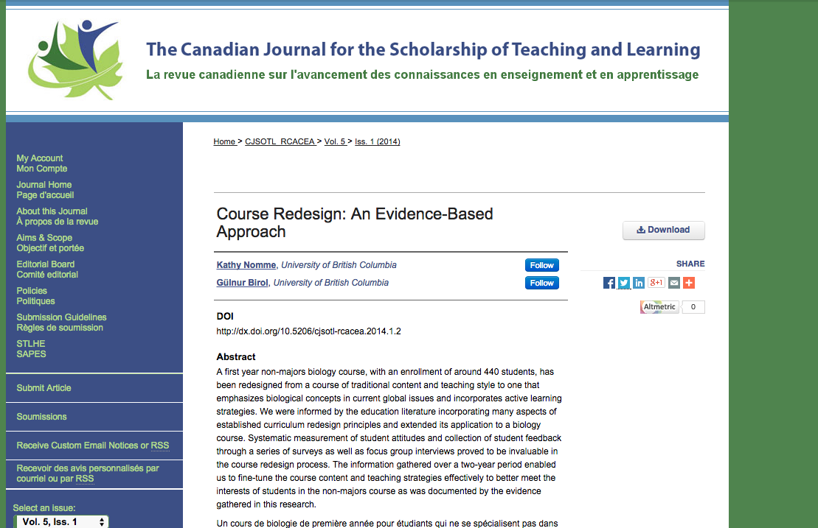

Slide 18
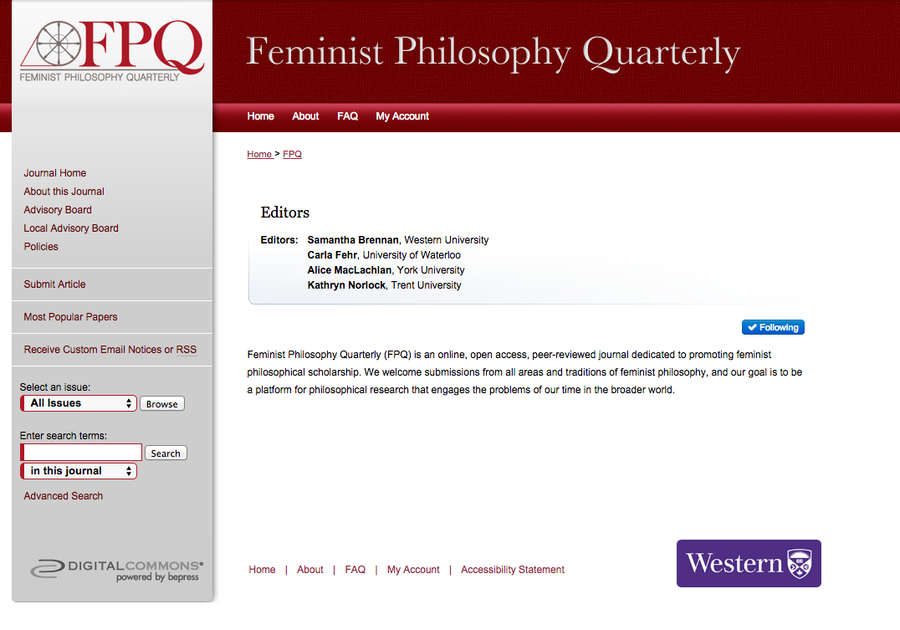
Notes:
one of the brand new journals launched this year

Slide 19
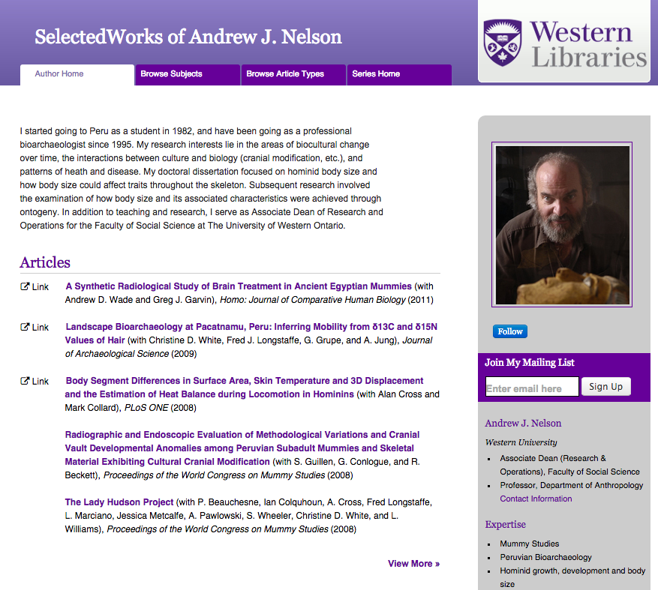
Raise your profile and attract students with the Researcher Gallery

Slide 20
Preservation
in a University branded digital repository
to avoid this:

Slide 21
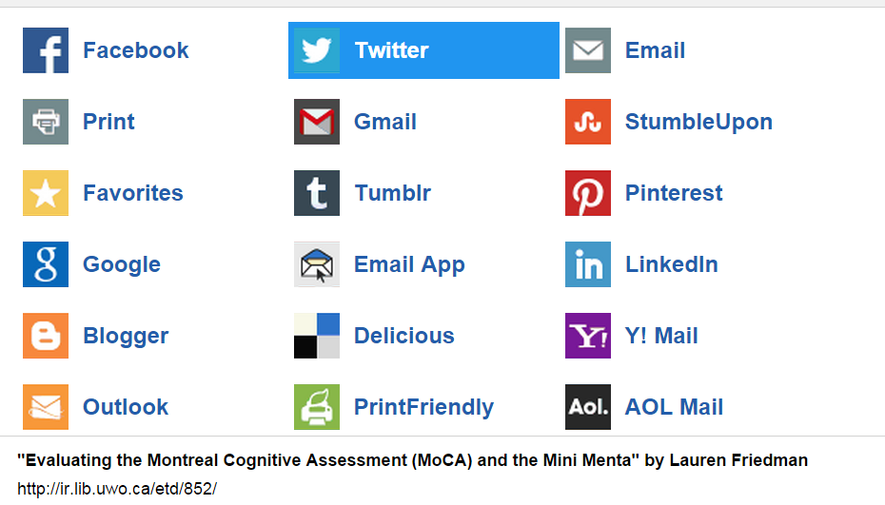
Share your work via Social Media

Slide 22
Host International Conferences
WILU 2014
Poster Sessions
Pre-Conference
Workshops
Keynotes
Presentations
Ignite Talks
Preserve and showcase it afterwards

Slide 23
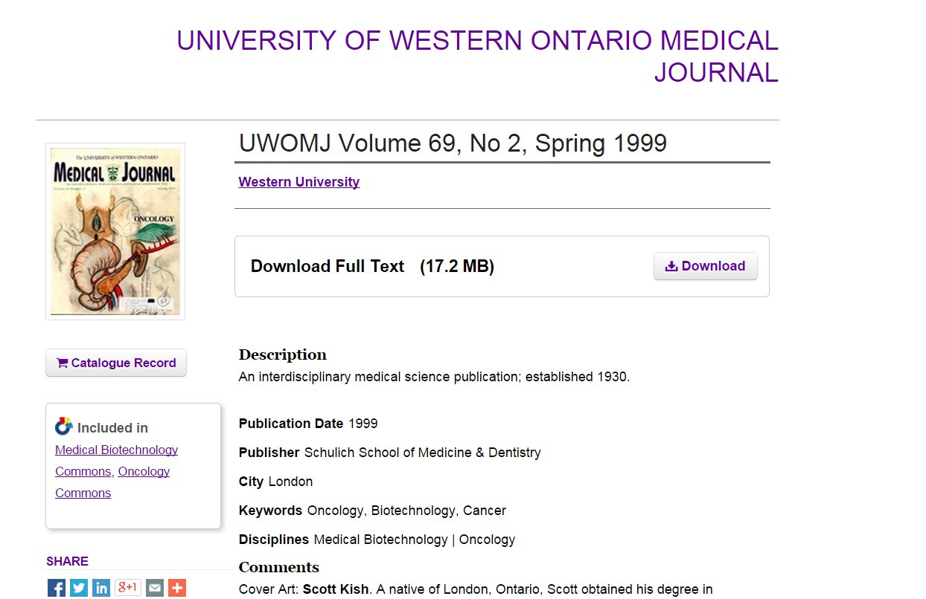
Host digitized materials

Slide 24
Initiate discussion & Post-peer review

Slide 25
2015 Milestone
Notes:
http://news.westernu.ca/2015/01/libraries-find-million-ways-to-educate-the-world/
Using Worked-Out Examples of Written Explanation for Writing-to-Learn in Evolutionary Biology http://ir.lib.uwo.ca/etd/2605 01/08/2015 14

Slide 26
Who can help me with Article Processing Charges?
Open Access Fund
For more information: Contact wloafund@uwo.ca
About the fund and application form: https://www.lib.uwo.ca/scholarship/oafund.html
Notes:
⅔ of OA journals do NOT charge an APC ; we do not fund hybrid journals

Slide 27
Open Access Fund
Supports Western researchers who wish to publish scholarly works in Open Access Journals and Open Access books
Open to the Western University community of
•faculty•librarians•archivists•postdoctoral fellows•graduate students

Slide 28
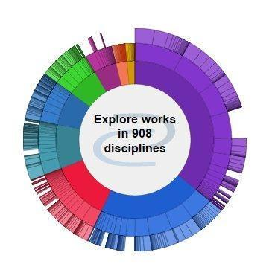
Questions?
Please contact
wlscholcomm@uwo.ca
for more information
THANK YOU!
Joanne Paterson

Slide 29
More information?
Contact your friendly neighbourhood Liaison Librarian
Western Libraries
>>Services >>Scholarly Publishing
http://www.lib.uwo.ca/scholarship
Open Access By Peter Suber
http://mitpress.mit.edu/sites/default/files/titles/content/openaccess/Suber_08_chap1.html#chap1
Open Access Explained (PhD Comics)
https://www.youtube.com/watch?v=L5rVH1KGBCY
Sherpa Romeo
Publisher copyright policies & self-archiving
http://www.sherpa.ac.uk/romeo/
Scholarly Open Access Blog
By Jeffrey Bealle (Librarian and skeptic)
http://scholarlyoa.com/
Directory of Open Access Journals
http://doaj.org/

