Slide 1
Find support in

Slide 2
What is Open Access?
Open Access is the free, immediate, online availability of research, coupled with the rights to use this research fully in the digital environment.
Open Access | SPARC www.sparc.arl.org/issues/open-access
Notes:
the right of users to "read, download, copy, distribute, print, search, or link to the full texts of these articles"as mandatory for a journal to be included in the directory.

Slide 3
Budapest Open Access Initiative
From the BOAI definition of 'open access' we take the right of users to "read, download, copy, distribute, print, search, or link to the full texts of these articles“
With attribution

Slide 4
What can Open Access do for me?
Different stakeholders in the system of scholarly communications can and will benefit from no restricted access to research and data:
Researchers as authors: immediate visibility for research output and thus increased visibility and usage of their results. Open Access may even lead to an increase of impact.
Researchers looking for information: access to literature everywhere, not only from a campus but also from any site with wifi access.
Notes:
http://sparceurope.org/open-access/benefits-of-open-access/

Slide 5
What can Open Access do for me?
Funding agencies: increased return on investment (ROI), increased visibility.
Universities & research institutes: greater visibility, clearer management of information.
Teachers & students: unrestricted access to material, enriched education, allowing equality of learning in poor as well as in rich nations.
Sciences: enhanced and accelerated research cycle.
SPARC Europe
Notes:
http://sparceurope.org/open-access/benefits-of-open-access/

Slide 6
Did you know?
Western Libraries spends
over $3 million each year for access to Wiley, Taylor & Francis, Springer and Elsevier Journals
And about $10 million in total to license access to Journals annually

Slide 7
Where can I publish?
Consider
Deposit your data, too!

Slide 8
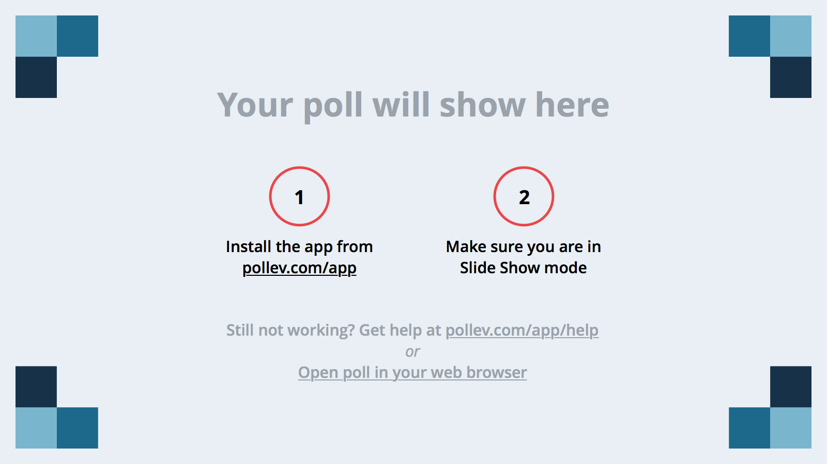
Notes:
Poll Title: Have you published using an open access platform like an Institutional Repository, in an Open Access Journal, or an Open Access Book? https://www.polleverywhere.com/multiple_choice_polls/mztB3aFRWyOMmdz

Slide 9
New Business Models for Scholarly Publishing
Hybrid Journal
Subscription or licensed content. Pay to access
Author pays to enable open access for their article
Open Journal
All content is freely available online
Author retains all rights and pays article processing fee
Open Journal
All content is freely available online
Author retains all rights with no APF costs.
May not retain all rights (?)
2/3 OAJournals do not charge APF
Notes:
http://sustainingknowledgecommons.org/open-access-article-processing-charges-apcs/

Slide 10
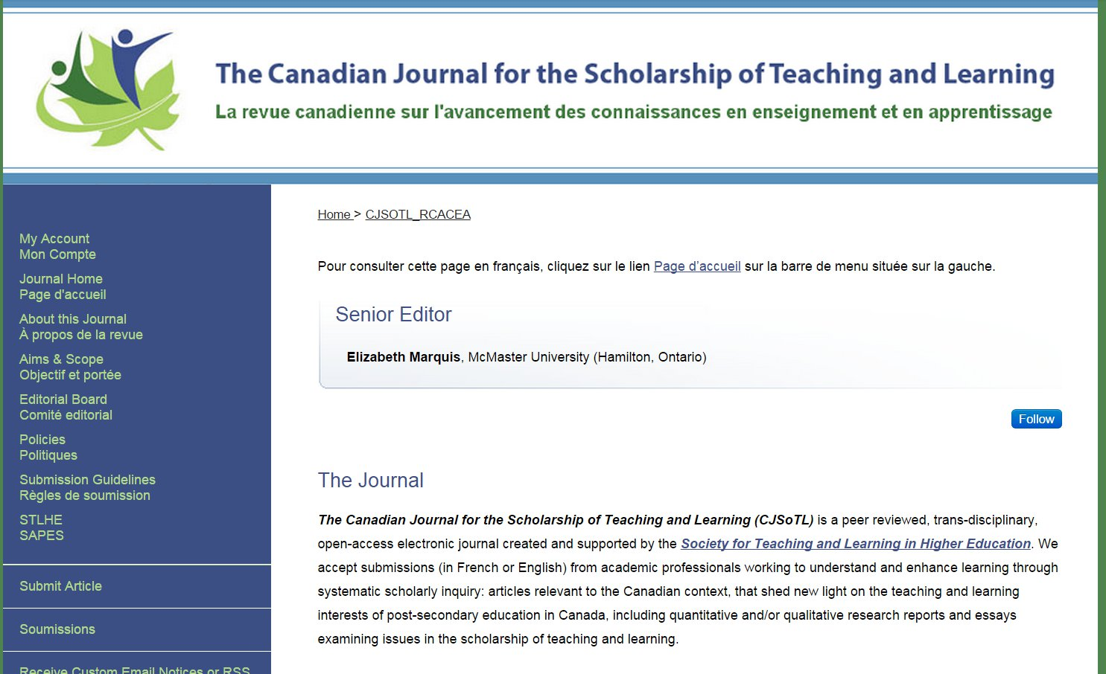

Slide 11
Hybrid Example: Publish your Article Open Access in a SAGE Subscription Journal with SAGE Choice
The SAGE Choice program offers authors the option to make their primary research articles freely available upon publication in most subscription-based SAGE Journals.
Notes:
It also enables authors to comply with funding body requirements, where publishing research papers open access is a stipulation of funding, while still publishing their article in the subscription journal of their choice.
The standard article processing charge (APC) for SAGE Choice is 3,000 USD/1,600 GBP in the Science, Technology and Medical fields, and 1,500 USD/800 GBP in the Humanities and Social Sciences. The fee excludes any other potential author fees levied by some journals (such as colour charges)...or applicable taxes

Slide 12
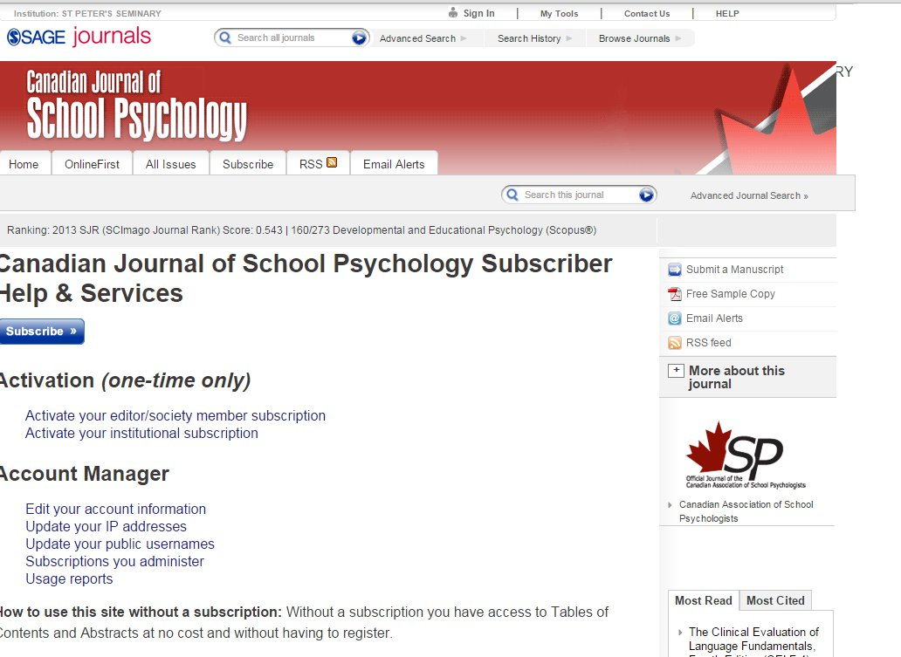

Slide 13
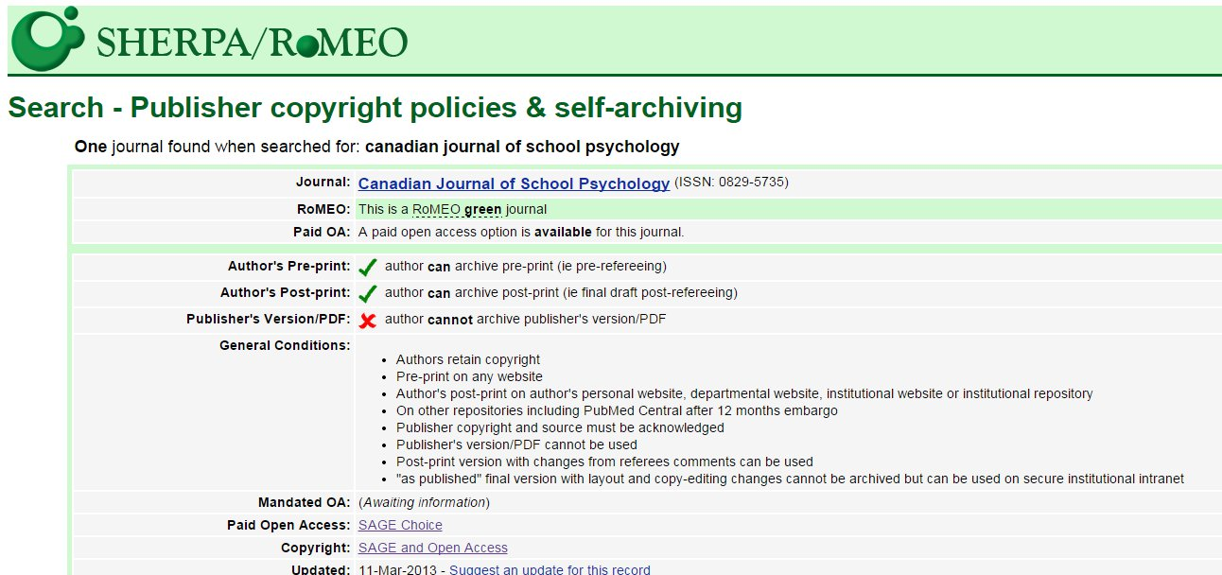
Notes:
http://www.sherpa.ac.uk/romeo/search.php
For most articles you can post / upload a pre-print in the Institutional Repository Scholarship@Western. Global reach , global impact, accurate metrics in the number of downloads.

Slide 14
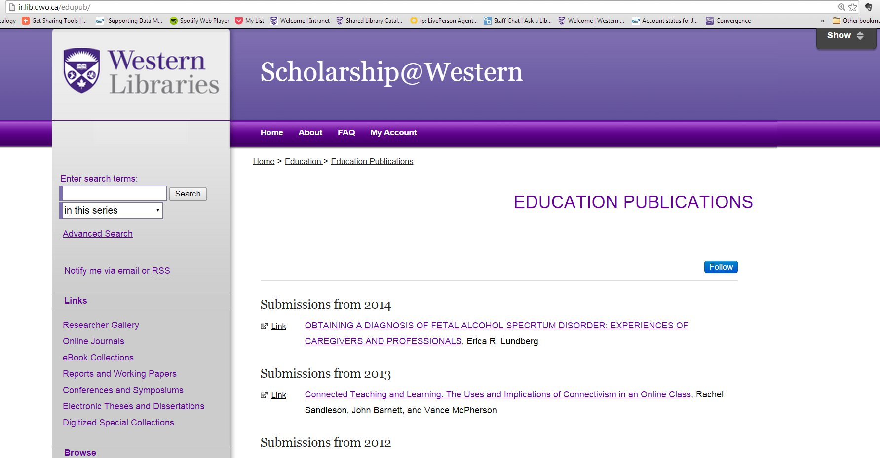

Slide 15
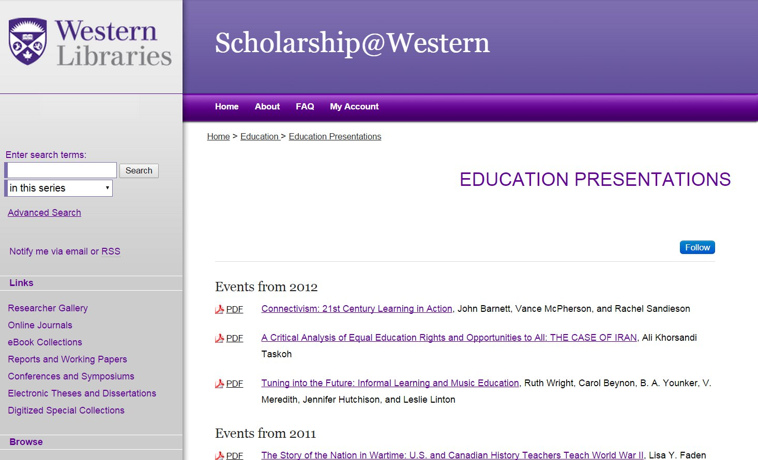

Slide 16
Who can help me with Article Processing Charges?
Open Access Fund

Slide 17
Open Access Fund
Supports Western researchers who wish to publish scholarly works in Open Access Journals and Open Access books

Slide 18
Open Access Fund
Up to $3000 per publication
Funds available on first-come, first-served basis
Open to the Western University community of
•faculty•librarians•archivists•postdoctoral fellows•graduate students
to cover costs associated with open access publishing in a peer-reviewed, open access journal or book

Slide 19
Open Access Fund
For more information
Contact wloafund@uwo.ca
About the fund and application form: https://www.lib.uwo.ca/scholarship/oafund.html

Slide 20
Scholarship@Western
the University’s Open Access Repository
showcasing Western’s research
to the world.

Slide 21
Scholarship@Western
What’s in it for me?
Wide dissemination of your work
More citations means more impact
Raises your profile, your department’s profile, the institution’s profile
Alt Metrics: monthly download counts

Slide 22
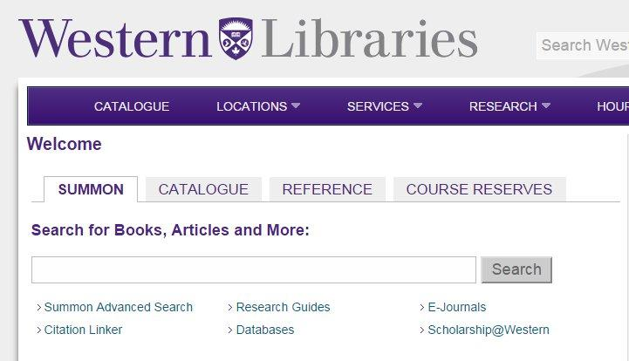
Scholarship@Western
indexes your work in Google and
Google scholar
and Summon, Western Libraries
discovery tool

Slide 23
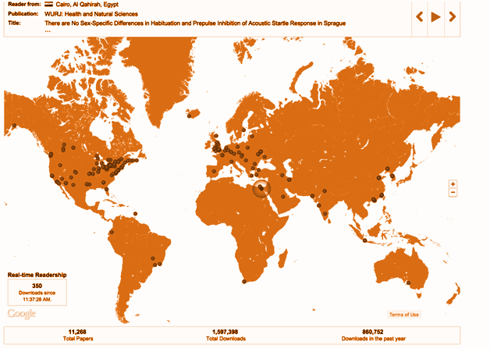
Global Reach, Global Impact
Realtime
downloads across the world
Notes:
Each “pin-drop” represents a download

Slide 24
Mapping Scholarship@Western : 2 hours compressed into 35 seconds
http://youtu.be/BhzGVkwfDK0

Slide 25
In 2014
IIPJ has surpassed 100,000 readers and our data indicates we have approximately 3,500 to 4,000 new readers per month.
Notes:
This is one of the Open Access journals that is published here using the IR software. This is the platform for publishing as well as for dissemination. The editorial and blind peer review process is fully managed by the software.

Slide 27
More Citations More Impact
11,743 digital items
1,855,904 total downloads
55,329 downloads in December 2014

Slide 28
Most popular papers last month
GeoWeb Tools for Library Instruction (799 downloads)
Beyond the database demo: Using discourse analysis to improve research and citation practices (730 downloads)
Evaluating the Montreal Cognitive Assessment (MoCA) and the Mini Mental State Exam (MMSE) for Cognitive Impairment Post Stroke (514 downloads)
December 2014

Slide 29
Fulfill your Open Access obligations to Granting Agencies
by publishing your research in Scholarship@Western, the University’s Institutional Repository
“Submit your manuscript to a journal that does not offer open access, but will permit you to archive the peer-reviewed manuscript in a central or institutional repository within 12 months of publication.”
-CIHR Open Access Policy
The final version of the Open Access Policy will be announced during OA Week 2014.
Tri-Agency Open Access Policy

Slide 30
Scholarship@Western
hosts Open Access Student Journals:
Chiasma: a site for thought
Entrehojas:
Revista de Estudios Hispánicos
Kino: The Western Undergraduate Journal of Film Studies
Nota Bene: Canadian Undergraduate Journal of Musicology
Sociological Imagination: Western's Undergraduate Sociology Student Journal
Totem: The University of Western Ontario Journal of Anthropology
Undergraduate Transitional Justice Review
Western Journal of Legal Studies
Western Undergraduate Psychology Journal
WURJN: The Western Undergraduate Research Journal: Health and Natural Sciences

Slide 31
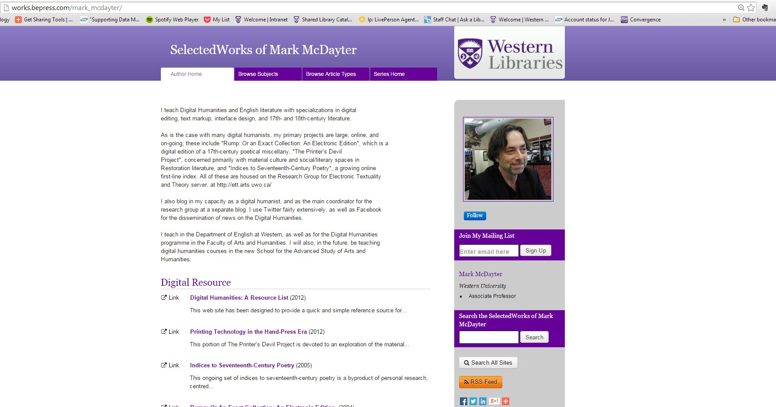
Raise your profile and attract students with the Researcher Gallery

Slide 32
Preservation
in a University branded digital repository
to avoid this:

Slide 33
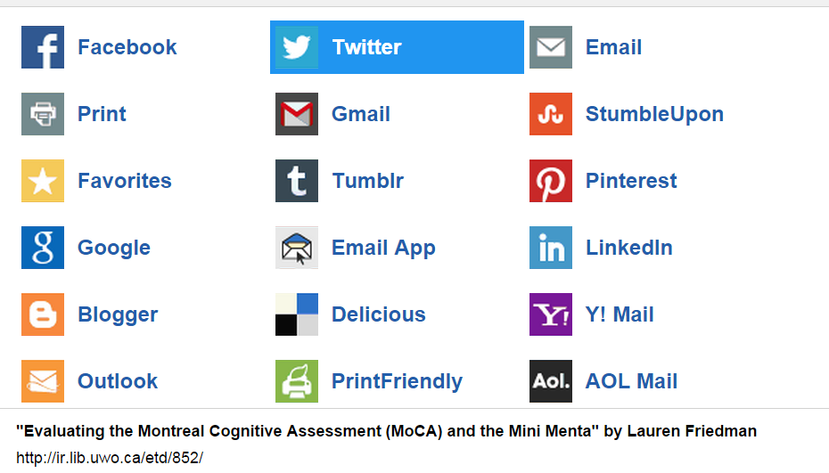
Share your work via Social Media

Slide 34
Host International Conferences
WILU 2014
Poster Sessions
Pre-Conference
Workshops
Keynotes
Presentations
Ignite Talks
Preserve and showcase it afterwards

Slide 35
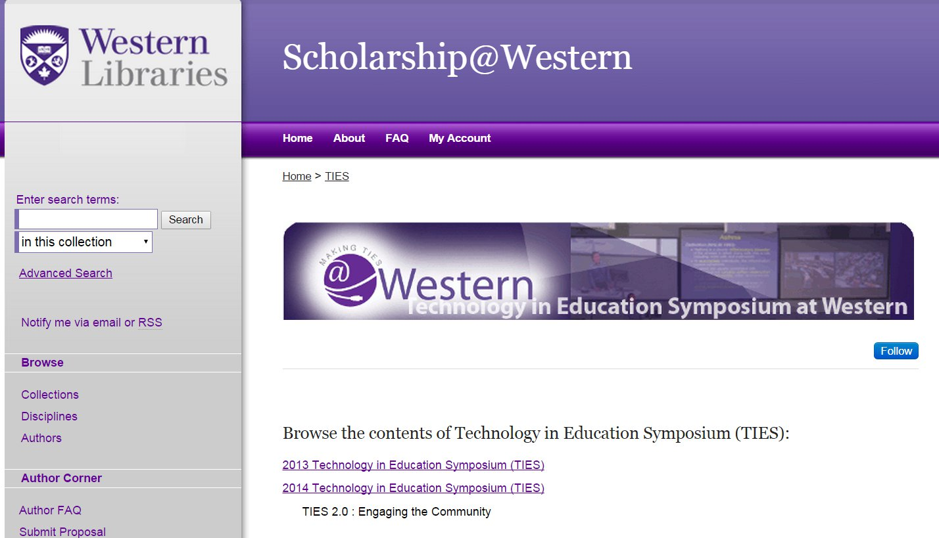

Slide 36
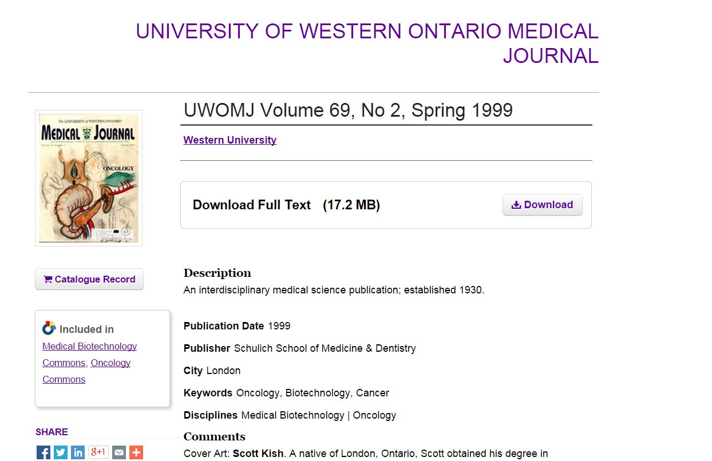
Host digitized materials

Slide 37
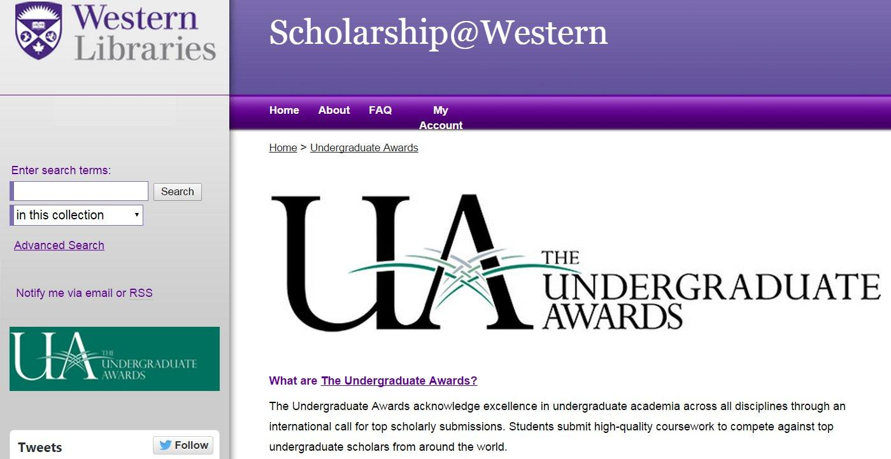
Showcase special achievement

Slide 38
Showcase special achievement

Slide 39
Libraries find million ways to educate the world JANUARY 22, 2015 BY ERIC GREEN
Western Libraries hit a big milestone at the beginning of the New Year, with the one-millionth download from the Electronic Thesis and Dissertation (ETD) hub of the Scholarship@Western repository.
The ETD was designed to provide a free, open-access way for people around the world to view a variety of materials created or endorsed by the Western community. On Jan. 3, the master’s thesis of Western graduate Kaylen Wheeler, Representing Game Dialogue as Expressions in First-Order Logic, was accessed and, as close as library staff can tell, became the one-millionth download since the ETD went live in January of 2011.
Notes:
http://news.westernu.ca/2015/01/libraries-find-million-ways-to-educate-the-world/
Using Worked-Out Examples of Written Explanation for Writing-to-Learn in Evolutionary Biology http://ir.lib.uwo.ca/etd/2605 01/08/2015 14

Slide 40
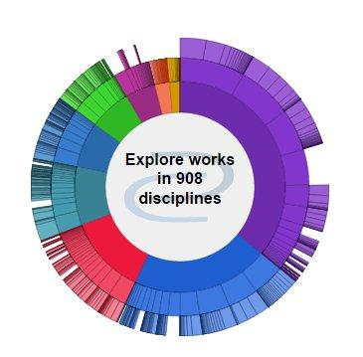
Questions?
Please contact
wlscholcomm@uwo.ca
for more information
THANK YOU!
Joanne Paterson

Slide 41
More information?
Contact your friendly neighbourhood Librarian
Western Libraries
>>Services >>Scholarly Publishing
http://www.lib.uwo.ca/scholarship
Open Access By Peter Suber
http://mitpress.mit.edu/sites/default/files/titles/content/openaccess/Suber_08_chap1.html#chap1
Open Access Explained (PhD Comics)
https://www.youtube.com/watch?v=L5rVH1KGBCY
Sherpa Romeo
Publisher copyright policies & self-archiving
http://www.sherpa.ac.uk/romeo/
Scholarly Open Access Blog
By Jeffrey Bealle (Librarian and skeptic)
http://scholarlyoa.com/
Directory of Open Access Journals
http://doaj.org/

